Slide 1
CSC4303 (Fall 2026)
Getting Started with AWS EC2
TA: Yiyun Zheng

Slide 2
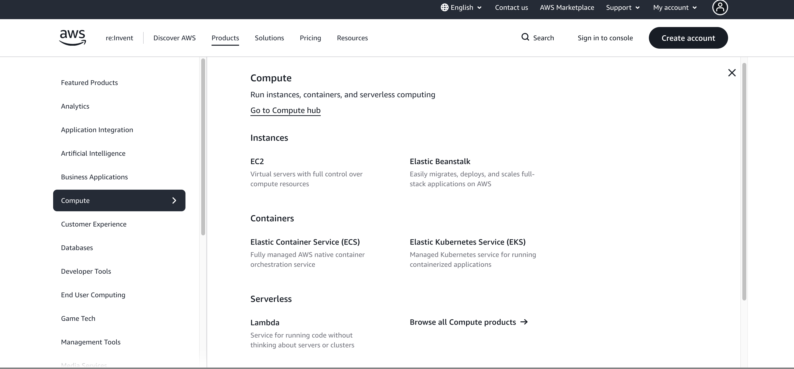
Amazon Web Services (AWS)
Notes:
Creating AWS account: http://www.youtube.com/watch?v=WviHsoz8yHk
Getting started with Amazon EC2-launch a windows instance: http://www.youtube.com/watch?v=OLfmqcYnhUM

Slide 3

What is EC2?
Amazon EC2
“Amazon Elastic Compute Cloud (Amazon EC2) is a web service that enables you to launch and manage Linux/Unix and windows server instances in Amazon's data centers.”
EC2 is part of Amazon’s “pay per use” web services for software development

Slide 4
Outline
Create an AWS Account
Launch an EC2 Instance
Connect to an EC2 Instance
Stop an EC2 Instance

Slide 5
I am Going to Introduce 2 Ways
Way 1: Get started with a Classroom Account
  Every student gets $50 USD credits in this course
  Activate educate account via invitation link from the instructor
Way 2: Get started with a normal account
  If some services are not supported by AWS Educate Program
  If the $50 USD credits have been run out of
  ...

Slide 6
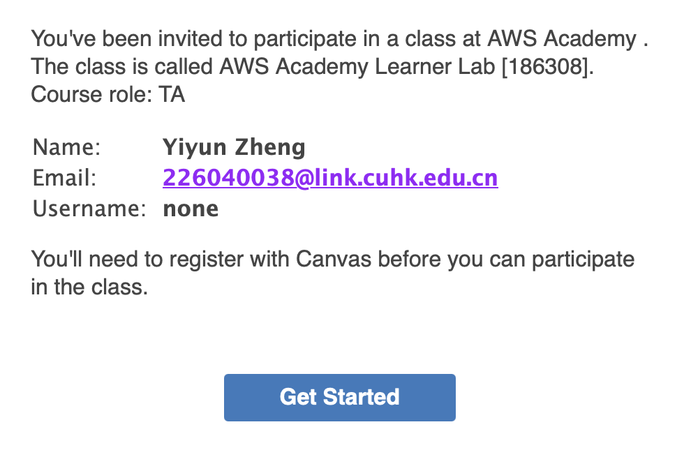
Get Started with a Classroom Account in Amazon Educate
After receiving this email, just click on the link

Slide 7
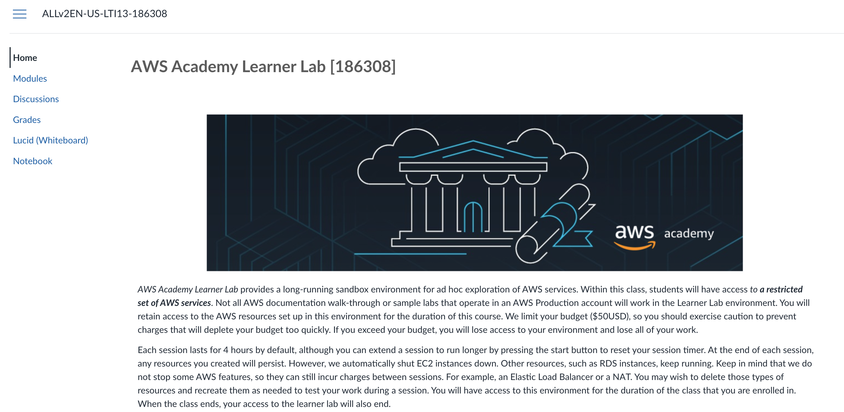
You are supposed to see AWS Academy homepage

Slide 8
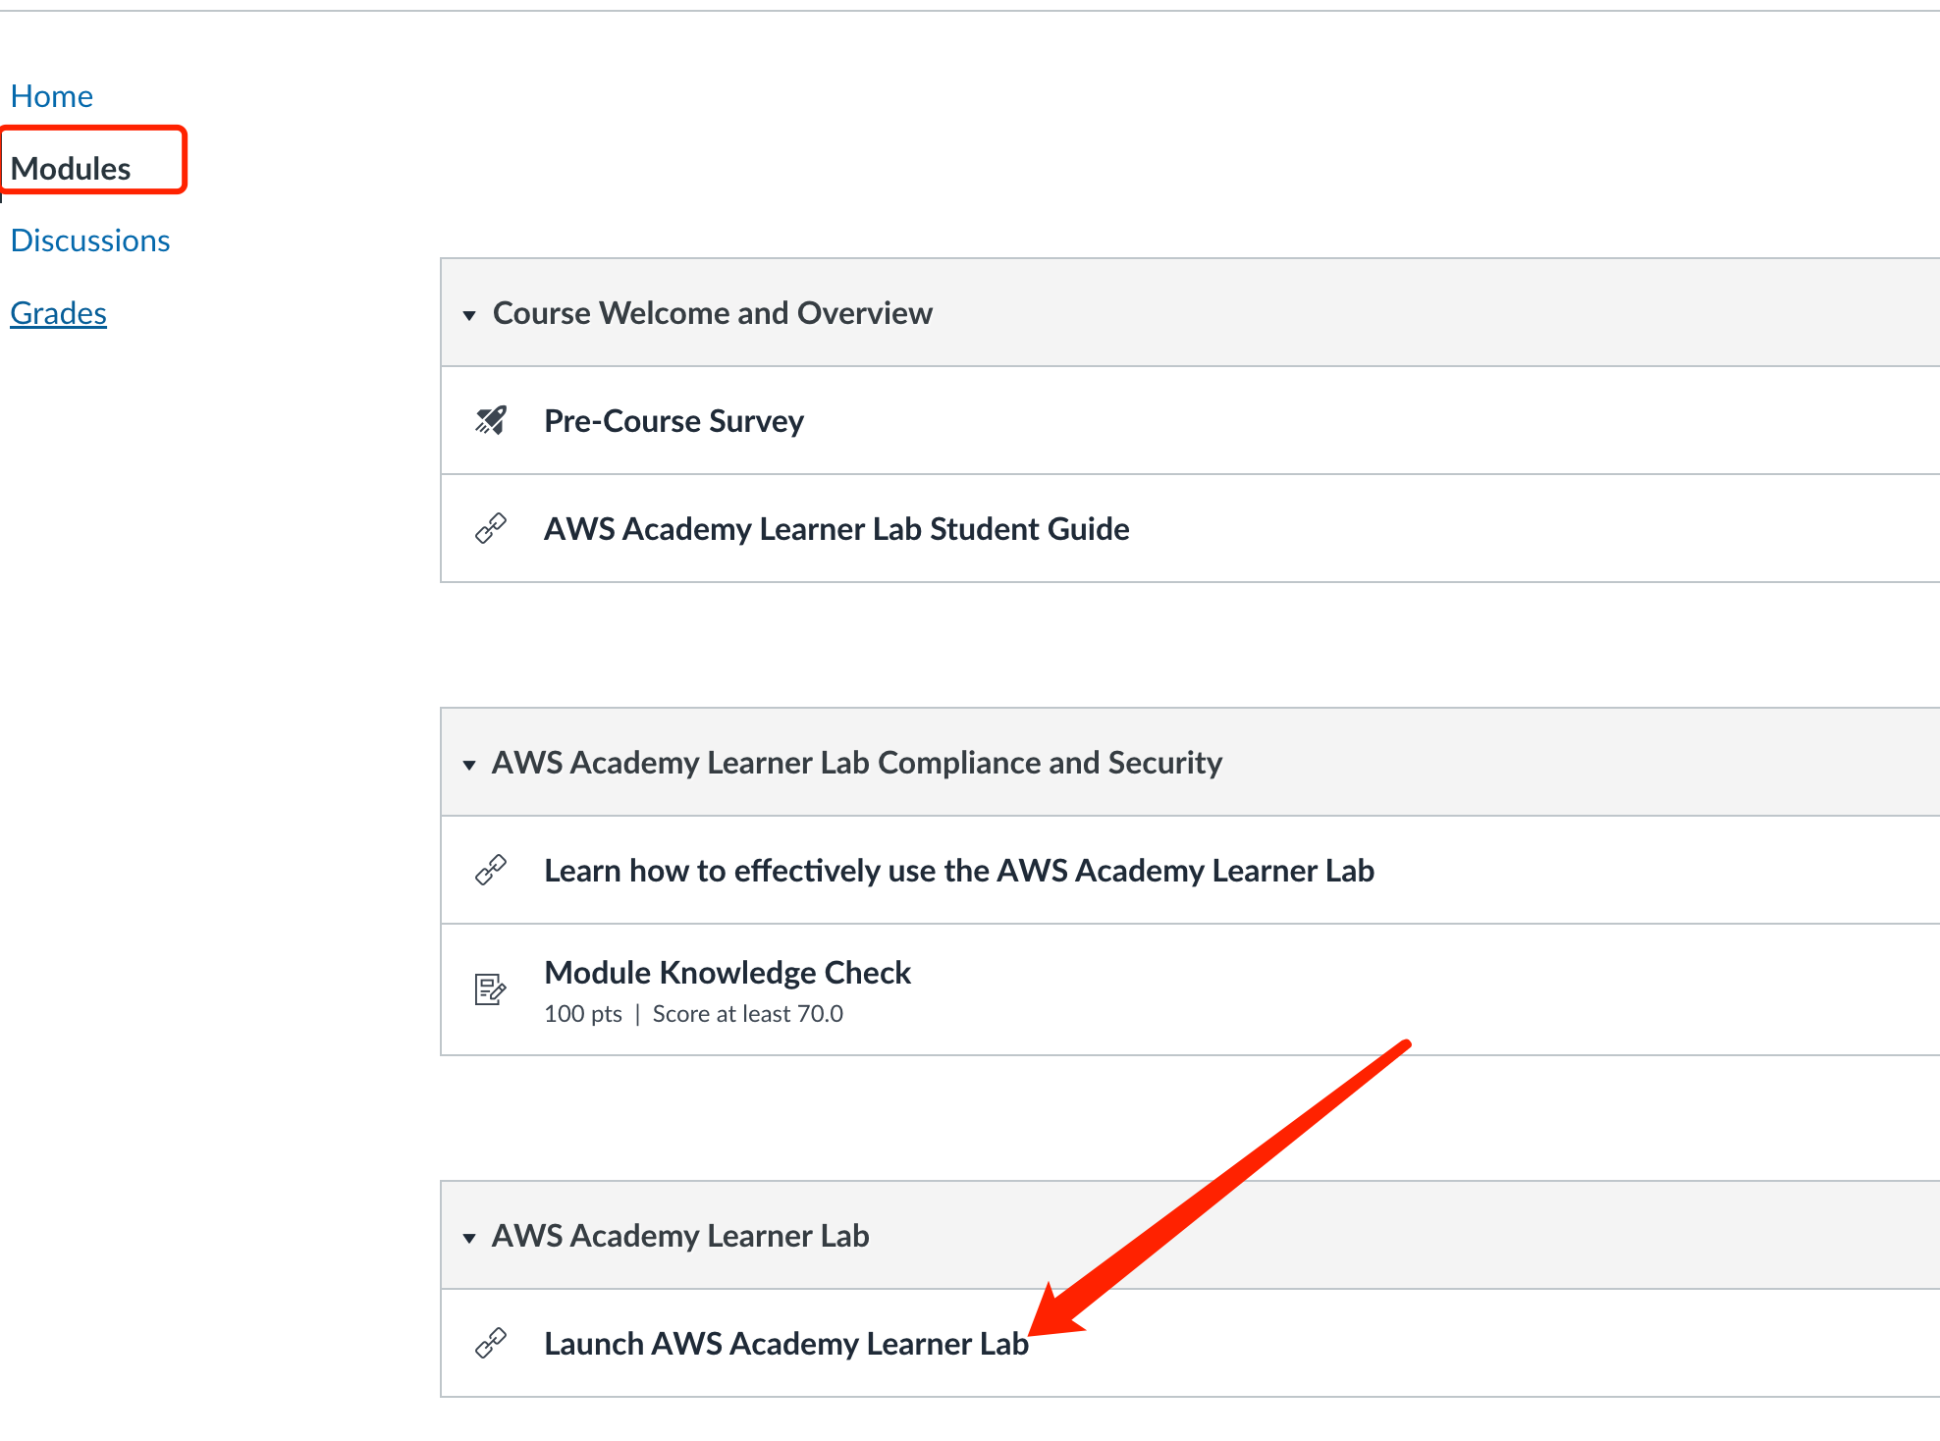

Slide 9
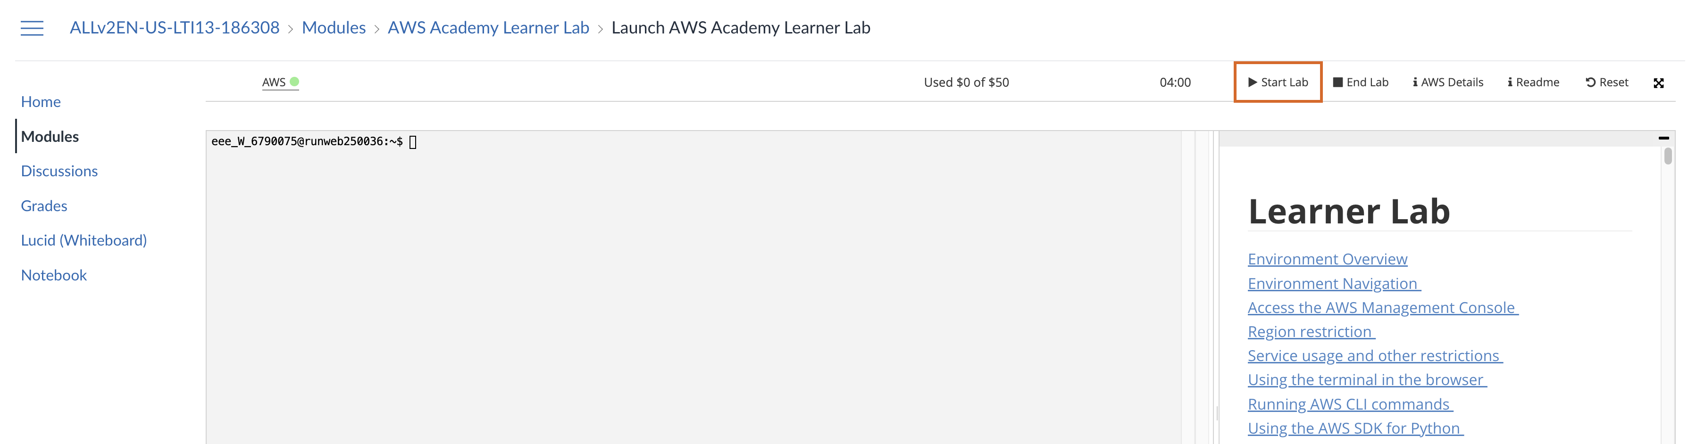
Under Module – Launch learner lab, you can start the lab sandbox for AWS services.
”green” means the lab is on; “red” means the lab is off.
Once the lab is on, click “AWS” then is directs you to AWS home console.

Slide 10
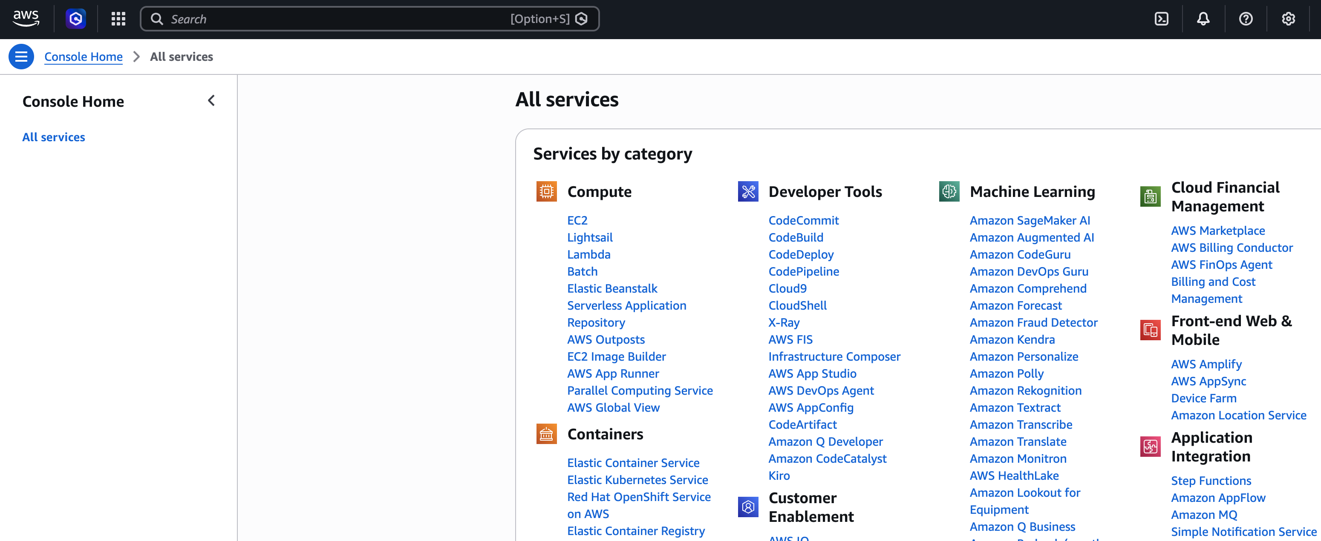
e.g., EC2 is the service that we will talk about later

Slide 11
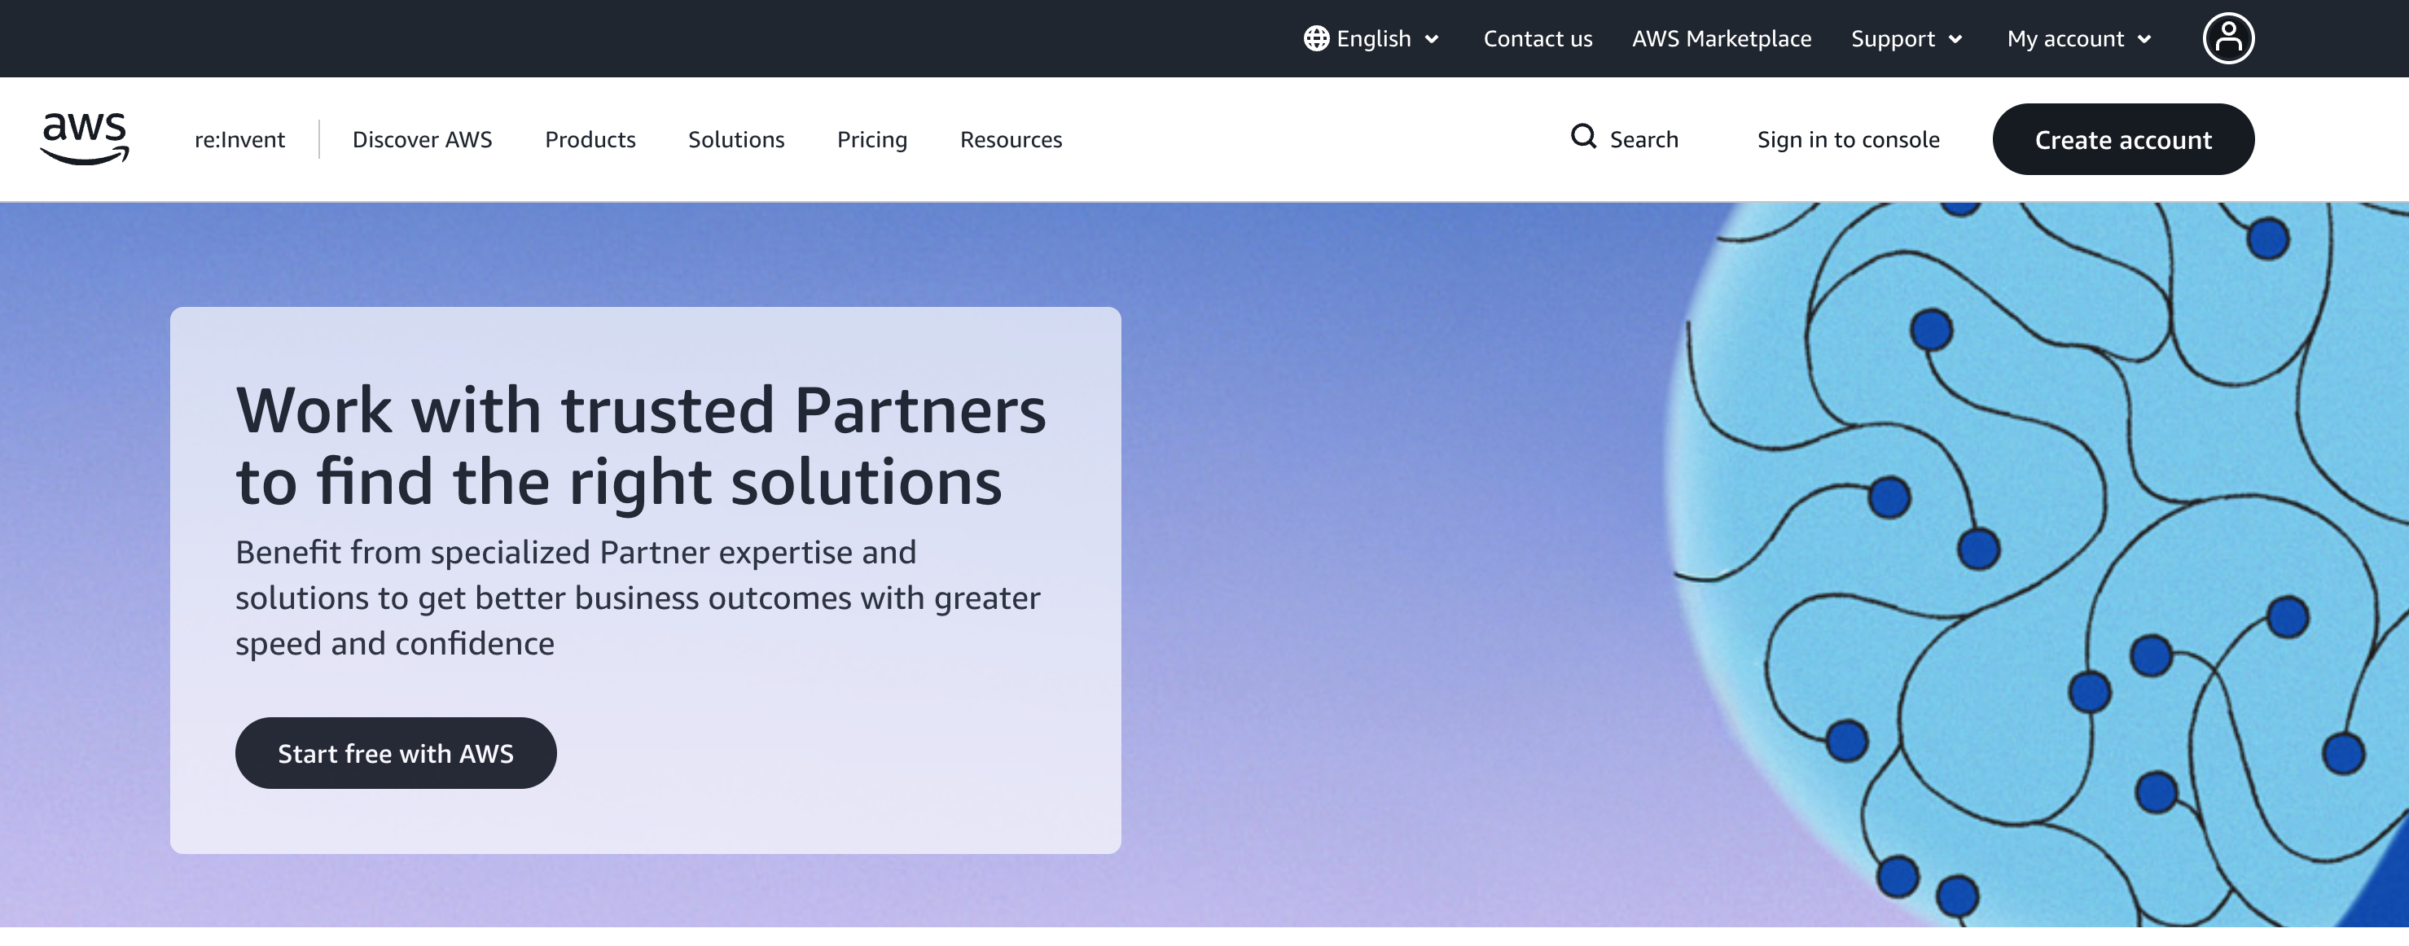
Way 2: Get Started with a Normal AWS Account
Click here
https://aws.amazon.com/

Slide 12
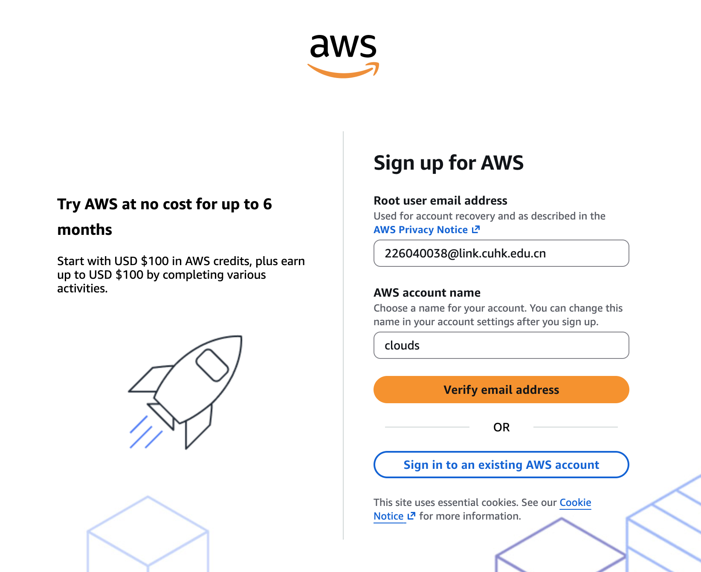
Get Started with a Normal AWS Account

Slide 13
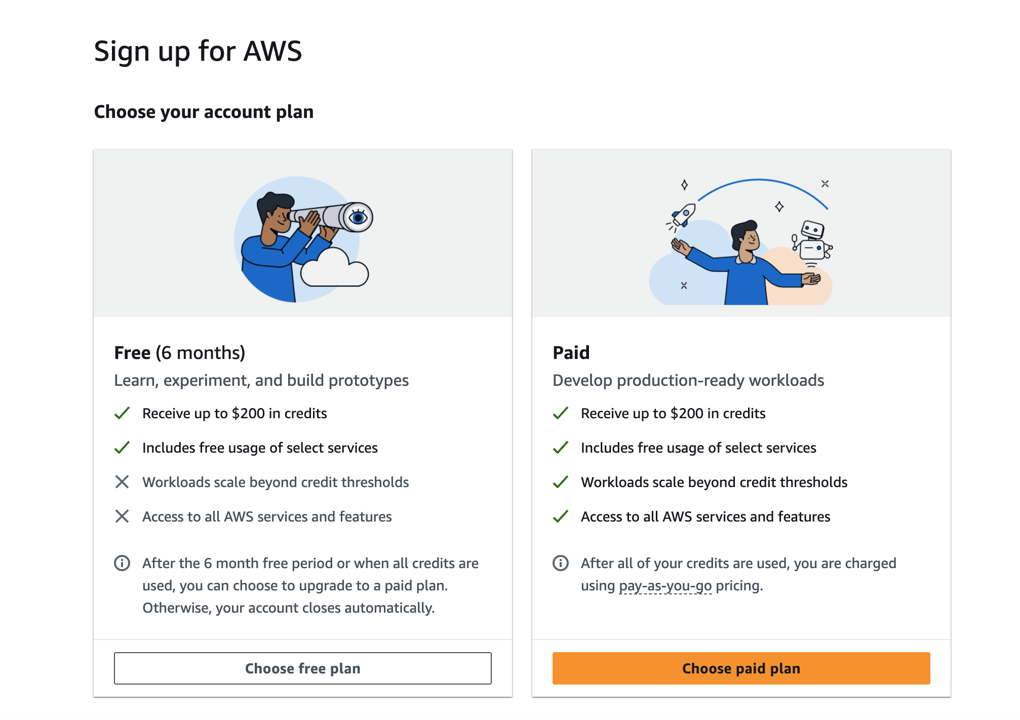
Get Started with a Normal AWS Account
Select “Free Plan”
and complete!

Slide 14
Get Started with a Normal AWS Account
Finish! You may explore the console now...
EC2 is the service that we will talk about later

Slide 15
Outline
Create an AWS Account
Launch an EC2 Instance
Connect to EC2 Instance
Stop an Instance

Slide 16
Surf the EC2 Console
Click here to enter
EC2 management console

Slide 17
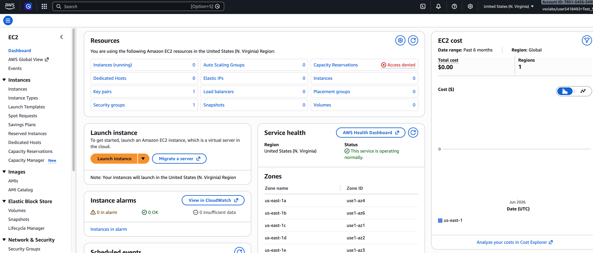
Surf the EC2 Console
On success you will see the Instances panel

Slide 18
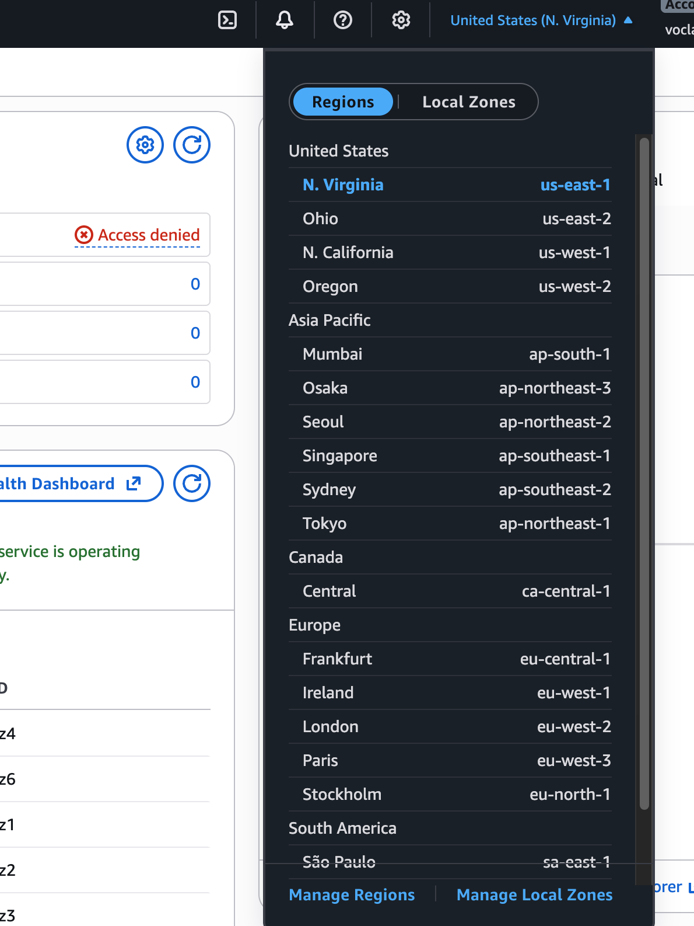
Switch to another EC2 Region
AWS provides EC2 instance located from different regions across the world
You can switch to a region that best suits you
(e.g., using us-east-1 if you are using a Classroom Account)

Slide 19
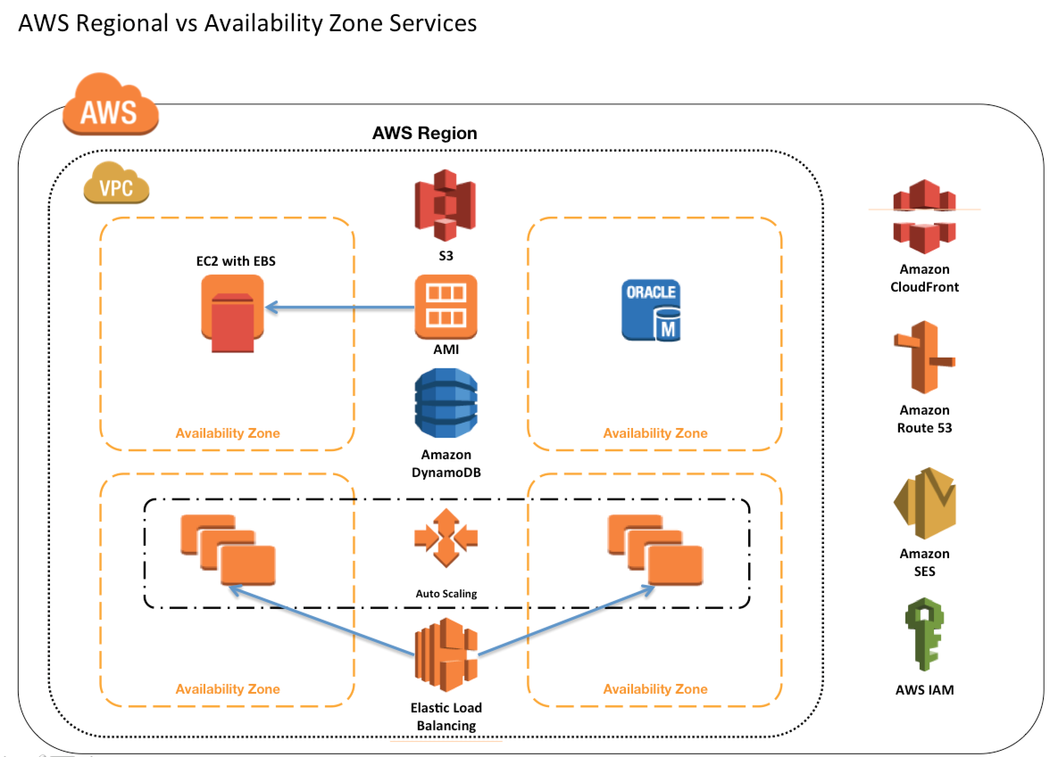
Pro Tip: Try to launch all your instances in the same availability zone, or inter-zone communication will cost you $$$$.

Slide 20






SSH Authentication Process
Private Key
Public Key
User
Server
ssh -i <private_key> user@server
Matching
Session Key
Encrypted Communication

Slide 21
Key pairs
Amazon EC2 uses public–key cryptography to encrypt and decrypt login information.
A public key is used to encrypt data, such as a password, then the recipient uses the private key to decrypt the data.
The public and private keys are known as a key pair.
Notes:
SSH requires key pair.
A brief introduction of public-key cryptography.

Slide 22
Create key pairs
To log in to your instance, you must create a key pair, specify the name of the key pair when you launch the instance, and provide the private key when you connect to the instance.
For how to create a key pair, please refer to https://docs.aws.amazon.com/AWSEC2/latest/UserGuide/ec2-key-pairs.html#having-ec2-create-your-key-pair
Or follow the next few slides!

Slide 23
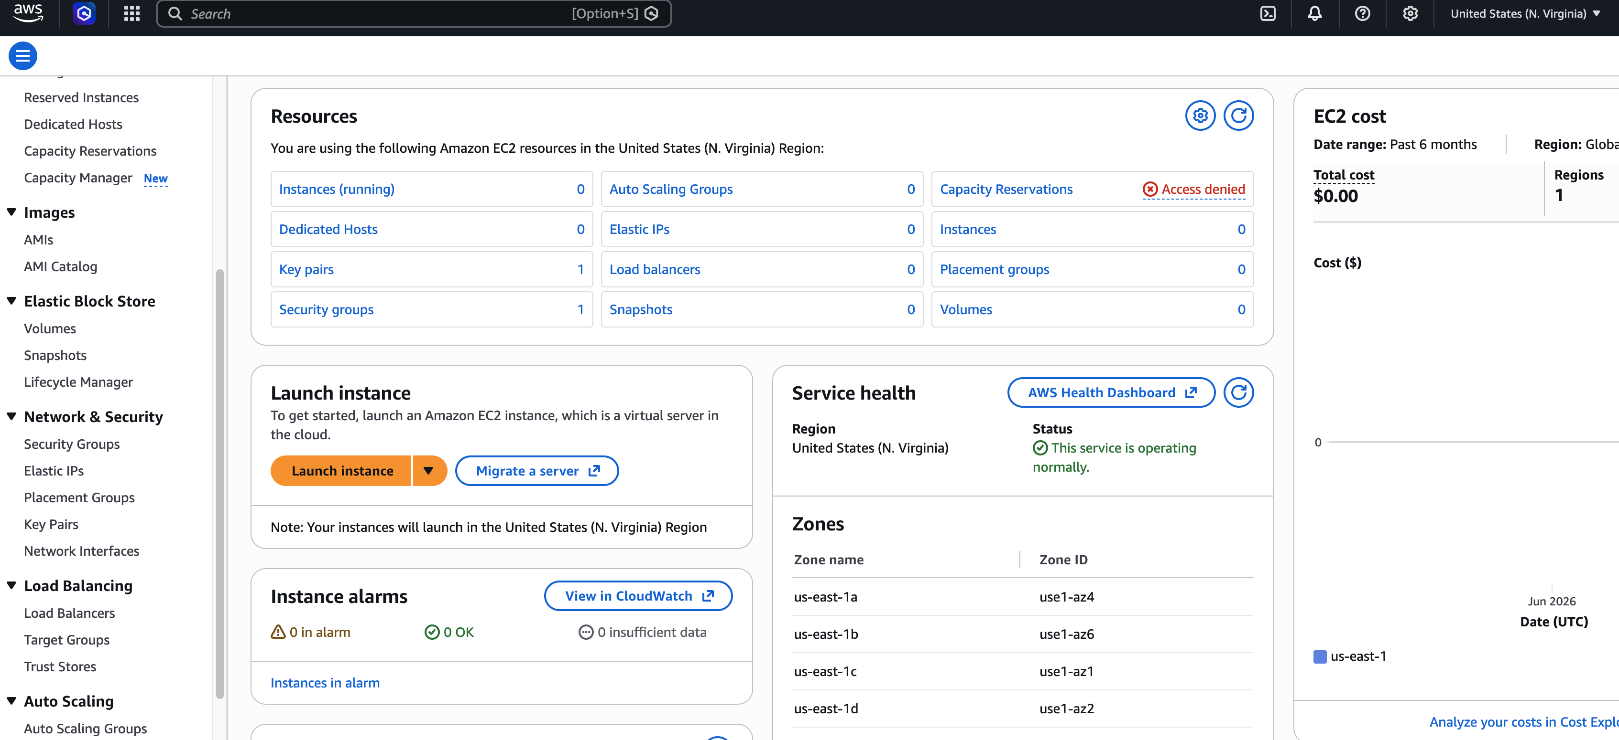
Create a Key Pair
Click here to manage your key pairs

Slide 24
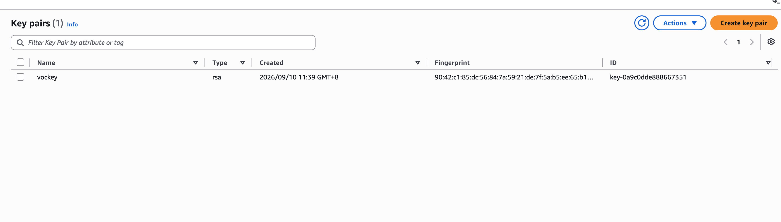
Create a Key Pair
Create a new one

Slide 25
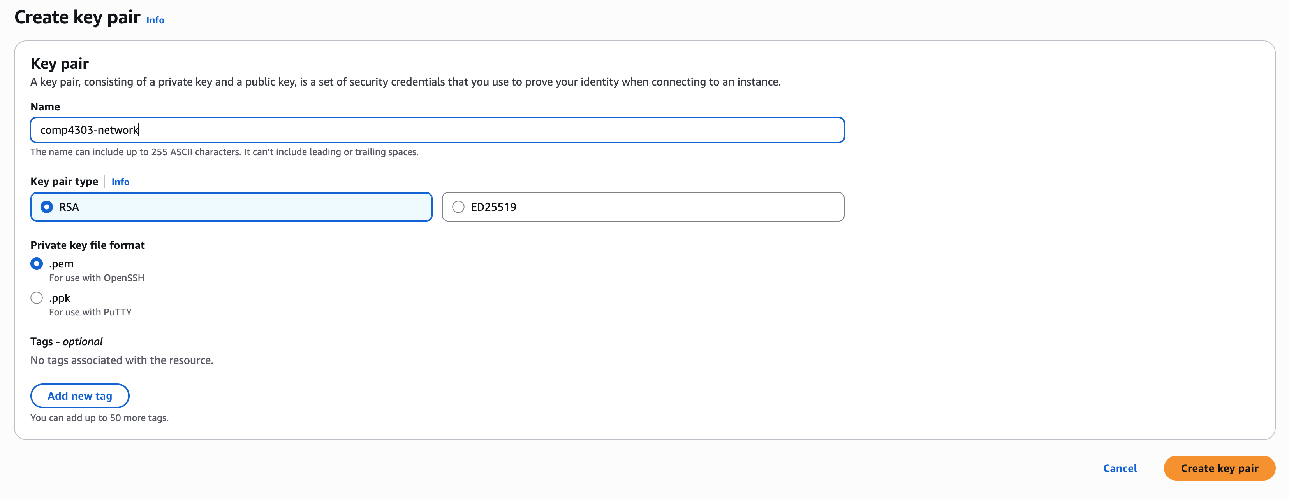
Create a Key Pair
Think of a name
Let other fields set by default... then create!

Slide 26
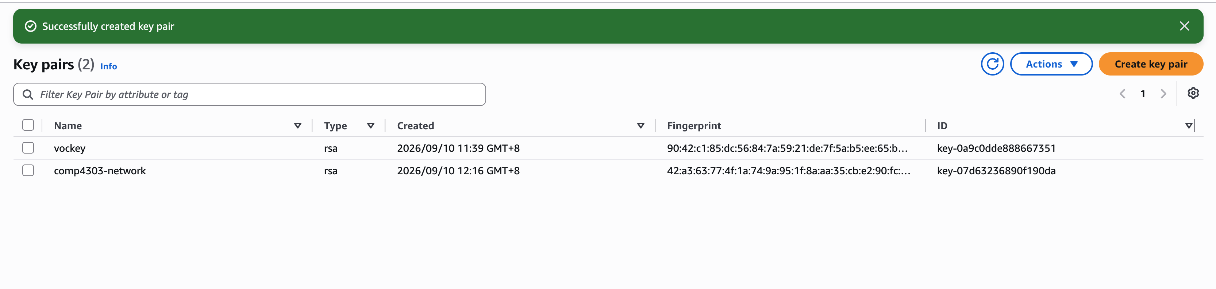
Create a Key Pair
On success, you see a banner
And a file is automatically downloaded...
That is the private key that you can use to access
your EC2 instances thereafter, so keep it safely!

Slide 27
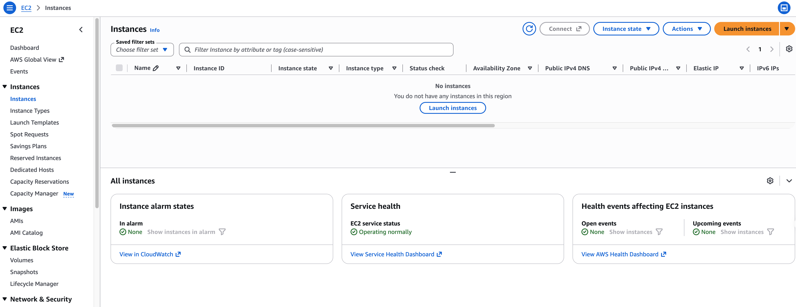
Launch an EC2 instance
With the key pair, we are ready to launch instances.

Slide 28
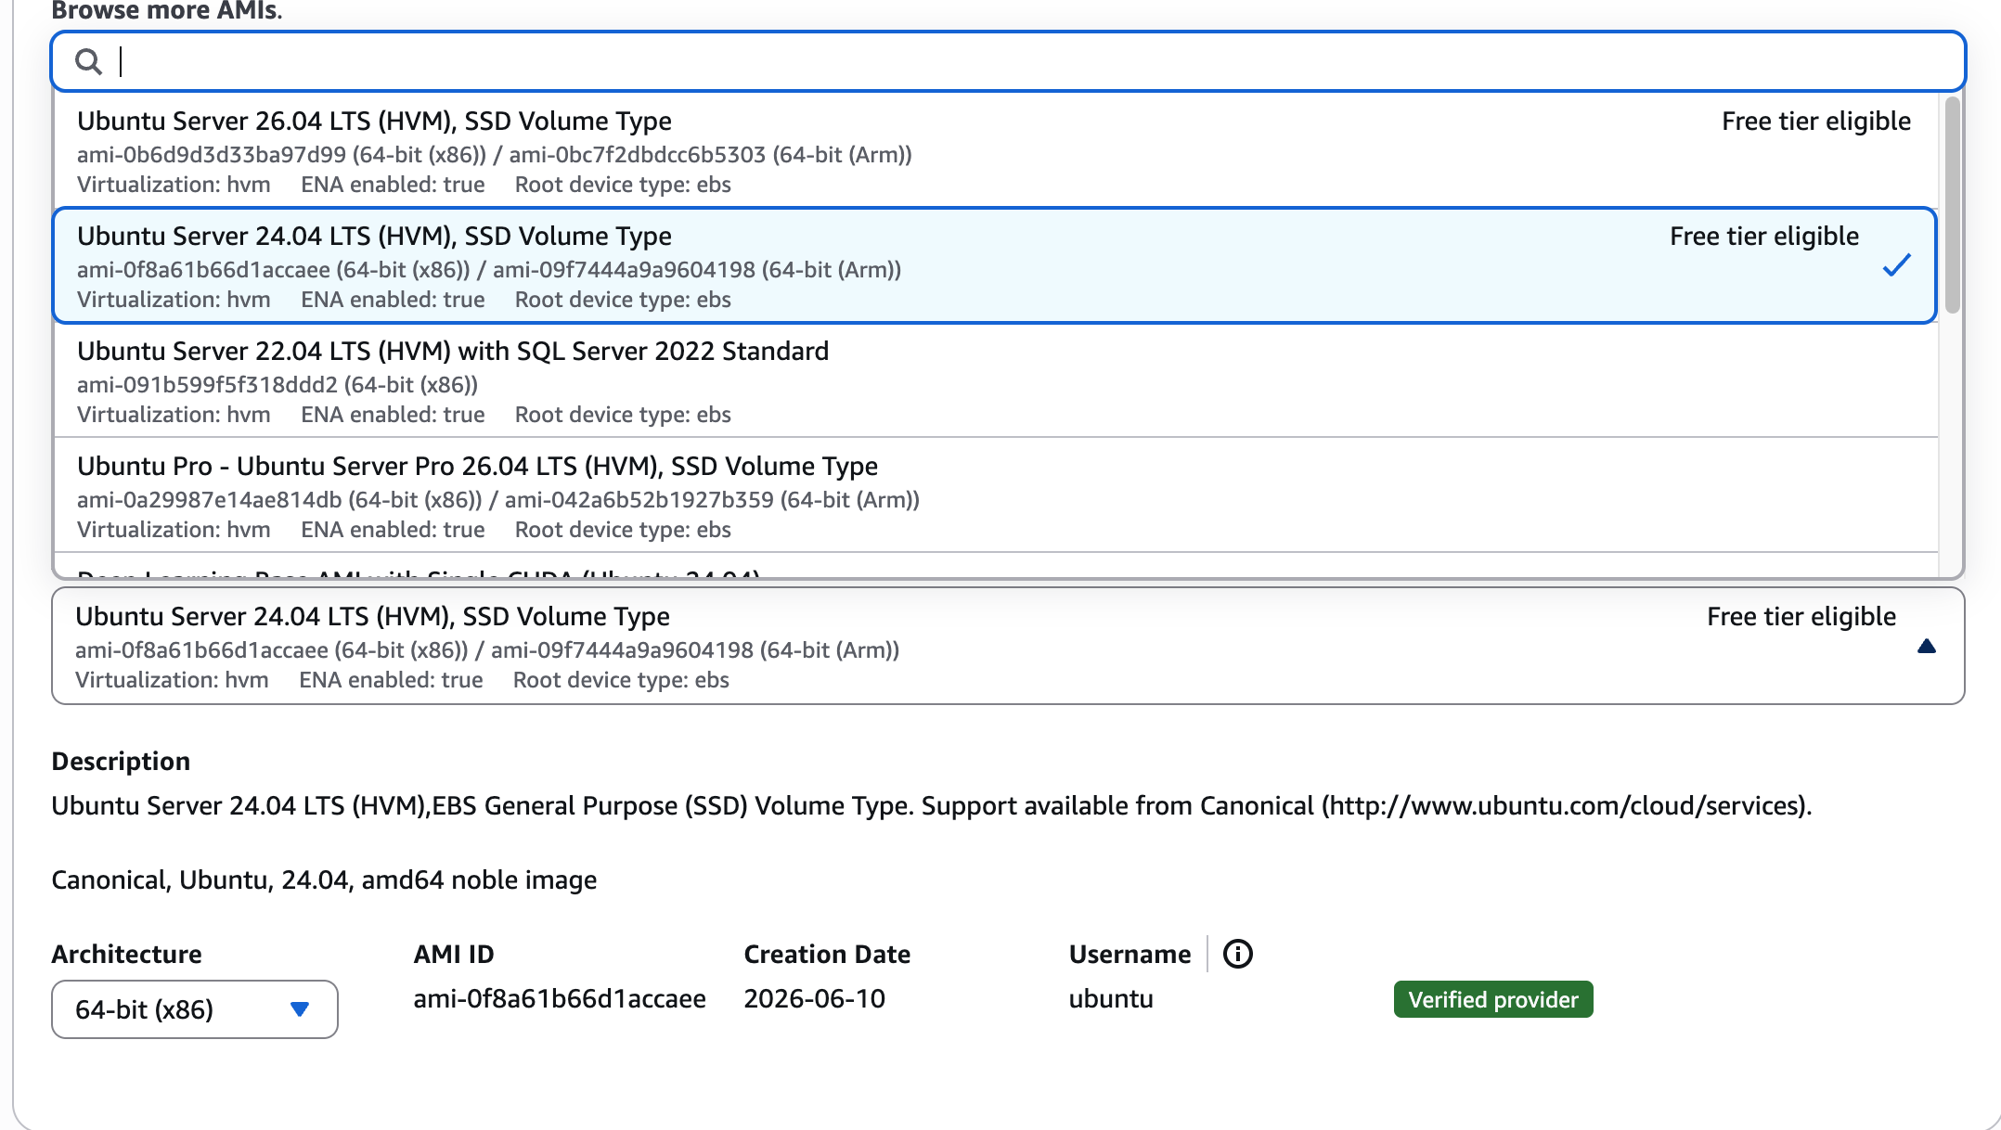
Launch an EC2 instance
Ubuntu is recommended
For example, choose Ubuntu 24.04 and click Select

Slide 29
Server OS in EC2
Common server OS’es: Linux (RedHat, openSUSE, Debian, CentOS, Ubuntu, Amazon Linux) and Windows Server.
There are over 5000 OS images in EC2 to choose from. (2996 versions of ubuntu!)

Slide 30
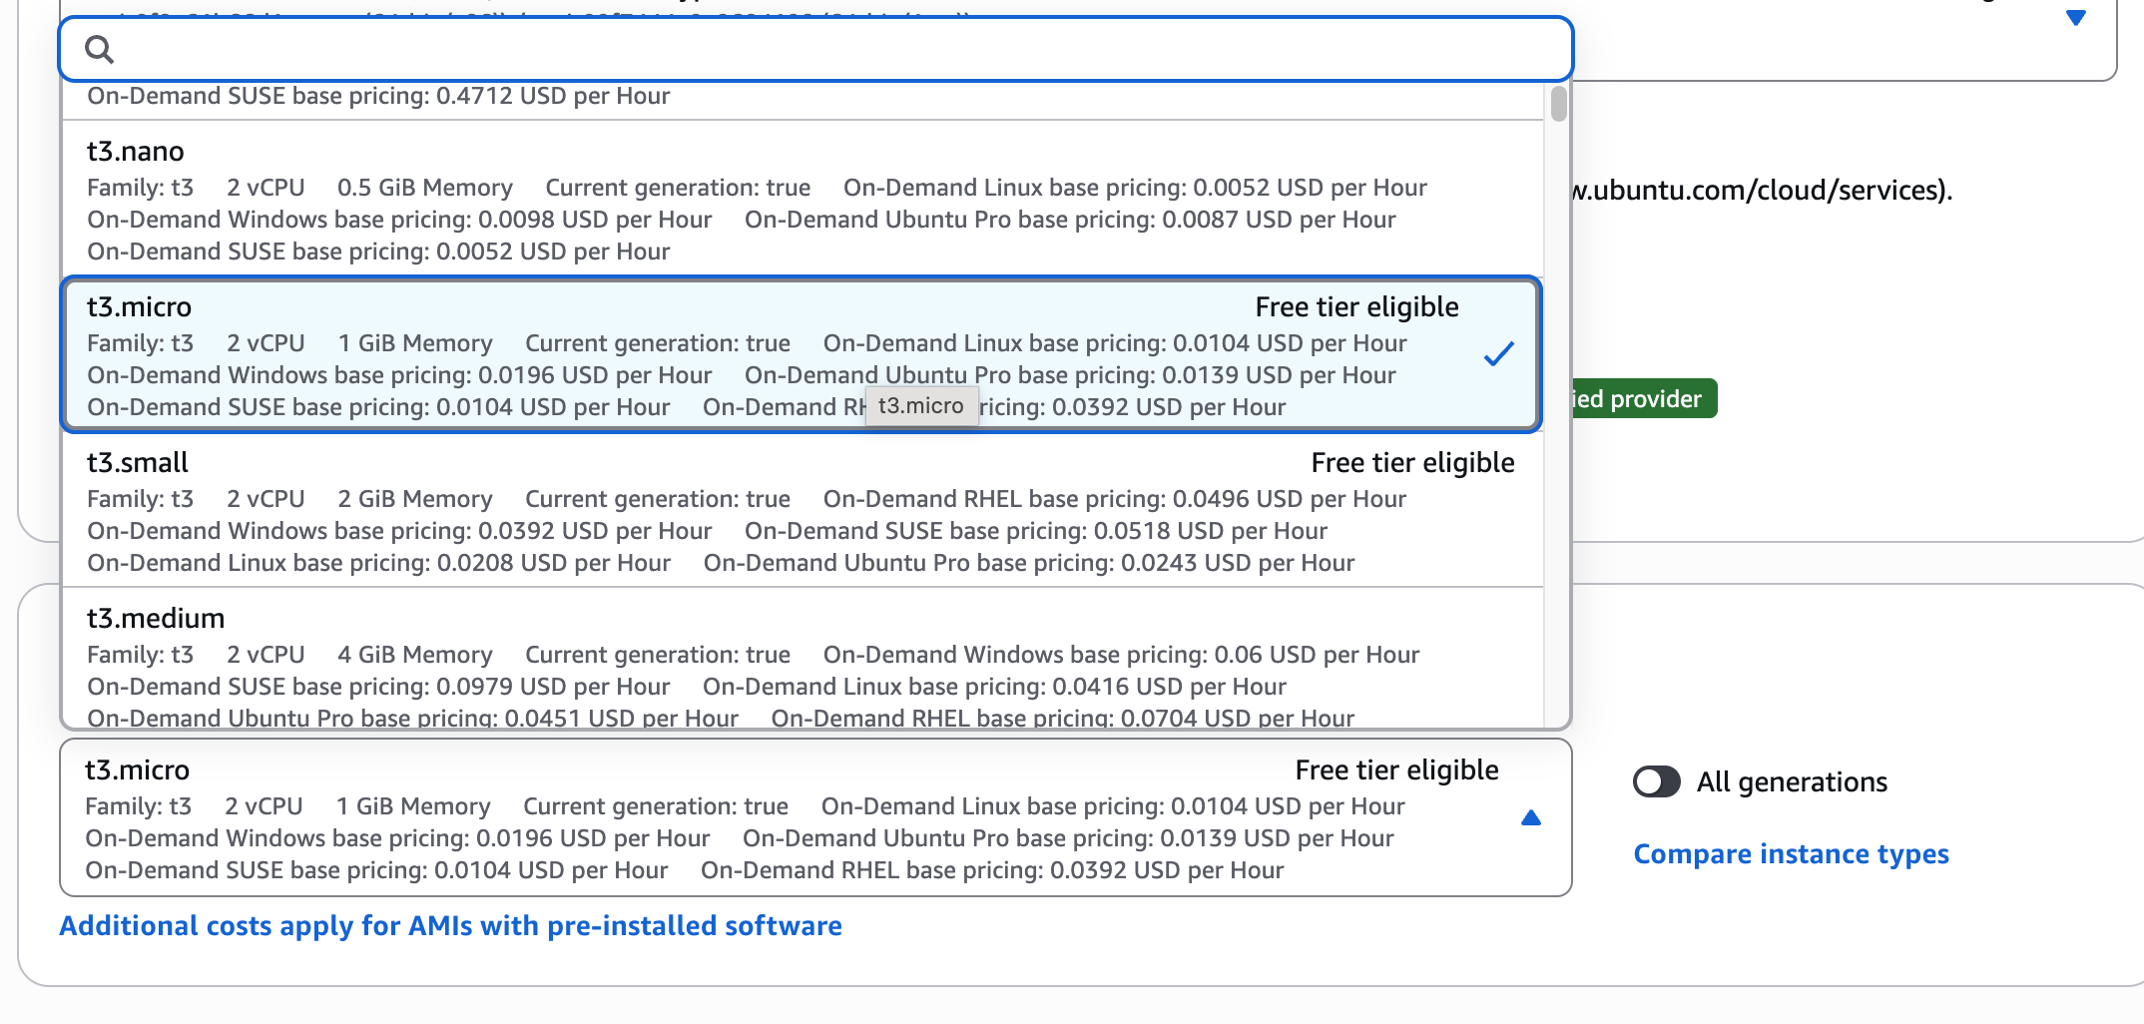
Launch an EC2 instance
For example, choose t3.micro
where t3: one class of General Purpose instances
micro: one tier of hardware specifications

Slide 31
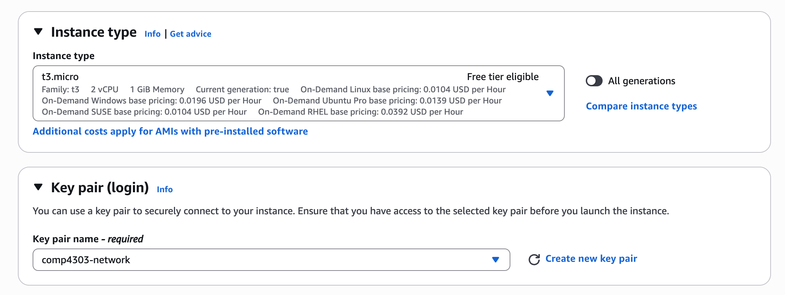
Launch an EC2 instance
Choose your key pair

Slide 32
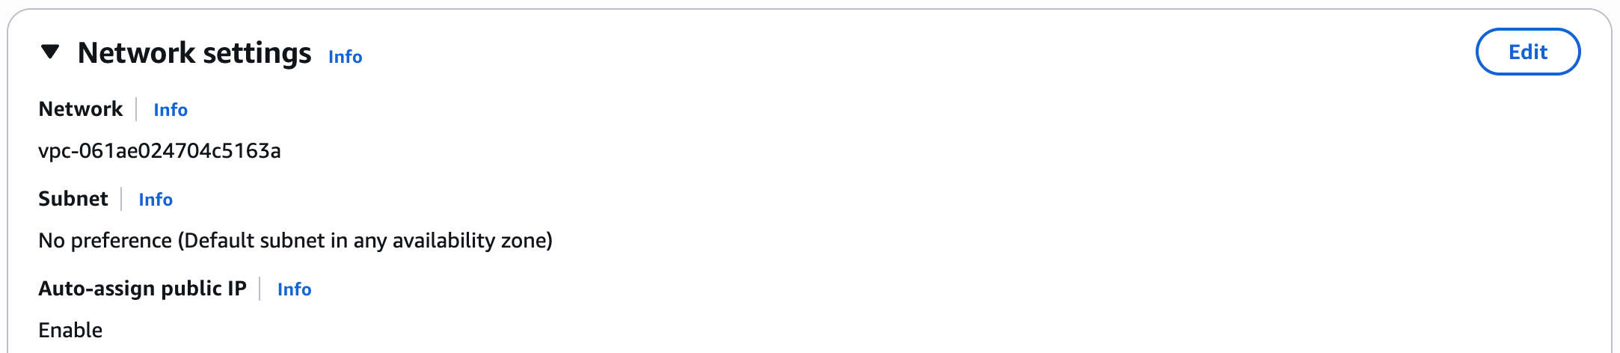
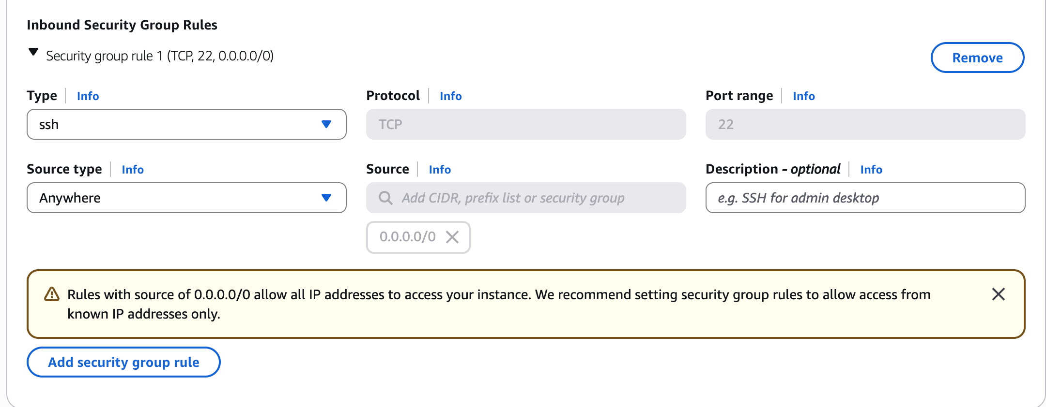
Launch an EC2 instance
Click edit
Add/Edit/Delete security rules if necessary
Caution! The default security group only enables port 22 for SSH programs from any source IPv4 address (0.0.0.0/0) to access your instance. You may want to allow programs from other IP address and ports to access to your instance.
Notes:
What are security groups used for?

Slide 33
EC2 instance types
General Purpose: a balance of compute, memory, and network resources
Memory optimized: lowest cost per GB of RAM
Storage optimized: better disk I/O and higher storage capacity
Compute optimized: lowest cost per vCPU
...
* For detailed information: https://aws.amazon.com/ec2/instance-types/

Slide 34
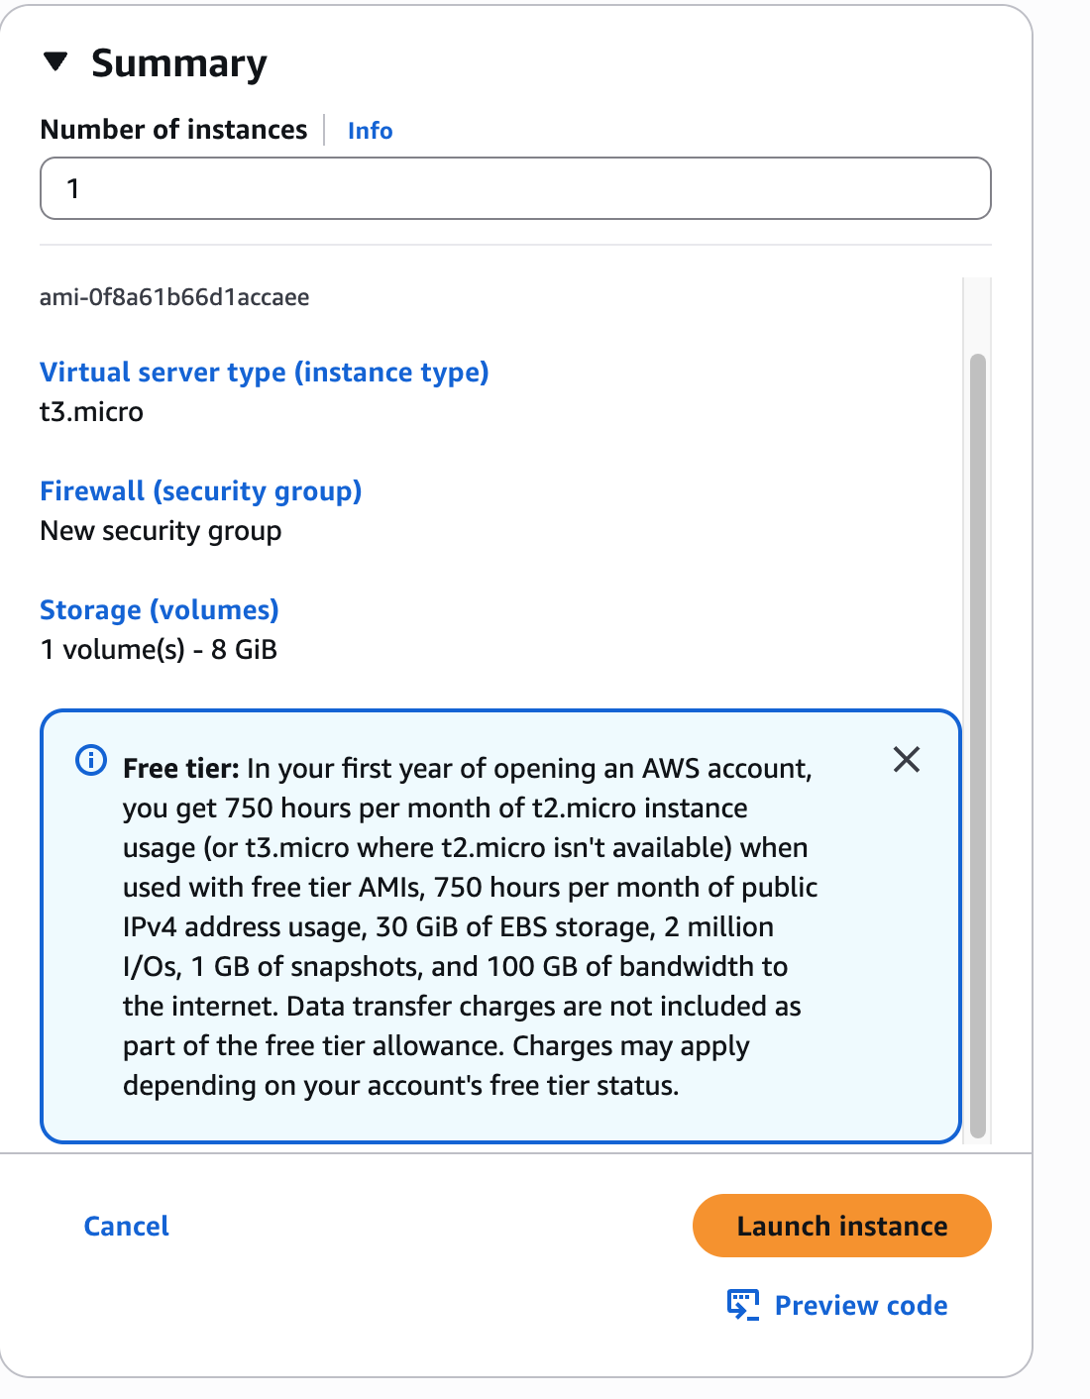
Launch an EC2 instance
Review and launch if no problem

Slide 35
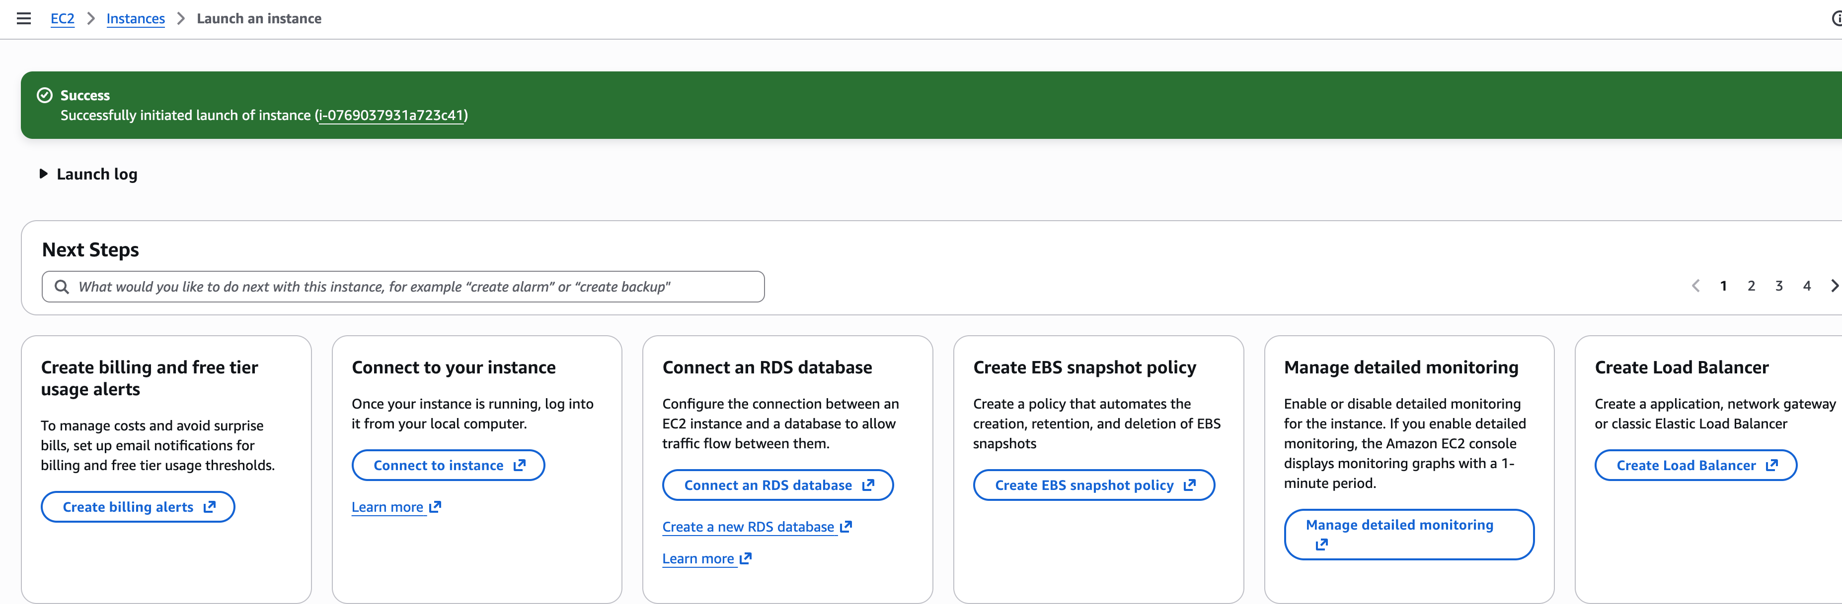
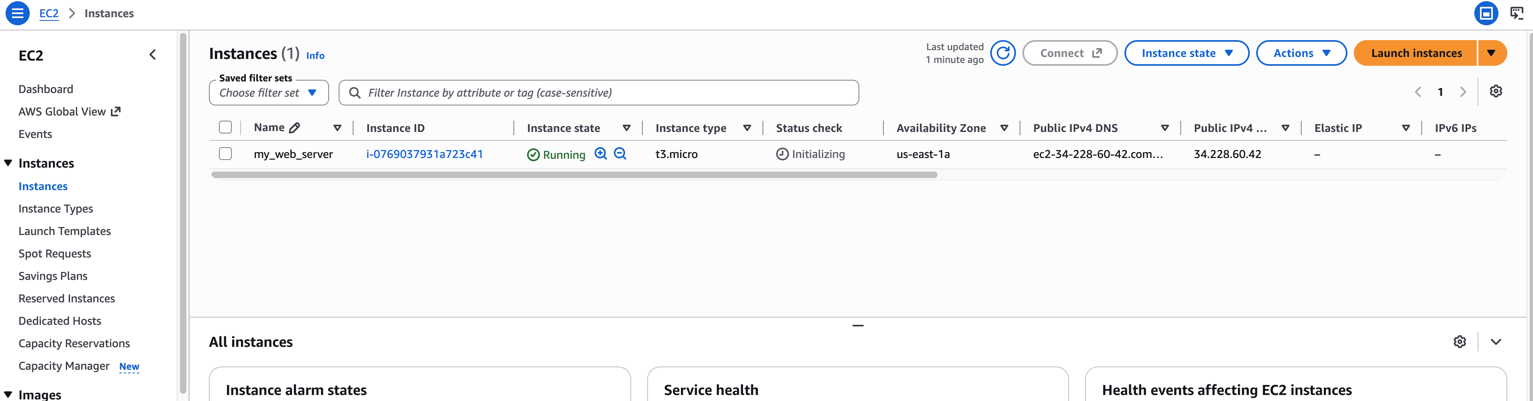

Launch an EC2 instance

Slide 36
Outline
Create an AWS Account
Launch an EC2 Instance
Connect to an Instance
Stop an EC2 Instance

Slide 37
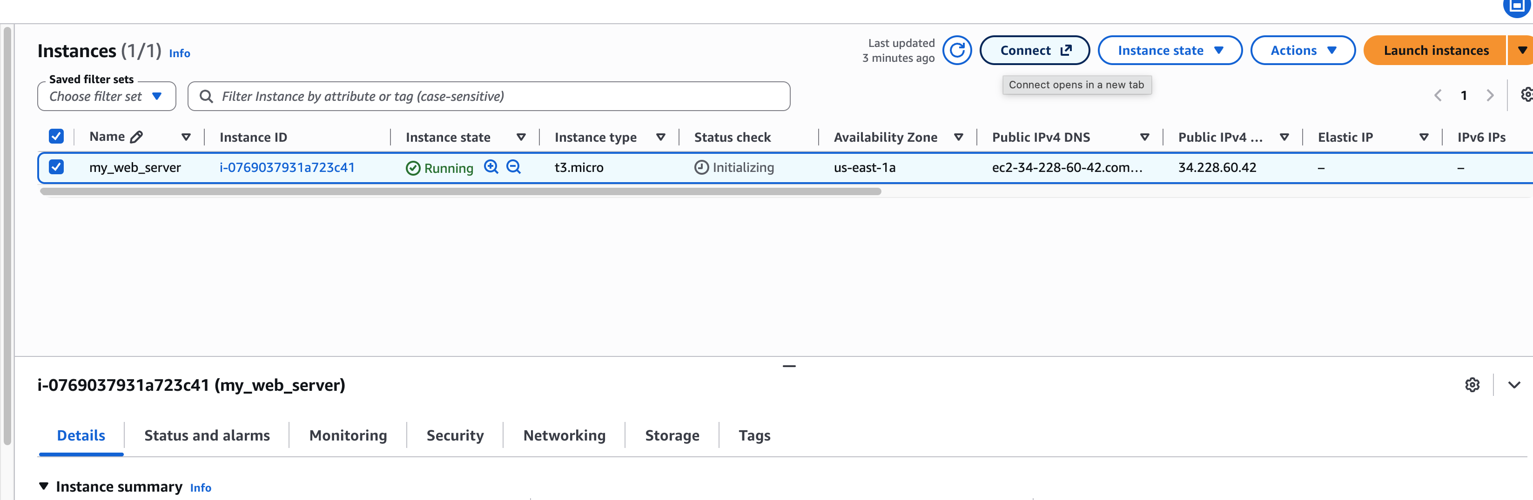
Connect to an EC2 instance
2. Click here and follow the instructions prompted
1. First select the target instance

Slide 38
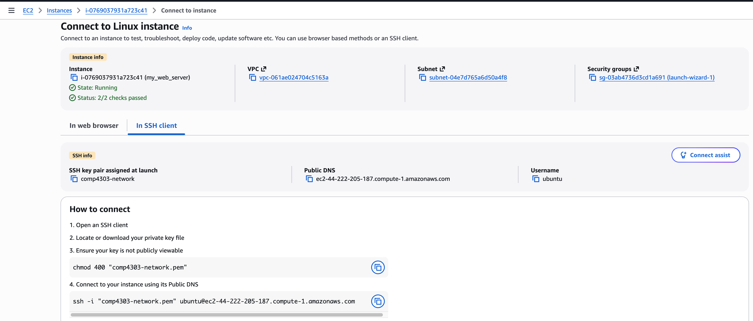
Connect to an EC2 instance
Just follow~

Slide 39
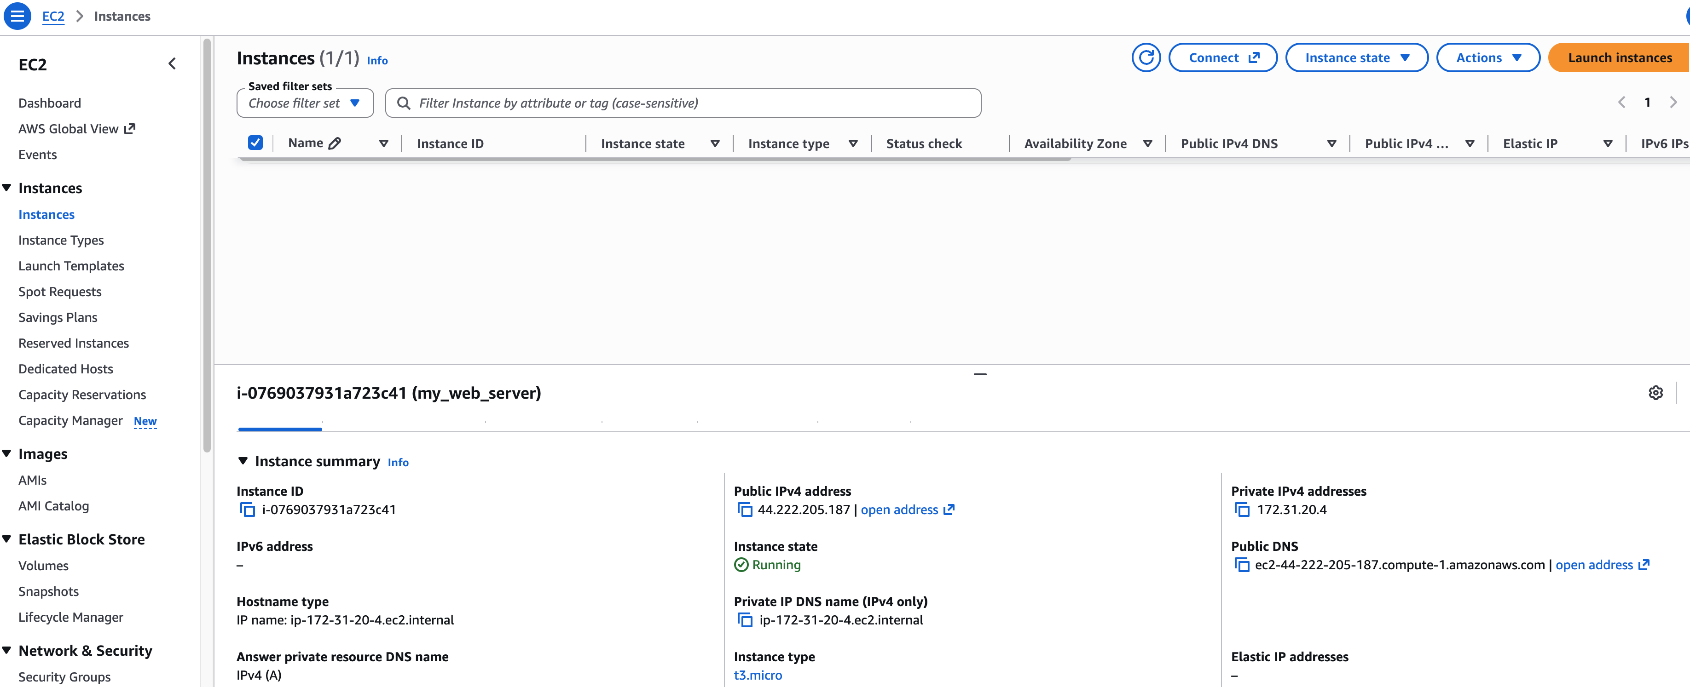
Public vs. Private IP
reachable within the same network
e.g., connecting from another instance in the same availability zone
(Never change)
reachable from the Internet
e.g., used in SSH from your laptop
(Change each time you start the instance!)

Slide 40
Connection Test
To test whether your instance is connected to the Internet, access google from your EC2 instance. Type the command in the SSH shell after successfully connecting to the instance. The command will download the homepage of Google to your current directory.
To test the connection from your computer to EC2 instance, upload a file from local computer to EC2 instance. Type the command in another terminal without SSH connection. The command copies <local_file> to the directory “~” of the remote instance.
scp -i <private_key_path> <local_file_path> ubuntu@<public_ip>:~

Slide 41
Outline
Create an AWS Account
Launch an EC2 Instance
Connect to an Instance
Stop an EC2 Instance

Slide 42
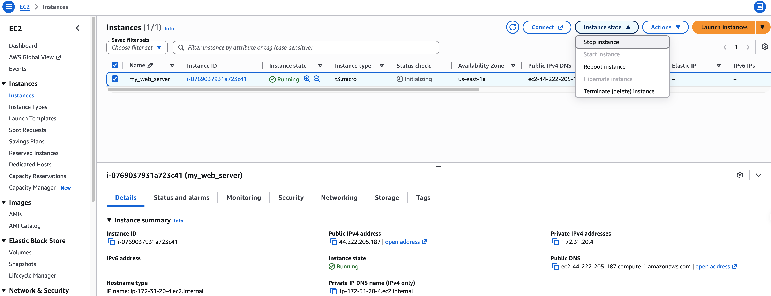
Stop an EC2 instance
1. Find the running instance
2. Select Stop
(Not Terminate!)
Stop: I won’t use it now, but I want to start it later (so your programs and data remain)
Terminate: I will never use it again, and thus I would like to forget about it forever

Slide 43
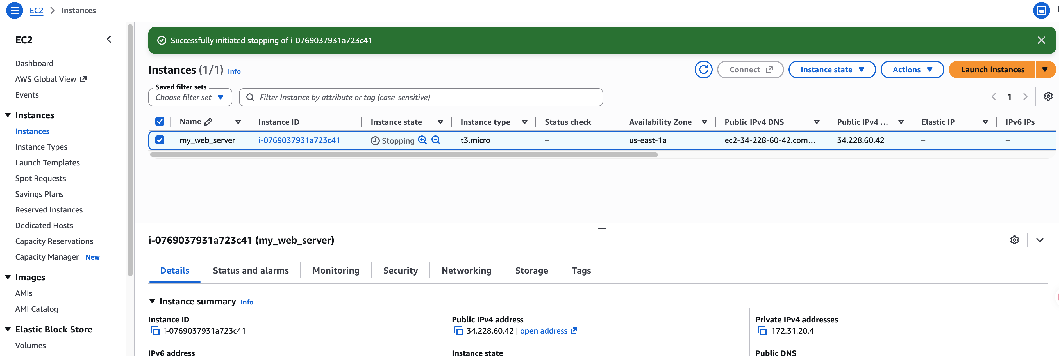
Stop an EC2 instance
On success you will see this

Slide 44
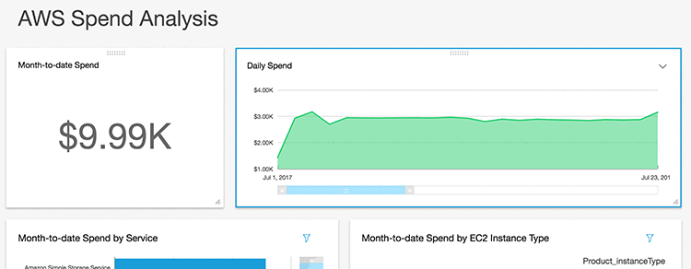
Stop an EC2 instance
Remember to stop the instance!!!
Otherwise, do expect bill like this:

