Slide 1
SQL

Slide 2
Summary of Earlier Contents
Relational Model
Relations, Tuples, Attributes
Integrity Constraints
ER to Relational Mapping
Relational Algebra
Select, Project, Union, Intersection, Difference, Cartesian Product, Join, Divide, Rename
Basic Operators vs Extended Operators
Aggregation

Slide 3
SQL-99
SQL = Structured Query Language (pronounced “sequel”).
Developed at IBM (San Jose Lab) during the 1970’s, and standardised during the 1980’s.
A standard language for querying and manipulating relational DBMSs.
Interactive via GUI or command line or embedded in programs.
Declarative, based on relational algebra.

Slide 4
SQL in Relational DBMS
In relational databases, what does SQL do?
A data definition language (DDL)
CREATE TABLE, DROP TABLE, …
A data manipulation language (DML)
SELECT (keywords relating to select: GROUP BY, HAVING, ORDER BY…), INSERT, DELETE, UPDATE, ALTER, …
Other Commands
indexes, constraints, views, triggers, transactions, authorization, …

Slide 5
Sample Database
To illustrate the features of SQL, we use a small example database below:
Beers(name, manf) Bars(name, addr, license)
Drinkers(name, addr, phone) Likes(drinker, beer)
Sells(bar, beer, price) Frequents(drinker, bar)
keys are in italic font and highlighted by underscore.

Slide 6
Sample Database (cont)
Name | Addr | License
Australia Hotel | The Rocks | 123456
Coogee Bay Hotel | Coogee | 966500
Lord Nelson | The Rocks | 123888
Marble Bar | Sydney | 122123
Regent Hotel | Kingsford | 987654
Royal Hotel | Randwick | 938500
Bars:
Name | Addr | Phone
Adam | Randwick | 9385-4444
Gernot | Newtown | 9415-3378
John | Clovelly | 9665-1234
Justin | Mosman | 9845-4321
Drinkers:

Slide 7
Sample Database (cont)
Name | Manf
80/- | Caledonian
Bigfoot Barley Wine | Sierra Nevada
Burragorang Bock | George IV Inn
Crown Lager | Carlton
Fosters Lager | Carlton
Invalid Stout | Carlton
Melbourne Bitter | Carlton
New | Toohey’s
Old | Toohey’s
Old Admiral | Lord Nelson
Pale Ale | Sierra Nevada
Premium Lager | Cascade
Red | Toohey’s
Sheaf Stout | Toohey’s
Sparkling Ale | Cooper’s
Stout | Cooper’s
Three Sheets | Lord Nelson
Victoria Bitter | Carlton
Beers:

Slide 8
Sample Database (cont)
Likes:
Frequents:
Drinker | Beer
Adam | Crown Lager
Adam | Fosters Lager
Adam | New
Gernot | Premium Lager
Gernot | Sparkling Ale
John | 80/-
John | Bigfoot Barley Wine
John | Pale Ale
John | Three Sheets
Justin | Sparkling Ale
Justin | Victoria Bitter
Drinker | Bar
Adam | Coogee Bay Hotel
Gernot | Lord Nelson
John | Coogee Bay Hotel
John | Lord Nelson
John | Australia Hotel
Justin | Regent Hotel
Justin | Marble Bar

Slide 9
Sample Database (cont)
Bar | Beer | Price
Australia Hotel | Burragorang Bock | 3.5
Coogee Bay Hotel | New | 2.25
Coogee Bay Hotel | Old | 2.5
Coogee Bay Hotel | Sparkling Ale | 2.8
Coogee Bay Hotel | Victoria Bitter | 2.3
Lord Nelson | Three Sheets | 3.75
Lord Nelson | Old Admiral | 3.75
Marble Bar | New | 2.8
Marble Bar | Old | 2.8
Marble Bar | Victoria Bitter | 2.8
Regent Hotel | New | 2.2
Regent Hotel | Victoria Bitter | 2.2
Royal Hotel | New | 2.3
Royal Hotel | Old | 2.3
Royal Hotel | Victoria Bitter | 2.3
Sells:

Slide 10
Example:
Name | Manf
80/- | Caledonian
Bigfoot Barley Wine | Sierra Nevada
Burragorang Bock | George IV Inn
Crown Lager | Carlton
Fosters Lager | Carlton
Invalid Stout | Carlton
Melbourne Bitter | Carlton
New | Toohey’s
Old | Toohey’s
Old Admiral | Lord Nelson
Pale Ale | Sierra Nevada
Premium Lager | Cascade
Red | Toohey’s
Sheaf Stout | Toohey’s
Sparkling Ale | Cooper’s
Stout | Cooper’s
Three Sheets | Lord Nelson
Victoria Bitter | Carlton
Beers:
SQL Queries: What beers are made by Toohey’s?”

Slide 11
Example:
Name | Manf
80/- | Caledonian
Bigfoot Barley Wine | Sierra Nevada
Burragorang Bock | George IV Inn
Crown Lager | Carlton
Fosters Lager | Carlton
Invalid Stout | Carlton
Melbourne Bitter | Carlton
New | Toohey’s
Old | Toohey’s
Old Admiral | Lord Nelson
Pale Ale | Sierra Nevada
Premium Lager | Cascade
Red | Toohey’s
Sheaf Stout | Toohey’s
Sparkling Ale | Cooper’s
Stout | Cooper’s
Three Sheets | Lord Nelson
Victoria Bitter | Carlton
Beers:
SQL Queries: What beers are made by Toohey’s?”
SELECT Name FROM Beers WHERE Manf = ‘Toohey’’s’;

Slide 12
SQL Queries
To answer the question “What beers are made by Toohey’s?”, we could ask:
SELECT Name FROM Beers WHERE Manf = ‘Toohey’’s’;
This gives a subset of the Beers relation, displayed as:
      Name
      --------------------
      New
      Old
      Red
      Sheaf Stout
Quotes are escaped by doubling them (‘ ‘)

Slide 13
Basic SELECT Structure
To retrieve information from a database, there is a basic query structure, known as the select statement.
SELECT <Attribute list>
FROM <Table list>
WHERE <Condition>
<attribute list>: list of attributes
<table list>: list of relations
<condition>: list of conditions (Boolean expression)
SELECT statement is also known as a select-from-where block. The result of this statement is a table, which is typically displayed on output.
The SELECT statement contains the functionality of select, project and join from the relational algebra.

Slide 14
SQL Identifiers
Names are used to identify objects such as tables, attributes, views, …
Identifiers in SQL use similar conventions to common programming languages:
  a sequence of alpha-numerics, starting with an alphabetic,
  not case-sensitive,
  reserve word disallowed, …
  Whether you can use sign (@), dollar sign ($), number sign (#), or underscore (_) depends on the standard.

Slide 15
SQL Keywords
Some of the frequently-used ones
  ALTER AND CREATE
  FROM INSERT NOT OR
  SELECT TABLE WHERE
For PostgreSQL Keywords see
https://www.postgresql.org/docs/current/sql-keywords-appendix.html .

Slide 16
SQL Data Types
All attributes in SQL relations have domain specified.
SQL supports a small set of useful built-in data types: strings, numbers, dates, bit-strings.
Self defined data type is allowed in PostgreSQL.
Various type conversions are available
  date to string, string to date, integer to real ...
  applied automatically “where they make sense”

Slide 17
SQL Data Types (cont.)
Basic domain (type) checking is performed automatically.
Constraints can be used to “enforce” more complex domain membership conditions.
The NULL value is a member of all data types.

Slide 18
SQL Data Types (cont.)
Comparison operators are defined on all types.
    < > <= >= = !=
Boolean operators AND, OR, NOT are available within WHERE expressions to combine results of comparisons.
Comparison against NULL yields FALSE.
Can explicitly test for NULL using:
  attr IS NULL attr IS NOT NULL
Most data types also have type-specific operations available (e.g., arithmetic for numbers).
Which operations are actually applied depends on the implementation.

Slide 19
Data Types - Numeric
Some options for specifying the attributes for holding numeric values:
If you need integers
smallint (2 byte integer)
int (4 byte integer)
bigint (8 byte integer)
If you need real numbers
real (4 byte floating point)
double (8 byte floating point)
numeric (<precision> , <scale>)
    <precision>: specify significant digits in the whole number
    <scale>: specify digits after the decimal point

Slide 20
Data Types – String Literal
Example of a string literal: ‘John’
A string literal is a sequence of zero or more characters
In SQL, you specify a literal by enclosing it in single quotes.
Two kinds of string literals are available:
  CHAR(n) n length, left-justified blank-padded
  VARCHAR(n) can be between 0 and n length, no padding
String literals are case sensitive: ‘John’ != ‘JOHN ’

Slide 21
String Operators
string || string … concatenate two strings
LENGTH (string) ... return length of string
SUBSTR (string, start, length) ... extract chars from within string
Example:
‘Post’|| ‘greSQL’ -> PostgreSQL
substring('Thomas' from 2 for 3) -> hom

Slide 22
SQL Like Operator
str LIKE pattern ... matches string to pattern
Two kinds of string pattern-matching
The symbol _ (underscore) matches any single characters
The symbol % (percent) matches zero or more characters
Practice
  String LIKE ‘Ja%’ Strings beginning with ‘Ja’
  String LIKE ‘_i%’ Strings with ‘i’ as 2nd letter
  String LIKE ‘%o%o%’ Strings contains two ‘o’s

Slide 23
SQL Dates
Dates are simply specially-formatted strings, with a range of operations to implement date semantics.
Format is typically DD-Mon-YYYY, e.g., ’18-Aug-1998’
Accepts other formats
Comparison operators implement before (<) and after (>).
(start1, end1) OVERLAPS (start2, end2)
This expression yields true when two time periods (defined by their endpoints) overlap, false when they do not overlap.
SELECT (DATE '2001-02-16', DATE '2001-12-21') OVERLAPS (DATE '2001-10-30', DATE '2002-10-30'); -> Result: true

Slide 24
Converting Data Types
Conversions between data types are an important skill to know.
E.g., division of one integer with an integer
Various type conversions are available:
integer to real ...
string to integer …
SQL supports a small set of useful built-in data types, e.g., numbers, strings, dates...
You can define your own type in SQL.

Slide 25
Tuple and Set Literals
Tuple and set constants are both written as:
(val1, val2, val3, ... )
The correct interpretation is worked out from the context.
Examples:
  Student(stude#, name, course)
  ( 2177364, ’Jack Smith’, ’BSc’) -- tuple literal
  SELECT name
  FROM Employees
  WHERE job IN (’Lecturer’, ’Tutor’, ’Professor’); -- set literal

Slide 26
Querying a Single Relation
Formal semantics (relational algebra):
start with relation R in FROM clause
apply σ using Condition in WHERE clause
apply π using Attributes in SELECT clause
    SELECT Attributes
    FROM R
    WHERE Conditions

Slide 27
Querying a Single Relation
Operationally, we think in terms of a tuple variable ranging over all tuples of the relation.
Operational semantics of SQL SELECT (single relation)
  FOR EACH tuple T in R DO
  check whether T satisfies the condition in the WHERE clause
  IF it does THEN
  print the attributes of T that are
  specified in the SELECT clause
  END
  END

Slide 28
Projection by SELECT Clause
The select clause lists the attributes desired in the result of a query
corresponds to the projection operation of the relational algebra
Example: Give all the names of all drinkers
SELECT Name
FROM Drinkers;
Note: FROM is always necessary with SELECT, whereas WHERE is optional.
Drinkers:
Name | Addr | Phone
Adam | Randwick | 9385-4444
Gernot | Newtown | 9415-3378
John | Clovelly | 9665-1234
Justin | Mosman | 9845-4321

Slide 29
Projection by SELECT Clause
The select clause lists the attributes desired in the result of a query
corresponds to the projection operation of the relational algebra
Example: Give all the names of all drinkers
SELECT Name
FROM Drinkers;
Note: FROM is always necessary with SELECT, whereas WHERE is optional.
Drinkers:
Name | Addr | Phone
Adam | Randwick | 9385-4444
Gernot | Newtown | 9415-3378
John | Clovelly | 9665-1234
Justin | Mosman | 9845-4321

Slide 30
Projection by SELECT Clause
Example: Give me both names and addresses of drinkers!
SELECT Name, Addr
FROM Drinkers;
An asterisk in the select clause denotes “all attributes”
SELECT *
FROM Drinkers;
Drinkers:
Name | Addr | Phone
Adam | Randwick | 9385-4444
Gernot | Newtown | 9415-3378
John | Clovelly | 9665-1234
Justin | Mosman | 9845-4321
Drinkers:
Name | Addr | Phone
Adam | Randwick | 9385-4444
Gernot | Newtown | 9415-3378
John | Clovelly | 9665-1234
Justin | Mosman | 9845-4321

Slide 31
DISTINCT
SQL allows duplicates in relations and in query results.
allows a table to have two or more tuples that are identical in all their attribute values.
In general, an SQL table can be a simple set of tuples, or a multiset of tuples.
Set: {a, b, c}
Multiset: {a, a, b, b, c, a, a, b, c, c …}

Slide 32
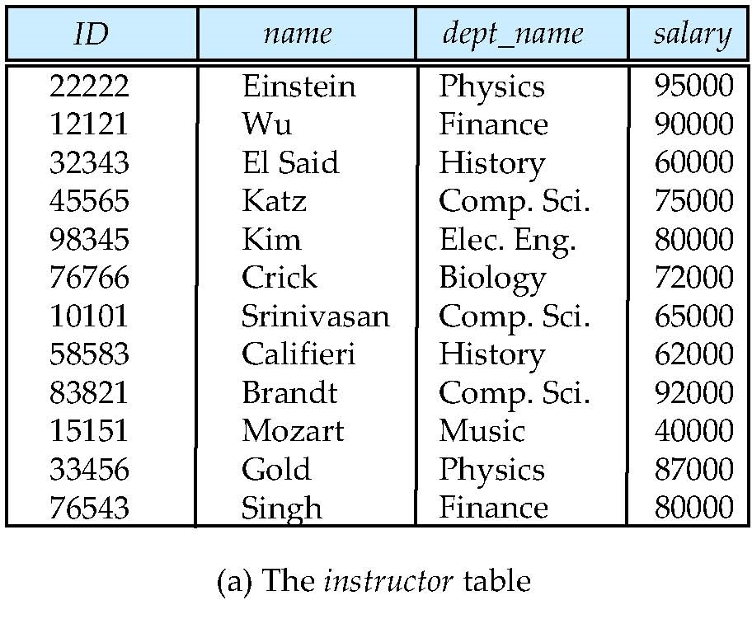
DISTINCT
To eliminate duplicates in the query results, insert the keyword distinct after select.
Example: Find the names of all departments and remove duplicates.
SELECT DISTINCT dept_name from instructor
Question: When are duplicates useful?
Notes:
4

Slide 33
Selection by Where Clause
Find the beers manufactured by Toohey’s
SELECT Name
FROM Beers
WHERE Manf = ‘Toohey’’s’;
The “typical” SELECT query:
SELECT a1, a2, a3
FROM Rel
WHERE Cond
This corresponds to select followed by project
π_{{a1,a2,a3}}(σ_{Cond}(Rel))
Name | Manf
80/- | Caledonian
Premium Lager | Cascade
Red | Toohey’s
Sheaf Stout | Toohey’s
Sparkling Ale | Cooper’s
Victoria Bitter | Carlton
Beers:

Slide 34
Example
Bar | Beer | Price
Australia Hotel | Burragorang Bock | 3.5
Coogee Bay Hotel | New | 2.25
Coogee Bay Hotel | Old | 2.5
Coogee Bay Hotel | Sparkling Ale | 2.8
Coogee Bay Hotel | Victoria Bitter | 2.3
Lord Nelson | Three Sheets | 3.75
Lord Nelson | Old Admiral | 3.75
Marble Bar | New | 2.8
Marble Bar | Old | 2.8
Marble Bar | Victoria Bitter | 2.8
Regent Hotel | New | 2.2
Regent Hotel | Victoria Bitter | 2.2
Royal Hotel | New | 2.3
Royal Hotel | Old | 2.3
Royal Hotel | Victoria Bitter | 2.3
Find the price that Regent Hotel charges for New
  SELECT price
  FROM Sells
  WHERE bar = ’Regent Hotel’ AND beer = ’New’;
  PRICE
  ----------
  2.2
The condition can be an arbitrarily complex boolean-valued expression using the operators mentioned previously.

Slide 35
Null in SQL
What happens when the condition makes a comparison with a null value?
Comparisons with null returns unknown
  Example: 5 < null, null <> null, null = null
Three-valued logic using the truth value unknown
  OR: (unknown or true) = true,
  (unknown or false) = unknown,
  (unknown or unknown) = unknown
  AND: (true and unknown) = unknown,
  (false and unknown) = false,
  (unknown and unknown) = unknown
  NOT: (not unknown) = unknown
  “P is unknown” evaluates to true if predicate P evaluates as unknown
Result of where clause predicate is treated as false if it evaluates as unknown

Slide 36
Example: Null Values
SELECT A3
FROM R
WHERE A1 + 5 > A2 and A4 = ‘x’
When it evaluates the second tuple:
Null + 5 -> Null (for A1 + 5)
Null > 4 -> Null (for A1 + 5 > A2)
Null = ‘x’ -> Null (for A4 = ‘x’)
Null and Null -> Null (for A1 + 5 > A2 and A4 = ‘x’)
Where clause results false since it is Null. So it does not output “beta”
What about the following?
select A3
from R
where (A1 + 5 > A2 and A4 = ‘x’) is unknown
A1 | A2 | A3 | A4
5 | 9 | alpha | x
 | 4 | beta
2 | 4 | gamma
3 |  | delta | x

Slide 37
Renaming via AS
In relational algebra we have the renaming operator ρ to avoid name clashes.
Example: ρ_{Beers(Brand, Brewer)}(Beers)
Gives a new relation, with same data as Beers, but with attribute names changed.
SQL provides AS to achieve this; it is used in the SELECT part.

Slide 38
Renaming via as (cont.)
Example:
Beers(name, manf)
SELECT name AS Brand, manf AS Brewer FROM Beers;
  BRAND BREWER
  ------------------------- --------------------
  80/- Caledonian
  Bigfoot Barley Wine Sierra Nevada
  Burragorang Bock George IV Inn
  Crown Lager Carlton
  Fosters Lager Carlton
  Invalid Stout Carlton
  …

Slide 39
Expressions as Values in Columns
AS can also be used to introduce computed values
Example:
Sells(bar, beer, price)
SELECT bar, beer, price*120 AS PriceInYen
FROM Sells;
  BAR BEER PRICEINYEN
  ------------------ ----------------------- ----------------
  Australia Hotel Burragorang Bock 420
  Coogee Bay Hotel New 270
  Coogee Bay Hotel Old 300
  Coogee Bay Hotel Sparkling Ale 336
  Coogee Bay Hotel Victoria Bitter 276
  …
Just Display but no change to the database

Slide 40
Inserting Text in Result Table
Trick: to put text in output columns, use constant expression with AS.
Example:
Likes(drinker, beer)
SELECT drinker, ‘likes Cooper’’s’ AS WhoLikes
FROM Likes
WHERE beer = ‘Sparkling Ale’;
DRINKER WHOLIKES
--------------- --------------
Gernot likes Cooper’s
Justin likes Cooper’s
Drinker | Beer
Adam | Crown Lager
Adam | Fosters Lager
Adam | New
Gernot | Premium Lager
Gernot | Sparkling Ale
John | 80/-
John | Bigfoot Barley Wine
John | Pale Ale
John | Three Sheets
Justin | Sparkling Ale
Justin | Victoria Bitter

Slide 41
Querying Multi-relations
Question: Find the brewers whose beers John likes?
Beers:
Name | Manf
80/- | Caledonian
Bigfoot Barley Wine | Sierra Nevada
Burragorang Bock | George IV Inn
Crown Lager | Carlton
Fosters Lager | Carlton
Invalid Stout | Carlton
Melbourne Bitter | Carlton
New | Toohey’s
Old | Toohey’s
Old Admiral | Lord Nelson
Pale Ale | Sierra Nevada
Premium Lager | Cascade
Red | Toohey’s
Sheaf Stout | Toohey’s
Sparkling Ale | Cooper’s
Stout | Cooper’s
Three Sheets | Lord Nelson
Victoria Bitter | Carlton
Likes:
Drinker | Beer
Adam | Crown Lager
Adam | Fosters Lager
Adam | New
Gernot | Premium Lager
Gernot | Sparkling Ale
John | 80/-
John | Bigfoot Barley Wine
John | Pale Ale
John | Three Sheets
Justin | Sparkling Ale
Justin | Victoria Bitter

Slide 42
Querying Multi-relations
Question: Find the brewers whose beers John likes?
Beers:
Name | Manf
80/- | Caledonian
Bigfoot Barley Wine | Sierra Nevada
Burragorang Bock | George IV Inn
Crown Lager | Carlton
Fosters Lager | Carlton
Invalid Stout | Carlton
Melbourne Bitter | Carlton
New | Toohey’s
Old | Toohey’s
Old Admiral | Lord Nelson
Pale Ale | Sierra Nevada
Premium Lager | Cascade
Red | Toohey’s
Sheaf Stout | Toohey’s
Sparkling Ale | Cooper’s
Stout | Cooper’s
Three Sheets | Lord Nelson
Victoria Bitter | Carlton
Likes:
Drinker | Beer
Adam | Crown Lager
Adam | Fosters Lager
Adam | New
Gernot | Premium Lager
Gernot | Sparkling Ale
John | 80/-
John | Bigfoot Barley Wine
John | Pale Ale
John | Three Sheets
Justin | Sparkling Ale
Justin | Victoria Bitter

Slide 43
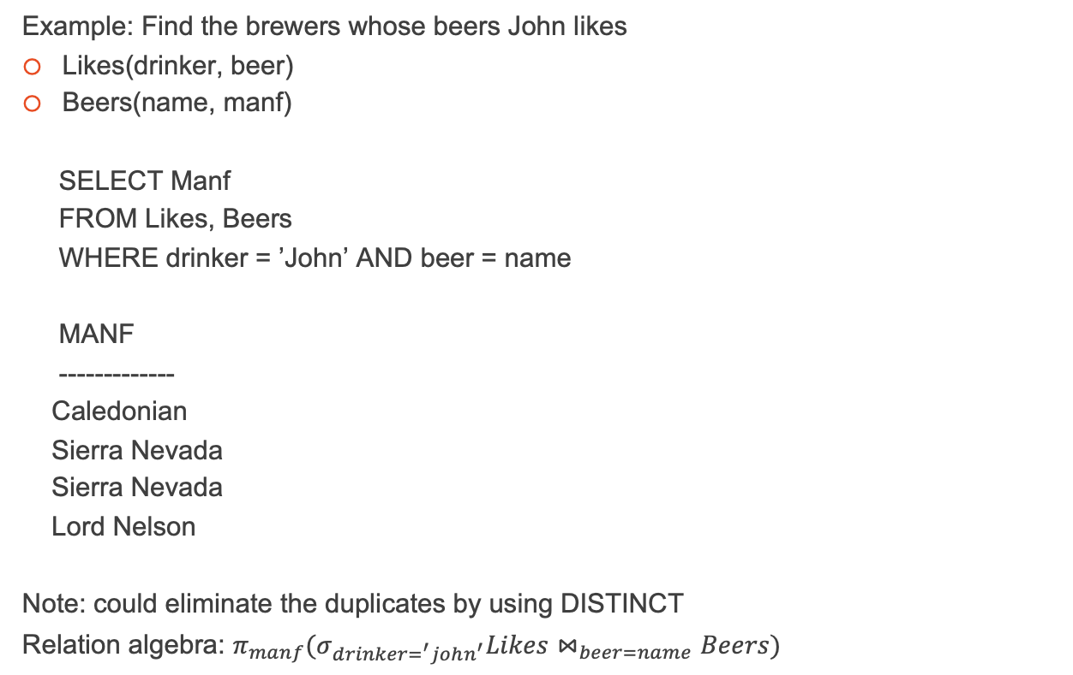
Querying Multi-relations

Slide 44
The From Clause
For SQL SELECT statement on several relations:
  SELECT Attributes
  FROM R1, R2, ...
  WHERE Condition
Formal semantics (relational algebra):
start with Cartesian Product R1 × R2 × ... in FROM clause
apply σ using Condition in WHERE clause
apply π using Attributes in SELECT clause

Slide 45
Querying Multi-relations
Operational semantics of SELECT (multi-relations):
  FOR EACH tuple T1 in R1 DO
  FOR EACH tuple T2 in R2 DO
  ...
  check WHERE condition for current
  assignment of T1, T2, ... vars
  IF holds THEN
  print attributes of T1, T2, ...
  specified in SELECT
  END
  ...
  END
  END
For efficiency reasons, it is not implemented in this way!

Slide 46
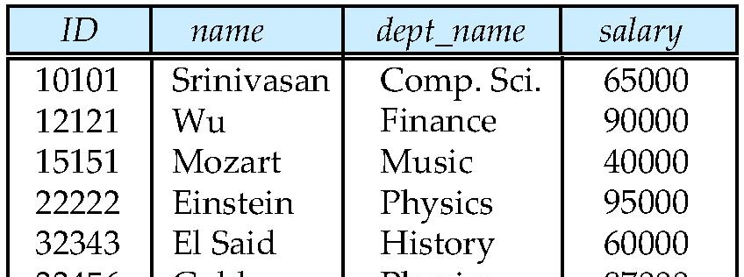
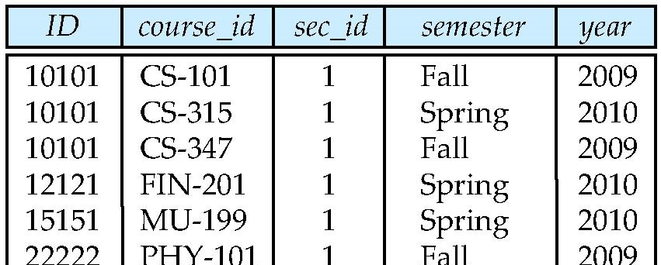
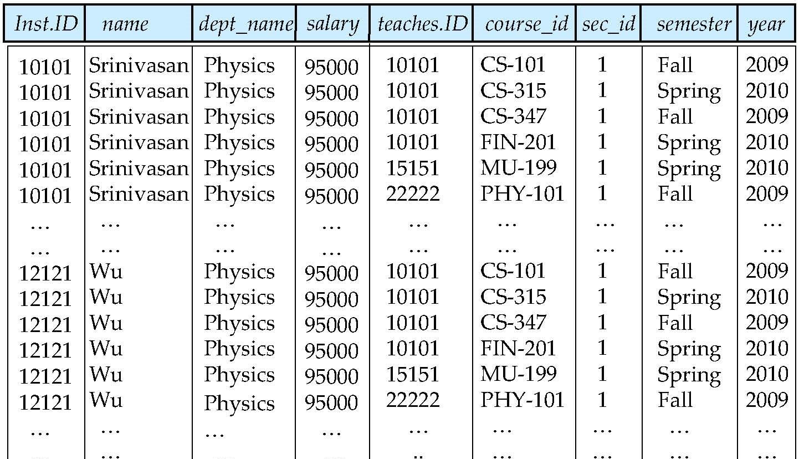
Cartesian Product
instructor
teaches
Comp. Sci
Comp. Sci
Comp. Sci
Comp. Sci
Comp. Sci
Comp. Sci
…
…
Finance
Finance
Finance
Finance
Finance
Finance
…
65000
65000
65000
65000
65000
65000
…
…
90000
90000
90000
90000
90000
90000
…
12121
12121

Slide 47
Attribute Name Clashes
Two tables can have attributes with the same name.
Beers (name, manf)
Bars (name, addr, license)
Problem: this ambiguity can lead to confusion if you write a query involving two tables with common column names:
if two same names appear in the WHERE clause
SELECT Bars.name
FROM Bars, Beers
WHERE name = name;
SQL: “ERROR: Ambiguous name column”.

Slide 48
Qualified Column Names
Solution: disambiguate attributes by specifying the relation name (giving a qualified name of a column)
e.g., Bars.name means the column name from table Bars
We typically qualify a column name to specify the table which the column comes from. (see previous example below)
SELECT Bars.name
FROM Bars, Beers
WHERE Bars.name = Beers.name;

Slide 49
Qualified Column Names
Question: can I use qualified names even if there is no ambiguity?
SELECT Sells.beer
FROM Sells
WHERE Sells.price > 3.00;

Slide 50
Table Name Clashes
The relation-dot-attribute convention doesn’t help if we use the same relation twice in SELECT.
To handle this, we need to define new names for each “instance” of the relation in the FROM clause.
Example: Find pairs of beers by the same manufacturer.
Note: we should avoid:
pairing a beer with itself e.g., (New, New)
same pairs with different order e.g., (New, Old) (Old, New)

Slide 51
Table Name Clashes
Beers:
SELECT b1.name, b2.name
FROM Beers b1, Beers b2
WHERE b1.manf = b2.manf AND b1.name < b2.name;
Name | Manf
80/- | Caledonian
Bigfoot Barley Wine | Sierra Nevada
Burragorang Bock | George IV Inn
Crown Lager | Carlton
Fosters Lager | Carlton
Invalid Stout | Carlton
Melbourne Bitter | Carlton
New | Toohey’s
Old | Toohey’s
Old Admiral | Lord Nelson
Pale Ale | Sierra Nevada
Premium Lager | Cascade
Red | Toohey’s
Sheaf Stout | Toohey’s
Sparkling Ale | Cooper’s
Stout | Cooper’s
Three Sheets | Lord Nelson
Victoria Bitter | Carlton
NAME NAME
---------------- ----------------
Crown Lager Fosters Lager
Crown Lager Invalid Stout
Fosters Lager Invalid Stout
Fosters Lager Melbourne Bitter
….

Slide 52
Joins (1)
For all instructors who have taught courses, find their names and the course ID of the courses they taught.
SELECT name, course_id
FROM instructor, teaches
WHERE instructor.ID = teaches.ID
instructor
teaches

Slide 53
Joins (2)
Find instructor names and the courses they taught in 2010.
SELECT name, course_id
FROM instructor, teaches
WHERE instructor.ID = teaches.ID AND year = 2010
instructor
teaches

Slide 54
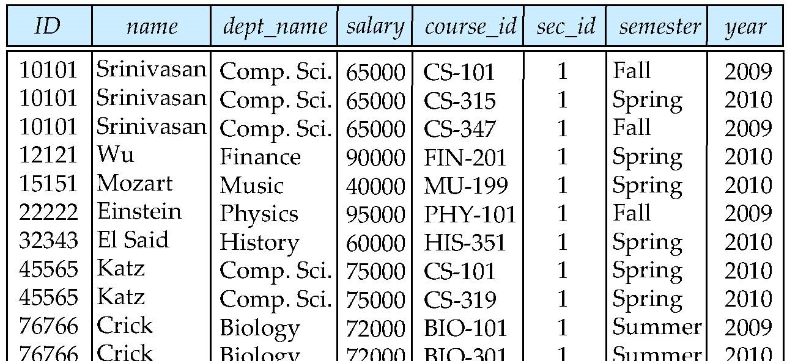
Natural Join
Natural join matches tuples with the same values for all common attributes, and retains only one copy of each common column
SELECT * FROM instructor NATURAL JOIN teaches;
instructor
teaches

Slide 55
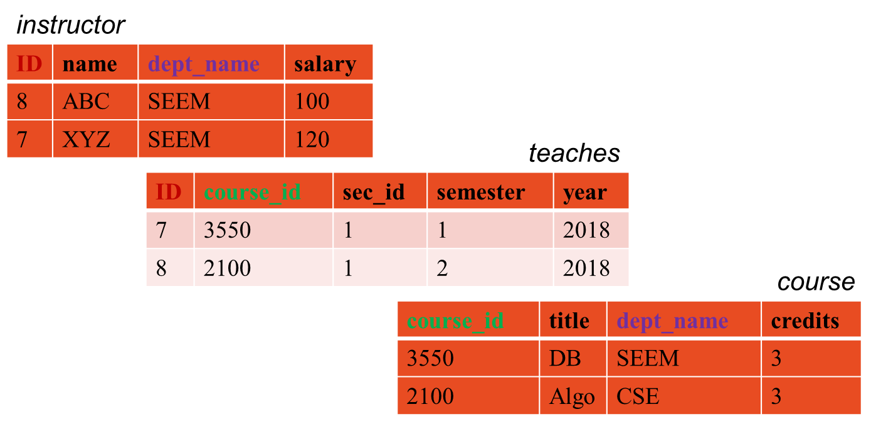
Danger of Natural Join
List the names of instructors along with the titles of courses that they teach. This is an incorrect version:
SELECT name, title
FROM instructor
NATURAL JOIN teaches
NATURAL JOIN course;

Slide 56
Danger of Natural Join
Course.dept_name and instructor.dept_name are not related
Therefore, cannot be assumed to be the same.

Slide 57
Correct Natural Join
List the names of instructors along with the titles of courses that they teach. This is a correct version:
SELECT name, title
FROM instructor, teaches, course
WHERE instructor.ID = teaches.ID AND teaches.course_id = course.course_id;

Slide 58
JOIN ON
Normally, filtering is processed in the WHERE clause once the two tables have already been joined. It's possible, though that you might want to filter one or both of the tables before joining them.
SELECT b.id, b.title, b.type, t.last_name AS translator
FROM books b
JOIN translators t
ON b.translator_id = t.id
ORDER BY b.id;

