Slide 1
Relational Algebra

Slide 2
Motivation
  We’ve seen what a relational model is?
  We needed a formal language to specify data (tuples) from the relational model.
  Relational Algebra (E.F. Codd (1970))

Slide 3
Why Relational Algebra?
It provides a formal foundation for relational model operations
It is used as a basis for implementing and optimizing queries in the query processing and optimization
Some of its concepts are incorporated into SQL

Slide 4
Relational Algebra
Relational Algebra is a procedural data manipulation language (DML).
It specifies operations on relations to define new relations:
Unary Relational Operations: Select, Project
Operations from Set Theory: Union, Intersection, Difference,
Cartesian Product
Binary Relational Operations: Join, Divide.

Slide 5
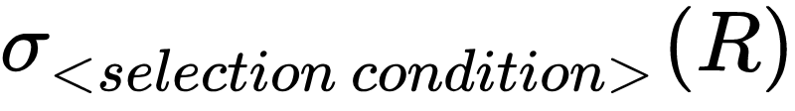
1 SELECT
The SELECT operation/predicate is used to select a subset of the tuples of a relation R, satisfying some condition.
Notation:
Intuition: Filters out all tuples that do not satisfy select condition; the result relation only keeps the relation that
Selection

Slide 6
Selection Condition
The condition is defined by a selection clause:
  <attribute> operator <constant>
  < attribute > operator < attribute >
Where operator is one of =, <, ≤, >, ≥ or ≠ …
Example:
  age ≤ 24
  commission ≥ 24 000

Slide 7
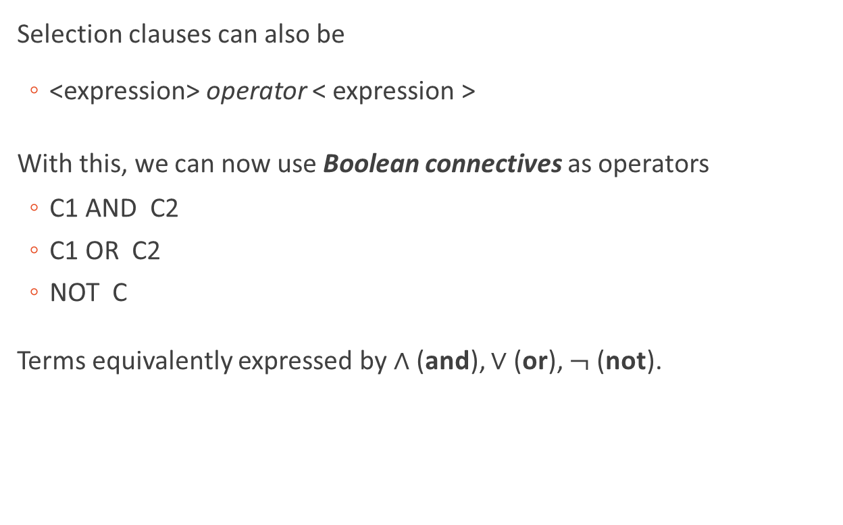
Selection Condition

Slide 8
Q: Select the enrolment records for the students whose supervisor is Person 1
ENROLMENT:
Enrolment# | Supervisee | Supervisor | Department | Degree
1 | 1 | 2 | Psychology | Ph.D.
2 | 3 | 1 | Comp.Sci. | Ph.D.
3 | 4 | 1 | Comp.Sci. | M.Sc.
4 | 5 | 1 | Comp.Sci. | M.Sc.
The output relation is
Enrolment# | Supervisee | Supervisor | Department | Degree
2 | 3 | 1 | Comp.Sci | Ph.D.
3 | 4 | 1 | Comp.Sci | M.Sc.
4 | 5 | 1 | Comp.Sci | M.Sc.

Slide 9
Q: Select the enrolment records for Person 1's non-Ph.D. students
ENROLMENT:
Enrolment# | Supervisee | Supervisor | Department | Degree
1 | 1 | 2 | Psychology | Ph.D.
2 | 3 | 1 | Comp.Sci. | Ph.D.
3 | 4 | 1 | Comp.Sci. | M.Sc.
4 | 5 | 1 | Comp.Sci. | M.Sc.
Same
The output relation is
Enrolment# | Supervisee | Supervisor | Department | Degree
3 | 4 | 1 | Comp.Sci | M.Sc.
4 | 5 | 1 | Comp.Sci | M.Sc.

Slide 10
Properties of Selection
Properties:
• Consecutive selects can be combined:
σ <cond1> (σ <cond2> (R))
• Selection is a commutative operation:
σ <cond1> (σ <cond2> (R)) is the same as…
σ <cond2> (σ <cond1> (R))

Slide 11
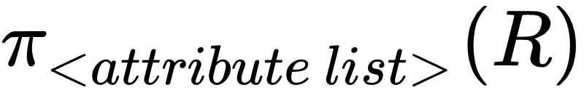
2 PROJECT
The PROJECT operation is used to project a subset of the attributes (column) of a relation, denoted by:
General form:
Result:
- schema: attribute list (A₁,…,A_{k})
- instance: the set of all subtuples t[A₁,…,A_{k}] where t ∈ R
Notes:
Definition
Example: To ignore the dept_name attribute of instructor.
Π_(𝐼𝐷,𝑛𝑎𝑚𝑒,𝑠𝑎𝑙𝑎𝑟𝑦) (𝑖𝑛𝑠𝑡𝑟𝑢𝑐𝑡𝑜𝑟)
Remove duplication
Because Single set (keys enforce that)

Slide 12
Q: Find departments and degree requirements for the courses that students enrol.
ENROLMENT:
Enrolment# | Supervisee | Supervisor | Department | Degree
1 | 1 | 2 | Psychology | Ph.D.
2 | 3 | 1 | Comp.Sci. | Ph.D.
3 | 4 | 1 | Comp.Sci. | M.Sc.
4 | 5 | 1 | Comp.Sci. | M.Sc.
The output relation is
Department | Degree
Psychology | Ph.D.
Comp.Sci | Ph.D.
Comp.Sci | M.Sc.

Slide 13
Duplicates of PROJECT
ENROLMENT:
Enrolment# | Supervisee | Supervisor | Department | Degree
1 | 1 | 2 | Psychology | Ph.D.
2 | 3 | 1 | Comp.Sci. | Ph.D.
3 | 4 | 1 | Comp.Sci. | M.Sc.
4 | 5 | 1 | Comp.Sci. | M.Sc.
Question: What if we do PROJECTION on only department?
?
Department
Psychology
Comp.Sci.
Comp.Sci.
Comp.Sci.

Slide 14
Duplicates of PROJECT
ENROLMENT:
Enrolment# | Supervisee | Supervisor | Department | Degree
1 | 1 | 2 | Psychology | Ph.D.
2 | 3 | 1 | Comp.Sci. | Ph.D.
3 | 4 | 1 | Comp.Sci. | M.Sc.
4 | 5 | 1 | Comp.Sci. | M.Sc.
Question: What if we do PROJECTION on only department?
Answer: We will only get one ‘Comp.Sci.’.
Relational Algebra is based on sets, so no duplicates are allowed.
The PROJECT operation removes any duplicate tuples, so the result of the PROJECT operation is a set of distinct tuples, and this is known as duplicate elimination.

Slide 15
Properties of PROJECT
Consider π _{<list1>} (π _{<list2>} (R))
If <list2> contains all the attributes in <list1> :
Then π _{<list1>} (π _{<list2>} (R)) = π _{<list1>} (R)
Else the operation is not well defined.

Slide 16
Project Predicate
Properties:
Question: is projection operator commutative with selection?
i.e., π_{X} (σ_{B}(R)) = σ_{B} (π_{X}(R))?

Slide 17
Project Predicate
Properties:
Question: is projection operator commutative with selection?
i.e., π_{X} (σ_{B}(R)) = σ_{B} (π_{X}(R))?
Consider the following:
Degree
Ph.D.
Error as SELECT cannot find Department
Answer:
The attribute used in SELECT must a subset of the attribute list in PROJECT

Slide 18
Intuition: Projection and Selection
Selection performs a horizontal decomposition, and
projection performs a vertical decomposition
Selection
Projection

Slide 19
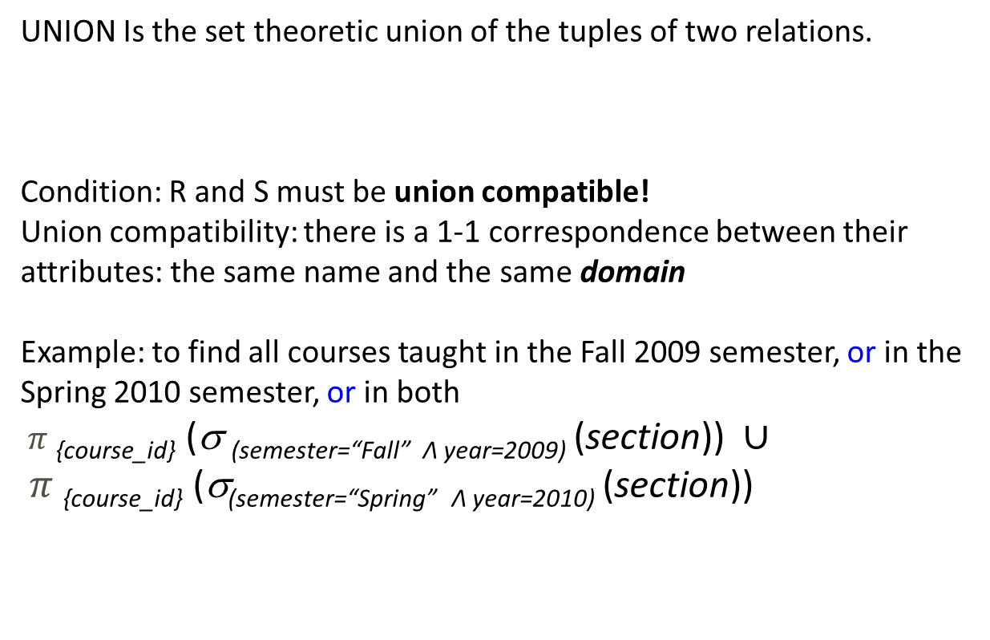

3 SET UNION

Slide 20
Example
STUDENT:
RESEARCHER:
Example: STUDENT ∪ RESEARCHER =
Person# | Name​
1​ | Dr C.C.Chen​
3 | Ms K.Juliff
4 | Ms J.Gledill
5 | Ms B.K.Lee
Person# | Name
1 | Dr C.C.Chen
2 | Dr R.G.Wilkinson
Person# | Name
1 | Dr C.C.Chen
3 | Ms K.Juliff
4 | Ms J.Gledhill
5 | Ms B.K.Lee
2 | Dr R.G.Wilkinson

Slide 21
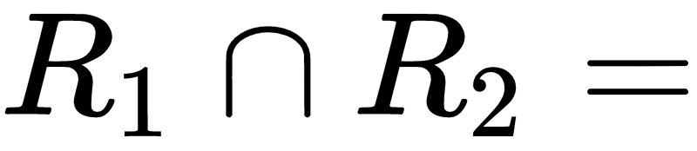
4 SET INTERSECTION
INTERSECTION is an operation that includes all tuples that are in present both relations, denoted by
Condition: R and S must also be union compatible!
Example:
Enrolment# | Supervisee | Supervisor | Department | Name
2 | 3 | 1 | Comp.Sci. | Ph.D.

Slide 22
Example of Intersection
STUDENT:
RESEARCHER:
Person# | Name​
1​ | Dr C.C.Chen​
3 | Ms K.Juliff
4 | Ms J.Gledill
5 | Ms B.K.Lee
Person# | Name
1 | Dr C.C.Chen
2 | Dr R.G.Wilkinson
Example: STUDENT ∩ RESEARCHER =
Person# | Name
1 | Dr C.C. Chen

Slide 23
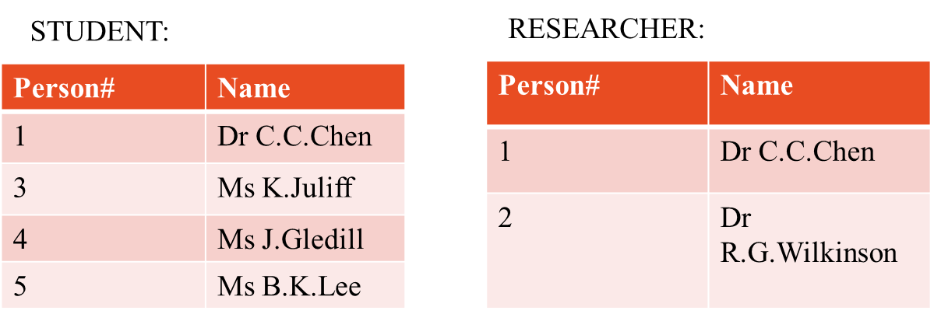
5 SET DIFFERENCE
DIFFERENCE is a relation that includes all tuples that are in the left relation but not in the right relation, denoted by
Condition: R and S must also be union compatible!
Example: STUDENT – RESEARCHRER =
Person# | Name
3 | Ms K. Juliff
4 | Ms J. Gledhill
5 | Ms B.K. Lee

Slide 24
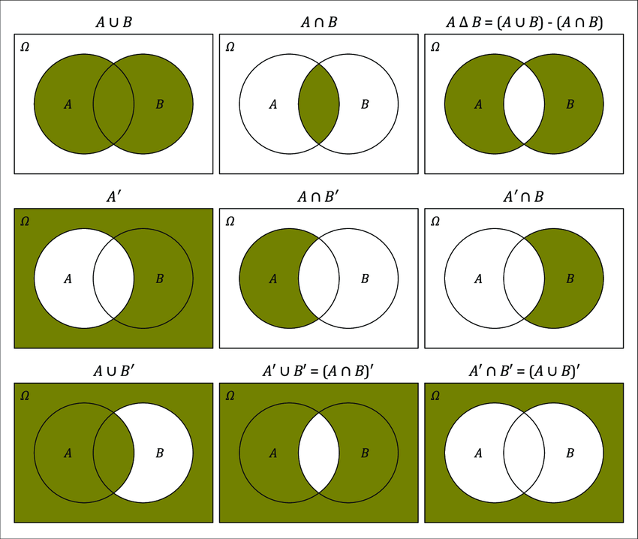
Summary
Operations on Relations
  UNION: A⋃B
  INTERSECTION: A⋂B
  DIFFERENCE: A-B

Slide 25
Express: The names of persons who are either a student or a researcher
STUDENT:
RESEARCHER:
Person# | Name​
1​ | Dr C.C.Chen​
3 | Ms K.Juliff
4 | Ms J.Gledill
5 | Ms B.K.Lee
Person# | Name
1 | Dr C.C.Chen
2 | Dr R.G.Wilkinson
25

Slide 26

Express: The names of persons who are either a student or a researcher
STUDENT:
RESEARCHER:
Person# | Name​
1​ | Dr C.C.Chen​
3 | Ms K.Juliff
4 | Ms J.Gledill
5 | Ms B.K.Lee
Person# | Name
1 | Dr C.C.Chen
2 | Dr R.G.Wilkinson
Name​
Dr C.C.Chen​
Dr R.G.Wilkinson
Ms K.Juliff
Ms J.Gledill
Ms B.K.Lee
26

Slide 27
Express: The names of persons who are a student and a researcher
STUDENT:
RESEARCHER:
Person# | Name​
1​ | Dr C.C.Chen​
3 | Ms K.Juliff
4 | Ms J.Gledill
5 | Ms B.K.Lee
Person# | Name
1 | Dr C.C.Chen
2 | Dr R.G.Wilkinson
27

Slide 28

Express: The names of persons who are a student and a researcher
STUDENT:
RESEARCHER:
Person# | Name​
1​ | Dr C.C.Chen​
3 | Ms K.Juliff
4 | Ms J.Gledill
5 | Ms B.K.Lee
Person# | Name
1 | Dr C.C.Chen
2 | Dr R.G.Wilkinson
Name​
Dr C.C.Chen​
28

Slide 29
Express: The names of persons who are a student but not a researcher
STUDENT:
RESEARCHER:
Person# | Name​
1​ | Dr C.C.Chen​
3 | Ms K.Juliff
4 | Ms J.Gledill
5 | Ms B.K.Lee
Person# | Name
1 | Dr C.C.Chen
2 | Dr R.G.Wilkinson
29

Slide 30

Express: The names of persons who are a student but not a researcher
STUDENT:
RESEARCHER:
Person# | Name​
1​ | Dr C.C.Chen​
3 | Ms K.Juliff
4 | Ms J.Gledill
5 | Ms B.K.Lee
Person# | Name
1 | Dr C.C.Chen
2 | Dr R.G.Wilkinson
Name​
Ms K.Juliff
Ms J.Gledill
Ms B.K.Lee
30

Slide 31
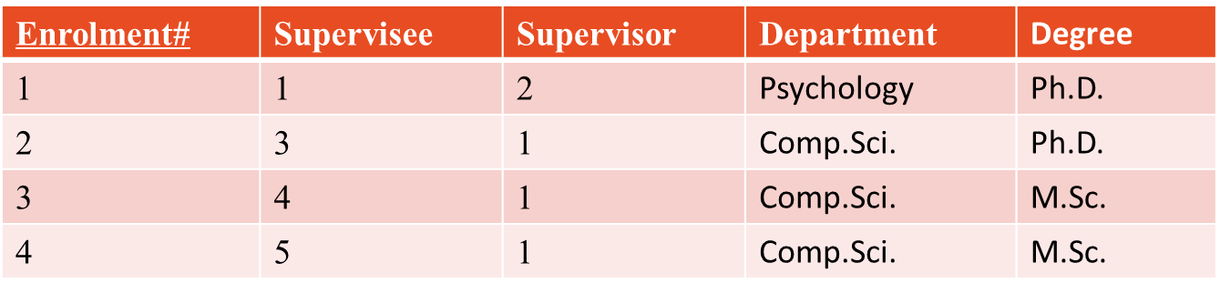
Express: The departments and degrees of Courses which are not enrolled by any student
ENROLMENT:
COURSE:
Department | Degree
Psychology | Ph.D.​​
Comp.Sci. | Ph.D.
Comp.Sci. | M.Sc.
Psychology | M.Sc.
31

Slide 32
Express: The departments and degrees of Courses which are not enrolled by any student
ENROLMENT:
COURSE:
Department | Degree
Psychology | Ph.D.​​
Comp.Sci. | Ph.D.
Comp.Sci. | M.Sc.
Psychology | M.Sc.
COURSE - (𝚷 _{(Department, Degree)} (ENROLMENT))
32

Slide 33
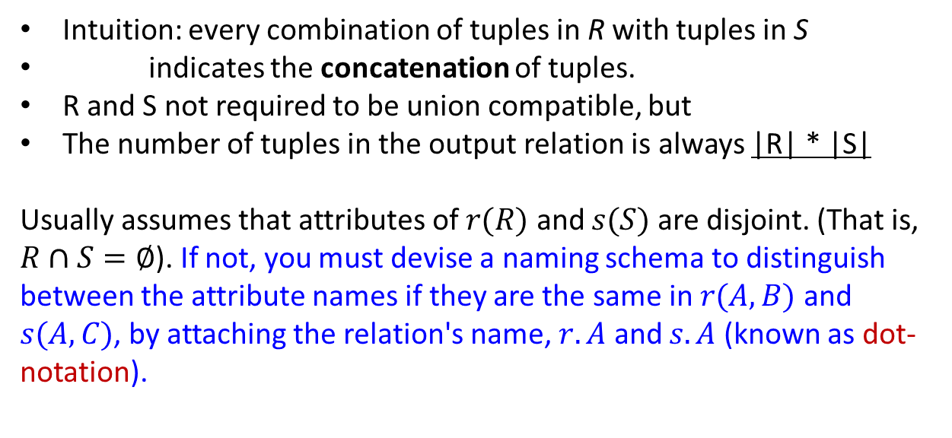

CARTESIAN PRODUCT
33
Notes:
Remember the domain? Definition of a relation schema
What if they have same variable name?
If attributes of 𝑟(𝑅) and 𝑠(𝑆) are not disjoint, then renaming must be used. Since it happens, we devise a naming schema to distinguish between the attribute names if they are the same in 𝑟(𝐴, 𝐵) and 𝑠(𝐴,𝐶), by attaching the relation name, 𝑟.𝐴 and 𝑠.𝐴 (known as dot-notation).

Slide 34
Example of cartesian product
ENROLMENT:
RESEARCHER:
Person# | Name
1 | Dr C.C.Chen
2 | Dr R.G.Wilkinson

Slide 35
Example of cartesian product
ENROLMENT X RESEARCHRER =
There were 4 tuples in ENROLMENT, 2 tuples in RESEARCHER. In the result, there are 8 tuples.
E’ment# | S’ee | S’or | D’ment | Degree | Person# | Name
1 | 1 | 2 | Psych. | Ph.D. | 1 | Dr C.C. Chen
1 | 1 | 2 | Psych. | Ph.D. | 2 | Dr R.G.Wilkinson
2 | 3 | 1 | Cmp.Sci | Ph.D. | 1 | Dr C.C. Chen
2 | 3 | 1 | Cmp.Sci | Ph.D. | 2 | Dr R.G.Wilkinson
3 | 4 | 1 | Cmp.Sci | M.Sc. | 1 | Dr C.C. Chen
3 | 4 | 1 | Cmp.Sci | M.Sc. | 2 | Dr R.G.Wilkinson
4 | 5 | 1 | Cmp.Sci | M.Sc. | 1 | Dr C.C. Chen
4 | 5 | 1 | Cmp.Sci | M.Sc. | 2 | Dr R.G.Wilkinson
Notes:
simplify
Same page for an example please
What if they have same variable name?
If attributes of 𝑟(𝑅) and 𝑠(𝑆) are not disjoint, then renaming must be used. Since it happens, we devise a naming schema to distinguish between the attribute names if they are the same in 𝑟(𝐴, 𝐵) and 𝑠(𝐴,𝐶), by attaching the relation name, 𝑟.𝐴 and 𝑠.𝐴 (known as dot-notation).

Slide 36
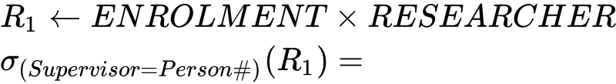
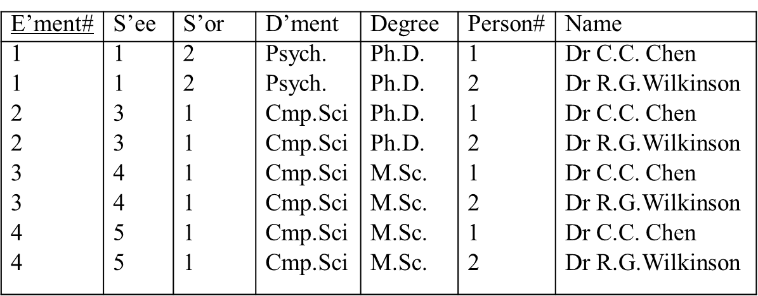
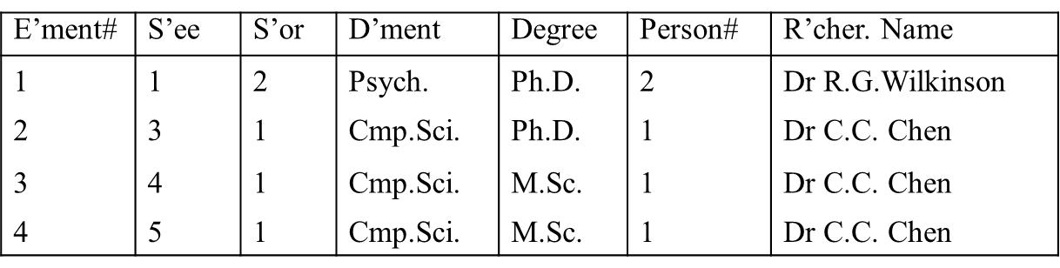
Useful if we add a condition
In practice it’s useful if we give a cartesian product specified condition
Notes:
When do we get
Isn’t this a join then?
𝑤(𝑊) implies that a relation 𝑤 following the schema 𝑊.
If attributes of 𝑟(𝑅) and 𝑠(𝑆) are not disjoint, then renaming must be used. Since it happens, we devise a naming schema to distinguish between the attribute names if they are the same in 𝑟(𝐴, 𝐵) and 𝑠(𝐴,𝐶), by attaching the relation name, 𝑟.𝐴 and 𝑠.𝐴 (known as dot-notation).

Slide 37
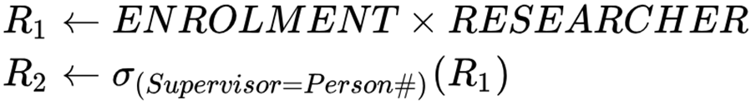
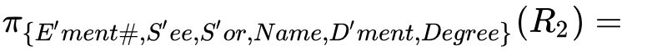
More useful if we add a projection
E’ment# | S’ee | S’or | Name | D’ment | Degree
1 | 1 | 2 | Dr R.G.Wilkinson | Psych. | Ph.D.
2 | 3 | 1 | Dr C.C. Chen | Comp.Sci. | Ph.D.
3 | 4 | 1 | Dr C.C. Chen | Comp.Sci. | M.Sc.
4 | 5 | 1 | Dr C.C. Chen | Comp.Sci. | M.Sc.
The two equal attributes occur only once
The last of these is also known as natural join, the next to last is equi-join.

Slide 38
6 JOIN
JOIN is used to combine related tuples from two relations into single "longer" tuples.
Theta-join
A general join condition is of the form:
<condition> AND <condition> AND … AND <condition>
Notes:
Theta Join allows you to merge two tables based on the condition represented by theta.
A general join condition could also be:
<condition> AND <condition> AND … AND <condition>
How many attributes in common?
𝐸𝑁𝑅𝑂𝐿𝑀𝐸𝑁𝑇⋈_((𝑎𝑔𝑒> =𝑃𝑒𝑟𝑠𝑜𝑛#)) 𝑅𝐸𝑆𝐸𝐴𝑅𝐶𝐻𝐸𝑅

Slide 39
6.1 Equi-join
A type of theta-join where the only comparison operator used is “=” is called an Equi-join
Example:

Slide 40
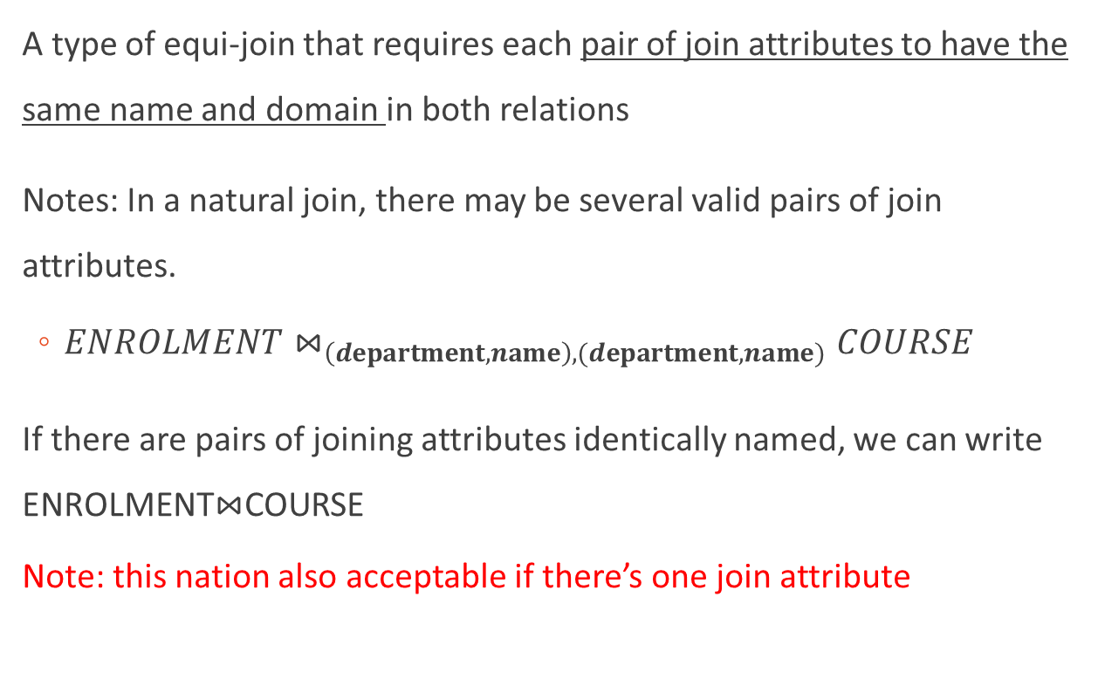
6.2 Natural Join

Slide 41
6.2 Natural Join
Intuitions:
Enforce equality on all attributes with same name
Eliminate one copy of duplicated attributes

Slide 42
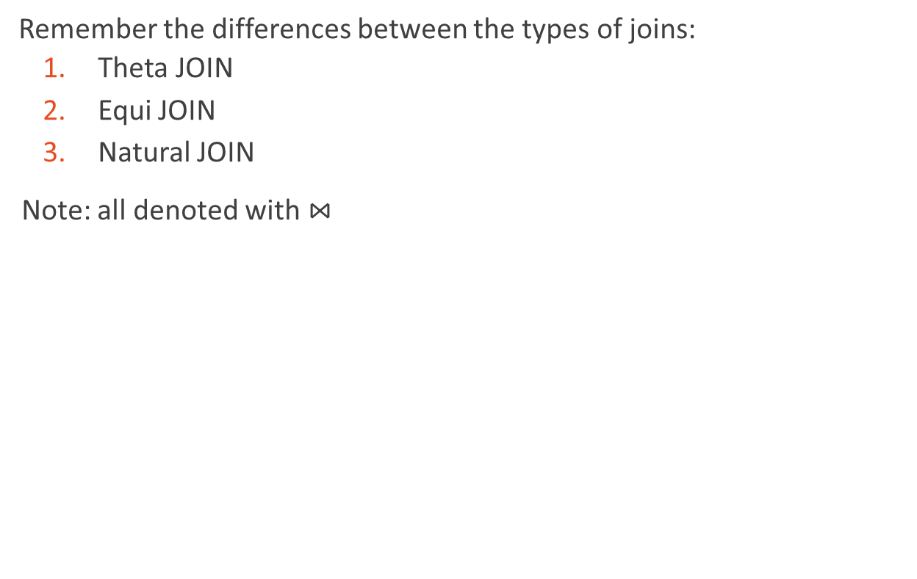
JOINS

Slide 43
Pracs
STUDENT:
RESEARCHER:
COURSE
Person# | Name​
1​ | Mr J.He​
3 | Ms K.Juliff
4 | Ms J.Gledill
5 | Ms B.K.Lee
Person# | Name
1 | Dr C.C.Chen
2 | Dr R.G.Wilkinson
Depart | Degree​
EE | PhD
CS | PhD
EE | MSc
CS | MSc
ENROLMENT:
Enrol# | Supervisee​ | Supervisor | Depart | Degree
1​ | 1 | 2 | EE | PhD
2 | 3 | 1 | CS | PhD
3 | 4 | 1 | CS | MSc
4 | 5 | 1 | CS | MSc
43

Slide 44
Pracs
STUDENT:
RESEARCHER:
COURSE
Person# | Name​
1​ | Mr J.He​​
3 | Ms K.Juliff
4 | Ms J.Gledill
5 | Ms B.K.Lee
Person# | Name
1 | Dr C.C.Chen
2 | Dr R.G.Wilkinson
Depart | Degree​
EE | PhD
CS | PhD
EE | MSc
CS | MSc
ENROLMENT:
Enrol# | Supervisee​ | Supervisor | Depart | Degree
1​ | 1 | 2 | EE | PhD
2 | 3 | 1 | CS | PhD
3 | 4 | 1 | CS | MSc
4 | 5 | 1 | CS | MSc
What are the names of students who are studying MSc in computer science
44

Slide 45
Pracs
STUDENT:
RESEARCHER:
COURSE
Person# | Name​
1​ | Mr J.He​
3 | Ms K.Juliff
4 | Ms J.Gledill
5 | Ms B.K.Lee
Person# | Name
1 | Dr C.C.Chen
2 | Dr R.G.Wilkinson
Depart | Degree​
EE | PhD
CS | PhD
EE | MSc
CS | MSc
ENROLMENT:
Enrol# | Supervisee​ | Supervisor | Depart | Degree
1​ | 1 | 2 | EE | PhD
2 | 3 | 1 | CS | PhD
3 | 4 | 1 | CS | MSc
4 | 5 | 1 | CS | MSc
What are the names of students who are studying MSc in computer science
45

Slide 46
Pracs
STUDENT:
RESEARCHER:
COURSE
Person# | Name​
1​ | Mr J.He​​
3 | Ms K.Juliff
4 | Ms J.Gledill
5 | Ms B.K.Lee
Person# | Name
1 | Dr C.C.Chen
2 | Dr R.G.Wilkinson
Depart | Degree​
EE | PhD
CS | PhD
EE | MSc
CS | MSc
ENROLMENT:
Enrol# | Supervisee​ | Supervisor | Depart | Degree
1​ | 1 | 2 | EE | PhD
2 | 3 | 1 | CS | PhD
3 | 4 | 1 | CS | MSc
4 | 5 | 1 | CS | MSc
The IDs of students who are supervised by Dr C.C.Chen
46

Slide 47
Pracs
STUDENT:
RESEARCHER:
COURSE
Person# | Name​
1​ | Mr J.He​​
3 | Ms K.Juliff
4 | Ms J.Gledill
5 | Ms B.K.Lee
Person# | Name
1 | Dr C.C.Chen
2 | Dr R.G.Wilkinson
Depart | Degree​
EE | PhD
CS | PhD
EE | MSc
CS | MSc
ENROLMENT:
Enrol# | Supervisee​ | Supervisor | Depart | Degree
1​ | 1 | 2 | EE | PhD
2 | 3 | 1 | CS | PhD
3 | 4 | 1 | CS | MSc
4 | 5 | 1 | CS | MSc
The IDs of students who are supervised by Dr C.C.Chen
R1 = ENROLMENT ⋈ (supervisor=person#) RESEARCHER
R2 = σ_{(name=Dr C.C.Chen)}R1
R3= 𝝅_{{supervisee}}R2
47

Slide 48

Divide
  The DIVISION operation is applied to two Relations R and S, where the attributes of S are a subset of the attributes of R.
  The relation returned by division operator will have attributes = (All attributes of R – All Attributes of S)
  Return all tuples from relation R which are associated to every S’s tuple.
R
A | B
a₁ | b₁
a₁ | b₂
a₂ | b₁
a₃ | b₂
a₄ | b₁
a₅ | b₁
a₅ | b₂
B
b₁
b₂
S
A
a₁
a₅

Slide 49
DIVIDE
Typical use: which courses are offered by all departments?

Slide 50
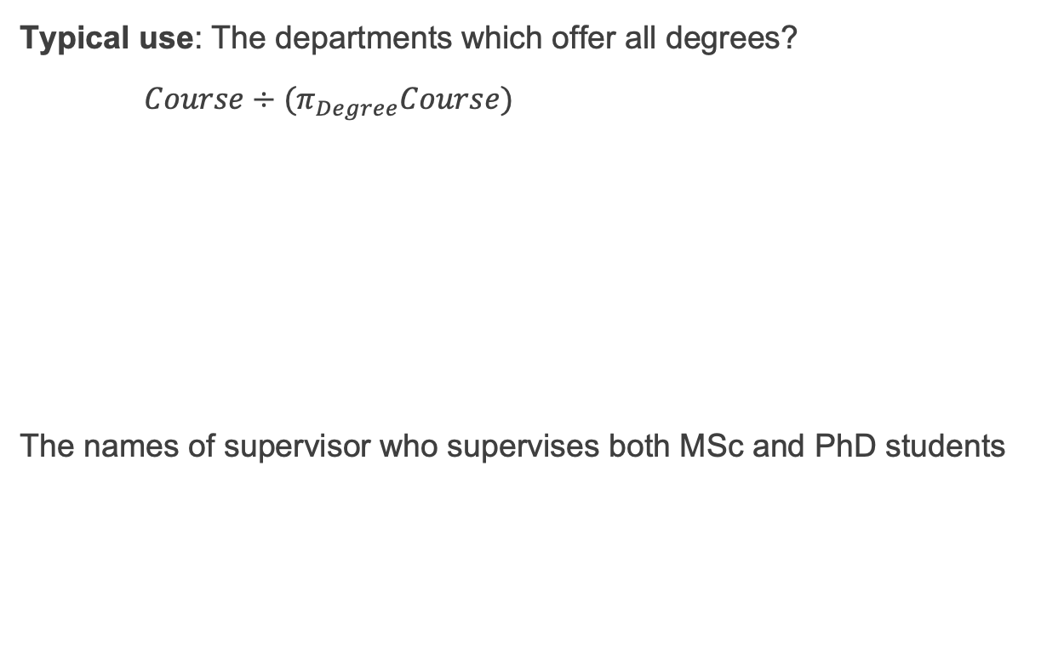
Divide
COURSE
Depart | Degree​
EE | PhD
CS | PhD
EE | MSc
CS | MSc

Slide 51
Pracs
STUDENT:
RESEARCHER:
COURSE
Person# | Name​
1​ | Mr J.He​​
3 | Ms K.Juliff
4 | Ms J.Gledill
5 | Ms B.K.Lee
Person# | Name
1 | Dr C.C.Chen
2 | Dr R.G.Wilkinson
Depart | Degree​
EE | PhD
CS | PhD
EE | MSc
CS | MSc
ENROLMENT:
Enrol# | Supervisee​ | Supervisor | Depart | Degree
1​ | 1 | 2 | EE | PhD
2 | 3 | 1 | CS | PhD
3 | 4 | 1 | CS | MSc
4 | 5 | 1 | CS | MSc
The names of supervisor who supervises both MSc and PhD students
R1 = 𝝅 _{{SUPERVISOR,DEGREE}} ENROLMET ÷ 𝝅 _{{DEGREE}} COURSE
R2 = 𝝅_{{Name}} (R1 ⋈ _{(supervisor=person#)} RESEARCH)
51

Slide 52
Exercise
RESEARCHER:
Person# | Name
1 | Dr C.C.Chen
2 | Dr R.G.Wilkinson
STUDENT:
Person# | Name​
1​ | Dr C.C.Chen​
3 | Ms K.Juliff
4 | Ms J.Gledill
5 | Ms B.K.Lee
COURSE:
Department | Degree
Psychology | Ph.D.​​
Comp.Sci. | Ph.D.
Comp.Sci. | M.Sc.
Psychology | M.Sc.
ENROLMENT:
Enrolment# | Supervisee | Supervisor | Department | Degree
1 | 1 | 2 | Psychology | Ph.D.
2 | 3 | 1 | Comp.Sci. | Ph.D.
3 | 4 | 1 | Comp.Sci. | M.Sc.
4 | 5 | 1 | Comp.Sci. | M.Sc.
52

Slide 53
Exercise
R:
S:
A | B | C
a₁ | b₁ | c₁
a₁ | b₁ | c₂
a₁ | b₁ | c₃
a₁ | b₂ | c₂
a₂ | b₁ | c₁
a₂ | b₂ | c₂
a₃ | b₁ | c₁
a₃ | b₂ | c₁
a₃ | b₂ | c₂
B | C
b₁ | c₁
b₁ | c₂
Write relational algebra that retrieve:
1. Find A of R that contains all S.
2. Find (A, B) of R that contains all C of S.
53

Slide 54
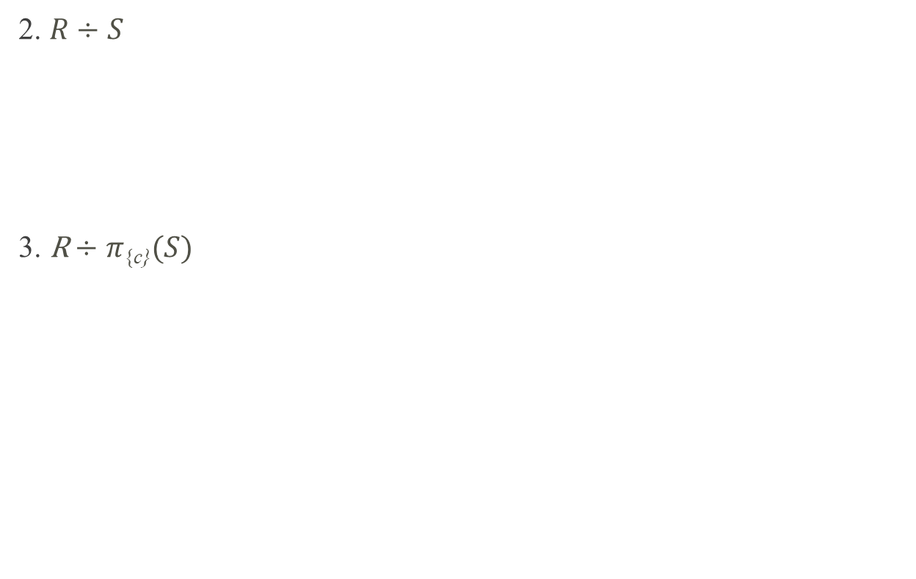
Exercise Answers:
A
a₁
A | B
a₁ | b₁
a₃ | b₂

Slide 55
Rename Operator
The rename operator ρ changes the name of one or more attributes
Change the names in a schema
Does not affect instance of the target relation
Why might this be useful? To be included in relational algebra?
Family
ρ _{(Parent, Child)} (Family)
Father
Child
Parent
Child
Adam
Abel
Adam
Abel
Adam
Cain
Adam
Cain
Abraham
Isaac
Abraham
Isaac
Notes:
Allow us to name, and therefore to refer to, the results of relational algebra expressions.
Allow us to refer to a relation by more than one name.
Example: 𝜌_𝑋 (𝐸)
returns the expression 𝐸 under the name 𝑋.
If a relational-algebra expression 𝐸 has arity 𝑛, then
𝜌_(𝑋(𝐴₁, 𝐴₂, …, 𝐴_{𝑛})) (𝐸)
returns the result of expression 𝐸 under the name 𝑋 with the attributes renamed to 𝐴₁, 𝐴₂, …,𝐴_{𝑛}.
You give the schema a new name
We don’t sayIt changes the schema
Change schema is a little excessive (change domain)
Check renaming operation!
e.g. change name of scheam
e.g. change name of attribugte
Rename into a temporaru relation yay

Slide 56
Why RENAME Operator?
To unify schemas for set operators
For disambiguation in “self-join”

Slide 57

Basic vs Extended Operators
Note: (and rename) are sufficient to define all these operations: this is a relationally complete set of operators. These are the basic operators of the Relational Algebra.
What about JOIN, INTERSECTION and DIVIDE?
They are extended operators because they can be derived by the basic operators.
E.g., We can write R ÷ S as
TEMP1 ← π_{R-S} (R)
TEMP2 ← π_{R-S} ((TEMP1 x S) – π_{R-S,S} (R))
RESULT = TEMP1 – TEMP2
  The result to the right of ← is assigned to the relation variable on the left of ←.
  May use variable in subsequent expressions.

Slide 58
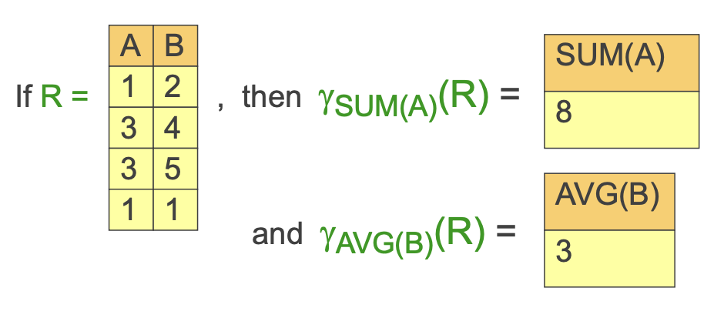
Aggregate Operators
What if we want a relation with information about “sum of salaries” of employees, or the “average age” of students.
We need more expressive power, we can use aggregation functions that to summarize information from multiple tuples into aggregate values.
We can use an aggregation operator γ and an function such as SUM, AVG, MIN, MAX, or COUNT. What if NULL?

Slide 59
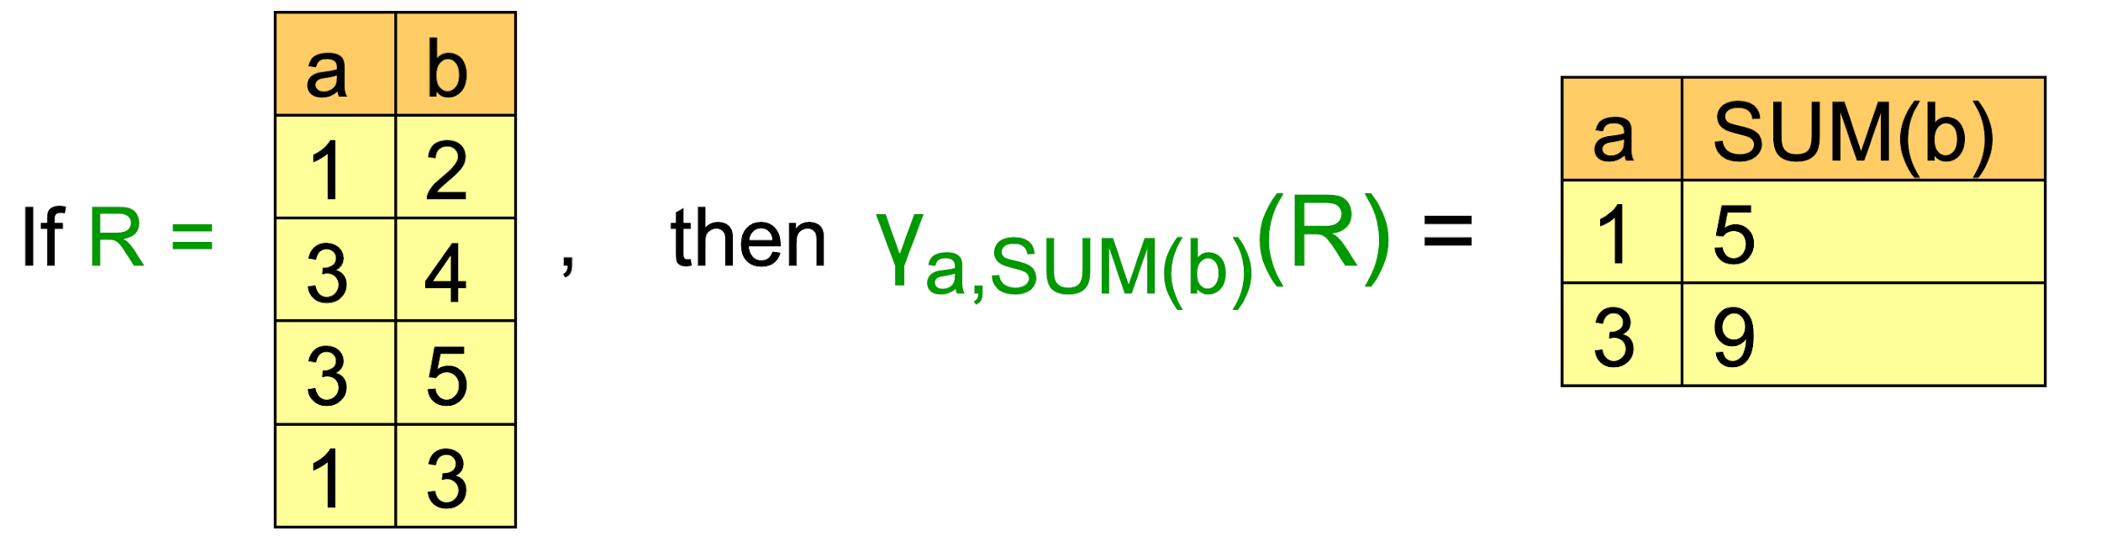
Aggregate Operators
We can also retrieve aggregate values for groups, like the “sum of employee salaries” per department, or the “average student age” per faculty.
We give γ additional arguments to specify that the aggregation behaviour should be based on groups (defined by a set of attributes).

Slide 60
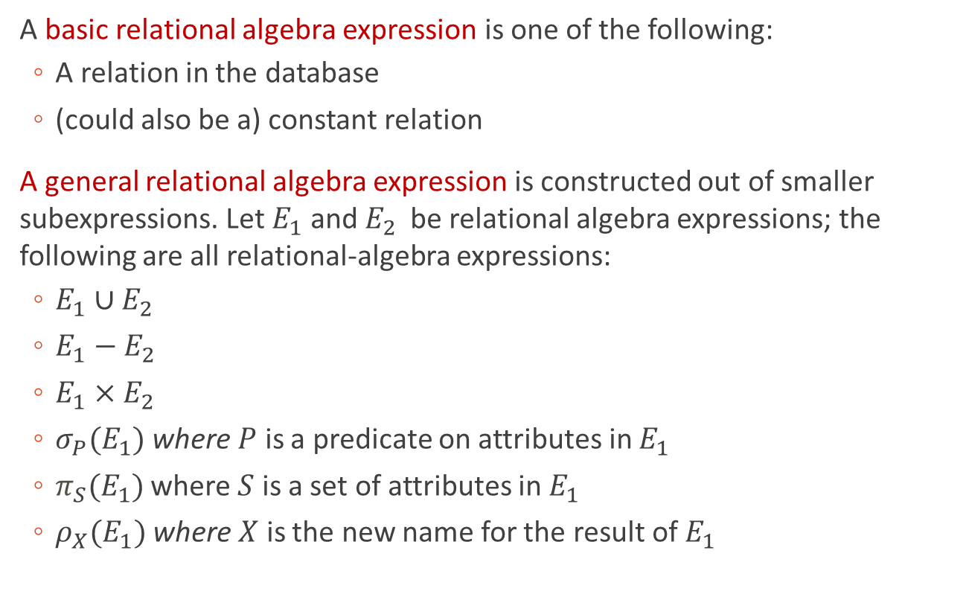
Formal Definition

Slide 61
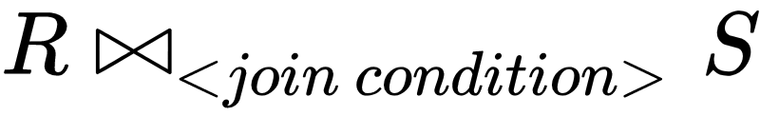



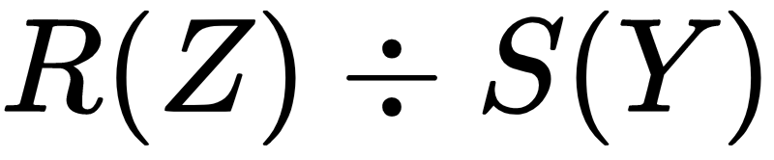
OPERATION | PURPOSE | NOTATION
SELECT | Selects all tuples that satisfy the selection condition from a relation R
PROJECT | Produces a new relation with only some of the attributes of R and removes duplicate tuples.
THETA-JOIN | Produces all combinations of tuples from R and S that satisfy the join condition.
EQUI-JOIN | Produces all the combinations of tuples from R and S that satisfy a join condition with only equality comparisons.
NATURAL-JOIN | Same as EQUIJOIN except that the join attributes of S are not included in the resulting relation; if the join attributes have the same names, they do not have to be specified at all.
UNION | Produces a relation that includes all the tuples in R or S or both R and S; R and S must be union compatible.
INTERSECTION | Produces a relation that includes all the tuples in both R and S; R and S must be union compatible.
DIFFERENCE | Produces a relation that includes all the tuples in R that are not in S; R and S must be union compatible. | R – S
CARTESIAN PRODUCT | Produces a relation that has the attributes of R and S and includes as tuples all possible combinations of tuples from R and S.
DIVISION | Produces a relation T(X) that includes all tuples t[X] in R(Z) that appear in R in combination with every tuple from S(Y), where Z = X ∪ Y.

