Slide 1
SQL (Part 2)

Slide 2
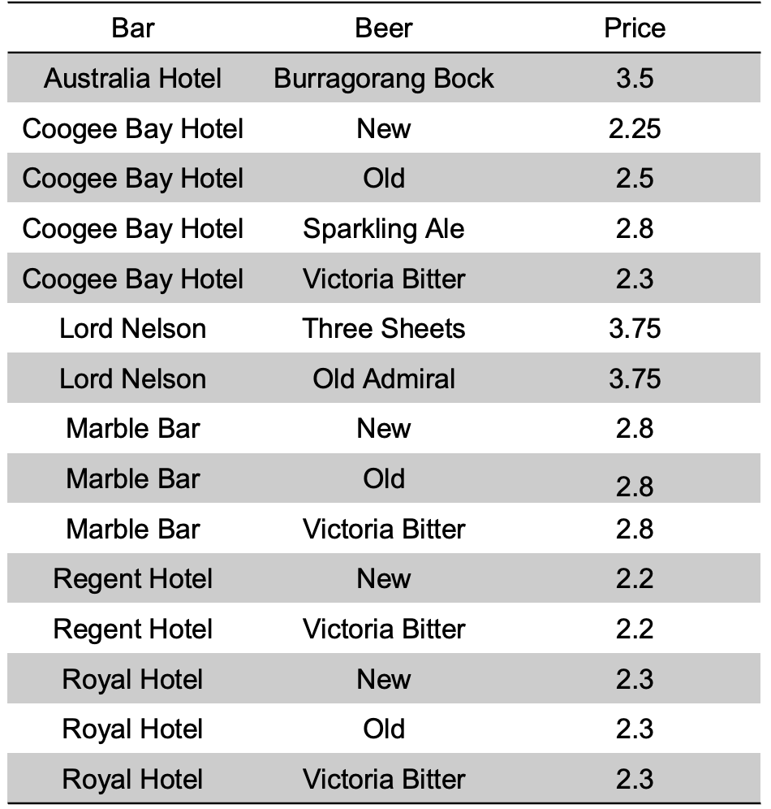
Querying With Subqueries
Example: Find bars that sell New at the price same as the Coogee Bay Hotel charges for VB.
Simplest Case: Subquery returns one tuple/value. If the subquery returns one tuple, you can treat the result as a constant value.
SELECT bar
FROM Sells
WHERE beer = ‘New’ AND price = (
SELECT price
FROM Sells
WHERE bar = ‘Coogee Bay Hotel’
AND beer = ‘Victoria Bitter’
);
Price
2.3

Slide 3
Querying Without Subqueries
Example: Find bars that sell New at the price same as the Coogee Bay Hotel charges for VB.
Can we do the one from before without subqueries? Of course…
SELECT b2.bar
FROM Sells b1, Sells b2
WHERE b1.beer = ‘Victoria Bitter’ and
b1.bar = ‘Coogee Bay Hotel’ and
b1.price = b2.price and b2.beer = ‘New’;
This will produce the same results, but what might it be doing here instead?

Slide 4
Query with Subquery
Regular Case: Subquery returns multiple tuples/a relation.
Common usage of subqueries:
compare the membership of one relation to that of another
compare results of one set to that of another

Slide 5
IN
The IN operator is typically used to filter a column. It can be used in subqueries to filter a column for a certain list of values.
SELECT * FROM Students WHERE Grade IN (‘HD', ‘D’);
Example: find the name and brewers of beers that John likes.
SELECT *
FROM Beers
WHERE name IN
(SELECT beer
FROM Likes
WHERE drinker = ’John’);

Slide 6
Exists
Exists keyword returns true if the relation is non-empty.
Example: Find the beers uniquely made by their manufacturer.
SELECT name
FROM Beers b1
WHERE NOT EXISTS
(SELECT *
FROM Beers
WHERE manf = b1.manf AND name != b1.name);
Note: add NOT before EXISTS to express the opposite condition (NOT EXISTS).

Slide 7
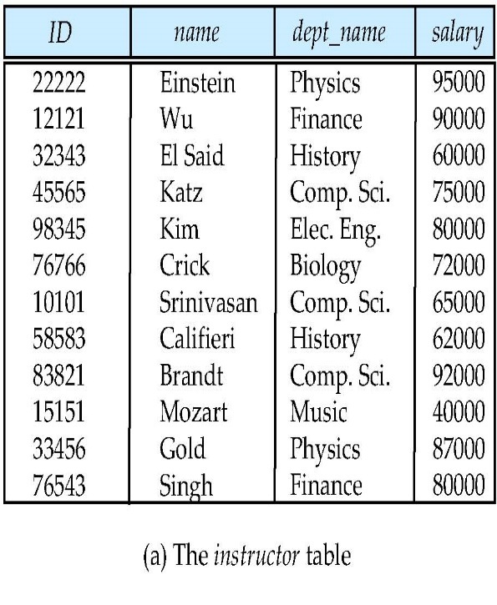
All
Find the names of all instructors whose salary is greater than the salary of all instructors in the Physics department.
SELECT name
FROM instructor
WHERE salary > ALL (SELECT salary
FROM instructor
WHERE dept name = ’Physics’);

Slide 8
Quantifiers
ANY and ALL behave as existential and universal quantifiers respectively.
SELECT column_name(s)
FROM table_name
WHERE column_name operator ANY
(SELECT column_name
FROM table_name
WHERE condition);
SELECT column_name(s)
FROM table_name
WHERE column_name operator ALL
(SELECT column_name
FROM table_name
WHERE condition);

Slide 9
Set Operations
Find courses that ran in Fall 2009 or in Spring 2010
Find courses that ran in Fall 2009 and in Spring 2010
Find courses that ran in Fall 2009 but not in Spring 2010
Note: Each of the above operations will eliminate duplicates.
To keep duplicates, use union all, intersect all, except all.
(select course_id from section where sem = ‘Fall’ and year = 2009)
union
(select course_id from section where sem = ‘Spring’ and year = 2010)
(select course_id from section where sem = ‘Fall’ and year = 2009)
intersect
(select course_id from section where sem = ‘Spring’ and year = 2010)
(select course_id from section where sem = ‘Fall’ and year = 2009)
except
(select course_id from section where sem = ‘Spring’ and year = 2010)

Slide 10
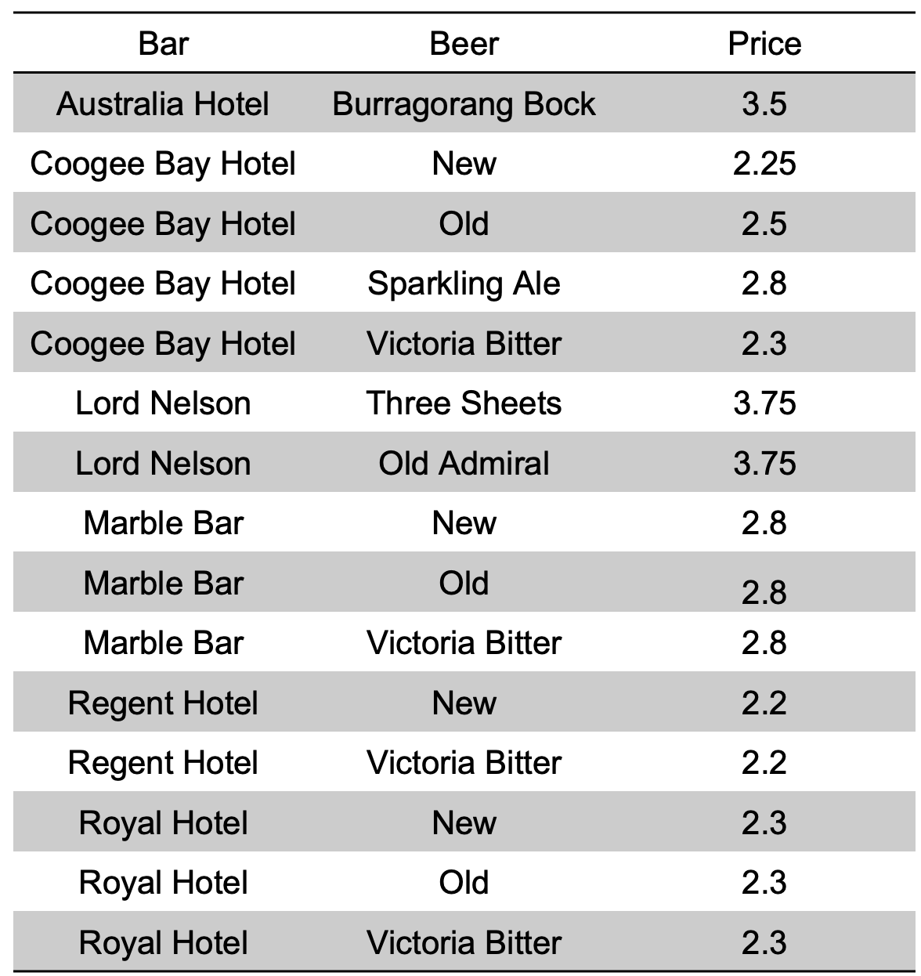
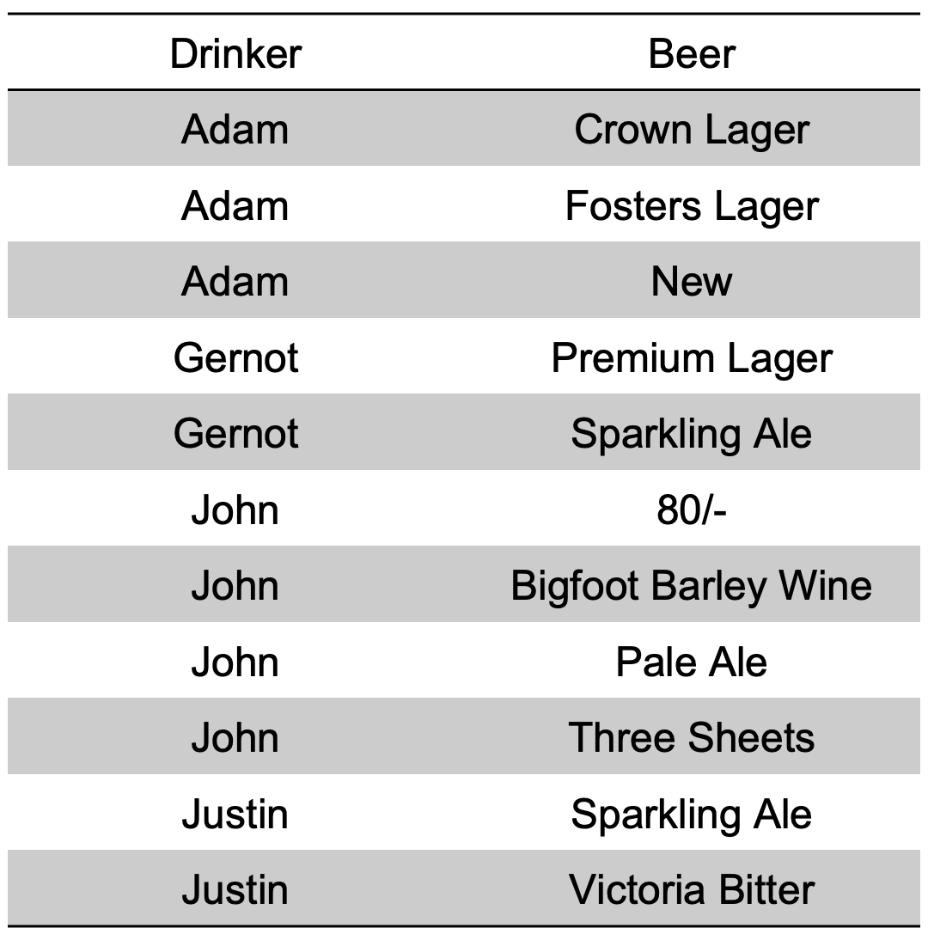
DIVIDE in SQL?
Example: Find bars each of which sell all beers Justin likes.
Relational Algebra: π_{bar,beer}Sells ÷ (π_{beer}(σ_{drinker=′Justin′} Likes))

Slide 11
DIVIDE in SQL?
Question: How do we do this in SQL?
Answer: This gives you the same results as a divide operator
SELECT DISTINCT a.bar
FROM sells a
WHERE NOT EXISTS
( (SELECT b.beer FROM likes b WHERE b.drinker = ’Justin’) EXCEPT
(SELECT c.beer FROM sells c WHERE c.bar = a.bar )
);
(Example: Find bars each of which sell all beers Justin likes)

Slide 12
Aggregate Functions in SQL
Selection clauses can contain aggregation operations.
Example: What is the average price of New?
SELECT AVG(price)
FROM Sells
WHERE beer = ’New’;
AVG(PRICE)
----------
2.3875
Bar | Beer | Price
Coogee Bay Hotel | New | 2.25
Marble Bar | New | 2.8
Regent Hotel | New | 2.2
Royal Hotel | New | 2.3

Slide 13
Aggregation in SQL
Aggregation follows a multi-set semantic.
We can specify a set semantic by using DISTINCT in the aggregation function.
SELECT COUNT(DISTINCT bar)
FROM Sells;
By default
SELECT COUNT(ALL bar)
FROM Sells;

Slide 14
Common Aggregations
List of several built-in aggregate functions exist in SQL:
SUM ()
AVG ()
MIN ()
MAX ()
COUNT ()
The above operators apply to numeric values in one column of a relation.
Exception: COUNT(*) gives the number of tuples in a relation.
Example: How many different beers are there?
SELECT COUNT(*) FROM Beers;
COUNT(*)
----------
18

Slide 15
Null Values and Aggregates
Aggregation ignores NULL values if present in the column specified.
Total all salaries: select sum (salary ) from instructor
Above statement ignores null amounts
Result is null if there is no non-null amount
All aggregate operations ignore tuples with null values on the aggregated attributes: except COUNT(*)

Slide 16
Aggregation & Null Values
select count(A1) from R
The answer is 3.
select count(distinct A1) from R
The answer is 3.
As specified by SQL
count(*) counts null and non-null tuples
count(attribute) counts all non-null tuples
Practice:
What would count(A1) if all values in column in A1 were NULL?
What would max(A1) if all values in column in A1 were NULL?
A1 | A2 | A3 | A4
5 | 9 | alpha | x
 | 4 | beta
2 | 4 | gamma
3 |  | delta | x

Slide 17
Grouping and Aggregation
What is grouping? Grouping is the application of aggregate functions to subgroups of tuples of a table
Grouping is typically used in queries involving the phrase “for each”
Example: I now know the SUM() of money all employees has made, but I’m more interested in the money made by each employee…

Slide 18
Grouping and Aggregation
In many cases we want to apply the aggregate functions to subgroups of tuples in a relation, where the subgroups are based on some attribute values.
Syntax:
SELECT attributes and aggregations
FROM relations
WHERE condition
GROUP BY attribute
Operational Semantics:
Partition result relation into groups based on distinct values of attribute
Apply the aggregation(s) on each group separately

Slide 19
Grouping and Aggregation
Example: For each drinker, find the average price of New at the bars they frequently go to.
SELECT drinker, AVG(price)
FROM Frequents, Sells
WHERE beer = ’New’ AND Frequents.bar = Sells.bar
GROUP BY drinker;
DRINKER AVG(PRICE)
------------------ ----------------
Adam 2.25
John 2.25
Justin 2.5

Slide 20
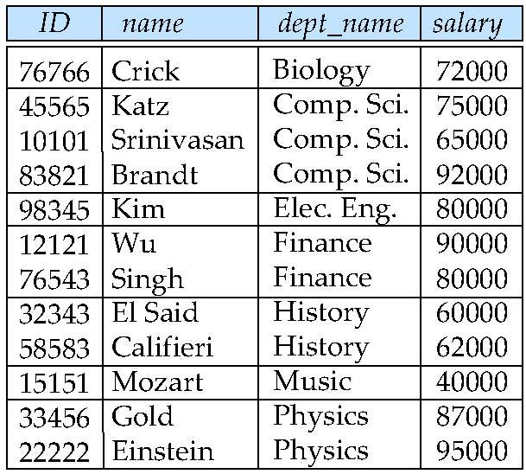
Grouping and Aggregation
To use group by correctly, every attribute in the SELECT list must either
be inside an aggregate function OR
be in the GROUP-BY clause without an aggregate function
Is this correct? No
SELECT dept_name, ID, AVG(salary)
FROM instructor
GROUP BY dept_name;

Slide 21
Grouping and Aggregation
Example: Find the cheapest beer price in each bar.
SELECT bar, MIN(price)
FROM Sells
GROUP BY bar;
Bar MIN(PRICE)
------------------- ---------------------
Australia Hotel 3.5
Coogee Bay Hotel 2.25
Lord Nelson 3.75
Marble Bar 2.8
…
What if I only wanted results with a min(price) >2.3?

Slide 22
Group by and Having
SQL provides a HAVING clause, which can appear in conjunction with a GROUP BY clause.
SELECT attributes and aggregations
FROM relations
WHERE condition
GROUP BY attribute
HAVING condition_on_group;
Example:
SELECT bar, MIN(price)
FROM Sells
GROUP BY BAR
HAVING MIN(price) > 2.3;
Thought: can we put the condition on select instead?
Bar MIN(PRICE)
------------------- ---------------------
Australia Hotel 3.5
Coogee Bay Hotel 2.25
Lord Nelson 3.75
Marble Bar 2.8
Royal Hotel 2.3
…

Slide 23
Order By
The result relation of a SQL query has no particular order since it’s a (multi-)set. We can enforce an order using order by.
SELECT column1, column2, ...
FROM table_name
ORDER BY column1, column2, ... ASC|DESC;

Slide 24
Summary on SQL
There are a maximum of six clauses that could be used in a SELECT stmt.
SELECT <attribute and function list>
FROM <table list>
[ WHERE <condition> ]
[ GROUP BY <grouping attribute(s)> ]
[ HAVING <group condition> ]
[ ORDER BY <attribute list> ];
Note on notation: clauses between square brackets [ ... ] being optional

Slide 25
Create Table Statement
A relational database can store a lot of relations, each relation is created with the create table statement.
Example: create a relation that stores info about people.
CREATE TABLE person(
  drivers_license VARCHAR(20) PRIMARY KEY,
  name VARCHAR(20)
  );

Slide 26
Drop Table Command
When a relational database no longer needs a relations, a relation can be deleted from the database using the drop table statement.
DROP TABLE person;
Note: Just like create, drop is the main command, where table is one of the many arguments drop takes.

Slide 27
Table Attributes - Domain
  Within the create table command, we specify it’s the columns/attributes, declare properties of the table and the properties of each attribute
  CREATE TABLE table (
  attribute1 datatype [properties],
  attribute2 datatype [properties],
  …
  [table property1]
  [table property2]
  …
  );

Slide 28
Table Attributes - Domain
  The syntax requires that attribute in an SQL table must specify a domain.
  CREATE TABLE table (
  attribute1 datatype [properties],
  attribute2 datatype [properties],
  …
  [table property1]
  [table property2]
  …
  );
The domain puts constraints on the value that an attribute is allowed to take. Defining the data type specifies the domain.

Slide 29
Attribute Constraints
Attributes properties can be used to “enforce” more complex domain membership conditions.
  CREATE TABLE table (
  attribute1 datatype [properties],
  attribute2 datatype [properties],
  …
  [table property1]
  [table property2]
  …
  );

Slide 30
Attribute Constraints
  By default, the NULL value is a member of all data types.
  Example:
    CREATE TABLE Likes (
    drinker VARCHAR(20) NOT NULL,
    beer VARCHAR(30)
    );
  More examples: UNIQUE, CHECK, DEFAULT, …

Slide 31
Declaring Primary Keys
Declare primary key constraint with the table property
primary key (Ai, ..., )
  Example: declare the name of a person to be primary key
  CREATE TABLE Person (
  name VARCHAR(20),
  PRIMARY KEY (name)
  );
  Primary key declaration on an attribute ensures not null and unique
  Note: there an equivalent syntax as an attribute property

Slide 32
Declaring Foreign Keys
Declare foreign keys with the foreign key constraint
  foreign key (Aj, ..., ) references r
  Example: declare the name of a person to be primary key
  CREATE TABLE employee (
  name VARCHAR(20),
  works_at VARCHAR(20),
  FOREIGN KEY (works_at) REFERENCES company(id)
  );
  Note: there an equivalent syntax as an attribute property

Slide 33
Declaring Foreign Keys
Declaring foreign keys assures referential integrity.
Foreign a key:
  specify Relation (Attribute) to which it refers.
For instance, if we want to delete a tuple from Beers, and there are tuples in Sells that refer to it, we could either:
  reject the deletion
  cascade the deletion and remove Sells records
  set-NULL the foreign key attribute
Can force cascade via ON DELETE CASCADE after REFERENCES.

Slide 34
Declaring Foreign Keys
The FOREIGN KEY constraint is used to prevent actions that would destroy links between tables.
If you delete a value of a primary key that is referred to in other tables as a foreign key, you risk violating the referential integrity. There are several ways to handle this.
If you want prefer to delete all records referring to the foreign key value in the database, you can specify ON DELETE CASCADE
  CREATE TABLE Person (
  name VARCHAR(20),
  ateburger VARCHAR(20),
  FOREIGN KEY(ateburger) REFERENCES burgers (Bid) ON DELETE CASCADE
  );

Slide 35
Insert Tuple(s) using values
The INSERT command inserts new tuple(s) into a table
  INSERT INTO Relation VALUES (val1, val2, val3, ...)
  (val1, val2, val3, ...) is a tuple of values
Example: Add the fact that Justin likes ’Old’.
  INSERT INTO Likes VALUES (’Justin’, ’Old’);
The following are the same
  INSERT INTO Sells (price,bar) VALUES (2.50, ’Coogee Bay Hotel’);
  INSERT INTO Sells (bar,price) VALUES (’Coogee Bay Hotel’, 2.50);
Note: The order of the attributes in VALUES can be different from the SQL table definition as long as the order is specified in the INTO clause.

Slide 36
Insert Tuple(s) using values
Basic attribute constraint checking by SQL
E.g., suppose the table specified that drinkers’ phone numbers cannot be NULL.
  ALTER TABLE Drinkers ALTER COLUMN phone SET NOT NULL;
And then try to insert a new drinker whose phone number we don’t know:
  INSERT INTO Drinkers(name, addr) VALUES (’Zoe’, ’Manly’);
  ERROR: null value in column "phone" violates not-null constraint
  DETAIL: Failing row contains (Zoe, Manly, null).

Slide 37
Insert Tuple(s) using Select
We can use the result of a query to perform insertion of multiple tuples at once.
  INSERT INTO Relation ( Subquery );
Condition: Tuples of subquery must be projected into a suitable format (by matching the tuple-type of Relation ).
A subquery:
  a query that is nested inside an outer query: SELECT , INSERT , UPDATE , or DELETE statement.
Subqueries:
  can also be nested inside another subqueries.
  are very helpful.

Slide 38
Insert Tuple(s) using Select
For Example: Populate a relation of John’s potential drinking buddies (i.e. people who go to the same bars as John).
  CREATE TABLE DrinkingBuddies (
  name varchar(20)
  );
  INSERT INTO DrinkingBuddies(
  SELECT DISTINCT f2.drinker
  FROM Frequents f1, Frequents f2
  WHERE f1.drinker = ’John’
  AND f2.drinker != ’John’
  AND f1.bar = f2.bar
  );

Slide 39
Delete Tuple(s)
The DELETE operation removes all tuples from Table that satisfy a condition.
  DELETE FROM Table
  WHERE Condition
Example: Justin no longer likes Sparkling Ale.
  DELETE FROM Likes
  WHERE drinker = ’Justin’
  AND beer = ’Sparkling Ale’;
Omitting the WHERE Clause deletes all tuples from relation R.
  DELETE FROM R;
  This doesn’t drop the table, the table still remains
Note: Delete is not the same as Drop

Slide 40
Delete Tuple(s)
Semantics of the above Deletion:
Evaluation of DELETE FROM R WHERE Cond can be viewed as:
  FOR EACH tuple T in R DO
  IF T satisfies Cond THEN
  make a note of this T
  END
  END
  FOR EACH noted tuple T DO
  remove T from relation R
  END

Slide 41
Update Value(s) in Tuple(s)
If you have an tuple but want to change part of its values, use the UPDATE command.
Updates specified attributes in specified tuples of a relation:
UPDATE R
SET list of assignments
WHERE Condition
Example: John moves to Coogee.
UPDATE Drinkers
SET addr = ’Coogee’ , phone = ’9665-4321’
WHERE name = ’John’;
Note: Careful because all tuples relation R that satisfies Condition has the assignments applied to it.

Slide 42
Update Value(s) in Tuple(s)
Can update many tuples at once (all tuples that satisfy condition)
Example: Make $3 the maximum price for beer.
  UPDATE Sells
  SET price = 3.00
  WHERE price > 3.00;
Example: Increase all beer prices by 10%.
  UPDATE Sells
  SET price = price * 1.10;

Slide 43
SQL Views
Tables (created by CREATE TABLE) are base relations
Views are virtual relations in SQL.
Views are derived from base relations and does not take up space in the DBMS. Base relations are physically stored in the DBMS
View are defined via:
CREATE VIEW View_name AS Query
Views may be removed via:
DROP VIEW View_name

Slide 44
Motivation
Example: an avid CUB drinker might not be interested in any other kinds of beer.
CREATE VIEW MyBeers AS
SELECT name, manf
FROM Beers
WHERE manf = ’Carlton’;
NAME. MANF
------------------------- ------------
Crown Lager Carlton
Fosters Lager Carlton
Invalid Stout Carlton
Melbourne Bitter Carlton
Victoria Bitter Carlton

Slide 45
Motivation
Example: we don’t really all the other columns of inner-city hotels.
CREATE VIEW InnerCityHotels AS
SELECT name, license
FROM Bars
WHERE addr = ’The Rocks’ OR addr = ’Sydney’;
NAME LICENSE
------------------------------ ----------
Australia Hotel 123456
Lord Nelson 123888
Marble Bar 122123
Note: a view can help if you are not interested in all attributes of a base relation.

Slide 46
Querying Views
Example: Using the InnerCityHotels view.
CREATE VIEW InnerCityHotels AS
SELECT name, license
FROM Bars
WHERE addr IN (’The Rocks’, ’Sydney’);
Views can be used in queries just as if they were base (stored) relations.
SELECT pub FROM InnerCityHotels WHERE lic = ’123456’;
This makes views especially useful, can you think of an usages?

Slide 47
Views Update
SELECT * FROM InnerCityHotels;
NAME LICENSE
-------------- ----------
Australia Hotel 123456
Marble Bar 12212
Lord Nelson 13
UPDATE Bars SET license=‘111223’ WHERE name=‘Lord Nelson’;
SELECT * FROM InnerCityHotels;
NAME LICENSE
-------------- ----------
Australia Hotel 123456
Marble Bar 12212
Lord Nelson 111223
Conclusion: Views update themselves automatically, if changes occur in the underlying relation(s).
Recall View Definition:
CREATE VIEW InnerCityHotels AS
SELECT name, license
FROM Bars
WHERE addr = ’The Rocks’ OR
addr = ’Sydney’;

Slide 48
Schema Change in SQL
Sometimes, we want to make changes to the table schema.
The definition of a base table or of other named schema elements can be changed by using the ALTER command.
  Add column(s) of table
  Delete column(s) of table
  Modify column(s) of table
Can be accomplished via the ALTER TABLE operation:
(you don’t have to alter tables in the upcoming project)

Slide 49
Example: Add New Column
Example: Add column phone numbers to table hotels.
ALTER TABLE Bars
ADD phone char(10) DEFAULT ’Unlisted’;
This appends a new column to the table and sets value for this attribute to ’Unlisted’ in every tuple.
Note: If no default values is given, values new column is set to all NULL.

Slide 50
Example: Modify Column
Example: Changing the primary key
ALTER TABLE Persons DROP PRIMARY KEY;
OR
ALTER TABLE Persons ADD PRIMARY KEY (ID);
Note: Typically, any changes need to be allowable with respect to any existing data.
In this case: any values in the new primary key column must obey NOT NULL, UNQIUE constraint.
So before you can specify the new primary key, you must update the table to delete all NULL, or non-unique values. e.g., UPDATE table SET col = 0 WHERE col IS NULL; (assuming col is numerical)

Slide 51
Create Index
Index helps to speed up retrieval of tuples (will be covered later).
CREATE INDEX index_name
ON table_name (column1, column2, ...);
CREATE UNIQUE INDEX index_name
ON table_name (column1, column2, ...);

Slide 52
Learning Outcomes
Basic queries in SQL
Querying multiple tables
Aggregate queries
Insert/delete/update
Change schemas
Views

