Slide 1

Price Prediction for AIRBNB Datasets for Boston and Seattle
Data Monks
Daksha Devasthale
Chinmay Deosthali
Kevin Linnane

Slide 2
Problem Statement
Airbnb wants to know how they can improve their rental programs for tourists and visiting professionals.
Using Boston and Seattle Datasets we attempt to find if there is an upward trend
1) Boston
2) Seattle
Using each data sets' properties is there a way to determine if a certain attribute holds significance for price

Slide 3
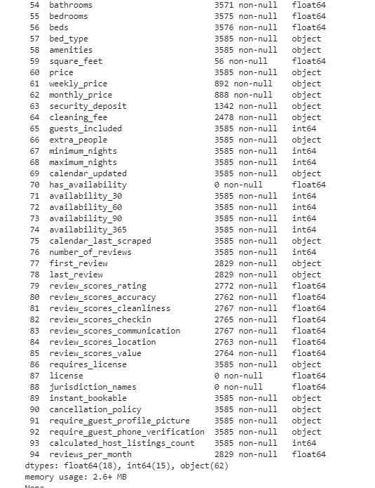
Boston
Notes:
There were 94 attributes initially inside of the boston dataset.
each attribute should have about 3585 rows but as you can see in this snippet some were completely null, some had random null spots, some were objects were classified as objects but should have been strings.
SO it was a messy dataset

Slide 4
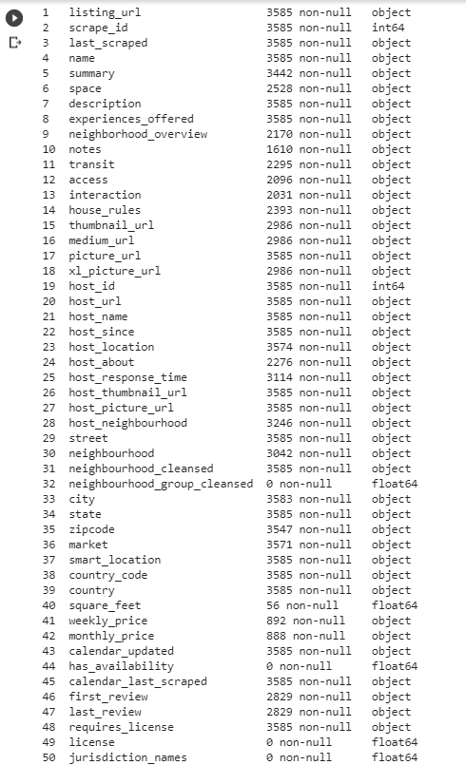
Boston Preprocessing: Removed Features
Notes:
A total of 50 attributes were removed. This is definitely something that could be improved on In the future as we removed features that we felt were strong if we were able to use a nlp to convert reviews into a scale of good or bad ratings.
We initially removed anything to do with the city location such as city, state, zipcode because we have longitude and latitude in the data set so that would be the best and accurate measure of a location.
And the rest are just blank spaces that were random variables.

Slide 5
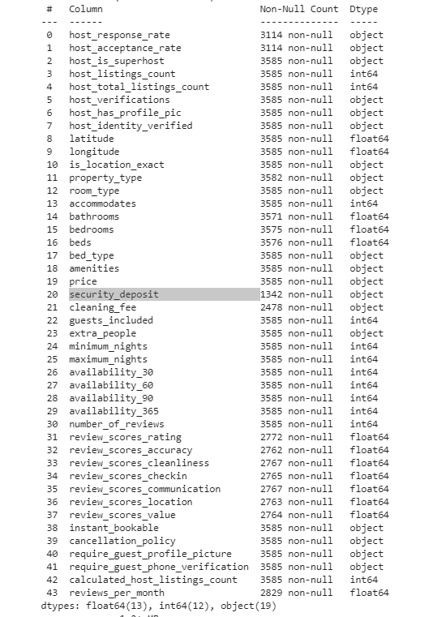
Data Preprocessing: Data After Remove
Notes:
So what this really tells us is that there are 19 objects that we still have to modify and potential null values that we will have to fill with the remaining 43 attributes.

Slide 6
Luckily data was consistently messy
specialOneHotEncoding = Needed to modify lists of lists to 0 and 1 for each value =['host_verifications', 'Amenities']
columnsToOneHotEncode = Columns that were labelEncoded, then hot encoded = ['property_type', 'room_type','bed_type', 'cancellation_policy']
columnToScaleAndParse = Removed % and reduced to a decimal = ['host_response_rate', 'host_acceptance_rate']
TrueFalseColumns = t/f = 1/0 =
['host_is_superhost', 'host_has_profile_pic', 'host_identity_verified', 'is_location_exact', 'instant_bookable', 'require_guest_profile_picture', 'require_guest_phone_verification']
dollarSignColumns = Removed $ and convert to float = ["extra_people", "price", "security_deposit", "cleaning_fee"]
Notes:
TODO: Explain what each column had to do.

Slide 7
Boston: Null Value Replacement
For 2 columns, we replaced null values with 0:
security_deposit
cleaning_fee
For rest of columns we used the mean of the data set.

Slide 8
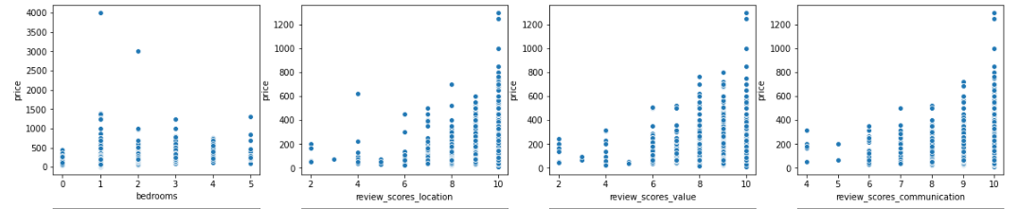
Boston: Scatter Plots of Numerical Datatype

Slide 9
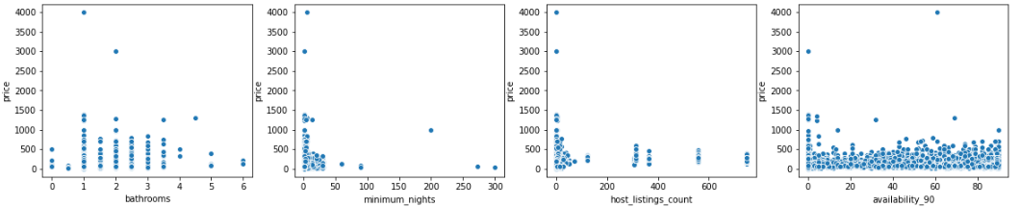
Boston: Scatter Plots cont.

Slide 10
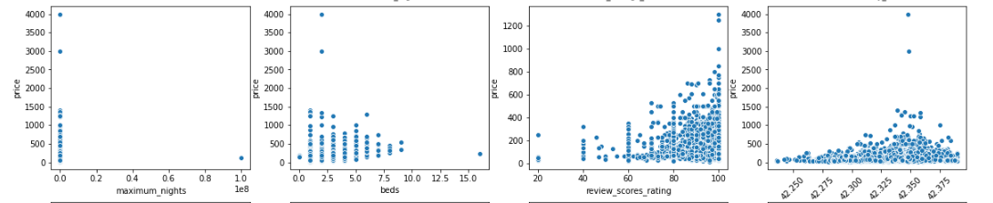
Boston: Scatter Plots cont.

Slide 11
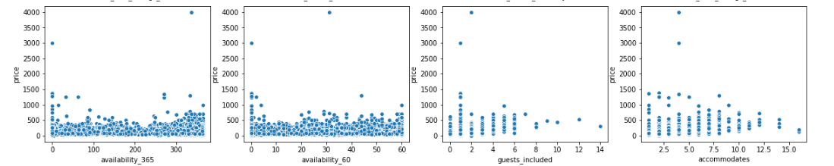
Boston: Scatter Plots cont.

Slide 12
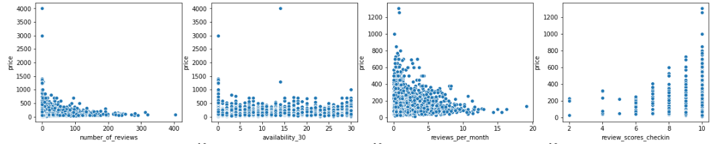
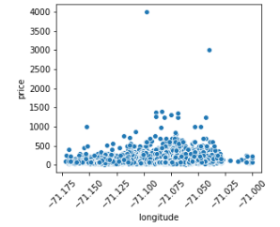
Boston: Scatter Plots cont.

Slide 13
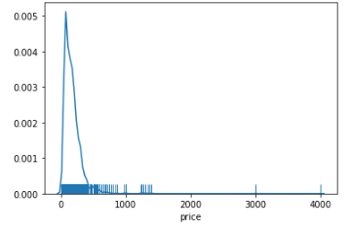
Boston: Price Histogram

Slide 14
Heat map
https://ibb.co/0DLPFj2

Slide 15
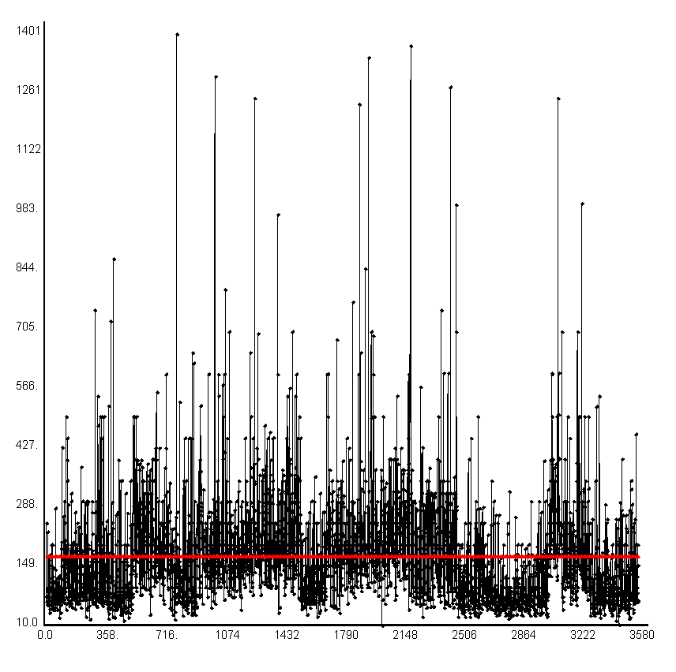
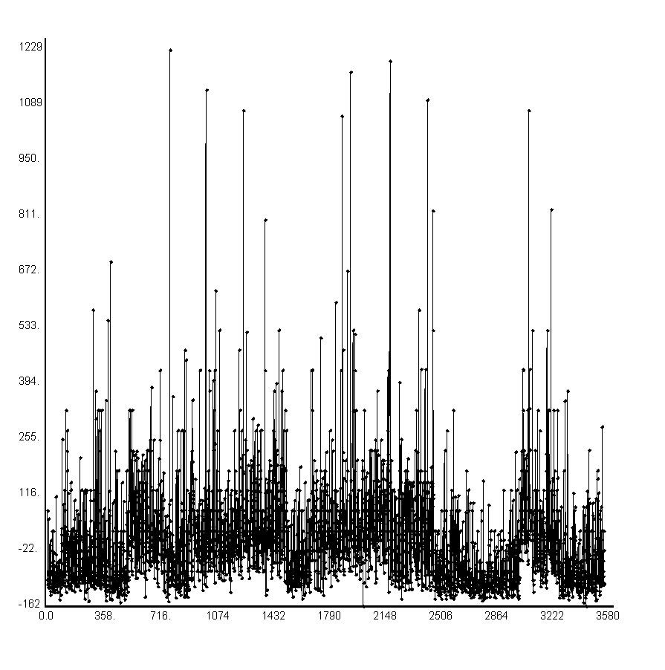
Boston Results
Graphs for Null Model :
b = VectorD(171.903)
RsqBar - -0.00028
Y (black) and Yp (red)
Error

Slide 16
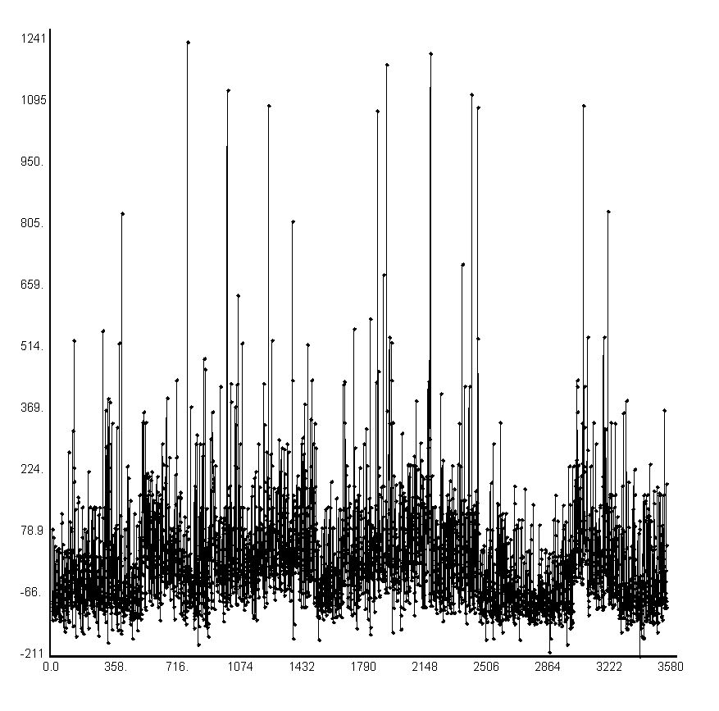
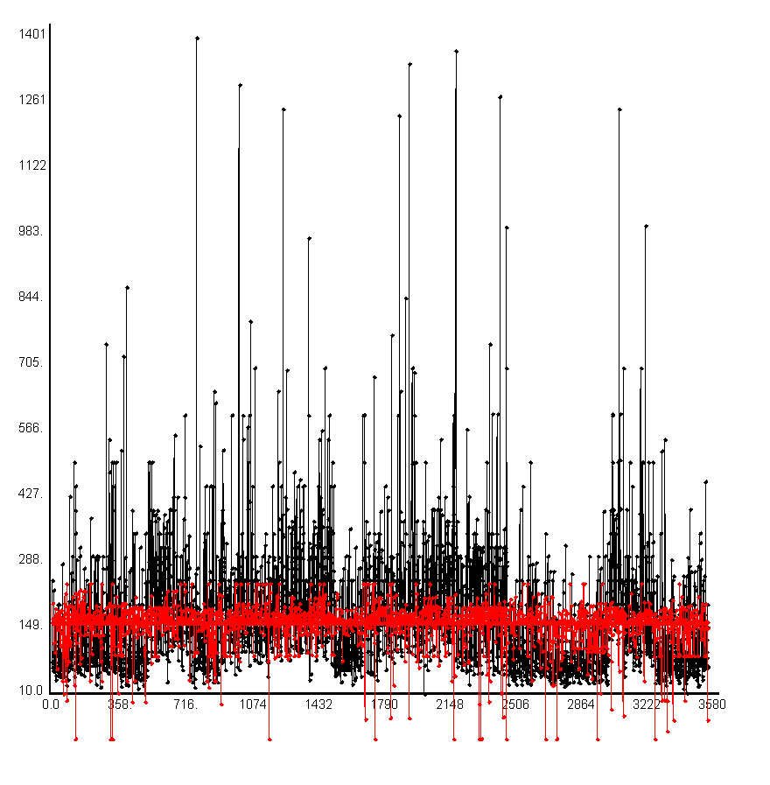
Boston Results
Simple Regression Graphs;
Y and YP

Slide 17
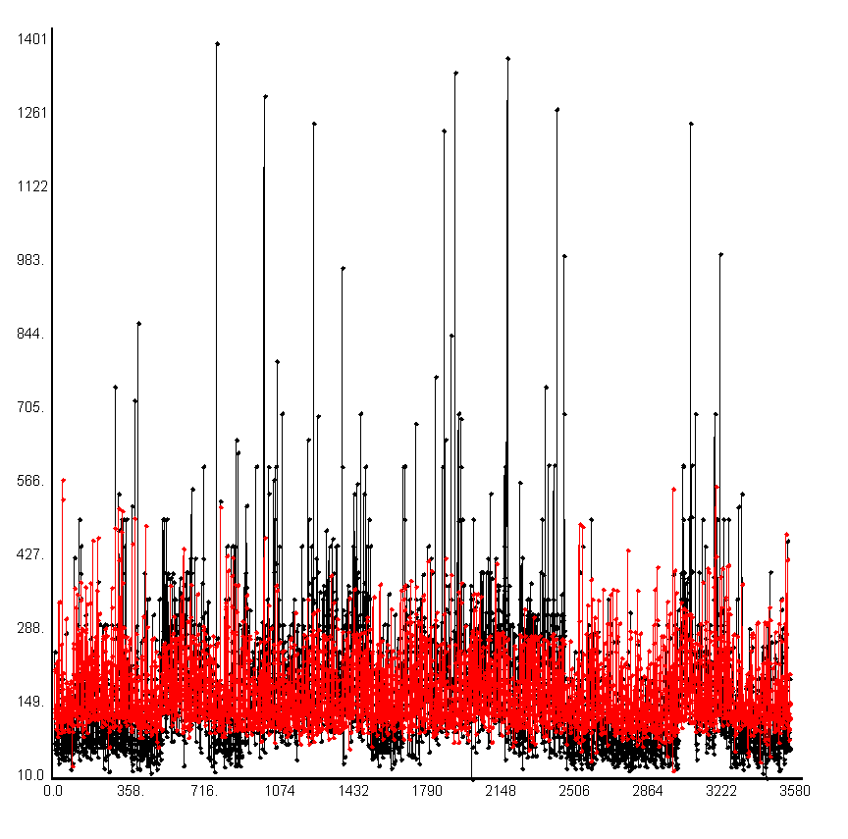
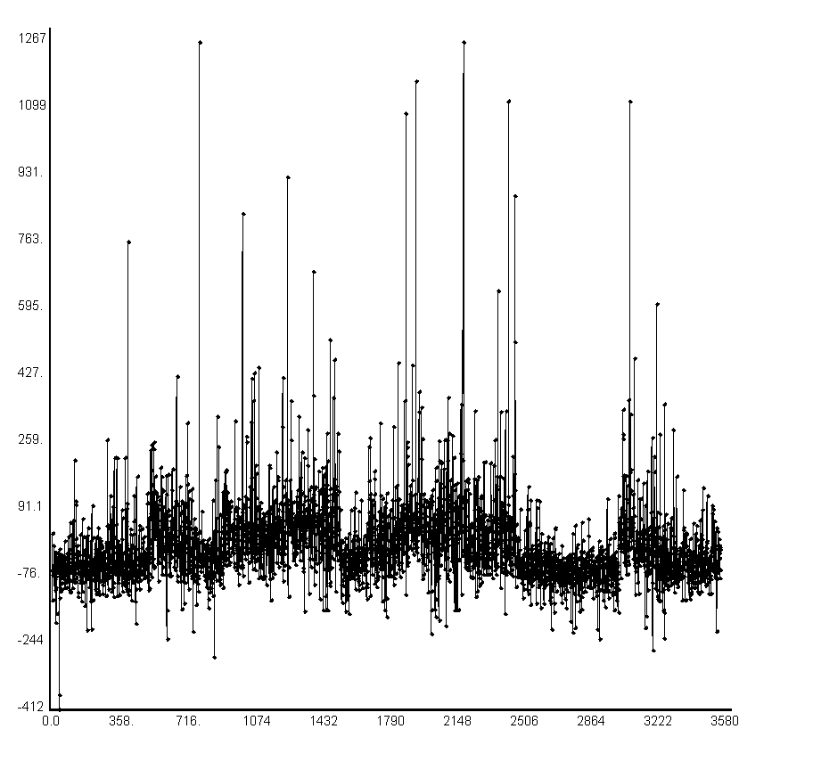
Boston Results : Multiple Regression

Slide 18
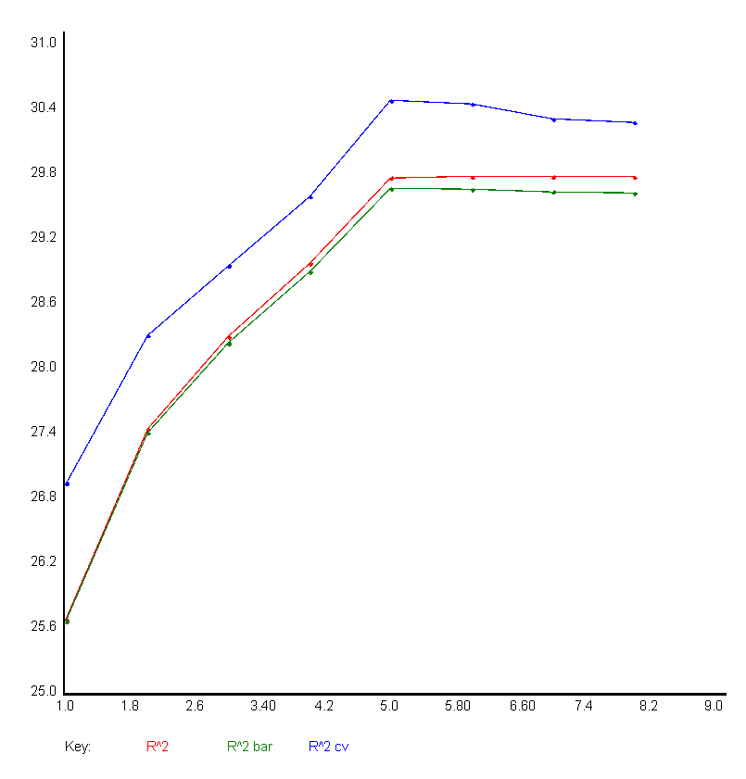
Boston Results : Multiple Regression

Slide 19
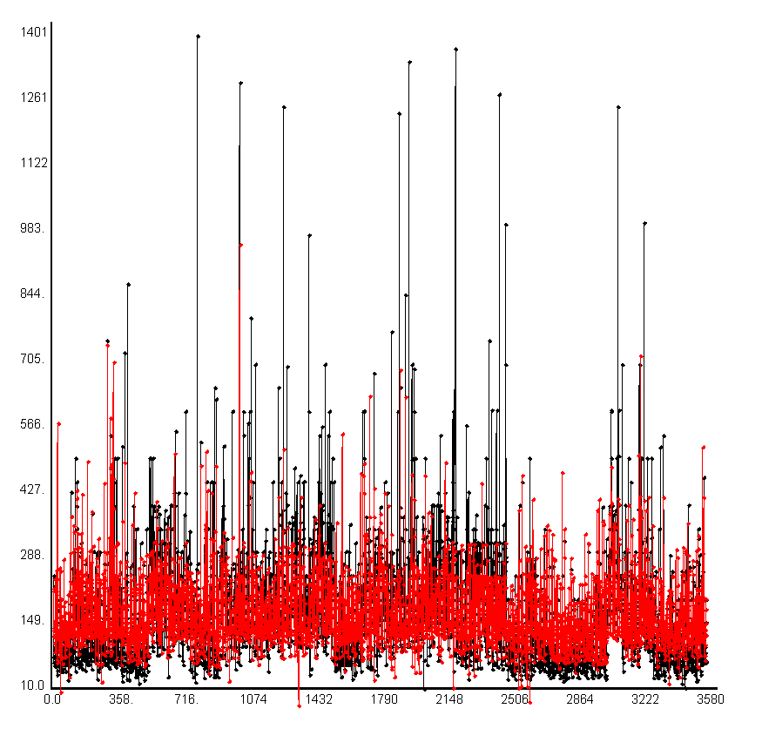
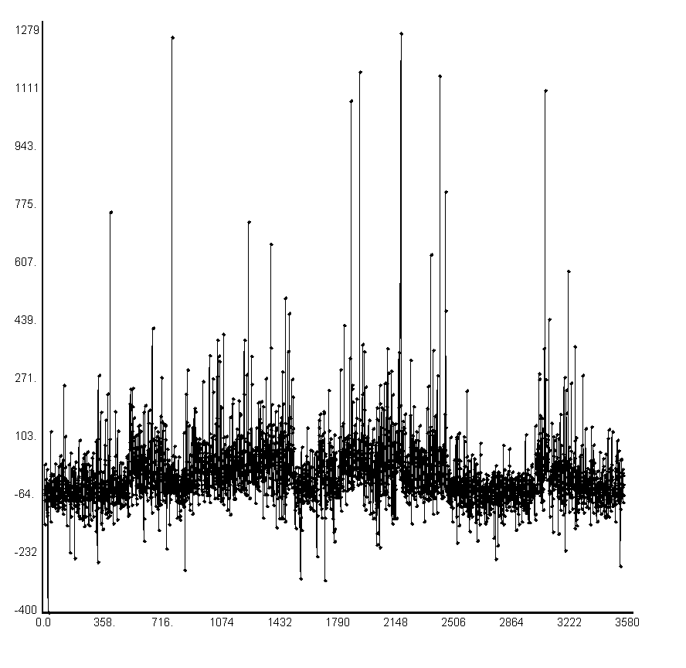
Boston Results: QuadXRegression

Slide 20
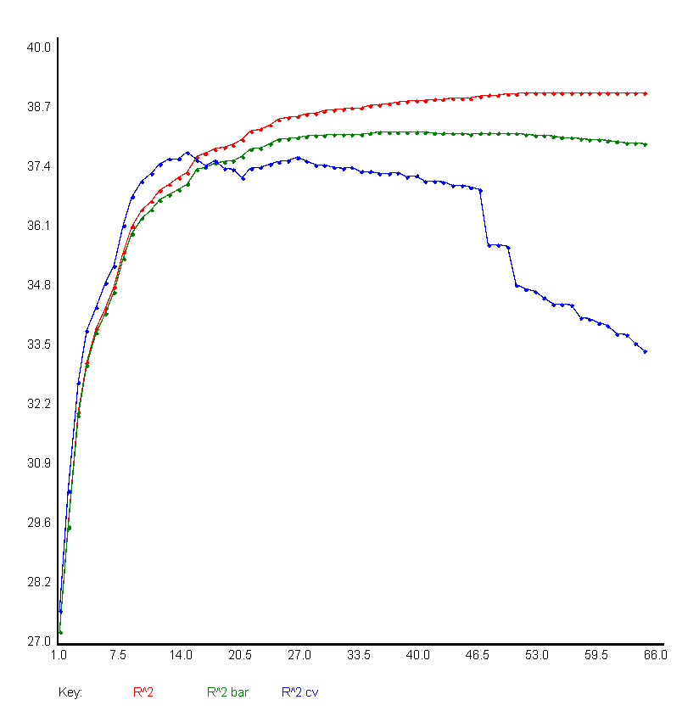

Boston Results: QuadXRegression

Slide 21
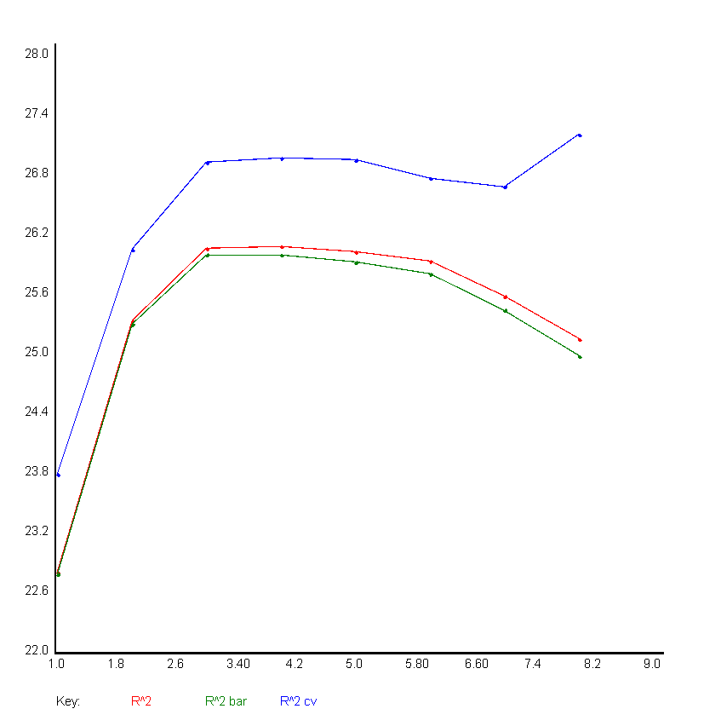
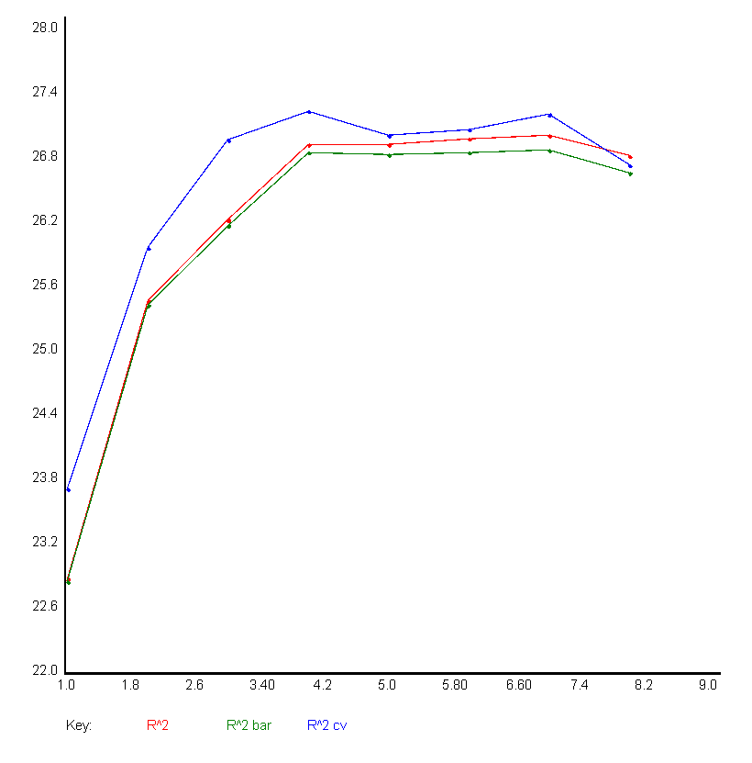
Boston Results : Perceptron
Sigmoid
Tanh

Slide 22

Boston Results: Perceptron

Slide 23
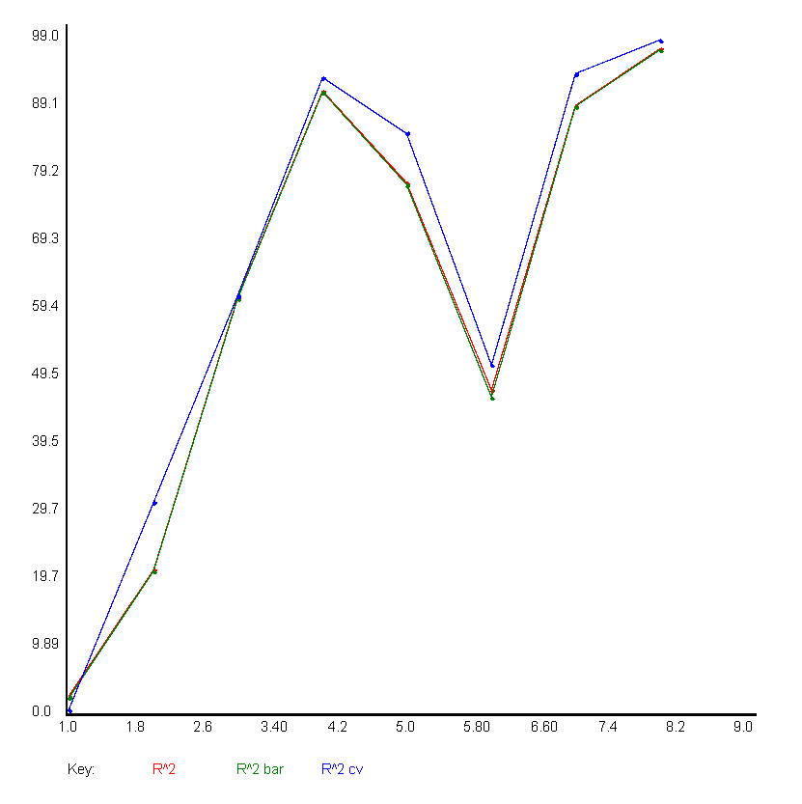
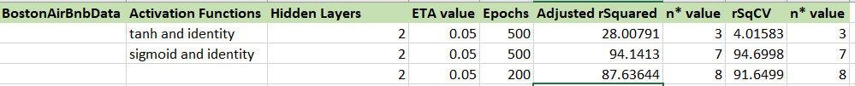
Boston Results : NNXL

Slide 24
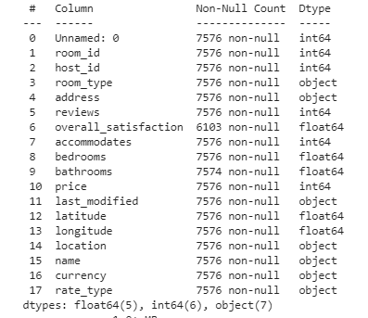
Seattle
Notes:
There were 94 attributes initially inside of the boston dataset.
each attribute should have about 3585 rows but as you can see in this snippet some were completely null, some had random null spots, some were objects were classified as objects but should have been strings.
SO it was a messy dataset

Slide 25
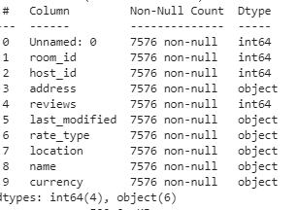
Seattle Preprocessing: Removed Features
Notes:
A total of 50 attributes were removed. This is definitely something that could be improved on In the future as we removed features that we felt were strong if we were able to use a nlp to convert reviews into a scale of good or bad ratings.
We initially removed anything to do with the city location such as city, state, zipcode because we have longitude and latitude in the data set so that would be the best and accurate measure of a location.
And the rest are just blank spaces that were random variables.

Slide 26
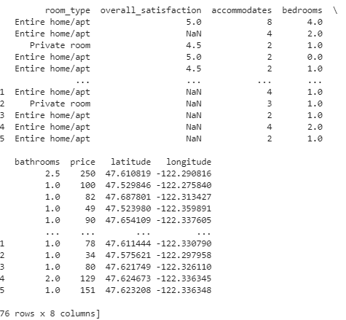
Seattle Data Preprocessing: Data After Remove
Notes:
So what this really tells us is that there are 19 objects that we still have to modify and potential null values that we will have to fill with the remaining 43 attributes.

Slide 27

Data Preprocessing
Not a lot to do with this data set
Room_type was label_encoded then one_hot encoded. This is needed when using keras to_categorical but you don't need to label encode with pandas get_dummies().
Then replaced NaN value with the mean.

Slide 28
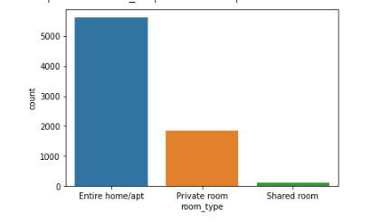
Seattle: Frequency of Categorical Datatype

Slide 29
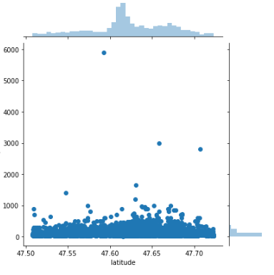
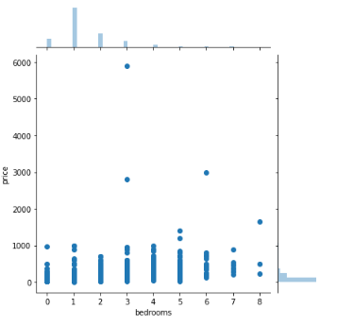
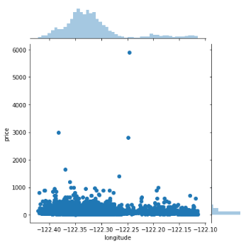
Seattle: Scatter Plots of Numerical Datatype

Slide 30
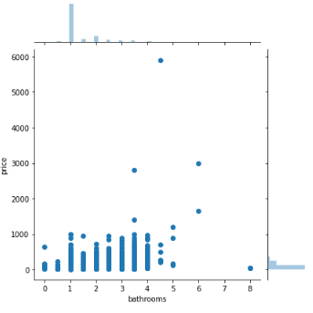
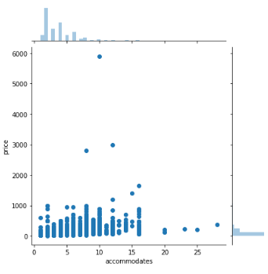
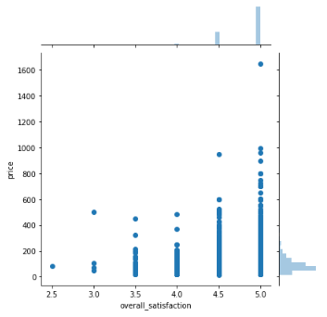
Seattle: Scatter Plots Cont.

Slide 31
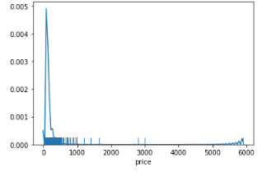
Seattle: Price Histogram

Slide 32
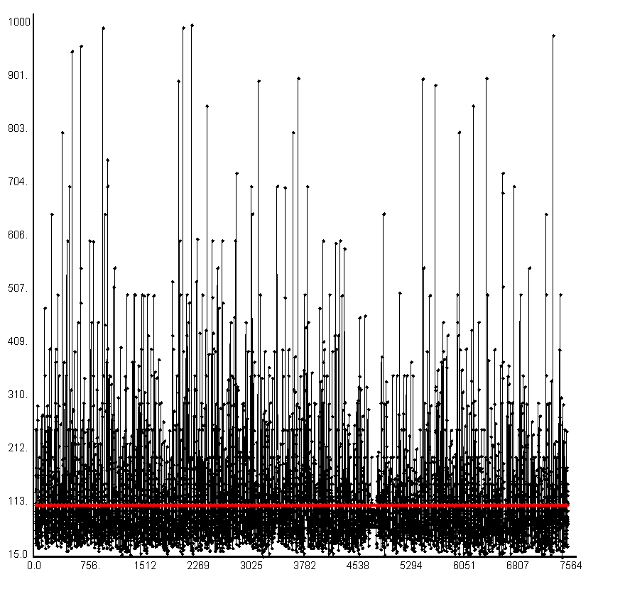
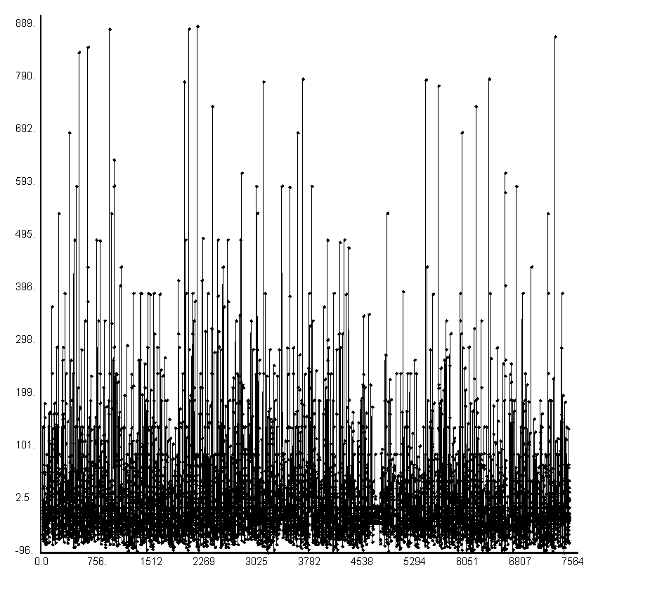
Seattle Results : Null Model

Slide 33
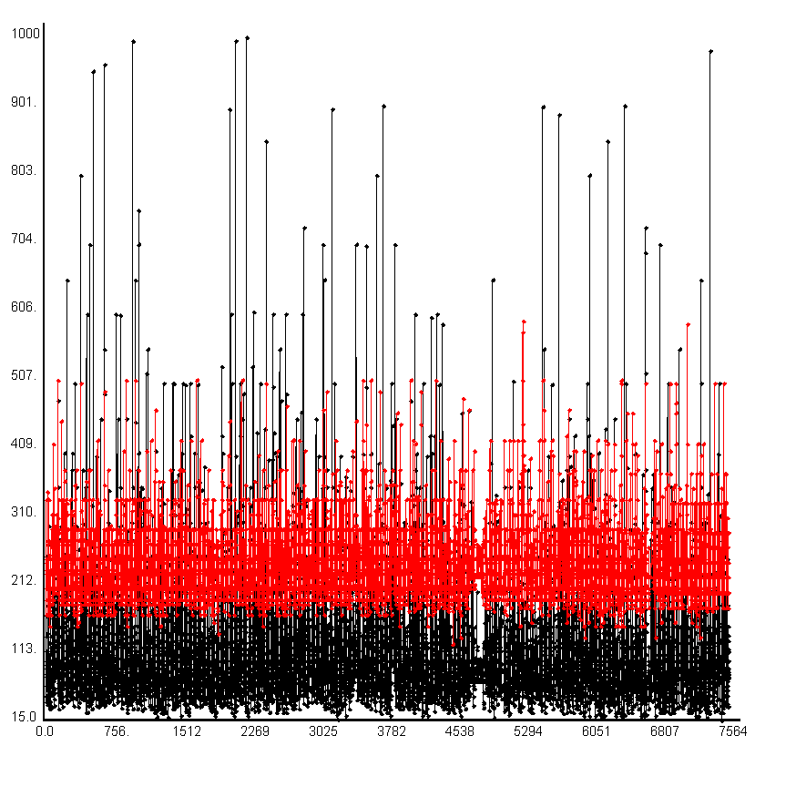
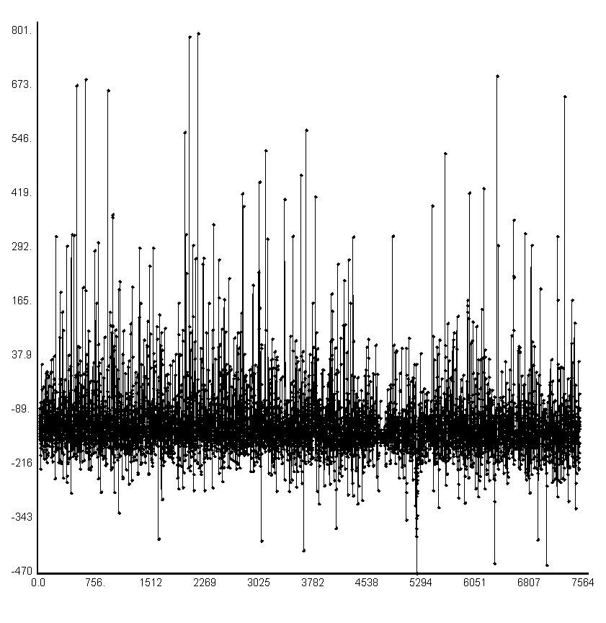
Seattle Results : Simple Regression

Slide 34
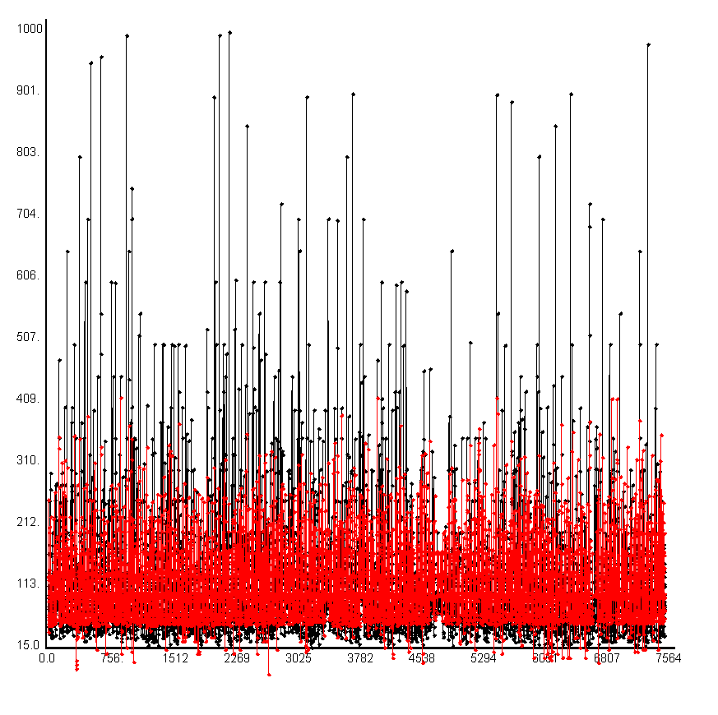
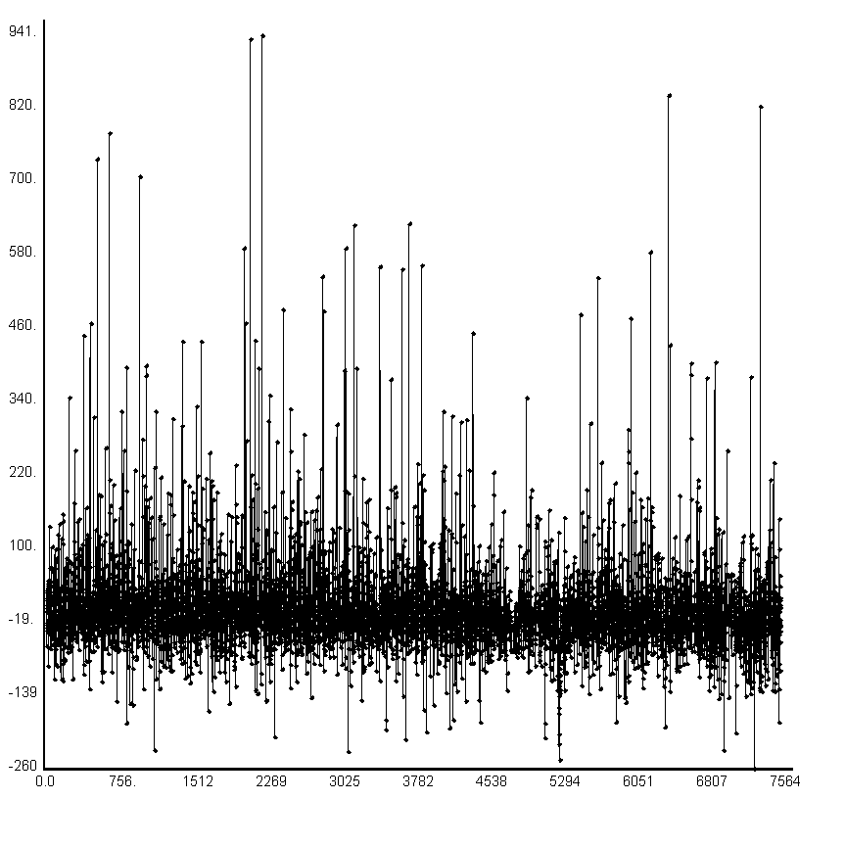
Seattle Results : Multiple Regression

Slide 35
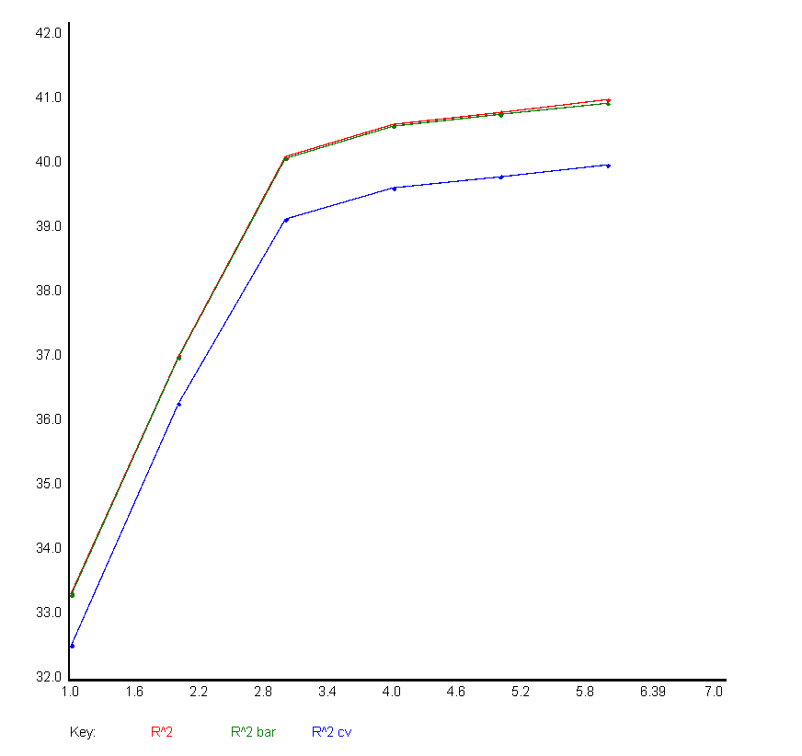
Seattle Results: Multiple Regression

Slide 36
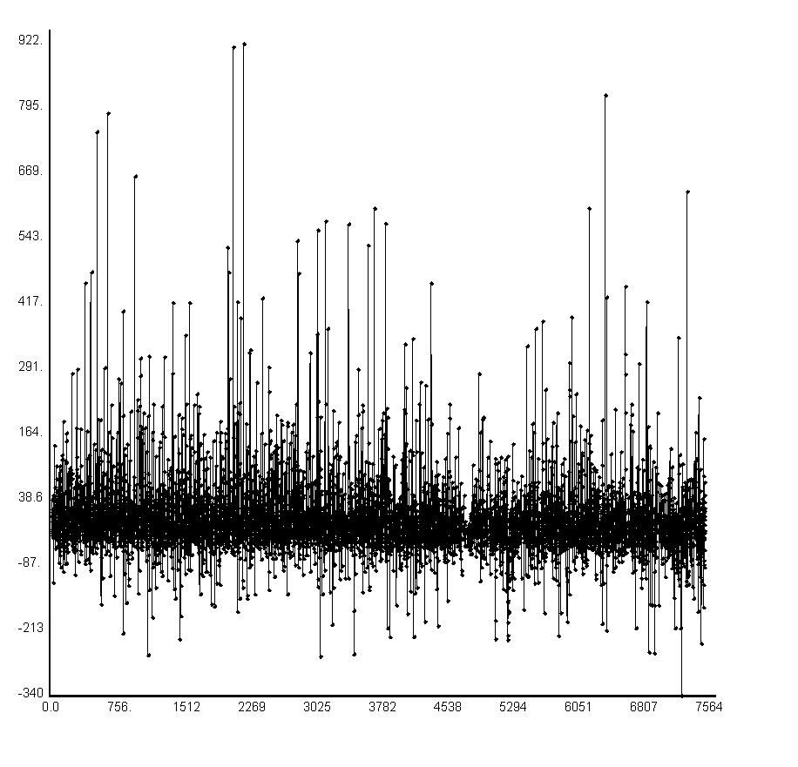
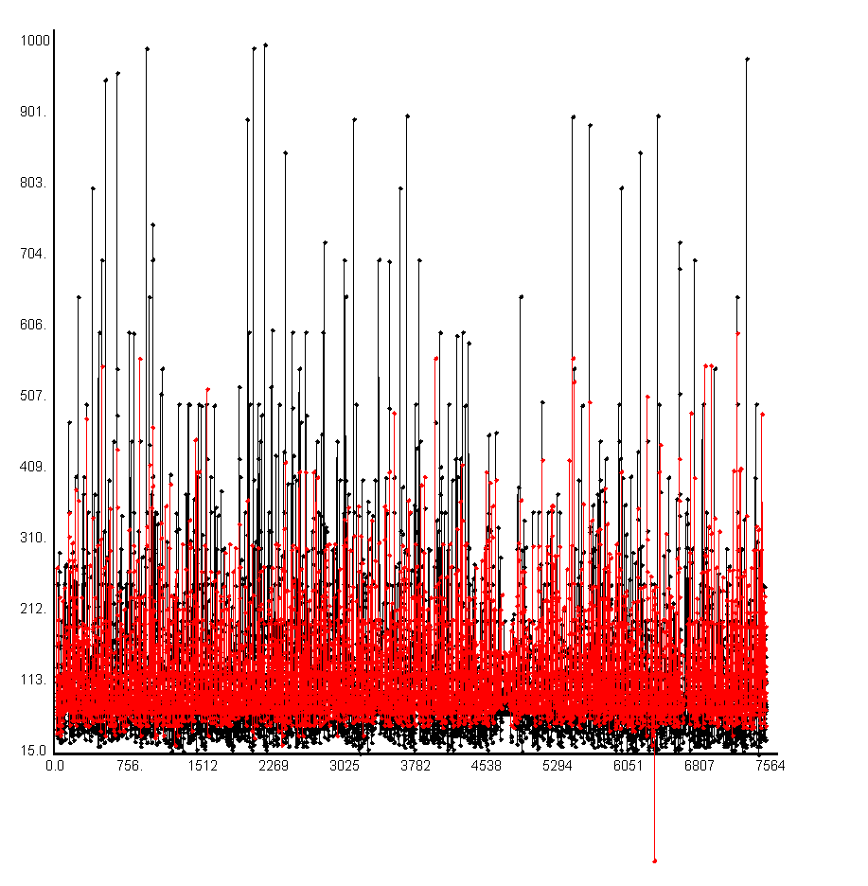
Seattle Results : QuadXRegression

Slide 37
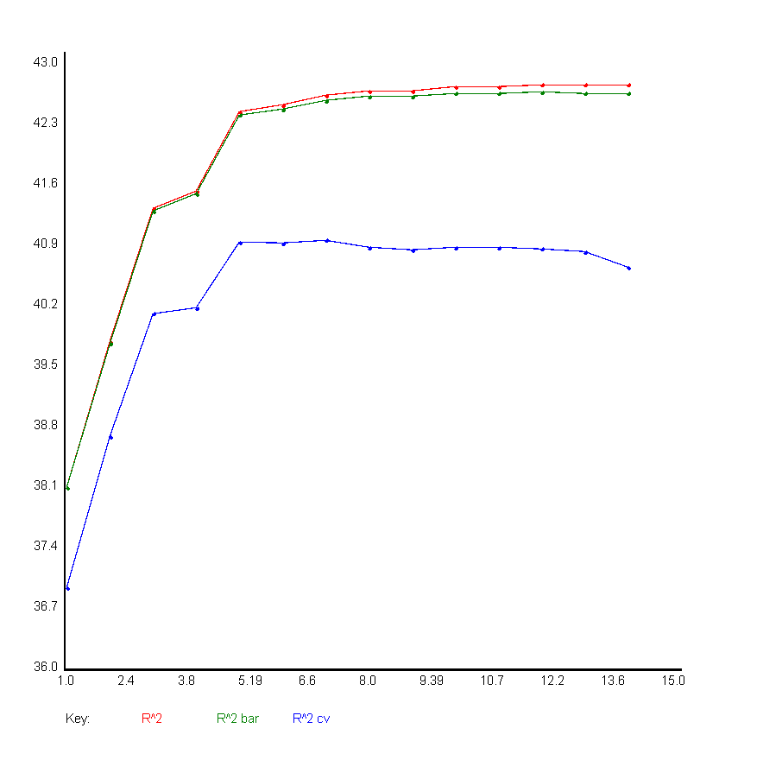

Seattle Results: QuadXRegression

Slide 38
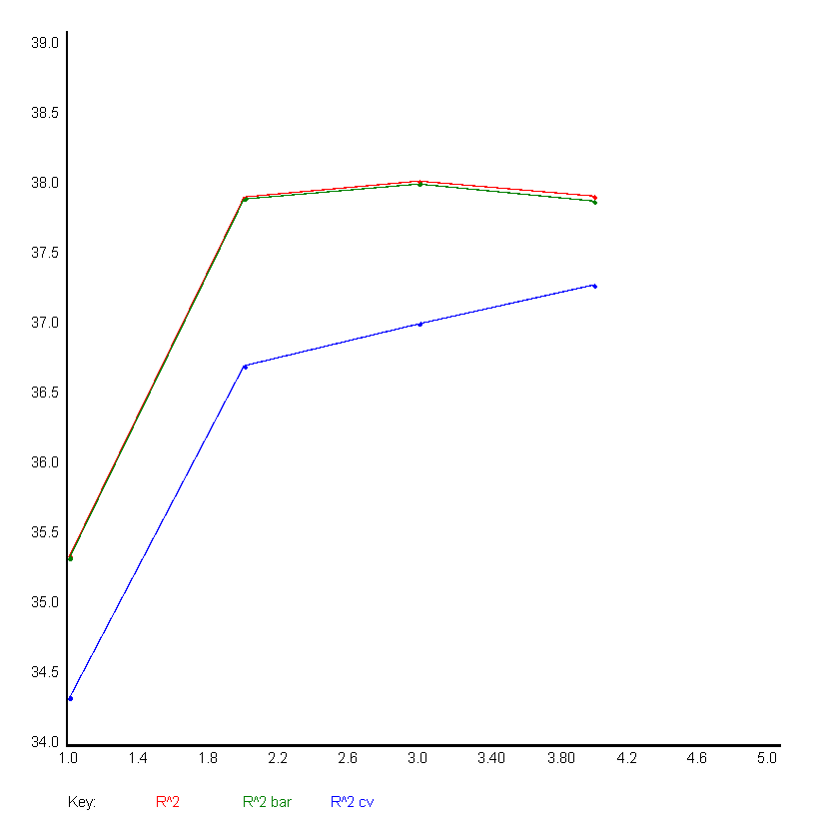

Seattle Results : Perceptron

Slide 39
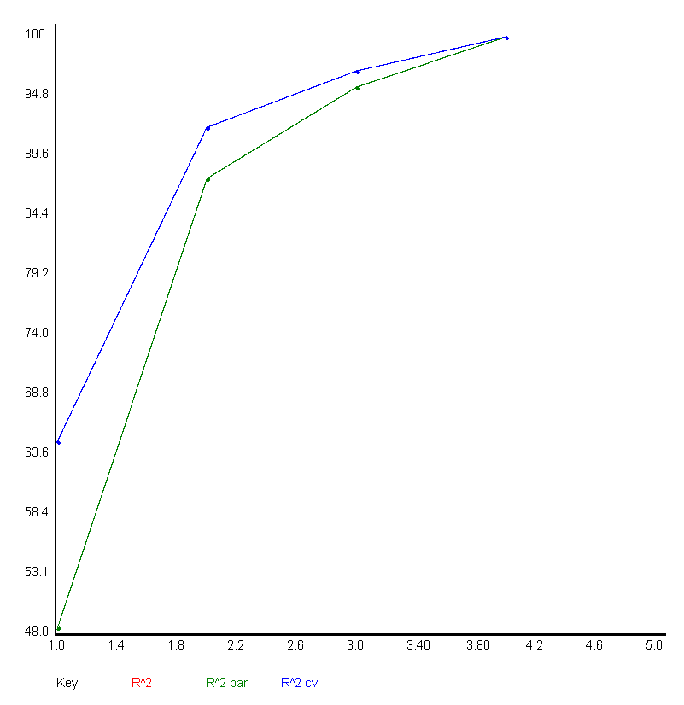

Seattle Results: NNXL

Slide 40
Conclusion
For the Boston Dataset , the following columns were found to be most useful for Price prediction:
host_response_rate, host_acceptance_rate, accommodates, beds, bathrooms, review_scores_rating, guests_included, minimum_nights
For the Seattle Dataset, the following columns were found to be most useful for Price prediction:
overall_satisfaction, accommodates, bedrooms, bathroom

Slide 41
Conclusion
We found out that the best predictions for both the Datasets were made by Neural Networks with 3 hidden layers with the Sigmoid function as the activation function

