Slide 1
Chapter 6: CPU Scheduling

Slide 2
Basic Concepts
Maximum CPU utilization obtained with multiprogramming
CPU–I/O Burst Cycle – Process execution consists of a cycle of CPU execution and I/O wait
CPU burst distribution

Slide 3
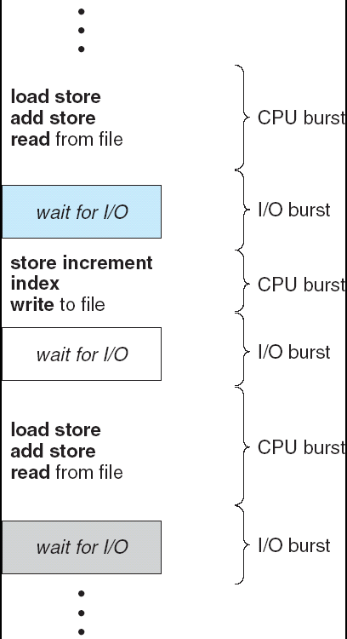
Alternating Sequence of CPU And I/O Bursts

Slide 4
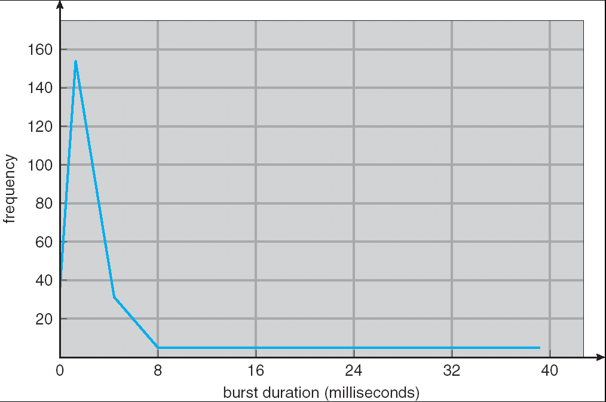
Histogram of CPU-burst Times

Slide 5
Aim of Scheduling
Assign processes to be executed by the processor(s)
Response time
Throughput
Processor efficiency

Slide 6
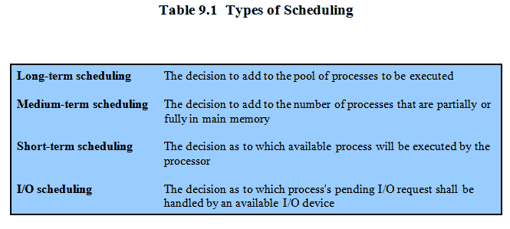
Types of Scheduling

Slide 7
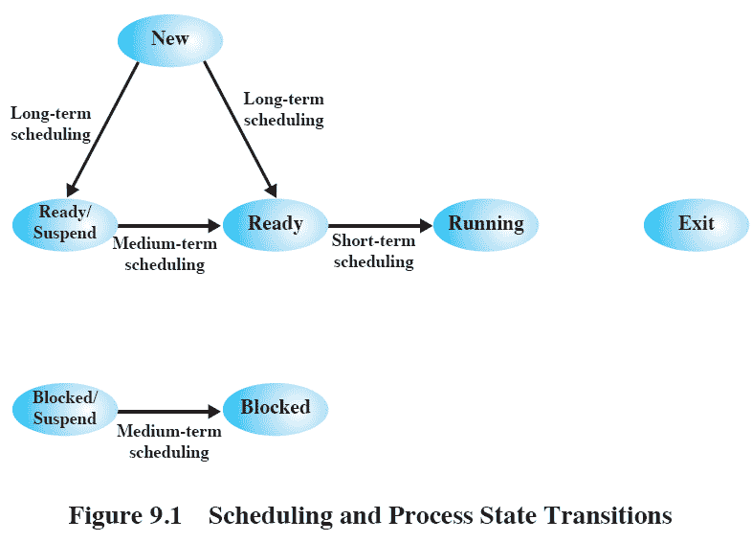
Scheduling and Process State Transitions

Slide 8
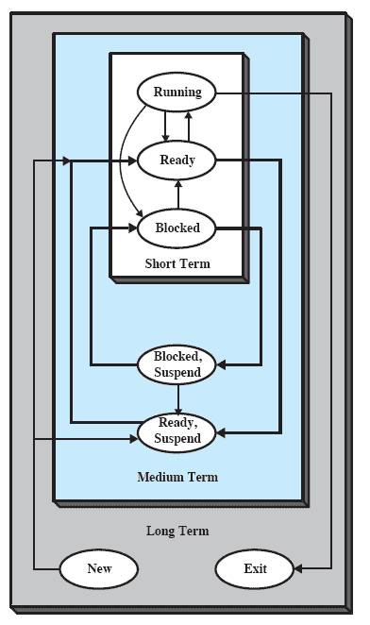
Levels of Scheduling

Slide 9
Long-Term Scheduling
Determines which programs are admitted to the system for processing
Controls the degree of multiprogramming
More processes, smaller percentage of time each process is executed

Slide 10
Medium-Term Scheduling
Part of the swapping function
Based on the need to manage the degree of multiprogramming

Slide 11
Short-Term Scheduling
Known as the dispatcher
Executes most frequently
Invoked when an event occurs
Clock interrupts
I/O interrupts
Operating system calls
Signals

Slide 12
Short-Term Scheduling Criteria
User-oriented
Response Time
Elapsed time between the submission of a request until there is output.
System-oriented
Effective and efficient utilization of the processor

Slide 13
Short-Term Scheduling Criteria
Performance-related
Quantitative
Measurable such as response time and throughput

Slide 14
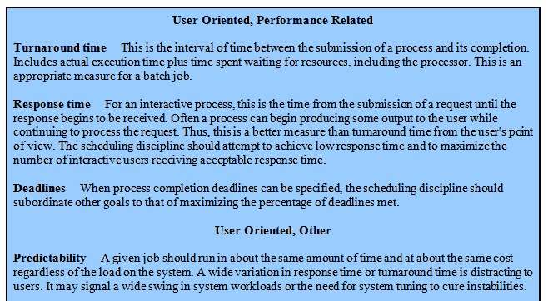
Scheduling Criteria

Slide 15
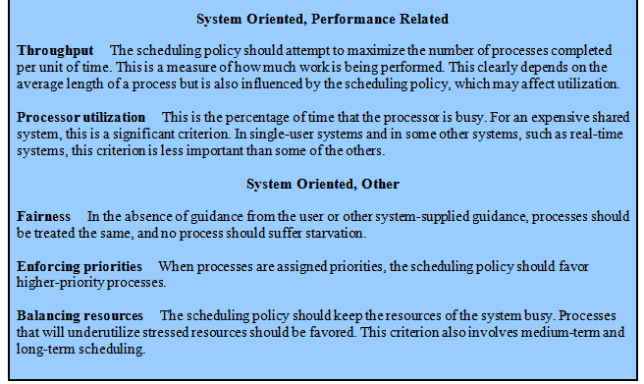
Scheduling Criteria

Slide 16
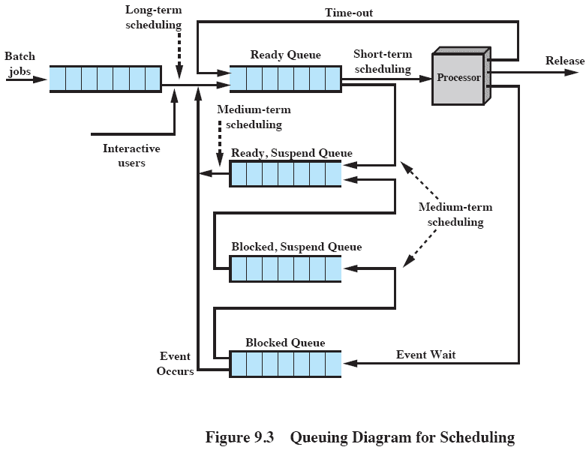
Queuing Diagram

Slide 17
CPU Scheduler
Selects from among the processes in memory that are ready to execute, and allocates the CPU to one of them
CPU scheduling decisions may take place when a process:
1. Switches from running to waiting state
2. Switches from running to ready state
3. Switches from waiting to ready
4. Terminates
Scheduling under 1 and 4 is nonpreemptive
All other scheduling is preemptive

Slide 18
Dispatcher
Dispatcher module gives control of the CPU to the process selected by the short-term scheduler; this involves:
switching context
switching to user mode
jumping to the proper location in the user program to restart that program
Dispatch latency – time it takes for the dispatcher to stop one process and start another running

Slide 19
Optimization Criteria
Max CPU utilization
Max throughput
Min turnaround time
Min waiting time
Min response time

Slide 20
First-Come, First-Served (FCFS) Scheduling
Process Burst Time
P₁ 24
P₂ 3
P₃ 3
Suppose that the processes arrive in the order: P₁ , P₂ , P₃ The Gantt Chart for the schedule is:
Waiting time for P₁ = 0; P₂ = 24; P₃ = 27
Average waiting time: (0 + 24 + 27)/3 = 17
P₁
P₂
P₃
0
24
27
30

Slide 21
FCFS Scheduling (Cont.)
Suppose that the processes arrive in the order
P₂ , P₃ , P₁
The Gantt chart for the schedule is:
Waiting time for P₁ = 6; P₂ = 0; P₃ = 3
Average waiting time: (6 + 0 + 3)/3 = 3
Much better than previous case
Convoy effect short process behind long process
P₂
P₃
P₁
0
3
6
30

Slide 22
Shortest-Job-First (SJF) Scheduling
Associate with each process the length of its next CPU burst. Use these lengths to schedule the process with the shortest time
Two schemes:
nonpreemptive – once CPU given to the process it cannot be preempted until completes its CPU burst
preemptive – if a new process arrives with CPU burst length less than remaining time of current executing process, preempt. This scheme is know as the Shortest-Remaining-Time-First (SRTF)
SJF is optimal – gives minimum average waiting time for a given set of processes

Slide 23
Example of Non-Preemptive SJF
Process Arrival Time Burst Time
P₁ 0.0 7
P₂ 2.0 4
P₃ 4.0 1
P₄ 5.0 4
SJF (non-preemptive)
Average waiting time = (0 + 6 + 3 + 7)/4 = 4
P₁
P₃
P₂
P₄
0
3
7
8
12
16

Slide 24
Example of Preemptive SJF
Process Arrival Time Burst Time
P₁ 0.0 7
P₂ 2.0 4
P₃ 4.0 1
P₄ 5.0 4
SJF (preemptive)
Average waiting time = (9 + 1 + 0 +2)/4 = 3
P₁
P₂
P₃
P₂
P₄
P₁
0
2
4
5
7
11
16

Slide 25
Determining Length of Next CPU Burst
Can only estimate the length
Can be done by using the length of previous CPU bursts, using exponential averaging

Slide 26
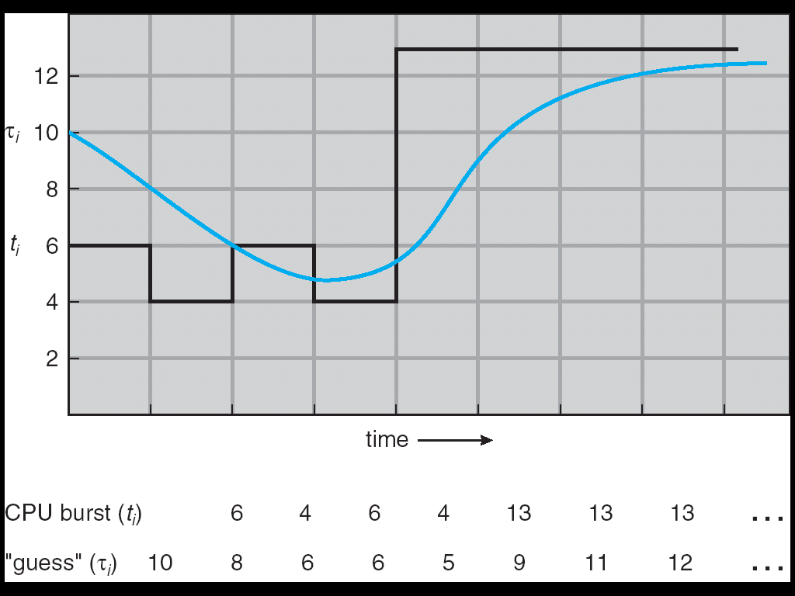
Prediction of the Length of the Next CPU Burst

Slide 27
Examples of Exponential Averaging
α =0
τ_{n+1} = τ_{n}
Recent history does not count
α =1
τ_{n+1} = α t_{n}
Only the actual last CPU burst counts
If we expand the formula, we get:
τ_{n+1} = α t_{n}+(1 - α)α t_{n} -1 + …
+(1 - α )^{j} α t_{n} _{-j} + …
+(1 - α )^{n +1} τ₀
Since both α and (1 - α) are less than or equal to 1, each successive term has less weight than its predecessor

Slide 28
Priority Scheduling
A priority number (integer) is associated with each process
The CPU is allocated to the process with the highest priority (smallest integer ≡ highest priority)
Preemptive
nonpreemptive
SJF is a priority scheduling where priority is the predicted next CPU burst time
Problem ≡ Starvation – low priority processes may never execute
Solution ≡ Aging – as time progresses increase the priority of the process

Slide 29
Round Robin (RR)
Each process gets a small unit of CPU time (time quantum), usually 10-100 milliseconds. After this time has elapsed, the process is preempted and added to the end of the ready queue.
If there are n processes in the ready queue and the time quantum is q, then each process gets 1/n of the CPU time in chunks of at most q time units at once. No process waits more than (n-1)q time units.
Performance
q large ⇒ FIFO
q small ⇒ q must be large with respect to context switch, otherwise overhead is too high

Slide 30
Example of RR with Time Quantum = 20
Process Burst Time
P₁ 53
P₂ 17
P₃ 68
P₄ 24
The Gantt chart is:
Typically, higher average turnaround than SJF, but better response
P₁
P₂
P₃
P₄
P₁
P₃
P₄
P₁
P₃
P₃
0
20
37
57
77
97
117
121
134
154
162

Slide 31
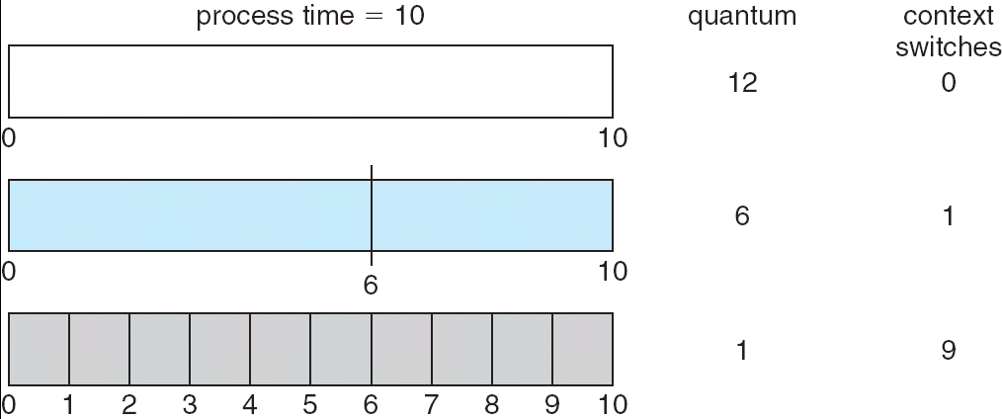
Time Quantum and Context Switch Time

Slide 32
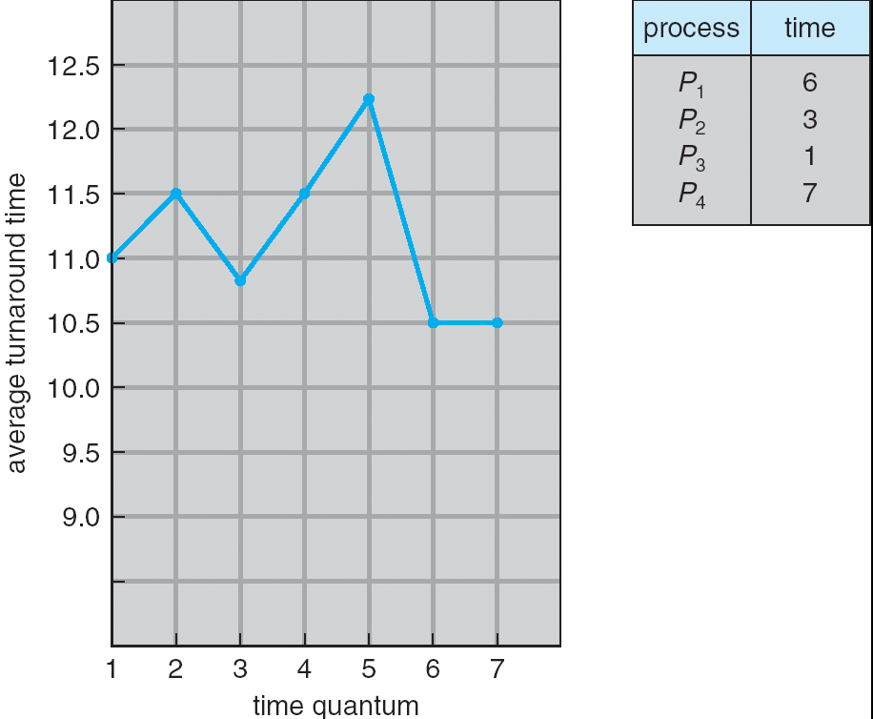
Turnaround Time Varies With The Time Quantum

Slide 33
Multilevel Queue
Ready queue is partitioned into separate queues: foreground (interactive) background (batch)
Each queue has its own scheduling algorithm
foreground – RR
background – FCFS
Scheduling must be done between the queues
Fixed priority scheduling; (i.e., serve all from foreground then from background). Possibility of starvation.
Time slice – each queue gets a certain amount of CPU time which it can schedule amongst its processes; i.e., 80% to foreground in RR
20% to background in FCFS

Slide 34
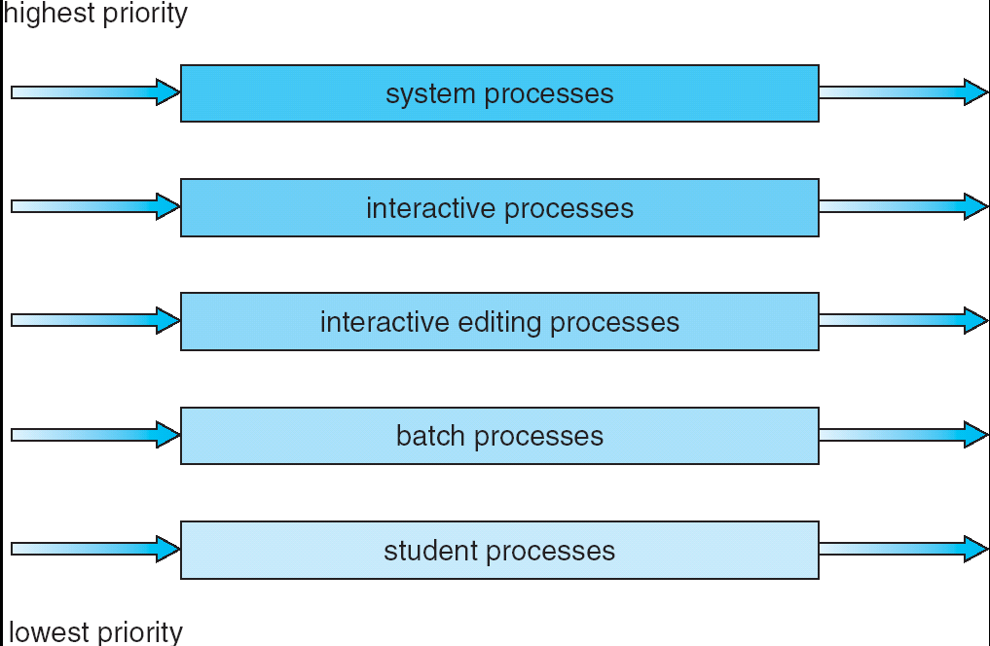
Multilevel Queue Scheduling

Slide 35
Multilevel Feedback Queue
A process can move between the various queues; aging can be implemented this way
Multilevel-feedback-queue scheduler defined by the following parameters:
number of queues
scheduling algorithms for each queue
method used to determine when to upgrade a process
method used to determine when to demote a process
method used to determine which queue a process will enter when that process needs service

Slide 36
Example of Multilevel Feedback Queue
Three queues:
Q₀ – RR with time quantum 8 milliseconds
Q₁ – RR time quantum 16 milliseconds
Q₂ – FCFS
Scheduling
A new job enters queue Q₀ which is served FCFS. When it gains CPU, job receives 8 milliseconds. If it does not finish in 8 milliseconds, job is moved to queue Q₁.
At Q₁ job is again served FCFS and receives 16 additional milliseconds. If it still does not complete, it is preempted and moved to queue Q₂.

Slide 37
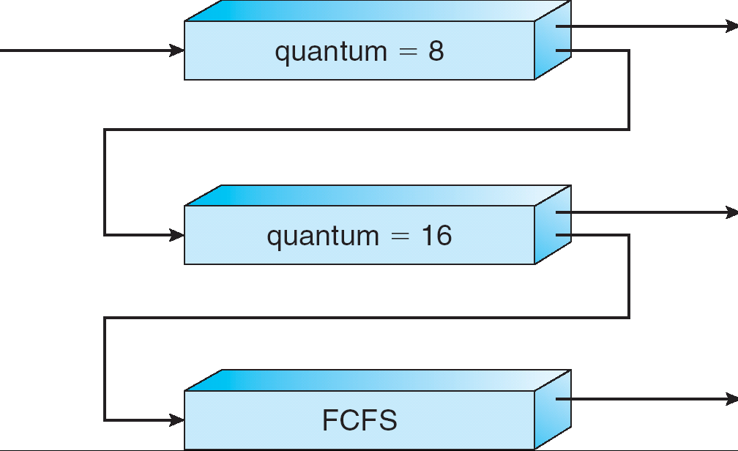
Multilevel Feedback Queues

Slide 38
Multiple-Processor Scheduling
Load sharing among multiple CPUs
Two approaches
Assymmetric Multiprocessing: All scheduling decisions, I/O processing, and other system activities are handled by master processor. The other processors execute user code.
Symmetric mutiprocessing: Each processor is self-scheduling, may use a common ready queue or each processor may have its own private queue of ready processes.
Processor affinity
Load balancing
Symmetric multithreading

Slide 39
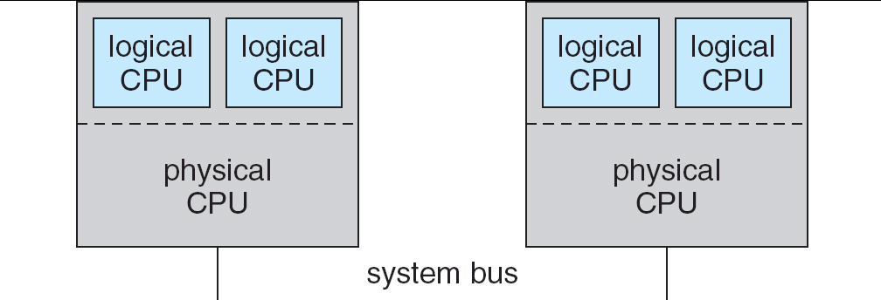
Symmetric multithreading

Slide 40
Thread Scheduling
User level threads are managed by thread library, and the kernel is unaware of them
User level threads must be mapped to an associated kernel level threads
Contention Scope
Process contention Scope (PCS)
System contention Scope (SCS)

Slide 41
Algorithm Evaluation
Deterministic modeling – takes a particular predetermined workload and defines the performance of each algorithm for that workload
Queueing models
Implementation

Slide 42
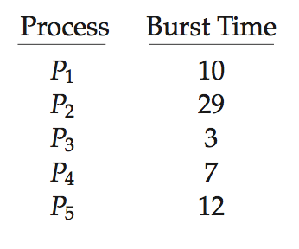
Algorithm Evaluation
How to select CPU-scheduling algorithm for an OS?
Determine criteria, then evaluate algorithms
Deterministic modeling
Type of analytic evaluation
Takes a particular predetermined workload and defines the performance of each algorithm for that workload
Consider 5 processes arriving at time 0:

Slide 43
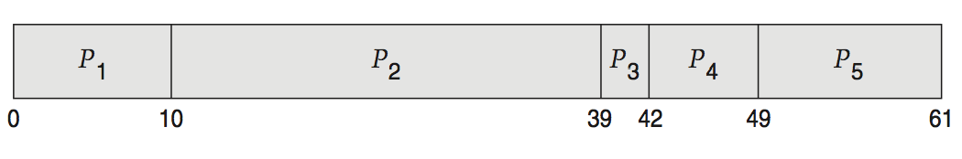
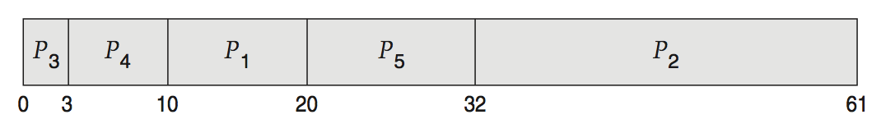
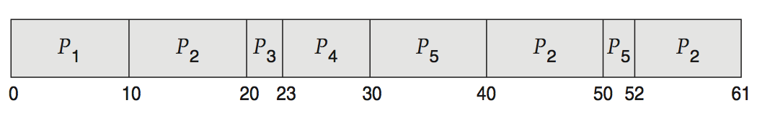
Deterministic Evaluation
For each algorithm, calculate minimum average waiting time
Simple and fast, but requires exact numbers for input, applies only to those inputs
FCS is 28ms:
Non-preemptive SFJ is 13ms:
RR is 23ms:

Slide 44
Queueing Models
Describes the arrival of processes, and CPU and I/O bursts probabilistically
Commonly exponential, and described by mean
Computes average throughput, utilization, waiting time, etc
Computer system described as network of servers, each with queue of waiting processes
Knowing arrival rates and service rates
Computes utilization, average queue length, average wait time, etc

Slide 45
Little’s Formula
n = average queue length
W = average waiting time in queue
λ = average arrival rate into queue
Little’s law – in steady state, processes leaving queue must equal processes arriving, thus n = λ x W
Valid for any scheduling algorithm and arrival distribution
For example, if on average 7 processes arrive per second, and normally 14 processes in queue, then average wait time per process = 2 seconds

Slide 46
Simulations
Queueing models limited
Simulations more accurate
Programmed model of computer system
Clock is a variable
Gather statistics indicating algorithm performance
Data to drive simulation gathered via
Random number generator according to probabilities
Distributions defined mathematically or empirically
Trace tapes record sequences of real events in real systems

Slide 47
Evaluation of CPU Schedulers by Simulation

Slide 48
Implementation
Even simulations have limited accuracy
Just implement new scheduler and test in real systems
High cost, high risk
Environments vary
Most flexible schedulers can be modified per-site or per-system
Or APIs to modify priorities
But again environments vary

Slide 49
End of Chapter 6

