Slide 1
Chapter 1: Introduction

Slide 2
Introduction to the Course
Operating systems – essential part of any computer system
Course discusses:
What they are
What they do
How they are designed and structures
Common features
Processes, Threads, CPU-scheduling, Synchronization, Deadlocks, Memory Management, Virtual Memory, File system interface
Book:
Silberschatz, Galvin and Gagne, Operating System Concepts – 9th Edition

Slide 3
Main Themes
Topic | #
Introduction | 1
Operating System Structures | 2
Processes | 3
Threads | 4
CPU Scheduling | 5
Process Synchronization | 6
Deadlocks | 7
Memory Management | 8
Virtual Memory | 9
File-System Interface | 10
File-System Implementation | 11

Slide 4
Chapter 1: Objectives
To provide a grand tour of the major operating systems components
To provide coverage of basic computer system organization

Slide 5
What is an Operating System?
A program that acts as an intermediary between a user of a computer and the computer hardware
Operating system goals:
Execute user programs and make solving user problems easier
Make the computer system convenient to use
Use the computer hardware in an efficient manner

Slide 6
Example – MS-Paint over Windows
Assume we are using MS-Paint over Windows - when do we need to access the OS?
Loading the application / terminating the application
Memory allocation / management (e.g., paging)
Access to IO devices – keyboard, mouse, printer, monitor
CPU allocation
Copy / Paste (inter-process communication)

Slide 7
Operating System Design & Goals
Each OS has different goals and design:
Mainframe – maximize HW utilization/efficiency
PC – maximum support to user applications
Handheld – convenient interface for running applications, performance per amount of battery life
efficiency
convenience
performance,
resource utilization
ease of use

Slide 8
Mainframe, PC, Handheld
Supercomputer - computer at the frontline of current processing capacity, particularly speed of calculation
Mainframe – powerful computers used mainly by large organizations for critical applications (the term originally referred to the large cabinets that housed the central processing unit and main memory of early computers. Later the term was used to distinguish high-end commercial machines from less powerful units)
Personal Computer (PC) - any general-purpose computer whose size, capabilities, and original sales price make it useful for individuals (and which is intended to be operated directly by an end-user with no intervening computer operator)
Handheld - pocket-sized computing device, typically having a display screen with touch input and/or a miniature keyboard.
Of course, one generation's "supercomputer" is the next generation's "mainframe"

Slide 9
Computer System Structure
Computer system can be divided into four components
Hardware – provides basic computing resources
CPU, memory, I/O devices
Operating system
Controls and coordinates use of hardware among various applications and users
Application programs – define the ways in which the system resources are used to solve the computing problems of the users
Word processors, compilers, web browsers, database systems, video games
Users
People, machines, other computers

Slide 10
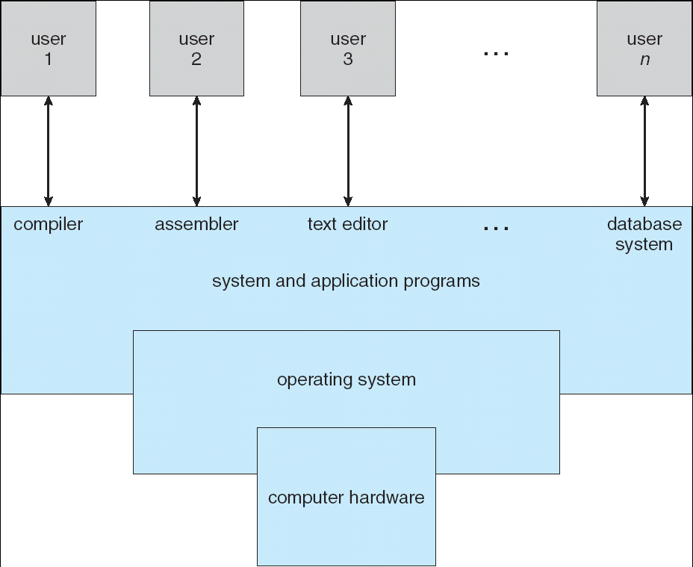
Four Components of a Computer System

Slide 11
Operating System Definition
OS is a resource allocator
Manages all resources
Decides between conflicting requests for efficient and fair resource use
OS is a control program
Controls execution of programs to prevent errors and improper use of the computer

Slide 12
Operating System Definition (Cont.)
No universally accepted definition
“Everything a vendor ships when you order an operating system” is good approximation
But varies wildly
“The one program running at all times on the computer” is the kernel. Everything else is either a system program (ships with the operating system) or an application program
Along with the kernel, there are two other types of programs:
system programs, which are associated with the operating system but are not necessarily part of the kernel, and
application programs, which include all programs not associated with the operation of the system.

Slide 13
Computer Startup
bootstrap program is loaded at power-up or reboot
Typically stored in ROM or EPROM, generally known as firmware
Initializates all aspects of system
Loads operating system kernel and starts execution

Slide 14
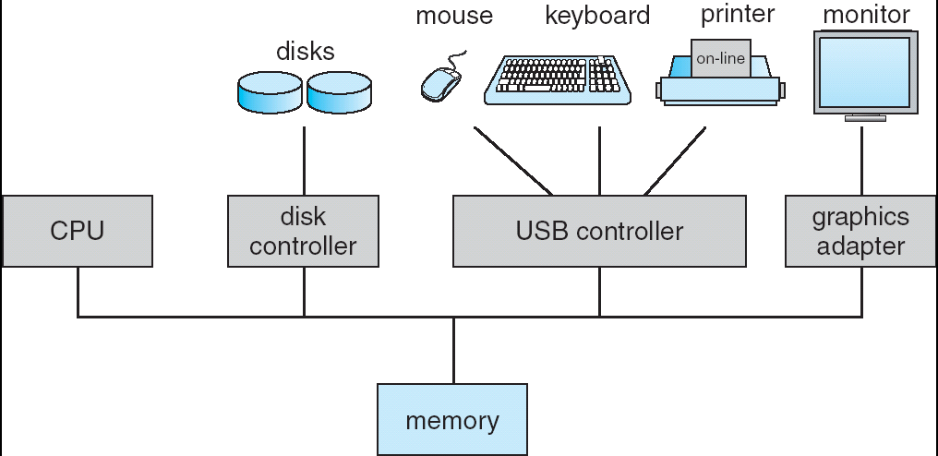
Computer System Organization and Architecture
Computer-system operation
One or more CPUs, device controllers connect through common bus providing access to shared memory
Concurrent execution of CPUs and devices competing for memory cycles

Slide 15
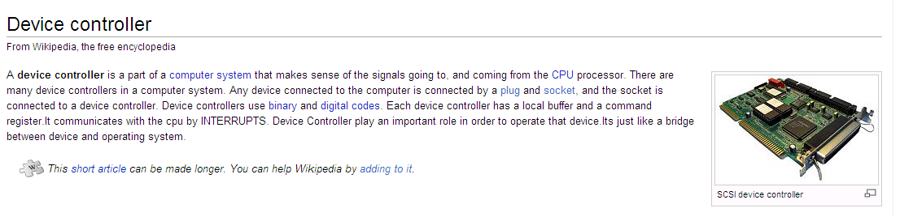
Device Controller
Each device controller is in charge of a particular device type (thus competing on memory cycles)
Each device controller has a local buffer
CPU moves data from/to main memory to/from local buffers
I/O is from the device to local buffer of controller
Device controller informs CPU that it has finished its operation by causing an interrupt

Slide 16
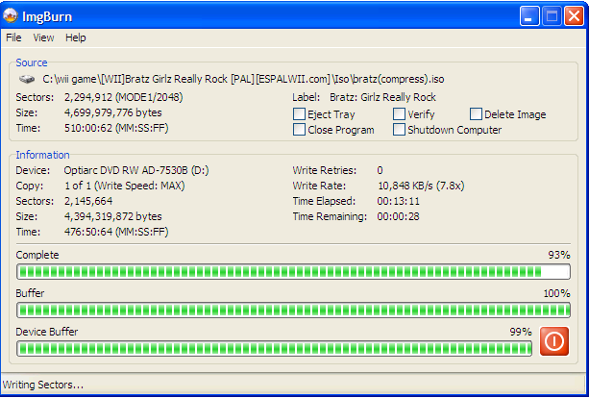

Slide 17
Computer-System Architecture
Most systems use a single general-purpose processor (PDAs through mainframes)
Most systems have special-purpose processors as well
Multiprocessors systems (two or more processors in close communication, sharing bus and sometimes clock and memory) growing in use and importance
Also known as parallel systems, tightly-coupled systems
Advantages include
Increased throughput
Economy of scale
Increased reliability – graceful degradation or fault tolerance

Slide 18
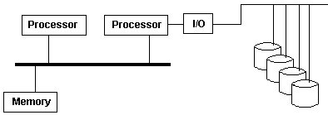
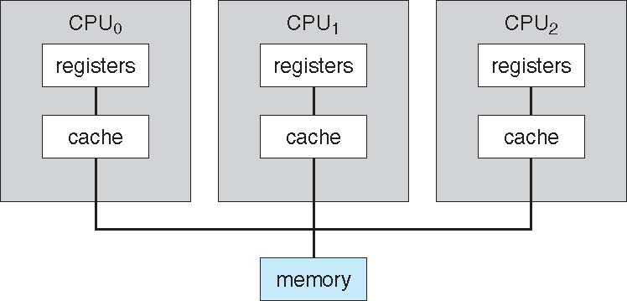
Multiprocessors systems
Two types of Multiprocessing:
Asymmetric Multiprocessing - assigns certain tasks only to certain processors. In particular, only one processor may be responsible for handling all of the interrupts in the system or perhaps even performing all of the I/O in the system
Symmetric Multiprocessing - treats all of the processing elements in the system identically
Key role – the scheduler

Slide 19
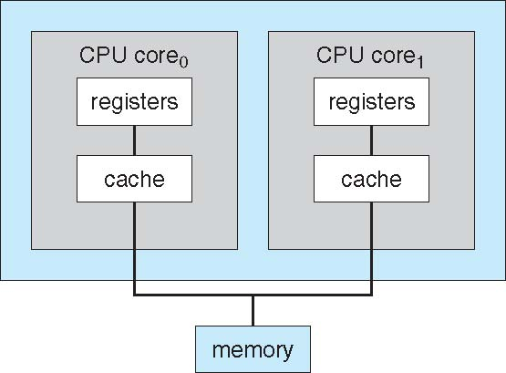
A Dual-Core Design

Slide 20
Clustered Systems
Like multiprocessor systems, but multiple systems working together
Usually sharing storage via a storage-area network (SAN)
Provides a high-availability service which survives failures
Asymmetric clustering has one machine in hot-standby mode
Symmetric clustering has multiple nodes running applications, monitoring each other
Some clusters are for high-performance computing (HPC)
Applications must be written to use parallelization

Slide 21
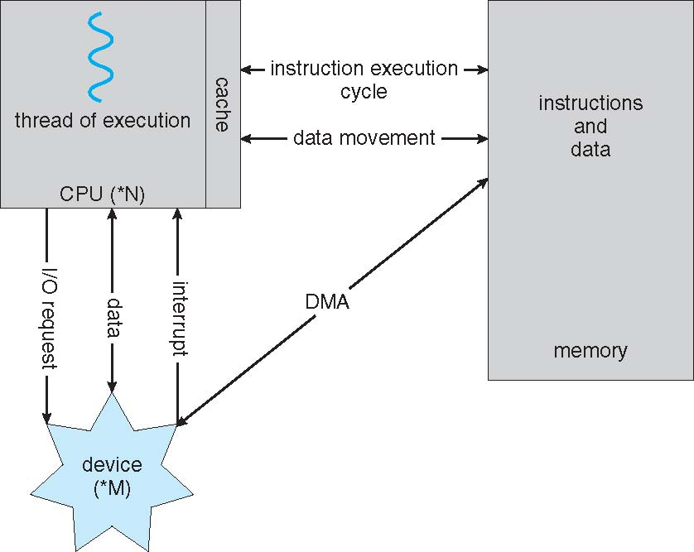
How a Modern Computer Works

Slide 22
Interrupts
Interrupt transfers control to the interrupt service routine generally, through the interrupt vector, which contains the addresses of all the service routines
Interrupt architecture must save the address of the interrupted instruction (and the state of registers if about to change)
Incoming interrupts are disabled while another interrupt is being processed to prevent a lost interrupt
A trap is a software-generated interrupt caused either by an error or a user request
An operating system is interrupt driven

Slide 23
Interrupt Handling
The operating system preserves the state of the CPU by storing registers and the program counter
Determines which type of interrupt has occurred:
polling
vectored interrupt system
Separate segments of code determine what action should be taken for each type of interrupt
Ideally, we would have used a generic code for analyzing the interrupt information and deciding what code to run, however speed is critical here…

Slide 24
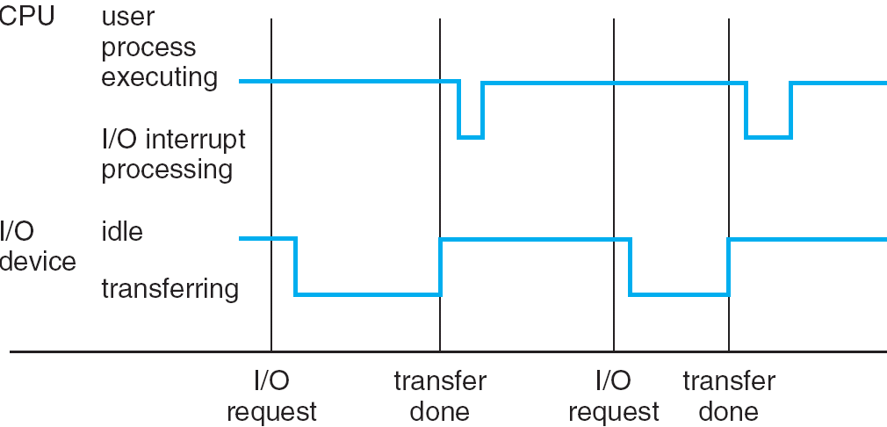
Interrupt Timeline

Slide 25
I/O Structure
After I/O starts, control returns to user program only upon I/O completion
Wait instruction idles the CPU until the next interrupt
Wait loop (contention for memory access)
At most one I/O request is outstanding at a time, no simultaneous I/O processing
After I/O starts, control returns to user program without waiting for I/O completion
System call – request to the operating system to allow user to wait for I/O completion
Device-status table contains entry for each I/O device indicating its type, address, and state
Operating system indexes into I/O device table to determine device status and to modify table entry to include interrupt
Synchronous
Asynchronous

Slide 26
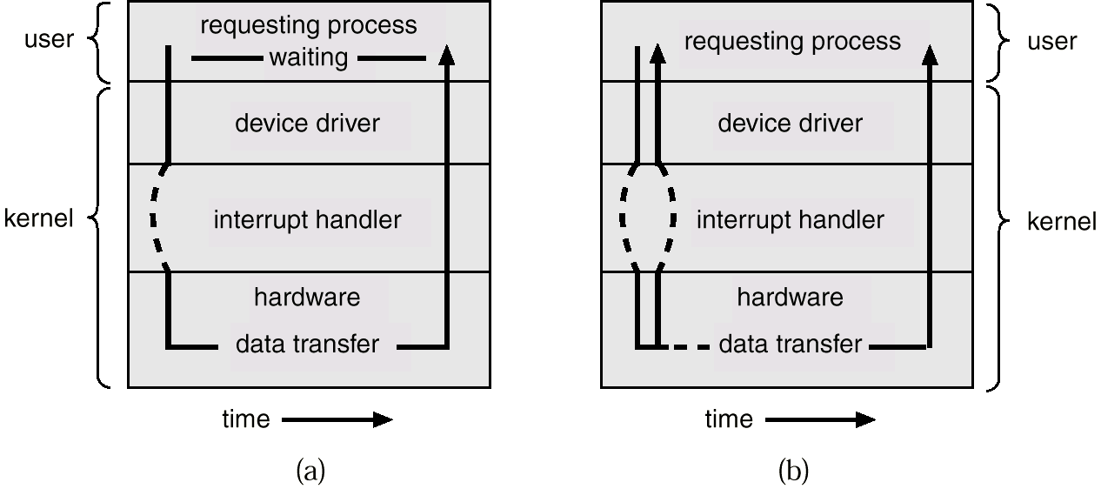
Two I/O Methods
Synchronous
Asynchronous

Slide 27
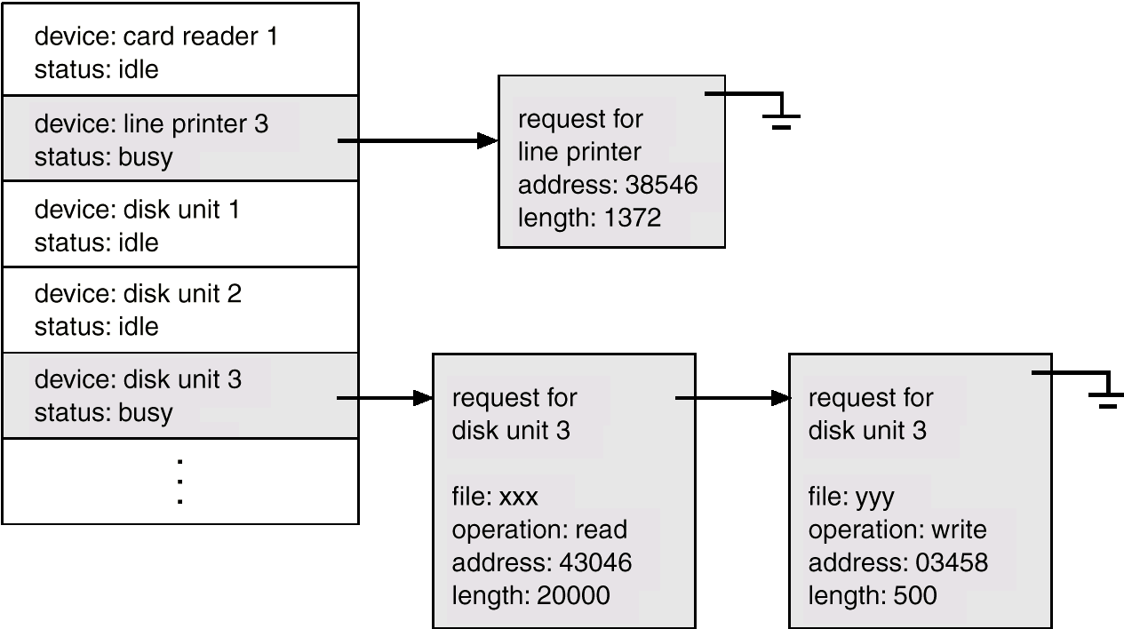
Device-Status Table

Slide 28
Memory Management
All data in memory before and after processing
All instructions in memory in order to execute
Memory management determines what is in memory when
Optimizing CPU utilization and computer response to users
Memory management activities
Keeping track of which parts of memory are currently being used and by whom
Deciding which processes (or parts thereof) and data to move into and out of memory
Allocating and deallocating memory space as needed

Slide 29
Storage Management
OS provides uniform, logical view of information storage
Abstracts physical properties to logical storage unit - file
Each medium is controlled by device (i.e., disk drive, tape drive)
Varying properties include access speed, capacity, data-transfer rate, access method (sequential or random)
File-System management
Files usually organized into directories
Access control on most systems to determine who can access what
OS activities include
Creating and deleting files and directories
Primitives to manipulate files and dirs
Mapping files onto secondary storage
Backup files onto stable (non-volatile) storage media

Slide 30
Mass-Storage Management
Main memory – only large storage media that the CPU can access directly
Why using disks?
Store data that does not fit in main memory
Store data that must be kept for a “long” period of time
Proper management is of central importance
Entire speed of computer operation hinges on disk subsystem and its algorithms
OS activities
Free-space management
Storage allocation
Disk scheduling

Slide 31
Mass Storage Management (2)
Some storage need not be fast
Includes optical storage, magnetic tape
Not critical to the computer performance but still must be managed
Varies between WORM (write-once, read-many-times) and RW (read-write)

Slide 32
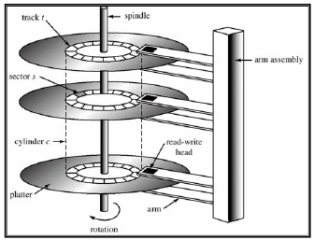
Storage Structure
Secondary storage:
Extension of main memory
Provides large nonvolatile storage capacity
Magnetic disks – rigid metal or glass platters covered with magnetic recording material
Disk surface is logically divided into tracks, which are subdivided into sectors
The disk controller determines the logical interaction between the device and the computer

Slide 33
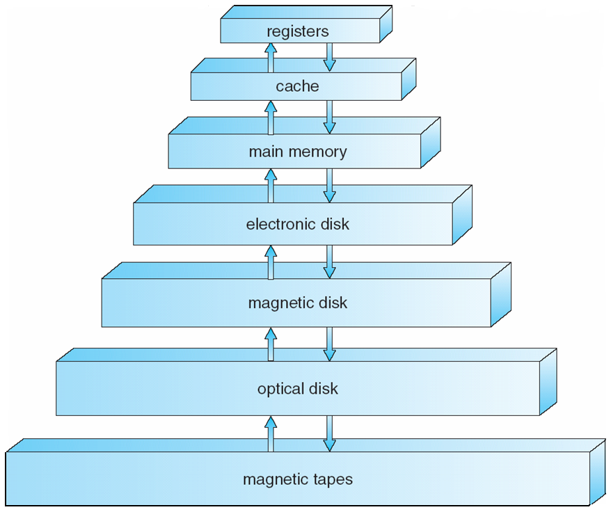
Storage Hierarchy
Storage systems organized in hierarchy
Speed
Cost
Volatility
Expensive but faster
It takes some time (several CPU cycles) to read/write to main memory – in the meantime the processor needs to stall because it doesn’t have the necessary data

Slide 34
Caching
Important principle, performed at many levels in a computer (in hardware, operating system, software)
Information in use copied from slower to faster storage temporarily
Faster storage (cache) checked first to determine if information is there
If it is, information used directly from the cache (fast)
If not, data copied to cache and used there
Cache smaller than storage being cached
Cache management important design problem
Cache size and replacement policy

Slide 35
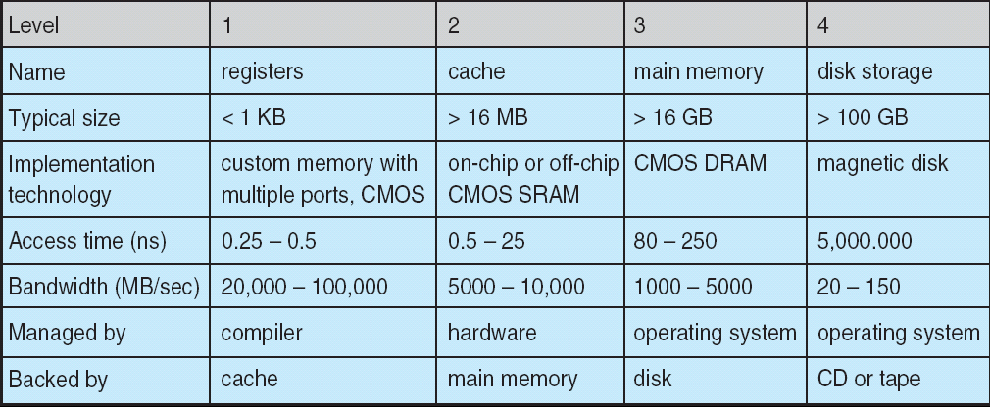
Performance of Various Levels of Storage
Movement between levels of storage hierarchy can be explicit or implicit

Slide 36
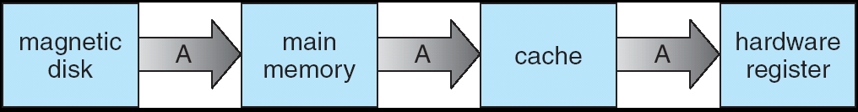
Migration of Integer A from Disk to Register
Multitasking environments must be careful to use most recent value, no matter where it is stored in the storage hierarchy
Multiprocessor environment must provide cache coherency in hardware such that all CPUs have the most recent value in their cache
Distributed environment situation even more complex
Several copies of a datum can exist
Various solutions covered in Chapter 17

Slide 37
Direct Memory Access Structure
Used for high-speed I/O devices able to transmit information at close to memory speeds
Good example: tape, disk
Bad example: keyboard
Device controller transfers blocks of data from buffer storage directly to main memory without CPU intervention
Only one interrupt is generated per block, rather than the one interrupt per byte

Slide 38
Operating System Structure
Multiprogramming needed for efficiency
Single user cannot keep CPU and I/O devices busy at all times
Multiprogramming organizes jobs (code and data) so CPU always has one to execute
A subset of total jobs in system is kept in memory
One job selected and run via job scheduling
When it has to wait (for I/O for example), OS switches to another job
Timesharing (multitasking) is logical extension in which CPU switches jobs so frequently that users can interact with each job while it is running, creating interactive computing
Response time should be < 1 second
Each user has at least one program executing in memory process
If several jobs ready to run at the same time  CPU scheduling
If processes don’t fit in memory, swapping moves them in and out to run
Virtual memory allows execution of processes not completely in memory

Slide 39
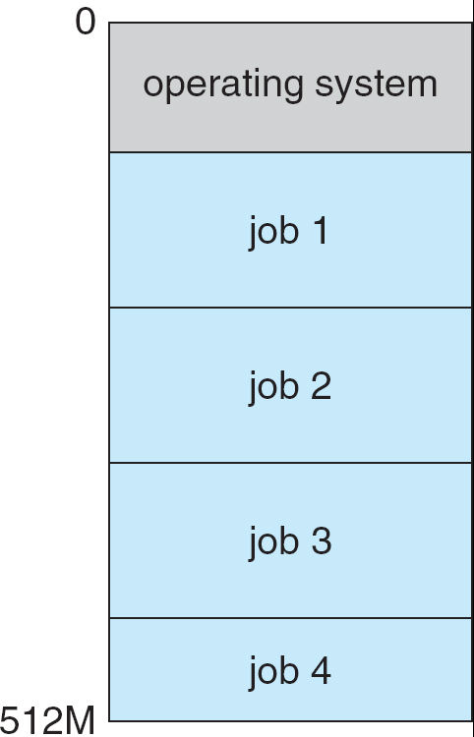
Memory Layout for Multiprogrammed System

Slide 40
Operating-System Operations
Interrupt driven by hardware
Software error or request creates exception or trap
Division by zero, request for operating system service
Other process problems include infinite loop, processes modifying each other or the operating system
Dual-mode operation allows OS to protect itself and other system components
User mode and kernel mode
Mode bit provided by hardware
Provides ability to distinguish when system is running user code or kernel code
Some instructions designated as privileged, only executable in kernel mode
System call changes mode to kernel, return from call resets it to user

Slide 41
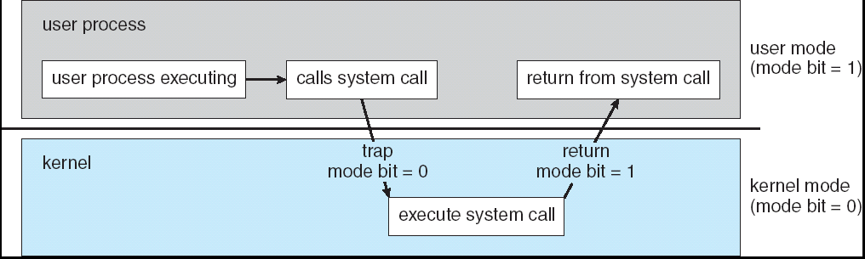
Transition from User to Kernel Mode
Timer to prevent infinite loop / process hogging resources
Set interrupt after specific period
Operating system decrements counter
When counter zero generate an interrupt
Set up before scheduling process to regain control or terminate program that exceeds allotted time

Slide 42
Process Management
Process and Program:
A process is a program in execution (unit of work within the system).
Program is a passive entity, process is an active entity.
Process needs resources to accomplish its task
CPU, memory, I/O, files (received upon creation and along execution)
Initialization data (e.g., a process for presenting the status of a file)
Process termination requires reclaim of any reusable resources
Single-threaded process has one program counter specifying location of next instruction to execute
Process executes instructions sequentially, one at a time, until completion
Multi-threaded process has one program counter per thread
Typically system has many processes, some user, some operating system running concurrently on one or more CPUs
Concurrency by multiplexing the CPUs among the processes / threads

Slide 43
Process Management Activities
The operating system is responsible for the following activities:
Creating and deleting both user and system processes
Suspending and resuming processes
Providing mechanisms for process synchronization
Providing mechanisms for process communication
Providing mechanisms for deadlock handling

Slide 44
Protection and Security
Protection – any mechanism for controlling access of processes or users to resources defined by the OS
Security – defense of the system against internal and external attacks
Huge range, including denial-of-service, worms, viruses, identity theft, theft of service
Systems generally first distinguish among users, to determine who can do what
User identities (user IDs, security IDs) include name and associated number, one per user
User ID then associated with all files, processes of that user to determine access control
Group identifier (group ID) allows set of users to be defined and controls managed, then also associated with each process, file

Slide 45
Computing Environments
Traditional computer
Blurring over time
Office environment
PCs connected to a network, terminals attached to mainframe or minicomputers providing batch and timesharing
Now portals allowing networked and remote systems access to same resources
Home networks
Used to be single system, then modems
Now firewalled, networked

Slide 46
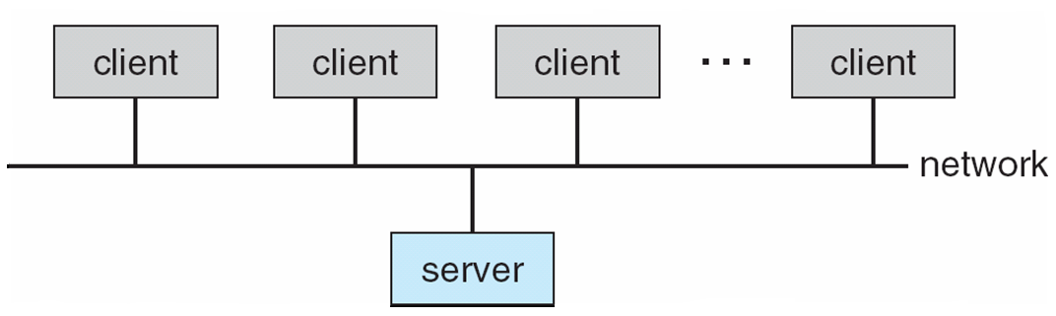
Computing Environments (Cont)
Client-Server Computing
Dumb terminals supplanted by smart PCs
Many systems now servers, responding to requests generated by clients
Compute-server provides an interface to client to request services (i.e. database)
File-server provides interface for clients to store and retrieve files

Slide 47
Peer-to-Peer Computing
Another model of distributed system
P2P does not distinguish clients and servers
Instead all nodes are considered peers
May each act as client, server or both
Node must join P2P network
Registers its service with central lookup service on network, or
Broadcast request for service and respond to requests for service via discovery protocol
Examples include Napster and Gnutella

Slide 48
Web-Based Computing
Web has become ubiquitous
PCs most prevalent devices
More devices becoming networked to allow web access
New category of devices to manage web traffic among similar servers: load balancers
Use of operating systems like Windows 95, client-side, have evolved into Linux and Windows XP, which can be clients and servers

Slide 49
Open-Source Operating Systems
Operating systems made available in source-code format rather than just binary closed-source
Counter to the copy protection and Digital Rights Management (DRM) movement
Started by Free Software Foundation (FSF), which has “copyleft” GNU Public License (GPL)
Examples include GNU/Linux, BSD UNIX (including core of Mac OS X), and Sun Solaris

Slide 50
End of Chapter 1

