Slide 1
Chapter 4: Threads

Slide 2
Chapter 4: Threads
Overview
Multithreading Models
Threading Issues
Pthreads
Windows XP Threads
Linux Threads
Java Threads

Slide 3
Processes and Threads
Processes have two characteristics:
Resource ownership - process includes a virtual address space to hold the process image
Scheduling/execution - follows an execution path that may be interleaved with other processes
These two characteristics are treated independently by the operating system

Slide 4
Processes and Threads
The unit of dispatching is referred to as a thread or lightweight process
The unit of resource ownership is referred to as a process or task

Slide 5
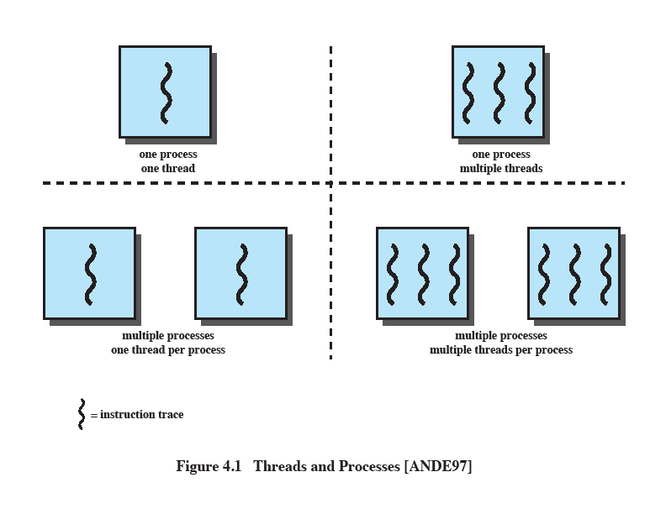
Multithreading
The ability of an OS to support multiple, concurrent paths of execution within a single process.
Notes:
Multithreading refers to the ability of an OS to support multiple, concurrent paths of execution within a single process.

Slide 6
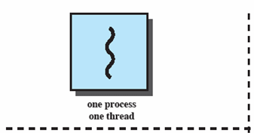
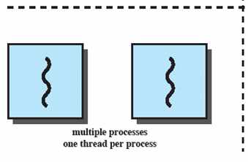
Single Thread Approaches
MS-DOS supports a single user process and a single thread.
Some UNIX, support multiple user processes but only support one thread per process
Notes:
Animated Slide
Onload Enlarges top-left to discuss DOS
Click1: Enlarges bottom-left for Unix
Single Threaded approach: The traditional approach of a single thread of execution per process, in which the concept of a thread is not recognized, examples are
MS DOS (single process, single thread)
Unix (multiple, single threaded processes)

Slide 7
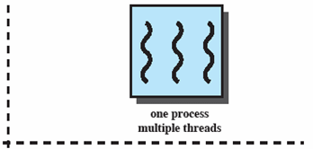
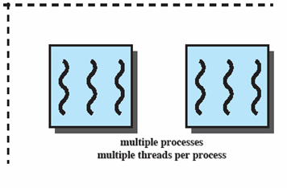
Multithreading
Java run-time environment is a single process with multiple threads
Multiple processes and threads are found in Windows, Solaris, and many modern versions of UNIX
Notes:
Animated Slide
Onload: Emphasis on top-right and JRE (single process, multiple thread),
Click 1: Emphasis on multiple processes with multiple threads – this is the main topic of this chapter
JRE is an example of a system of one process with multiple threads.
Of main interest in this chapter is the use of multiple processes, each of which support multiple threads.
Examples include:
Windows,
Solaris,
and many modern versions of UNIX.

Slide 8
Processes
A virtual address space which holds the process image
Protected access to
Processors,
Other processes,
Files,
I/O resources
Notes:
In a multithreaded environment, a process is defined as the unit of resource allocation and a unit of protection.

Slide 9
One or More Threads in Process
Each thread has
An execution state (running, ready, etc.)
Saved thread context when not running
An execution stack
Some per-thread static storage for local variables
Access to the memory and resources of its process (all threads of a process share this)
Notes:
Within a process, there may be one or more threads, each with the following:
• A thread execution state (Running, Ready, etc.).
• A saved thread context when not running;
one way to view a thread is as an independent program counter operating within a process.

Slide 10
One view…
One way to view a thread is as an independent program counter operating within a process.

Slide 11
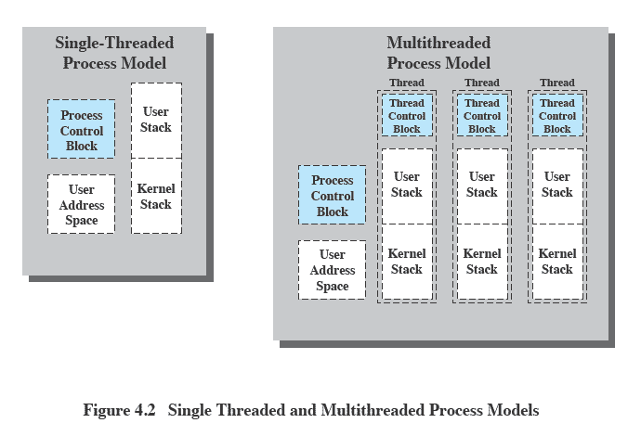
Threads vs. processes
Notes:
Distinction between threads and processes from the point of view of process management.
In a single-threaded process model, the representation of a process includes
its process control block
user address space,
user and kernel stacks to manage the call/return behaviour of the execution of the process.
While the process is running, it controls the processor registers. The contents of these registers are saved when the process is not running.
In a multithreaded environment,
there is still a single process control block and user address space associated with the process,
but separate stacks for each thread,
as well as a separate control block for each thread containing register values, priority, and other thread-related state information.
Thus, all of the threads of a process share the state and resources of that process.
They reside in the same address space and have access to the same data.
When one thread alters an item of data in memory, other threads see the results if and when they access that item.
If one thread opens a file with read privileges, other threads in the same process can also read from that file.

Slide 12
Benefits of Threads
Takes less time to create a new thread than a process
Less time to terminate a thread than a process
Switching between two threads takes less time that switching processes
Threads can communicate with each other
without invoking the kernel
Notes:
If there is an application or function that should be implemented as a set of related units of execution,
it is far more efficient to do so as a collection of threads - rather than a collection of separate processes.

Slide 13
Benefits
Responsiveness – may allow continued execution if part of process is blocked, especially important for user interfaces
Resource Sharing – threads share resources of process, easier than shared memory or message passing
Economy – cheaper than process creation, thread switching lower overhead than context switching
Scalability – process can take advantage of multiprocessor architectures

Slide 14
Multicore Programming
Multicore or multiprocessor systems putting pressure on programmers, challenges include:
Dividing activities
Balance
Data splitting
Data dependency
Testing and debugging
Parallelism implies a system can perform more than one task simultaneously
Concurrency supports more than one task making progress
Single processor / core, scheduler providing concurrency
Types of parallelism
Data parallelism – distributes subsets of the same data across multiple cores, same operation on each
Task parallelism – distributing threads across cores, each thread performing unique operation
As # of threads grows, so does architectural support for threading
CPUs have cores as well as hardware threads
Consider Oracle SPARC T4 with 8 cores, and 8 hardware threads per core

Slide 15
Concurrency vs. Parallelism
Concurrent execution on single-core system:
Parallelism on a multi-core system:

Slide 16
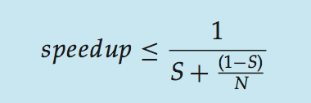
Amdahl’s Law
Identifies performance gains from adding additional cores to an application that has both serial and parallel components
S is serial portion
N processing cores
I.e. if application is 75% parallel / 25% serial, moving from 1 to 2 cores results in speedup of 1.6 times
As N approaches infinity, speedup approaches 1 / S
Serial portion of an application has disproportionate effect on performance gained by adding additional cores
But does the law take into account contemporary multicore systems?

Slide 17
Multithreaded Server Architecture

Slide 18
Threads
Several actions that affect all of the threads in a process
The OS must manage these at the process level.
Examples:
Suspending a process involves suspending all threads of the process
Termination of a process, terminates all threads within the process
Notes:
Suspension involves swapping the address space of one process out of main memory to make room for the address space of another process.
Because all threads in a process share the same address space, all threads are suspended at the same time.
Similarly, termination of a process terminates all threads within that process.

Slide 19
Activities similar to Processes
Threads have execution states and may synchronize with one another.
Similar to processes
We look at these two aspects of thread functionality in turn.
States
Synchronisation

Slide 20
Thread Execution States
States associated with a change in thread state
Spawn (another thread)
Block
Issue: will blocking a thread block other, or all, threads
Unblock
Finish (thread)
Deallocate register context and stacks
Notes:
A significant issue is whether the blocking of a thread results in the blocking of the entire process.
If one thread in a process is blocked, does this prevent the running of any other thread in the same process even if that other thread is in a ready state?
Clearly, some of the flexibility and power of threads is lost if the one blocked thread blocks an entire process.

Slide 21
Example: Remote Procedure Call
Consider:
A program that performs two remote procedure calls (RPCs)
to two different hosts
to obtain a combined result.

Slide 22
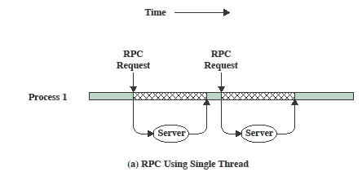
RPC Using Single Thread
Notes:
The results are obtained in sequence,
so that the program has to wait for a response from each server in turn.

Slide 23
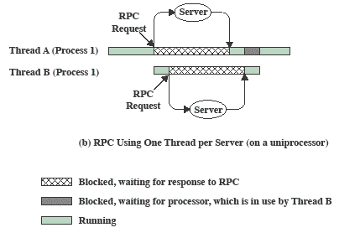
RPC Using One Thread per Server
Notes:
Rewriting the program to use a separate thread for each RPC results in a substantial speedup.
Note that if this program operates on a uniprocessor, the requests must be generated sequentially and the results processed in sequence;
however, the program waits concurrently for the two replies.

Slide 24
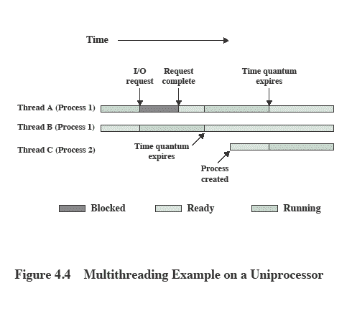
Multithreading on a Uniprocessor
Notes:
On a uniprocessor, multiprogramming enables the interleaving of multiple threads within multiple processes.
In the example,
- three threads in two processes are interleaved on the processor.
- Execution passes from one thread to another either when the currently running thread is blocked or its time slice is exhausted.

Slide 25
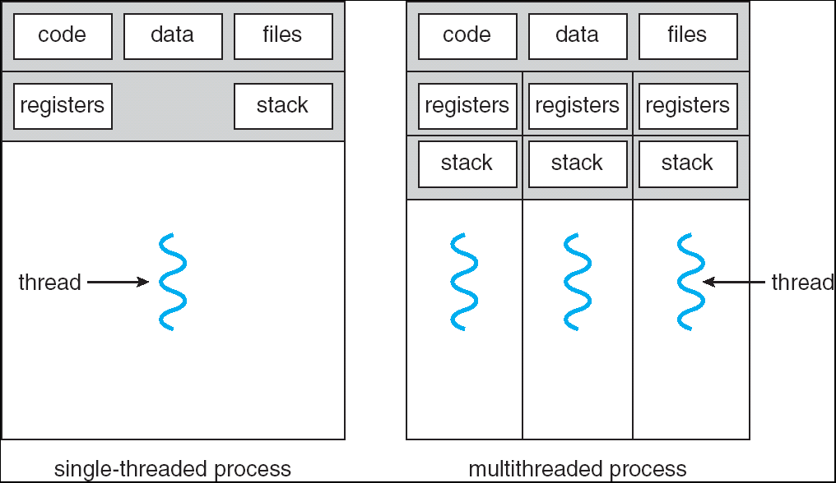
Single and Multithreaded Processes

Slide 26
Categories of Thread Implementation
User Level Thread (ULT)
Kernel level Thread (KLT) also called:
kernel-supported threads
lightweight processes.

Slide 27
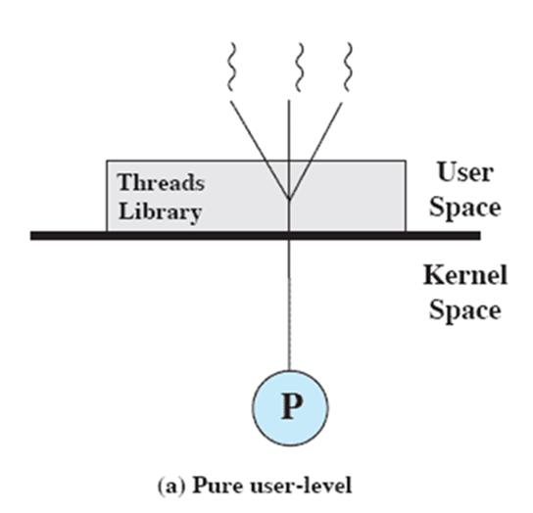
User-Level Threads
All thread management is done by the application
The kernel is not aware of the existence of threads
Three primary thread libraries:
POSIX Pthreads
Win32 threads
Java threads

Slide 28
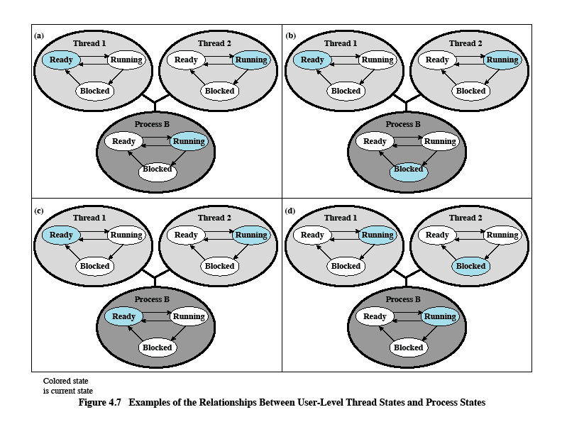
Relationships between ULT Thread and Process States

Slide 29
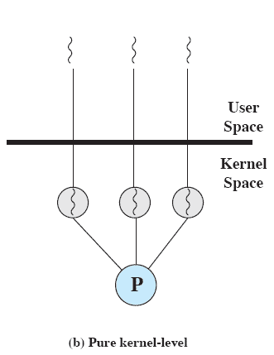
Kernel-Level Threads
Kernel maintains context information for the process and the threads
No thread management done by application
Scheduling is done on a thread basis
Windows is an example of this approach
Notes:
The kernel maintains context information for the process as a whole and for individual threads within the process.
Scheduling by the kernel is done on a thread basis.
-

Slide 30
Kernel Threads
Supported by the Kernel
Examples
Windows XP/2000
Solaris
Linux
Tru64 UNIX
Mac OS X

Slide 31
Advantages of KLT
The kernel can simultaneously schedule multiple threads from the same process on multiple processors.
If one thread in a process is blocked, the kernel can schedule another thread of the same process.
Kernel routines themselves can be multithreaded.

Slide 32
Disadvantage of KLT
The transfer of control from one thread to another within the same process requires a mode switch to the kernel

Slide 33
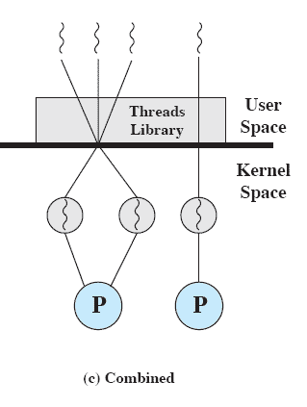
Combined Approaches
Thread creation done in the user space
Bulk of scheduling and synchronization of threads by the application
Example is Solaris
Notes:
In a combined approach, multiple threads within the same application can run in parallel on multiple processors,
and a blocking system call need not block the entire process.
If properly designed, this approach should combine the advantages of the pure ULT and KLT approaches while minimizing the disadvantages.

Slide 34
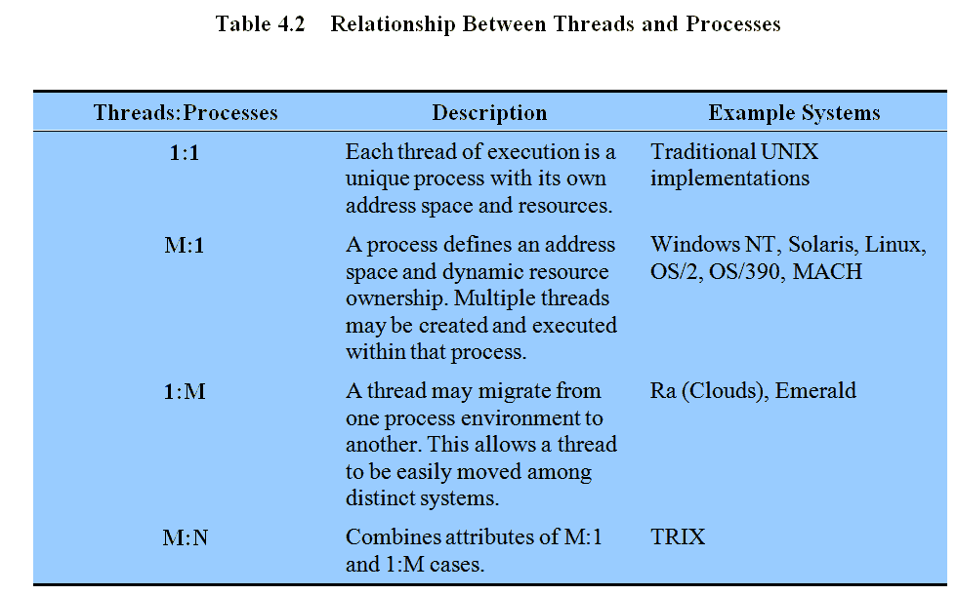
Relationship Between Thread and Processes
Notes:
The concepts of resource allocation and dispatching unit have traditionally been embodied in the single concept of the process; that is, as a 1 : 1 relationship between threads and processes.
There has been much interest in providing for multiple threads within a single process, which is a many-to-one relationship
.
However, as the table shows, the other two combinations have also been investigated, namely,
a many-to-many relationship and
a one-to-many relationship.

Slide 35
Multithreading Models
Many-to-One
One-to-One
Many-to-Many

Slide 36
Many-to-One
Many user-level threads mapped to single kernel thread
Examples:
Solaris Green Threads
GNU Portable Threads

Slide 37
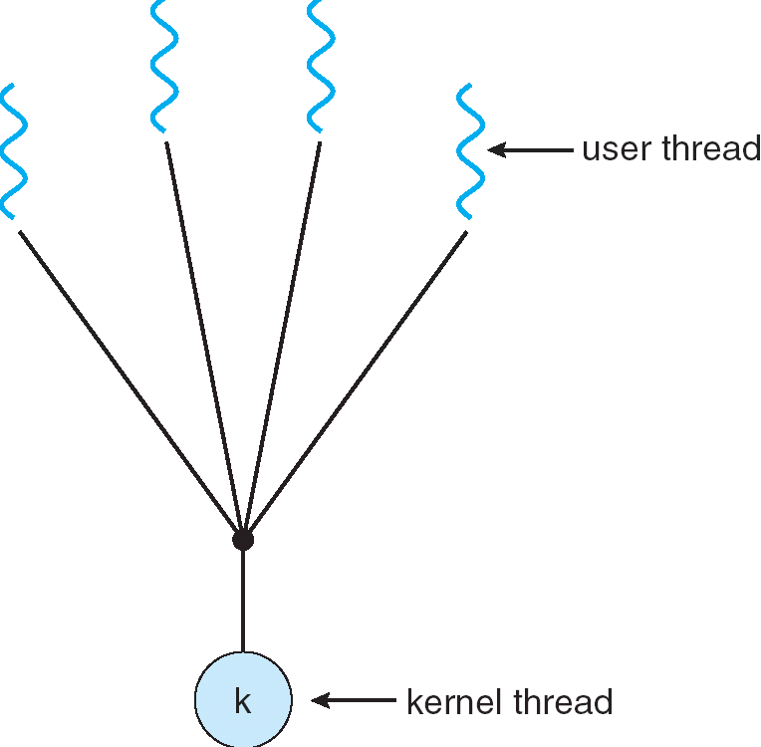
Many-to-One Model

Slide 38
One-to-One
Each user-level thread maps to kernel thread
Examples
Windows NT/XP/2000
Linux
Solaris 9 and later

Slide 39
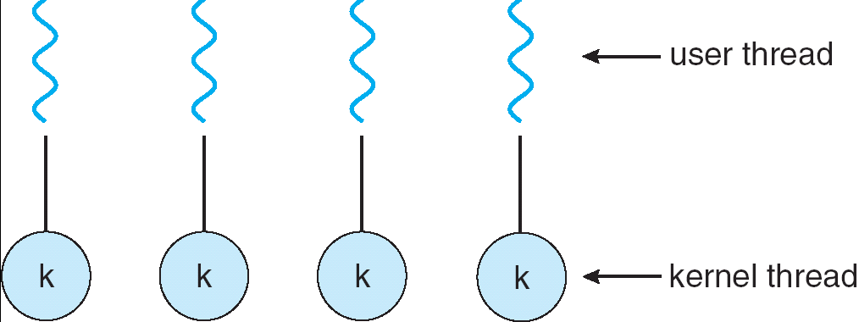
One-to-one Model

Slide 40
Many-to-Many Model
Allows many user level threads to be mapped to many kernel threads
Allows the operating system to create a sufficient number of kernel threads
Solaris prior to version 9
Windows NT/2000 with the ThreadFiber package

Slide 41
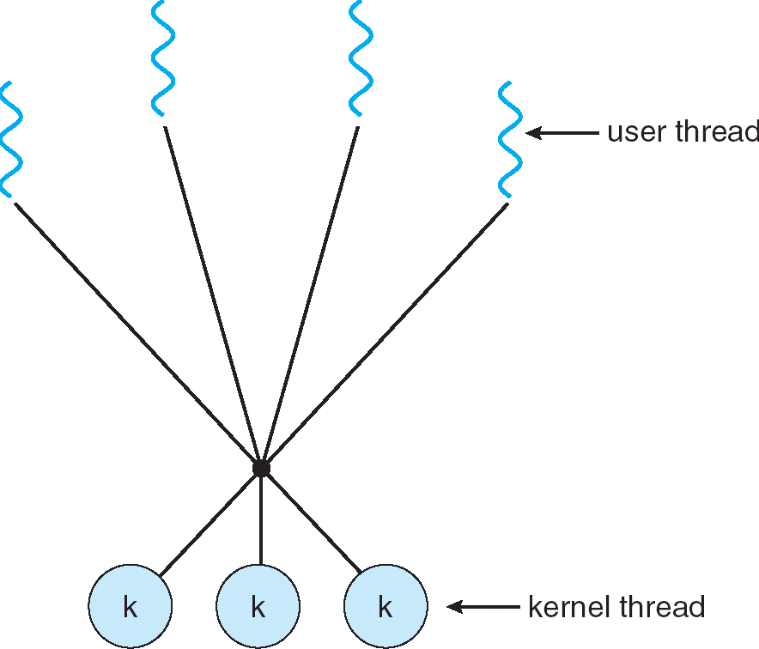
Many-to-Many Model

Slide 42
Two-level Model
Similar to M:M, except that it allows a user thread to be bound to kernel thread
Examples
IRIX
HP-UX
Tru64 UNIX
Solaris 8 and earlier

Slide 43
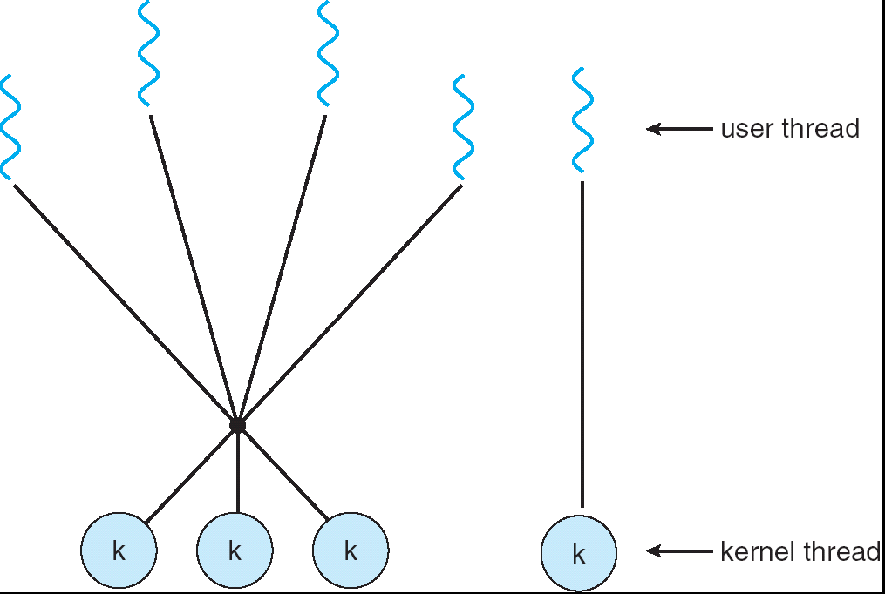
Two-level Model

Slide 44
Thread Libraries
Thread library provides programmer with API for creating and managing threads
Two primary ways of implementing
Library entirely in user space
Kernel-level library supported by the OS

Slide 45
Pthreads
May be provided either as user-level or kernel-level
A POSIX standard (IEEE 1003.1c) API for thread creation and synchronization
Specification, not implementation
API specifies behavior of the thread library, implementation is up to development of the library
Common in UNIX operating systems (Solaris, Linux, Mac OS X)

Slide 46
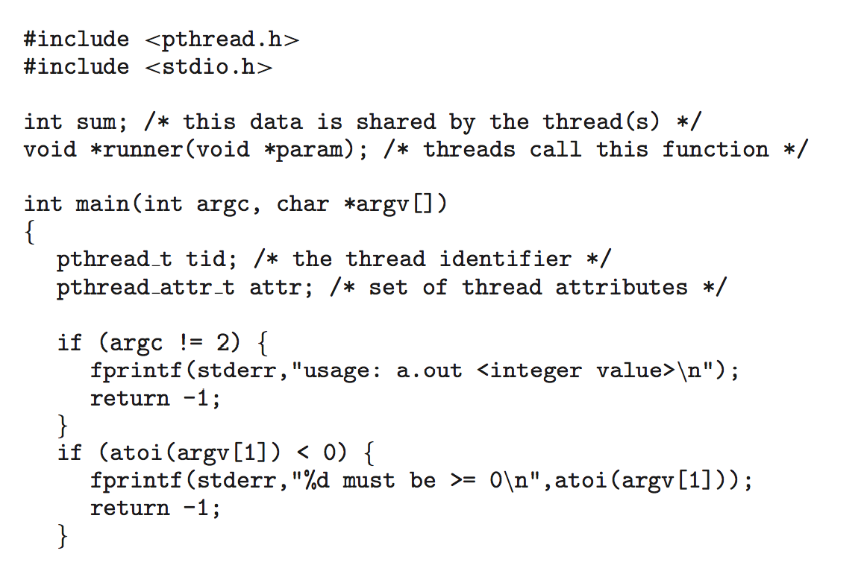
Pthreads Example

Slide 47
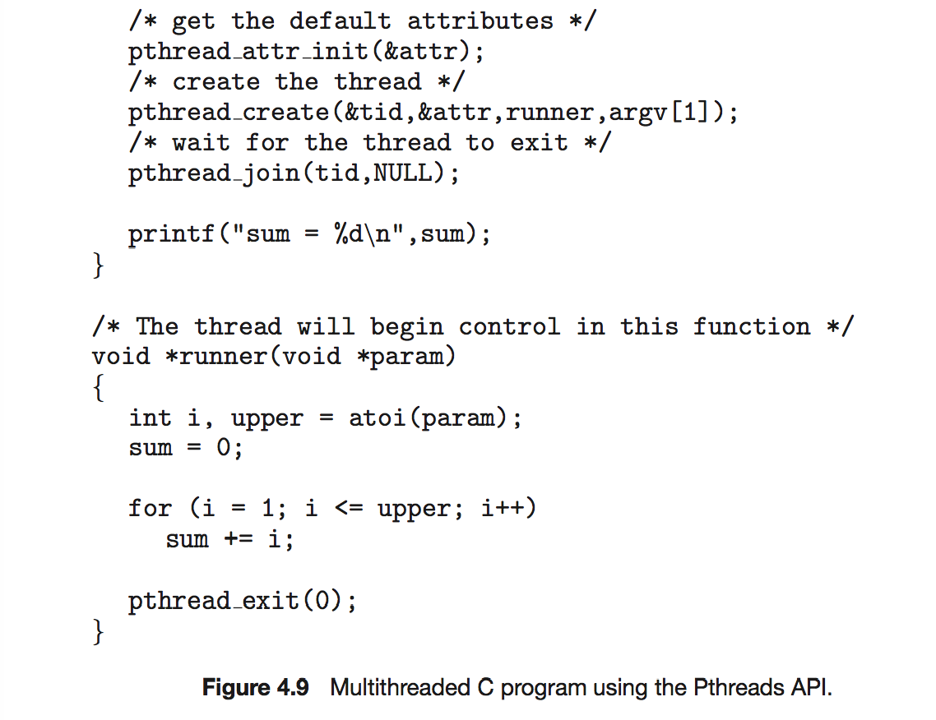
Pthreads Example (Cont.)

Slide 48
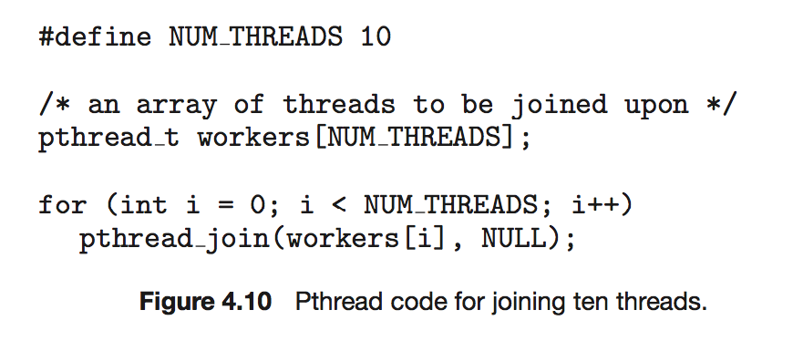
Pthreads Code for Joining 10 Threads

Slide 49
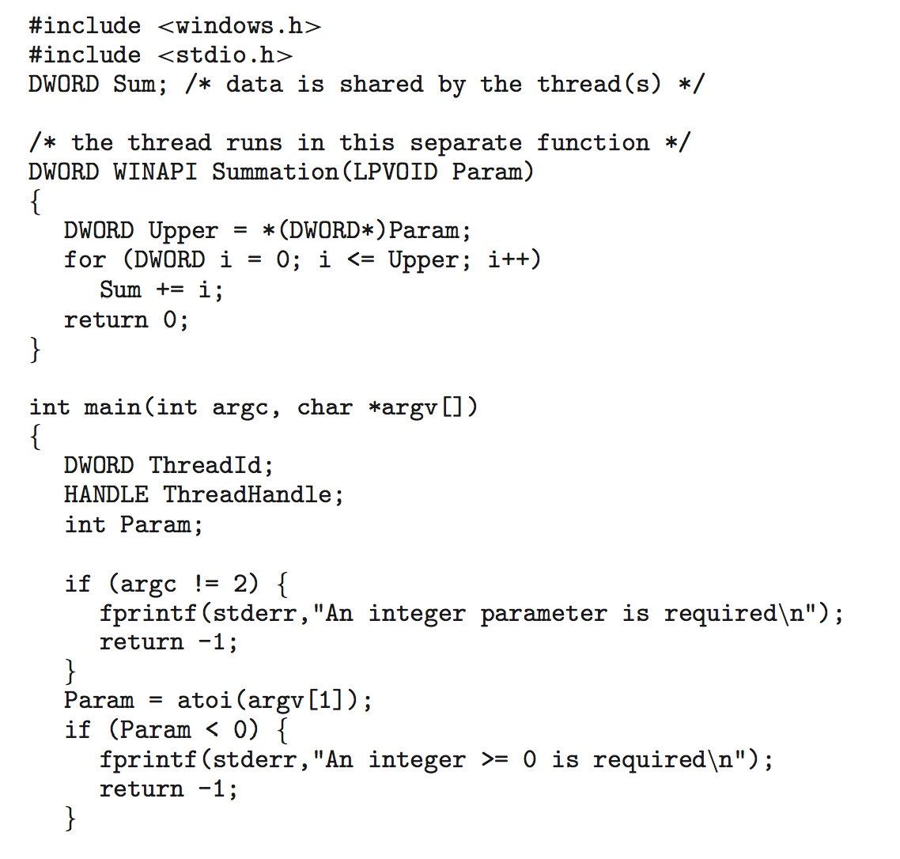
Windows Multithreaded C Program

Slide 50
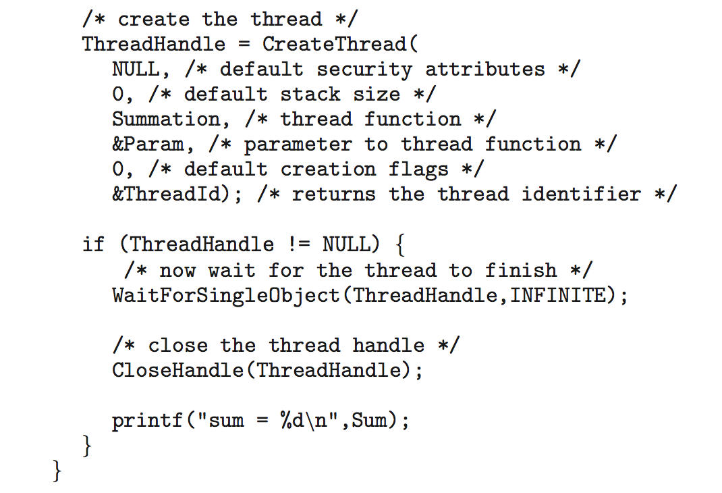
Windows Multithreaded C Program (Cont.)

Slide 51
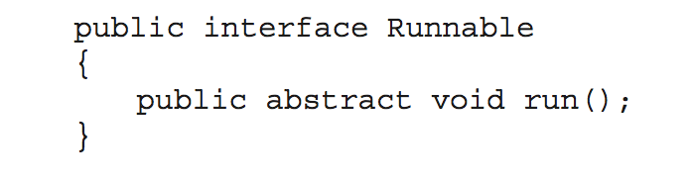
Java Threads
Java threads are managed by the JVM
Typically implemented using the threads model provided by underlying OS
Java threads may be created by:
Extending Thread class
Implementing the Runnable interface

Slide 52
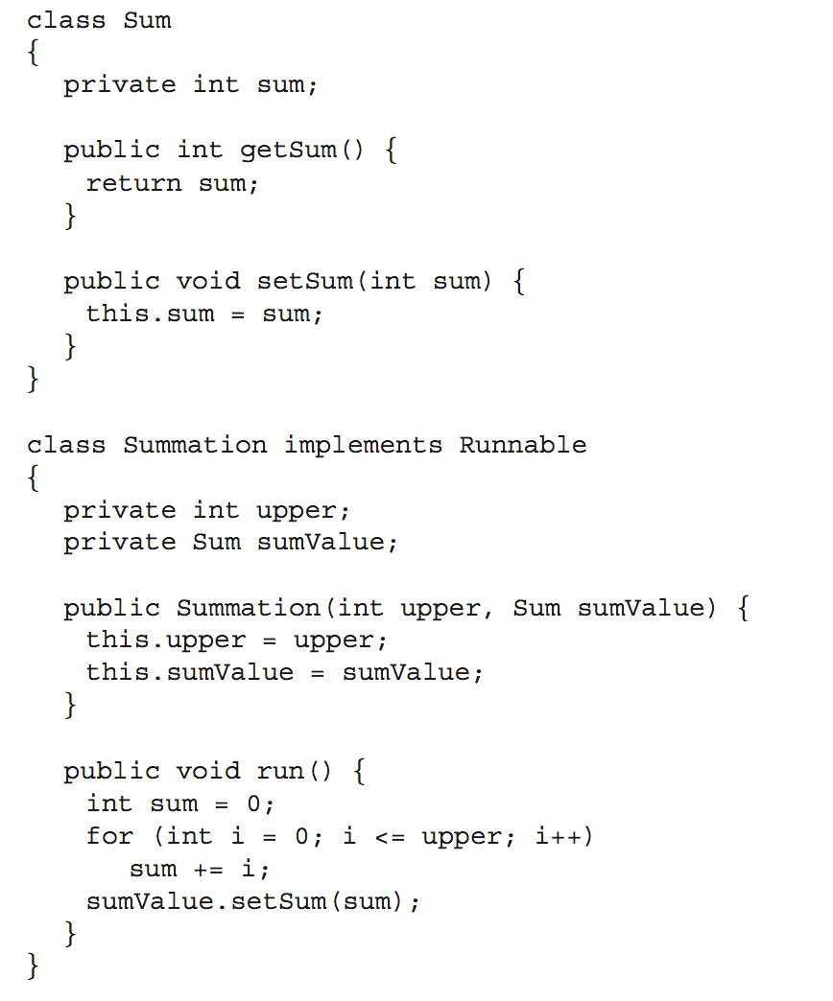
Java Multithreaded Program

Slide 53
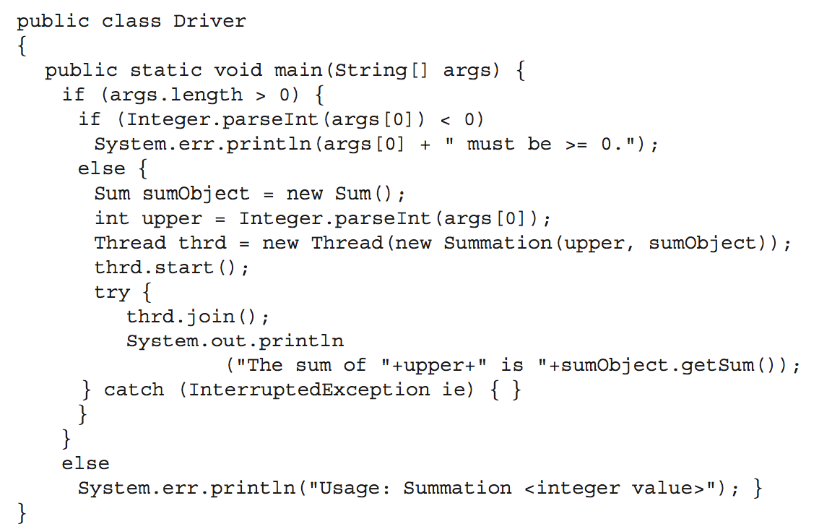
Java Multithreaded Program (Cont.)

Slide 54
Implicit Threading
Growing in popularity as numbers of threads increase, program correctness more difficult with explicit threads
Creation and management of threads done by compilers and run-time libraries rather than programmers
Three methods explored
Thread Pools
OpenMP
Grand Central Dispatch
Other methods include Microsoft Threading Building Blocks (TBB), java.util.concurrent package

Slide 55
Thread Pools
Create a number of threads in a pool where they await work
Advantages:
Usually slightly faster to service a request with an existing thread than create a new thread
Allows the number of threads in the application(s) to be bound to the size of the pool

Slide 56
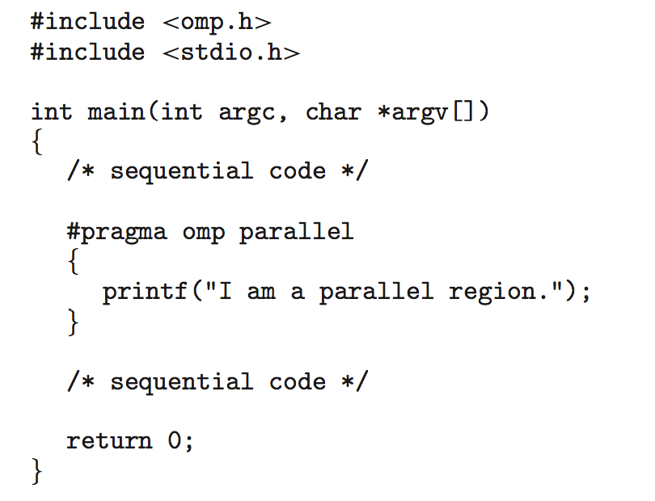
OpenMP
Set of compiler directives and an API for C, C++, FORTRAN
Provides support for parallel programming in shared-memory environments
Identifies parallel regions – blocks of code that can run in parallel
#pragma omp parallel
Create as many threads as there are cores
#pragma omp parallel for for(i=0;i<N;i++) {
c[i] = a[i] + b[i];
}
Run for loop in parallel

Slide 57
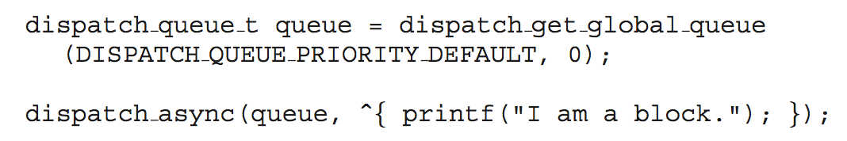
Grand Central Dispatch
Apple technology for Mac OS X and iOS operating systems
Extensions to C, C++ languages, API, and run-time library
Allows identification of parallel sections
Manages most of the details of threading
Block is in “^{ }” - ˆ{ printf("I am a block"); }
Blocks placed in dispatch queue
Assigned to available thread in thread pool when removed from queue
Two types of dispatch queues:
serial – blocks removed in FIFO order, queue is per process, called main queue
Programmers can create additional serial queues within program
concurrent – removed in FIFO order but several may be removed at a time
Three system wide queues with priorities low, default, high

Slide 58
Threading Issues
Semantics of fork() and exec() system calls
Thread cancellation
Signal handling
Thread pools
Thread specific data
Scheduler activations

Slide 59
Semantics of fork() and exec()
Does fork() duplicate only the calling thread or all threads?

Slide 60
Thread Cancellation
Terminating a thread before it has finished
Two general approaches:
Asynchronous cancellation terminates the target thread immediately
Deferred cancellation allows the target thread to periodically check if it should be cancelled

Slide 61
Signal Handling
Signals are used in UNIX systems to notify a process that a particular event has occurred
A signal handler is used to process signals
Signal is generated by particular event
Signal is delivered to a process
Signal is handled
Options:
Deliver the signal to the thread to which the signal applies
Deliver the signal to every thread in the process
Deliver the signal to certain threads in the process
Assign a specific threa to receive all signals for the process

Slide 62
Thread Specific Data
Allows each thread to have its own copy of data
Useful when you do not have control over the thread creation process (i.e., when using a thread pool)

Slide 63
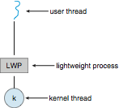
Scheduler Activations
Both M:M and Two-level models require communication to maintain the appropriate number of kernel threads allocated to the application
Typically use an intermediate data structure between user and kernel threads – lightweight process (LWP)
Appears to be a virtual processor on which process can schedule user thread to run
Each LWP attached to kernel thread
How many LWPs to create?
Scheduler activations provide upcalls - a communication mechanism from the kernel to the upcall handler in the thread library
This communication allows an application to maintain the correct number kernel threads

Slide 64
End of Chapter 4

