Slide 1
BPMN (Business Process Model and Notation)

Slide 2
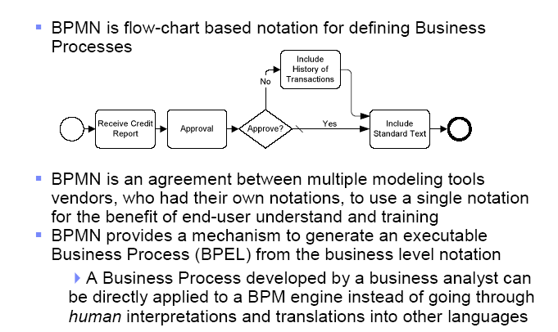
What is BPMN ?

Slide 3
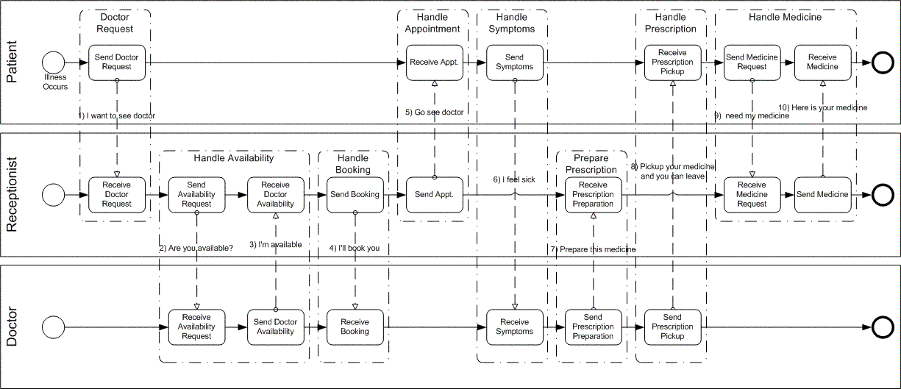
BPMN example

Slide 4
BPMN History
BPMN 1.0 (BPMI) – Mai 2004
BPMN1.x
BPMN 1.1 (OMG) – Januar 2008
BPMN 1.2 (OMG) – Januar 2009
BPMN 2.0 final Juni 2010
http://www.omg.org/spec/BPMN/2.0/

Slide 5
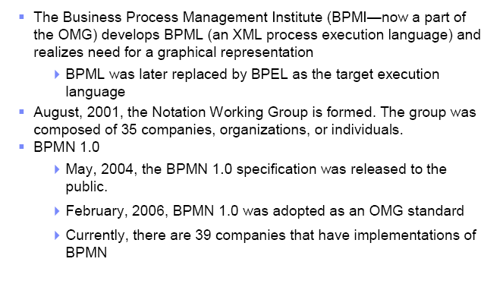
History for BPMN

Slide 6
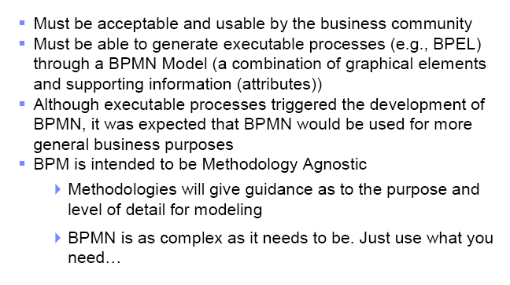
BPMN requirements

Slide 7
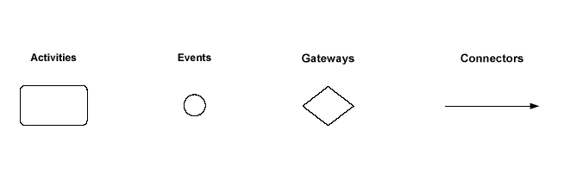
BPMN Diagram elements

Slide 8
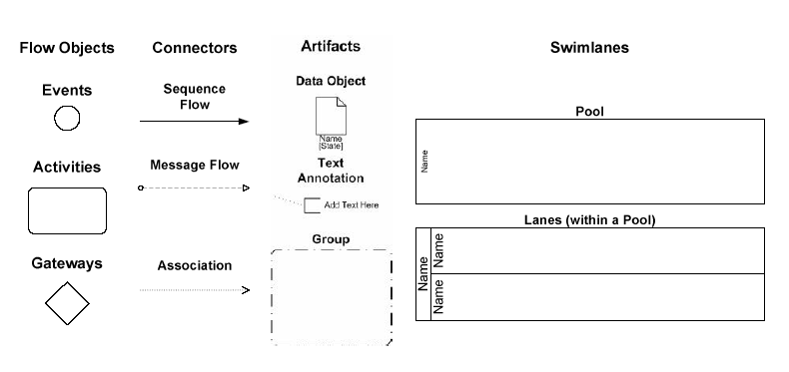
Diagram elements (2)

Slide 9
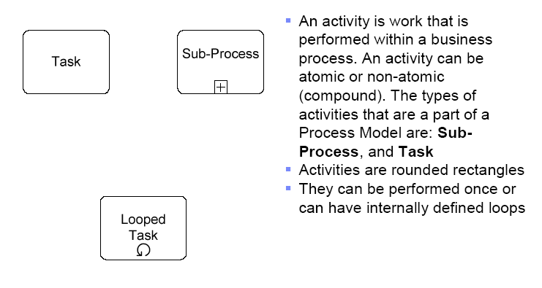
Activities

Slide 10
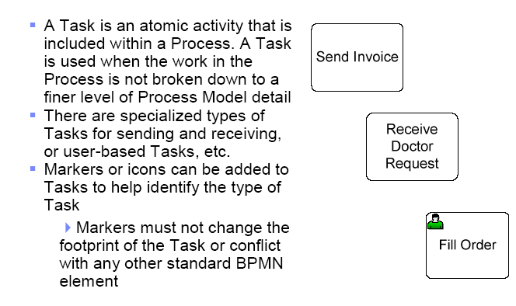
Task

Slide 11
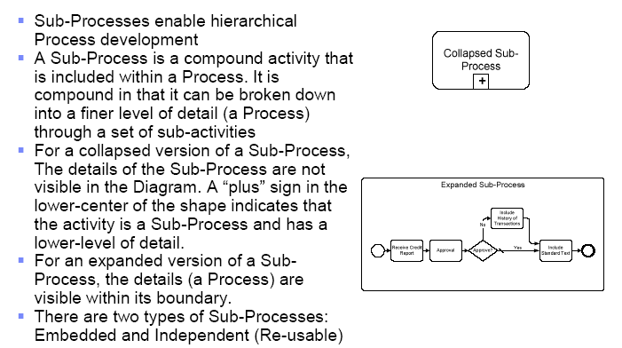
Sub-processes

Slide 12
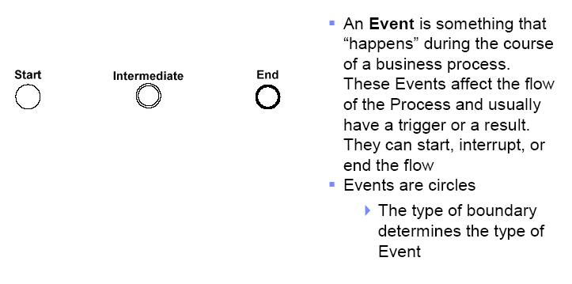
Events

Slide 13
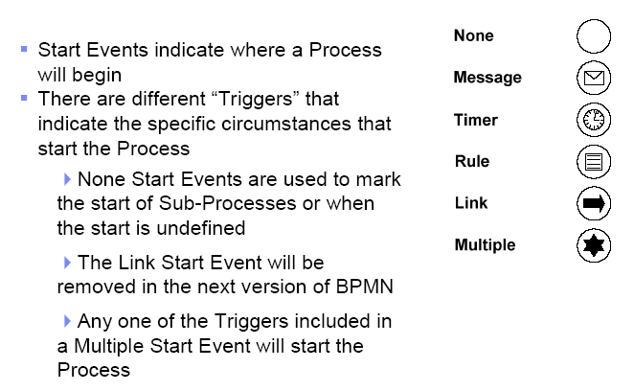
Start Events

Slide 14
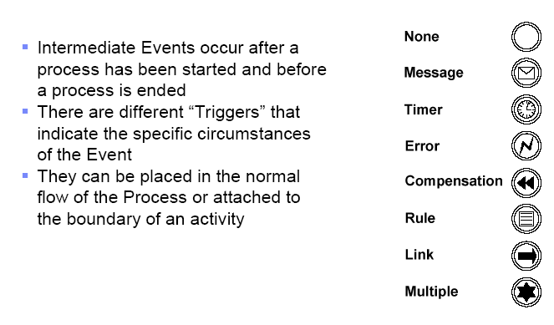
Intermediate Events

Slide 15
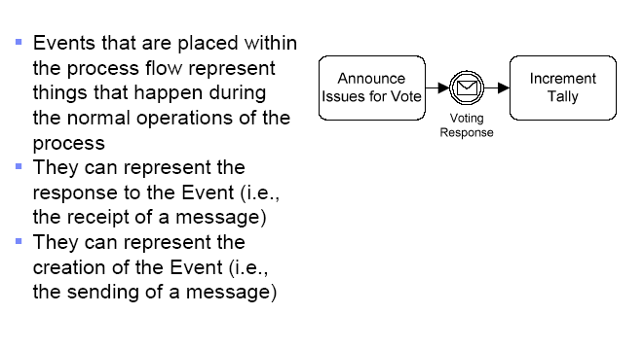
Intermediate events (normal flow)

Slide 16
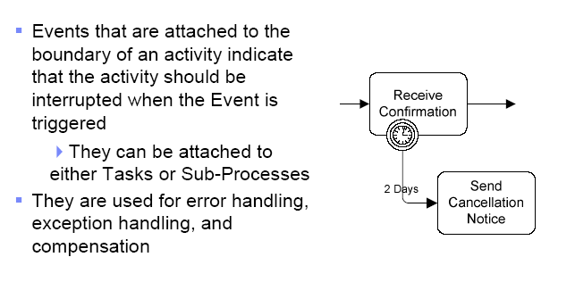
Intermediate events (linked to Boundary)

Slide 17
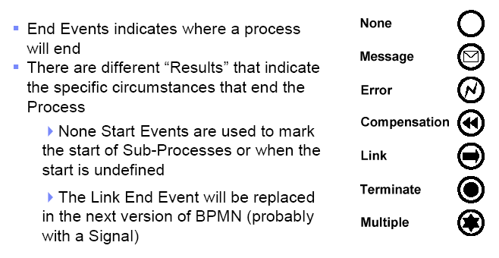
End events

Slide 18
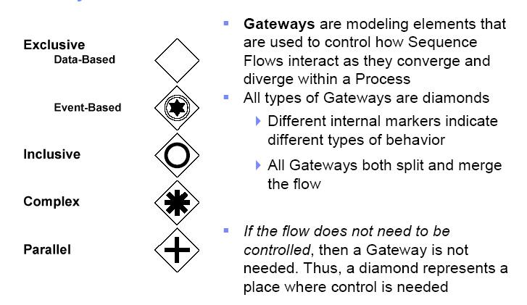
Gateways

Slide 19
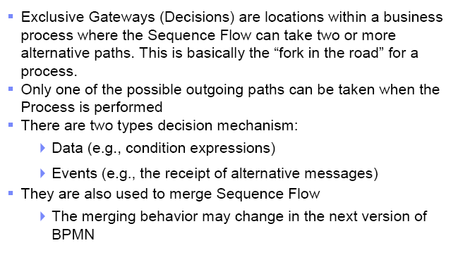
Exclusive Gateways

Slide 20
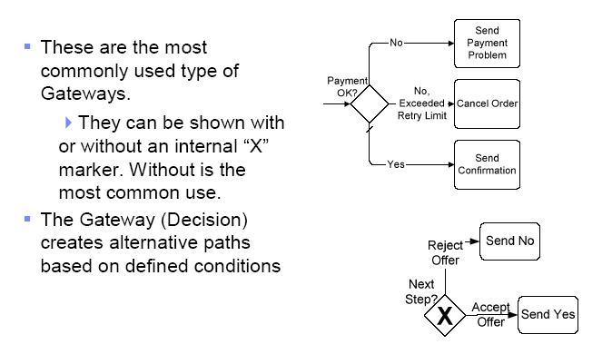
Exclusive Gateways, based on data

Slide 21
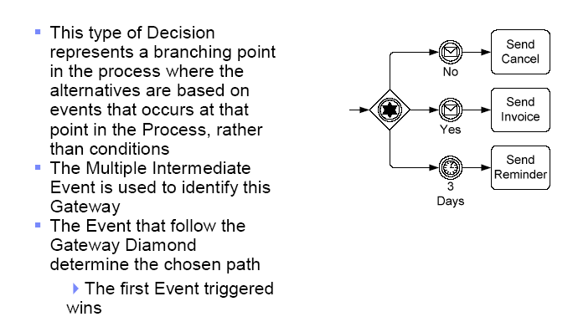
Exclusive Gateways, based on events

Slide 22
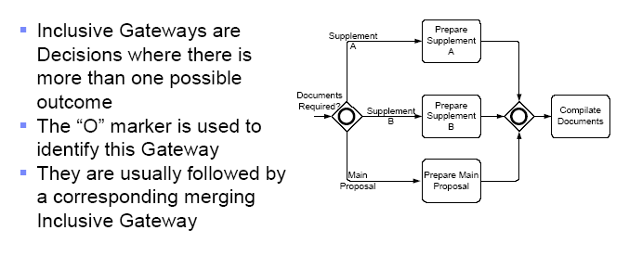
Inclusive Gateways

Slide 23
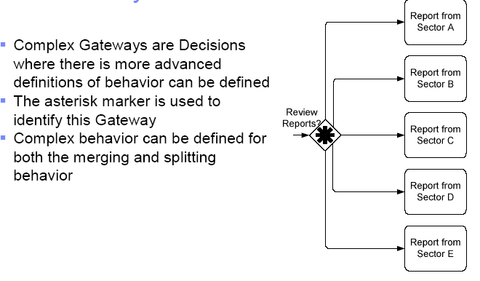
Complex Gateways

Slide 24
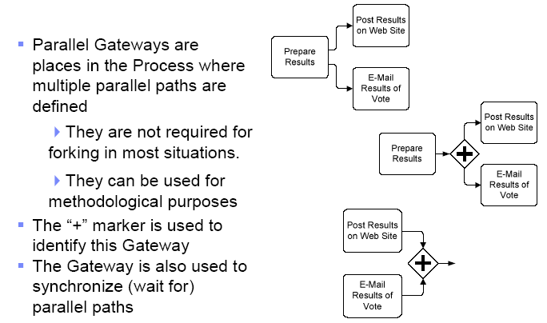
Complex Gateways

Slide 25
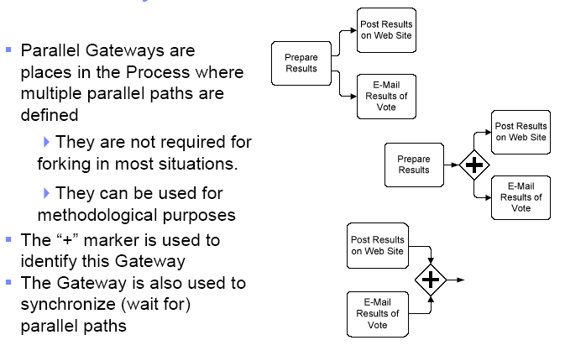
Parallell Gateways

Slide 26
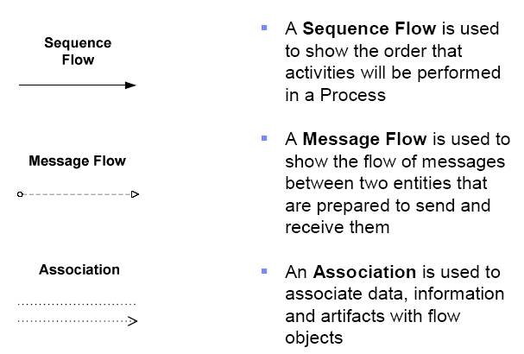
Conectors

Slide 27
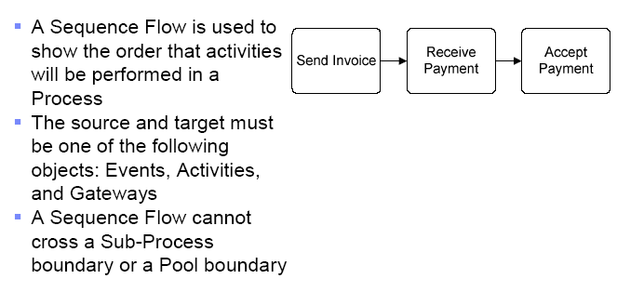
Sequence flow

Slide 28
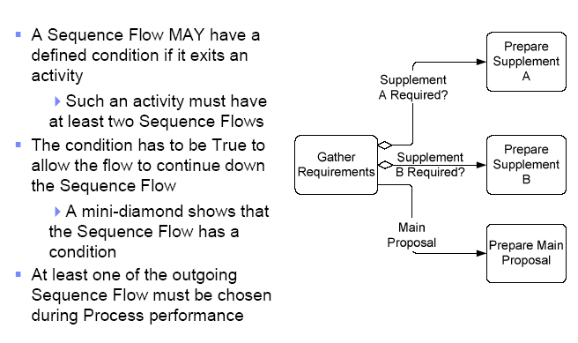
Conditions in sequence flow

Slide 29
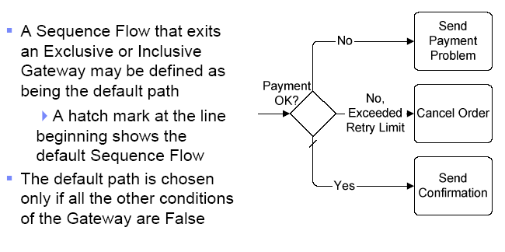
Default sequence flow

Slide 30
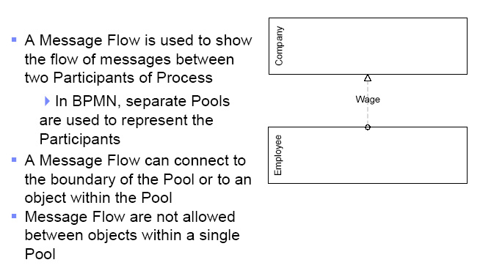
Message flow

Slide 31
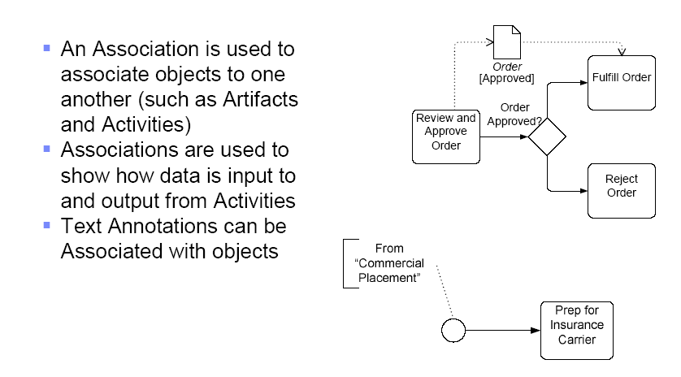
Associations

Slide 32
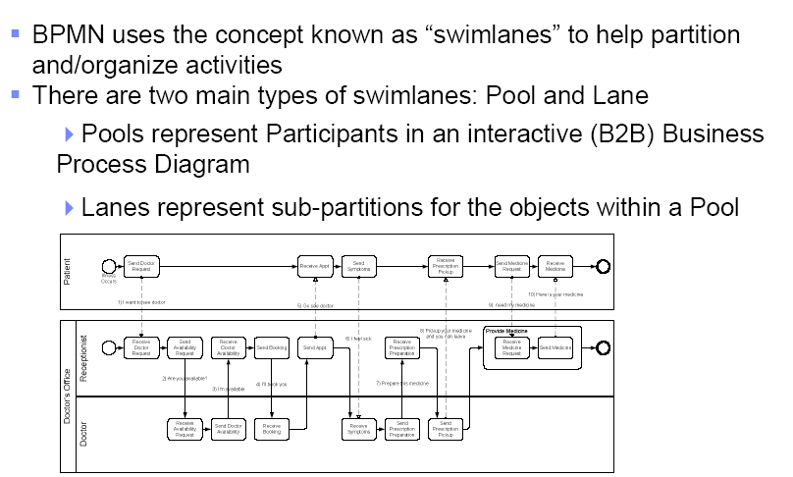
Swim lanes

Slide 33
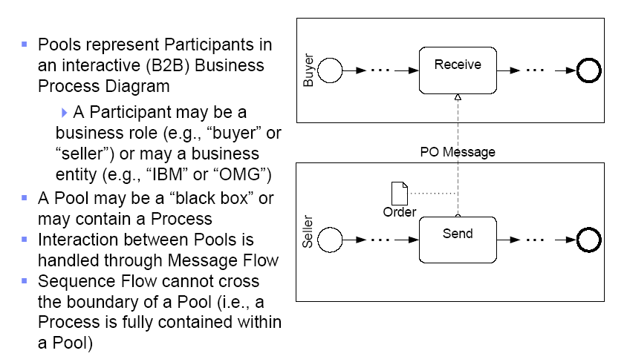
Pool

Slide 34
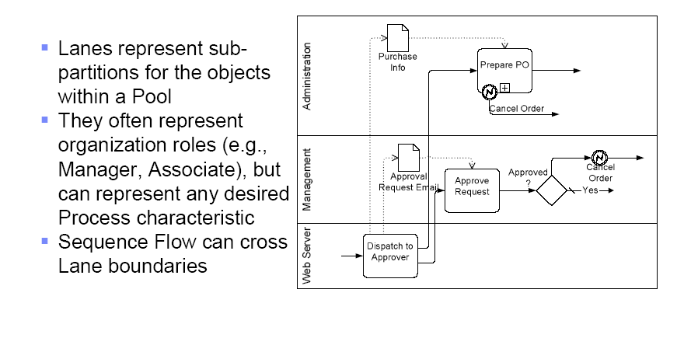
Lanes

Slide 35
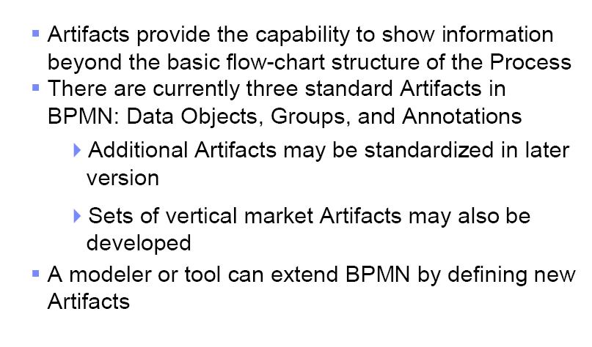
Artifacts

Slide 36
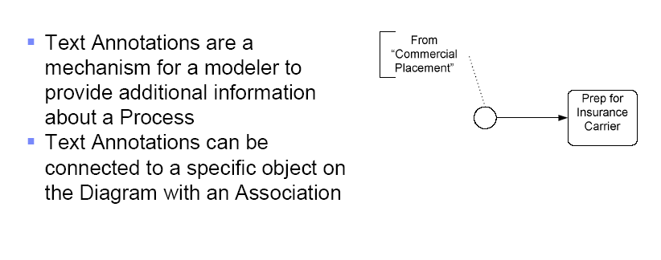
Text annotations

Slide 37
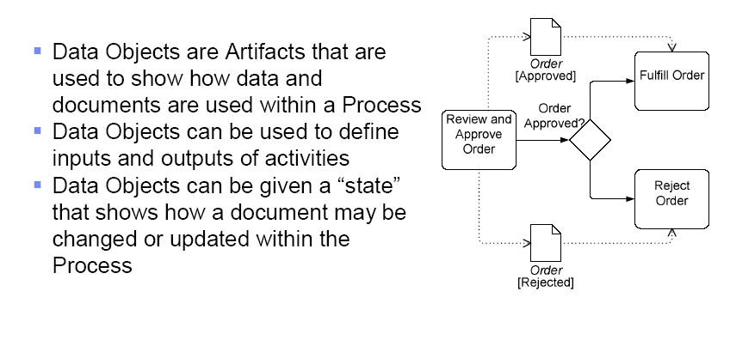
Data objects

Slide 38
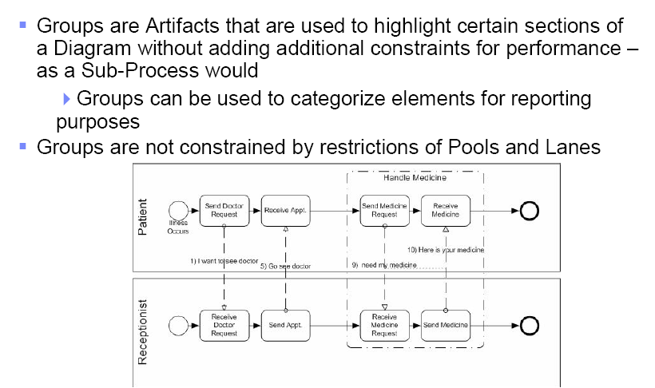
Groups

Slide 39
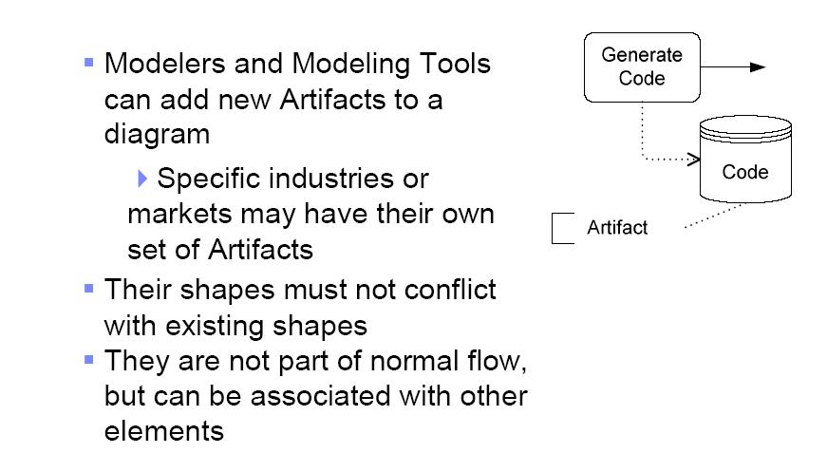
Extended artifacts

Slide 40
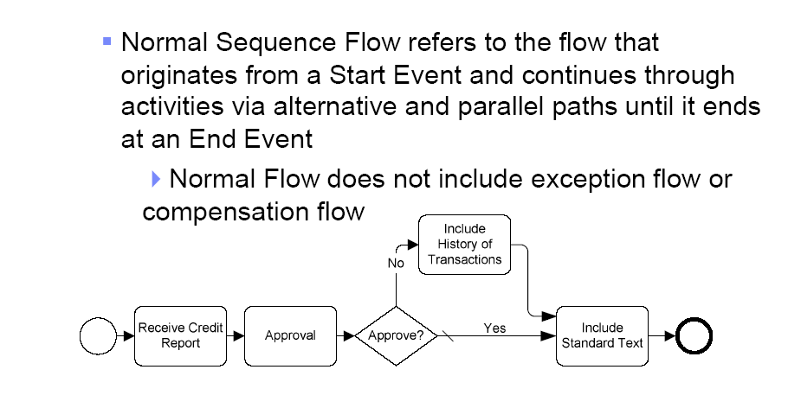
Normal flow

Slide 41
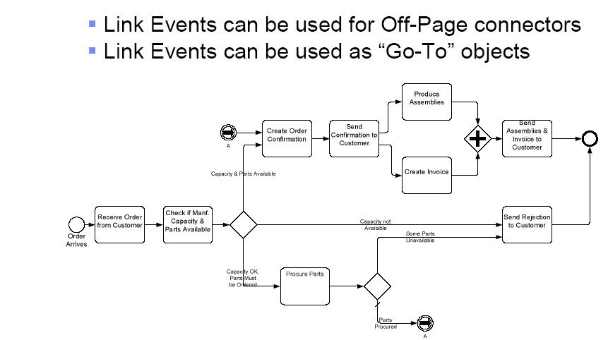
Link events

Slide 42
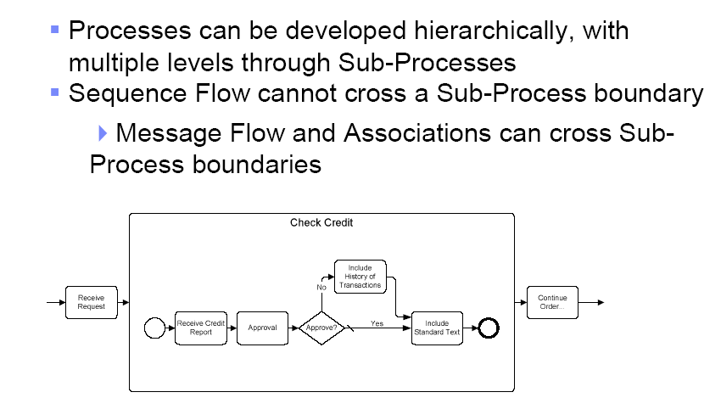
Process leves

Slide 43
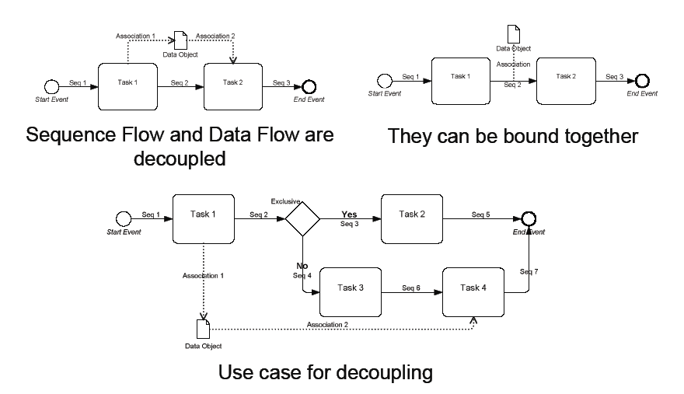
Data flow

Slide 44
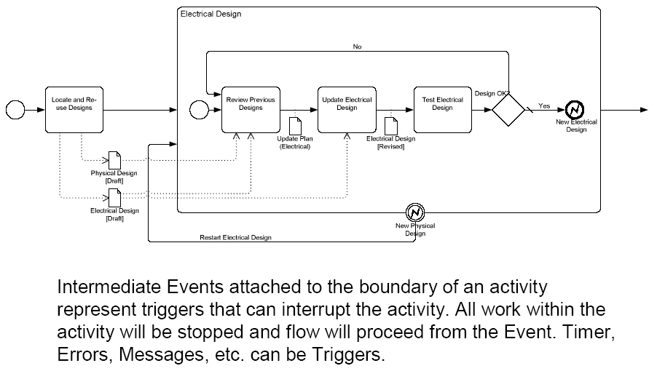
Exceptions

Slide 45
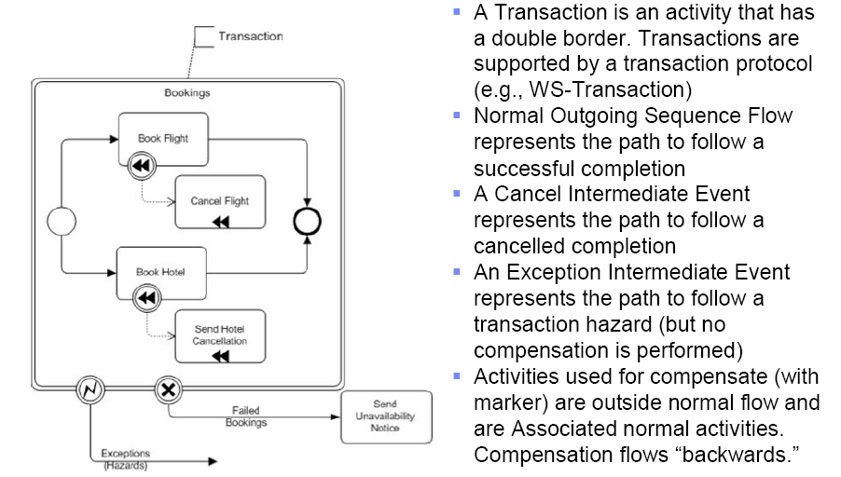
Compenations and transacations

Slide 46
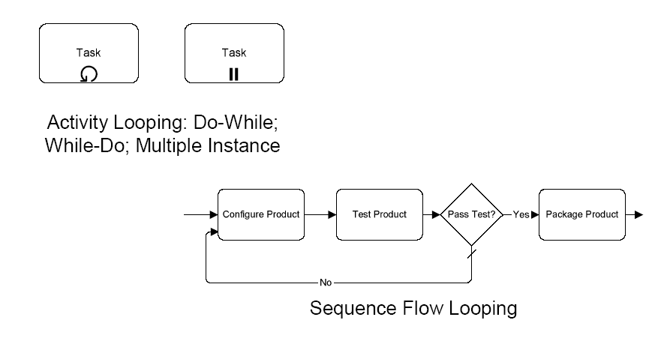
Loops

Slide 47
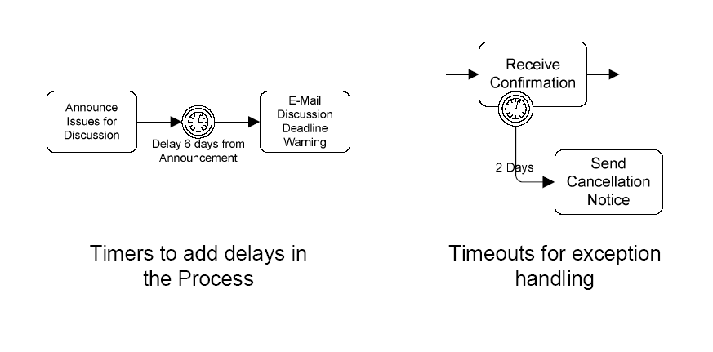
Timers

Slide 48
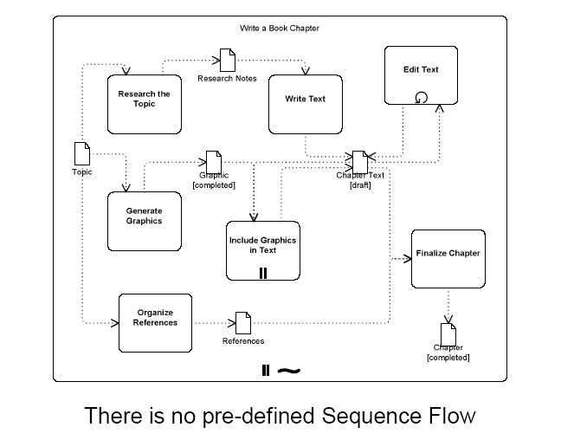
Ad hoc processes

Slide 49
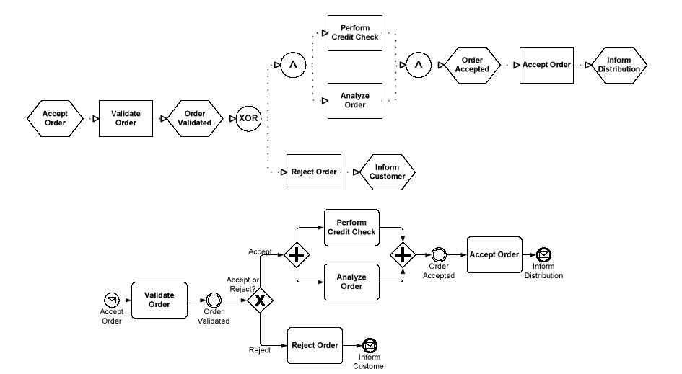
EPC og BPMN
EPC
EPC
BPMN

Slide 50
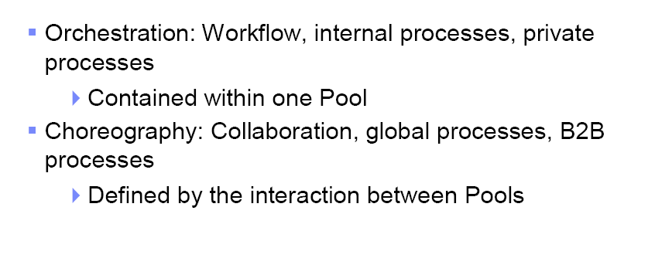
Orchestration versus Choreography

Slide 51
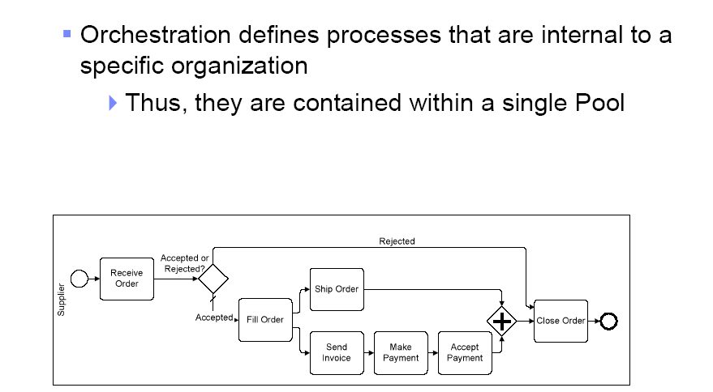
Orkestrering

Slide 52
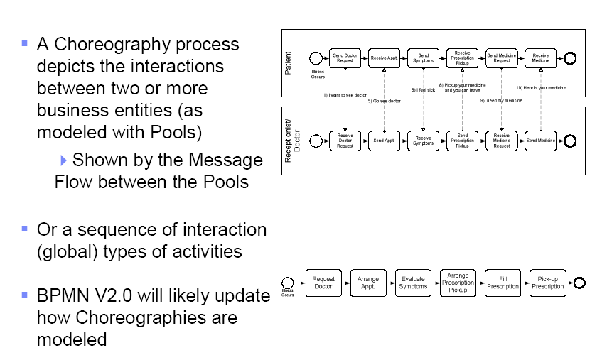
Koreografi

Slide 53

Eksempel

Slide 54

Prosess informasjon

Slide 55


Slide 56


Slide 57


Slide 58


Slide 59


Slide 60
Example – doctor’s office
A text description of the choreography was presented as so:
1) Patient send a "I want to see doctor" message to the Receptionist
2) Receptionist send a "Are you available ?" message to a a list of Doctors
3) One doctor send a "I'm available" message to the Receptionist.
4) Receptionist send a "I'll book you" message to the Doctor.
5) Receptionist send a "Go see doctor" message to the Patient
6) Patient send a "I feel sick" message to Doctor
7) Doctor send a "Prepare this medicine" message to Receptionist
8) Doctor send a "Pickup your medicine and you can leave" message to Patient
9) Patient send a "I need my medicine" message to Receptionist
10) Receptionist send a "Here is your medicine" message to Patient

Slide 61


Slide 62


Slide 64


Slide 65


Slide 66
BPMN 2.0: Major changes from BPMN1.x
Notational changes
New diagrams for Choreography and Conversation
New event-types (escalation, …)
Non-interrupting events
Event sub-process
Call Activity– replaces linked/reusable activity
Technical changes
Formal metamodel – specified in UML
Interchange formats for semantic model interchange (XMI, XSD)
Interchange formats for diagram interchange (XMI, XSD)
XSLT transformations between XMI and XSD formats

Slide 67

Process diagram
Flowchart view to sequence activities within an organization
Support the modeling of simple processes
Enhanced by BPMN to handle more complex concepts, such as exception handling, transactions, and compensation.

Slide 68

Collaboration diagram
Provides a view of the interactions (flow of messages) between two or more business partners (Participants).
Collaborations can be combined with Processes to show how the interactions are related to the internal Process activities.

Slide 69

Collaboration diagram example

Slide 70

Conversation diagram
Allows a modeler to group Collaboration interactions between two or more Participants, which together achieve a common goal, e.g. “negotiate delivery”
The grouping can be based on business keys such as customer id or shipping id.

Slide 71

Corresponding choreography example
Provides a flowchart view to sequence interactions between Participants
Choreographies define a “business contract” or protocol to which the Participants agree to follow during real-time interactions.

Slide 72

Choreography diagram
Provides a flowchart view to sequence interactions between Participants
Choreographies define a “business contract” or protocol to which the Participants agree to follow during real-time interactions.

Slide 73

Activity types - visualised

Slide 74

Multi-instance activites - visualised
Parallel
Serial

Slide 75





New Artifact Shapes
Data Artifact
Data Artifact Collection
Data Artifact Input
Data Artifact Output
Data Source Artifact

Slide 76





New Event Gateways
Current event-based gateway
Event Based Exclusive Intermediate
Event Based Exclusive Start Gateway
Event Based Inclusive Start
Event Based Inclusive Intermediate

Slide 77



Non-interrupting Intermediate Events
Boundary intermediate events in BPMN 1.0-1.2 are interrupting
BPMN2.0 introduces new non-interrupting intermediate events
Boundary events
Catching
Example of use

Slide 78

Non-interrupting Event Sub-process (expanded)

Slide 79

Non-interrupting Event Sub-process (collapsed)

Slide 80

Interrupting Event Sub-process

Slide 81

BPMN 2.0 Event Gallery

Slide 82
Sources
The (beta) BPMN 2.0 specification - http://www.omg.org/spec/BPMN/2.0/
Bruce Silver – http://www.bpmnstyle.com
Rick Geneva – http://processmodeling.info
Stephen White - https://apps.lotuslive.com/bpmblueworks/community/?p=902
BPMN 0.9, 1.0, 1.1, 1.2, …..

Slide 83
Thank You

