Slide 1
Input Design & Prototyping
CSE
Department of
Computer
Science
&
Engineering
Lecture 22
CSC 401: Database Management System

Slide 2
Data Capture and Data Entry
Data capture – the identification and acquisition of new data (at its source).
Source documents – forms used to record business transactions in terms of data that describe those transactions.
Data entry – the process of translating the source data or document (above) into a computer readable format.
Notes:
No additional notes.

Slide 3
Data Processing
Data processing is all processing that occurs on the data after it is input from a machine readable form.
In batch processing, the entered data is collected into files called batches and processed as a complete batch.
In on-line processing, the captured data is processed immediately
In remote batch processing, data is entered and edited on-line, but collected into batches for subsequent processing.
Notes:
No additional notes.

Slide 4
Input Implementation Methods
Keyboard
Mouse
Touch Screen
Point-of-sale terminals
Sound and speech
Automatic data capture
Optical mark recognition (OMR)
Bar codes
Optical character recognition (OCR)
Magnetic Ink
Electromagnetic transmission
Smart cards
Biometric
Notes:
No additional notes.

Slide 5
Taxonomy for Computer Inputs
Process Method | Data Capture | Data Entry | Data Processing
Keyboard | Data is usually captured on a business form that becomes the source document for input. Data can be collected real-time. | Data is entered via keyboard. This is the most common input method but also the most prone to errors. | OLD: Data can be collected into batch files (disk) for processing as a batch. NEW: Data is processed as soon as it has been keyed.
Mouse | Same as above. | Used in conjunction with keyboard to simplify data entry. Mouse serves as a pointing device for a screen. | Same as above, but the use of a mouse is most commonly associated with online and real-time processing.
Touch Screen | Same as above. | Data is entered o a touch screen display or handheld device. Data entry users either touch commands and data choices or enter data using handwriting recognition. | On PCs, touch screen choices are processed same as above. On handheld computers, data is sorted on the handheld for later processing as a remote batch.
Point of Sale | Data is captured as close to the point of sale as humanly possible. No source documents. | Data is often entered directly by the customer or by an employee directly interacting with the customer. | Data is almost always processed immediately as a transaction or inquiry.
Notes:
Teaching Notes
The categories are not necessarily mutually exclusive.

Slide 6
Taxonomy for Computer Inputs (continued)
Process Method | Data Capture | Data Entry | Data Processing
Sound | Data is captured as close to the source as possible, even when the customer is remotely located. | Data is entered using touch-tones (typically from a telephone). Usually requires fairly rigid command menu structure and limited input options. | Data is almost always processed immediately as a transaction or inquiry.
Speech | Same as sound. | Data (and commands) is spoken. This technology is not as mature and is much less reliable and common than other techniques. | Data is almost always processed immediately as a transaction or inquiry.
Optical Mark | Data is recorded on optical scan sheets as marks or precisely formed letter, numbers, and punctuation. | Eliminates the need for data entry. | Data is almost always processed as a batch.
Magnetic Ink | Data is usually prerecorded on forms that are subsequently completed by the customer. The customer records additional information on the form. | A magnetic ink reader reads the magnetized data. The customer-added data must be entered using another input method. | Data is almost always processed as a batch.
Notes:
Teaching Notes
The categories are not necessarily mutually exclusive.

Slide 7
Taxonomy for Computer Inputs (concluded)
Process Method | Data Capture | Data Entry | Data Processing
Electromagnetic | Data is recorded directly on the object to be described by data. | Data is transmitted by radio frequency. | Data is almost always processed immediately.
Smart Card | Data is recorded directly on a device to be carried by the customer, employee, or other individual that is described by that data. | Data is read by smart card readers. | Data is almost always processed immediately.
Biometric | Unique human characteristics become data | Data is read by biometric sensors. Primary applications are security and medical monitoring | Data is processed immediately.
Notes:
Teaching Notes
The categories are not necessarily mutually exclusive.

Slide 8
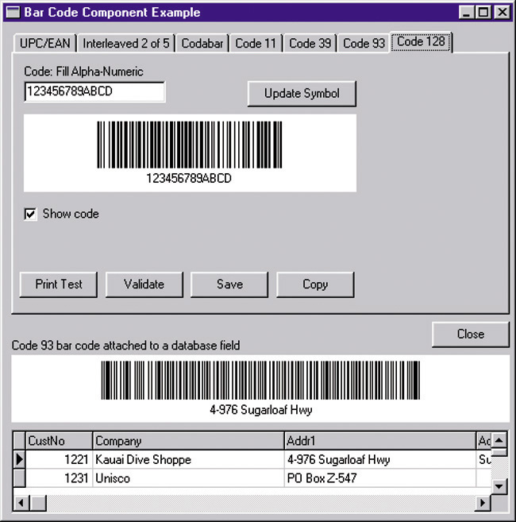
Automatic Identification: Bar Codes
Notes:
No additional notes.

Slide 9
Input Design Guidelines
Capture only variable data.
Not data that can be looked up.
Do not capture data that can calculated or stored in computer programs as constants.
Extended Price, Federal Withholding, etc.
Use codes for appropriate attributes.
Notes:
No additional notes.

Slide 10
Source Document / Form Design Guidelines
Include instructions for completing the form.
Minimize the amount of handwriting.
Data to be entered (keyed) should be sequenced top-to-bottom and left-to-right.
When possible use designs based on known metaphors.
Notes:
No additional notes.

Slide 11
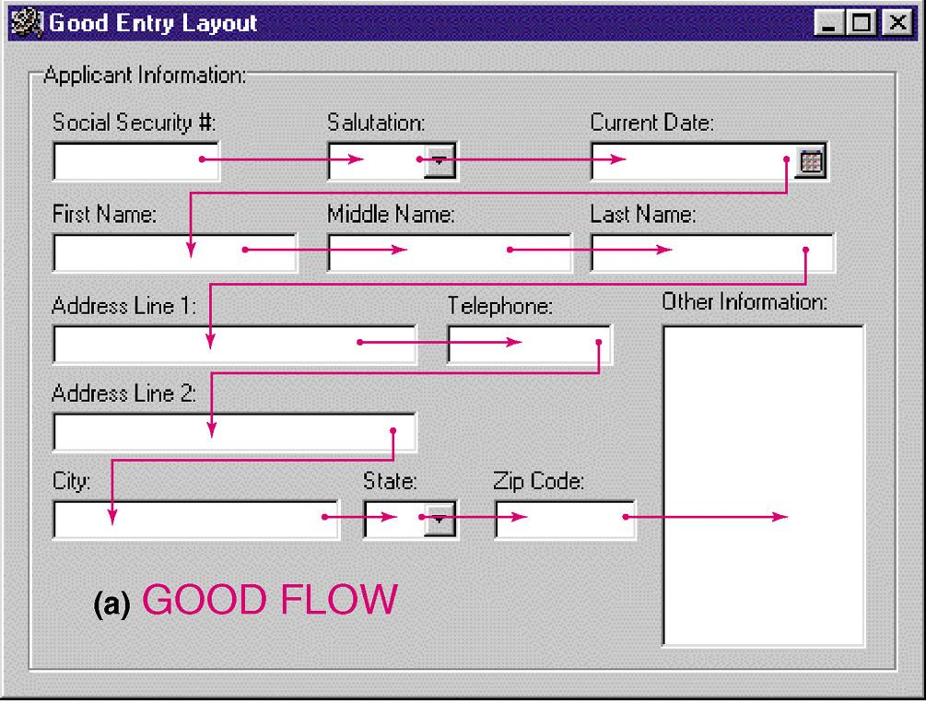
Bad Flow in a Form
Notes:
No additional notes.

Slide 12
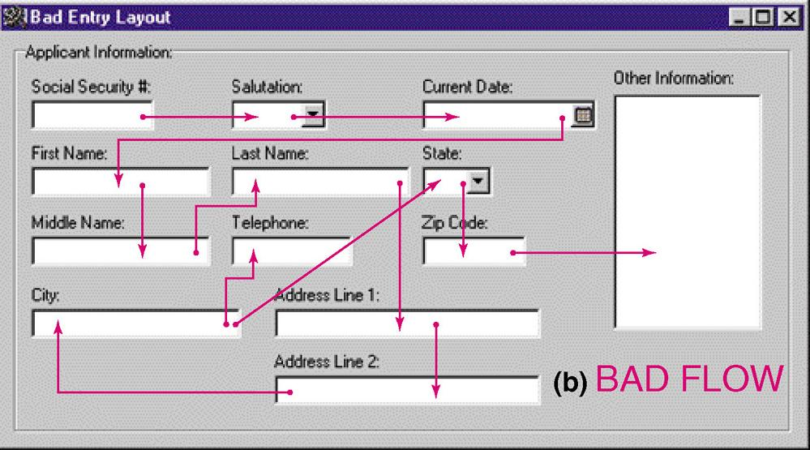
Good Flow in a Form
Notes:
No additional notes.

Slide 13
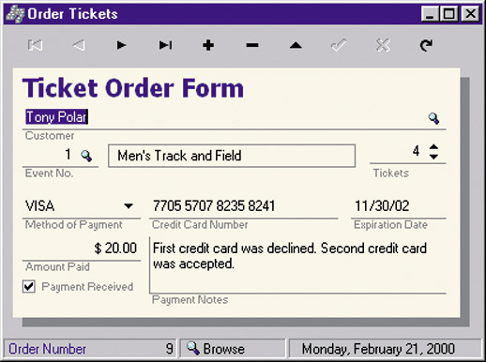
Metaphoric Screen Design
Notes:
Teaching Notes
Other useful metaphors include a check, a register, and a calendar.
Pictures of objects can also be metaphors. For example, many Web sites use a picture of each credit card accepted instead of the names.

Slide 14
Internal Controls for Inputs
The number of inputs should be (to minimize risk of lost transactions).
For batch processing
Use batch control slips
Use one-for-one checks against post-processing detail reports
For on-line systems
Log each transaction as it occurs to a separate audit file
Validate all data
Existence checks
Data-type checks
Domain checks
Combination checks
Self-checking digits
Format checks
Notes:
No additional notes.

Slide 15
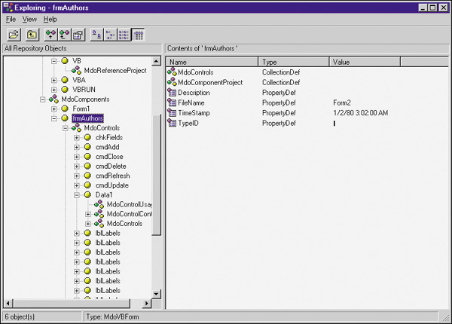
Repository-Based Prototyping and Development
Define properties and constraints for a reusable field
Notes:
No additional notes.

Slide 16
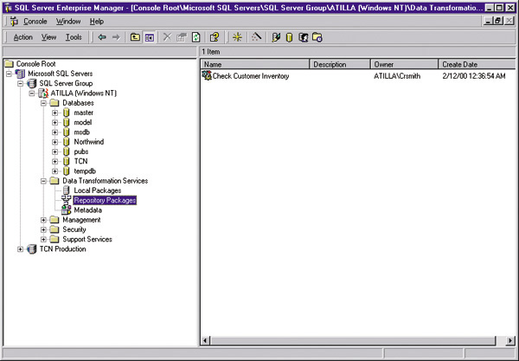
Repository-Based Prototyping and Development
Define data validation code for a field
Notes:
No additional notes.

Slide 17
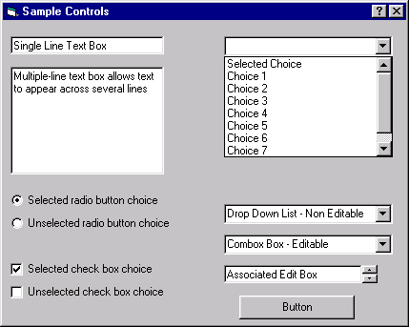
Common GUI Controls (Windows and Web)
Text boxes
Radio buttons
Check boxes
List boxes
Drop down lists
Combination boxes
Spin boxes
Buttons
Notes:
No additional notes:

Slide 18
Common GUI Controls Uses
Text boxes
When the input data values are unlimited in scope
Radio buttons
When data has limited predefined set of mutually exclusive values
Check boxes
When value set consists of a simple yes or no value
List boxes
When data has a large number of possible values
Drop down lists
When data has large number of possible values and screen space is too limited for a list box
Combination boxes
When need to provide the user with option of selecting a value from a list or typing a value that may or may not appear in the list
Spin boxes
When need to navigate through a small set of choices or directly typing a data value
Notes:
Teaching Notes
It would be helpful to also go over the guidelines discussed in the text for each.

Slide 19
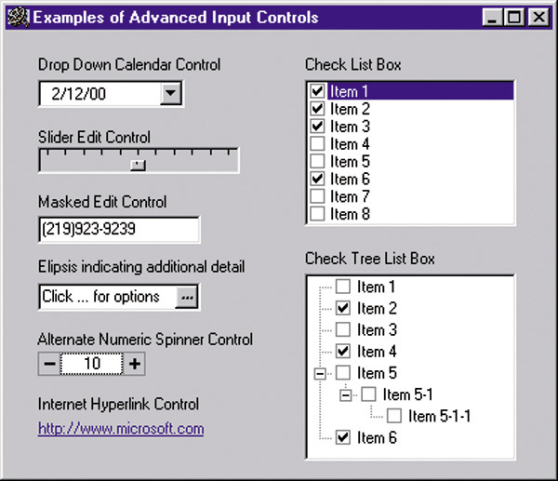
Advanced Controls
Drop down calendars
Slider edit controls
Masked edit controls
Ellipsis controls
Alternate numerical spinners
Check list boxes
Check tree boxes
Notes:
No additional notes:

Slide 20
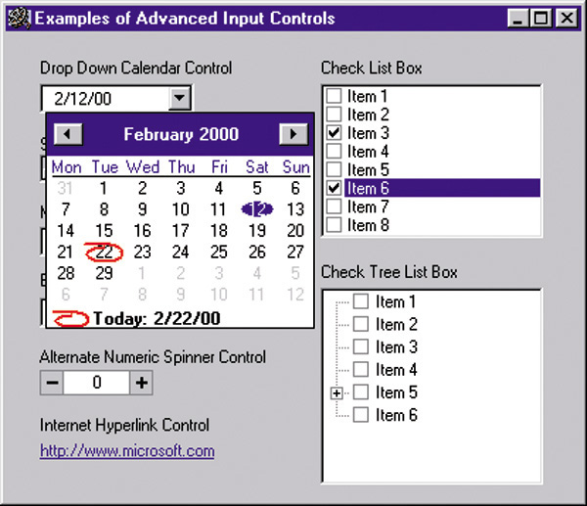
Advanced Controls
Notes:
No additional notes:

Slide 21
Automated Tools for Input Design and Prototyping
Old Tools
Record Layout Charts
Display Layout Charts
Newer Prototyping Tools
Microsoft Access
CASE Tools
Visual Basic
Excel
Visio

Slide 22
Input Design Process
Identify system inputs and review logical requirements.
Select appropriate GUI controls.
Design, validate and test inputs using some combination of:
Layout tools (e.g., hand sketches, spacing charts, or CASE tools.
Prototyping tools (e.g., spreadsheet, PC DBMS, 4GL)
As necessary design source documents.
Notes:
No additional notes.

Slide 23
A Logical Data Structure for Input Requirements
ORDER = ORDER NUMBER
+ ORDER DATE
+ CUSTOMER NUMBER
+ CUSTOMER NAME
+ CUSTOMER SHIPPING ADDRESS = ADDRESS >
+ ( CUSTOMER BILLING ADDRESS = ADDRESS > )
+ 1 { PRODUCT NUMBER +
QUANTITY ORDERED } n
+ ( DEFAULT CREDIT CARD NUMBER )
ADDRESS = ( POST OFFICE BOX NUMBER )
+ STREET ADDRESS
+ CITY
+ STATE
+ POSTAL ZONE
Notes:
Teaching Notes
It may be useful to walk through this technique for specifying “logical” output requirements.
The red and blue symbols are relational operators, that is, they specify the relationship between attributes to be included in the output in terms of
Sequence +
Selection [ data attributes]
Iteration min { data attributes } max
Optionality ( data attributes)
Many CASE tools support this logical notation.

Slide 24
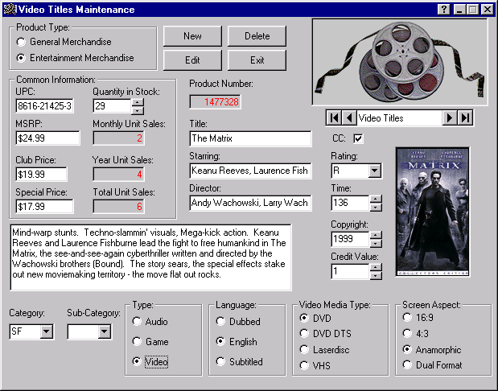
Input Prototype for Video Title Maintenance
Notes:
No additional notes.

Slide 25
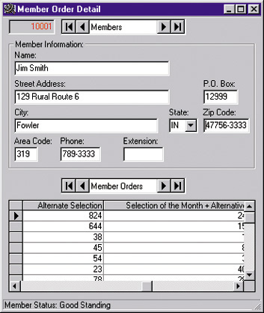
Input Prototype for Member Order
Notes:
No additional notes.

Slide 26
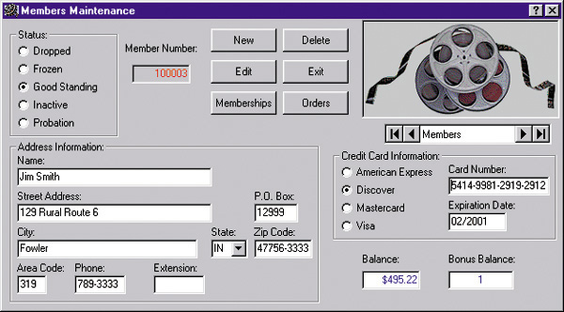
Input Prototype for Member Shopping
Notes:
No additional notes.

Slide 27
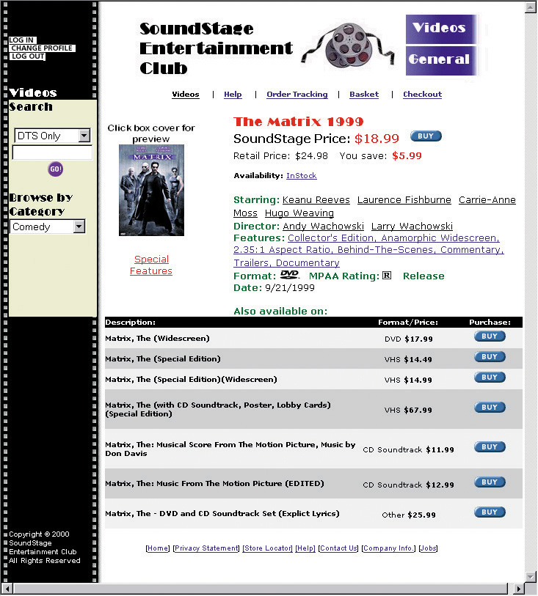
Input Prototype for Web Shopping Cart
Notes:
No additional notes.

Slide 28
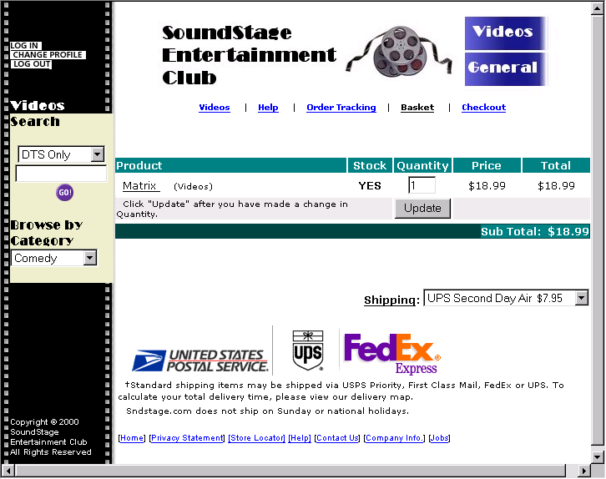
Input Prototype for Web Interface
Notes:
No additional notes.

Slide 29
Thank You

