Slide 1
Enhanced Entity Relationship Diagram
CSE
Department of
Computer
Science
&
Engineering
Lecture 06
CSC 303: Database Management System

Slide 2
Enhanced entity-relationship (EER) model
A model that has resulted from extending the original E-R model with new modeling constructs
Subtype: A subgrouping of the entities in an entity type that is meaningful to the organization and that shares common attributes or relationships distinct from other subgroupings.
Supertype: A generic entity type that has a relationship with one or more subtypes.
For example, STUDENT is an entity type in a university. Two subtypes of STUDENT are GRADUATE STUDENT and UNDERGRADUATE STUDENT. In this example, we refer to STUDENT as the supertype.

Slide 3
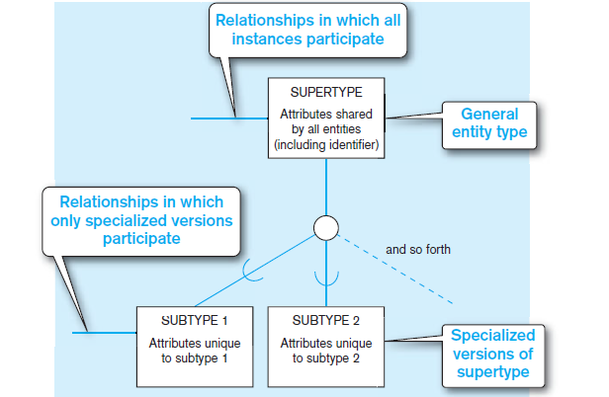
Basic notation for supertype/subtype relationships

Slide 4
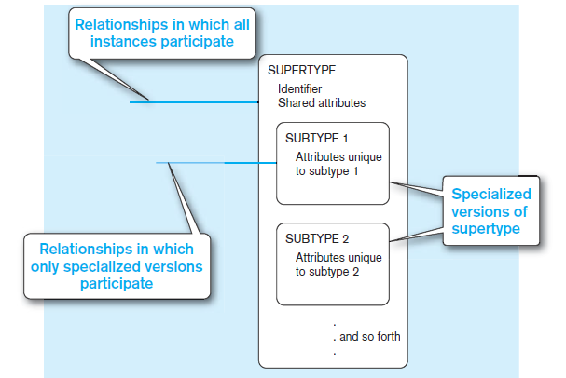
Subtypes inside supertypes notation

Slide 5
EXAMPLE OF A SUPERTYPE/SUBTYPE RELATIONSHIP
Hourly employees Employee Number, Employee Name, Address, Date Hired, Hourly Rate
Salaried employees Employee Number, Employee Name, Address, Date Hired, Annual Salary, Stock Option
Contract consultants Employee Number, Employee Name, Address, Date Hired, Contract Number, Billing Rate.
Three Choices
Define a single entity type called EMPLOYEE. Although conceptually simple, this approach has the disadvantage that EMPLOYEE would have to contain all of the attributes for the three types of employees.
Define a separate entity type for each of the three entities.
Define a supertype called EMPLOYEE with subtypes HOURLY EMPLOYEE, SALARIED EMPLOYEE, and CONSULTANT.

Slide 6
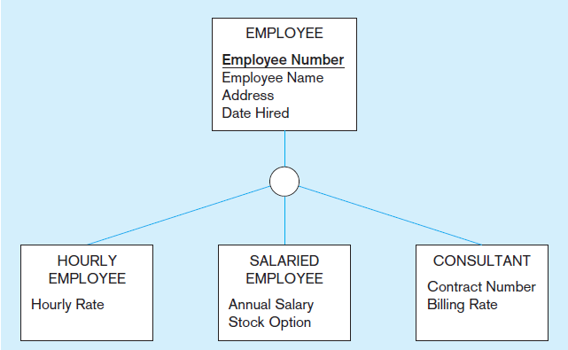
Employee supertype with three subtypes

Slide 7
Attribute inheritance
A property by which subtype entities inherit values of all attributes and instances of all relationships of their supertype.
This important property makes it unnecessary to include supertype attributes or relationships redundantly with the subtypes.
For example, Employee Name is an attribute of EMPLOYEE but not of the subtypes of EMPLOYEE. Thus, the fact that the employee’s
name is inherited from the EMPLOYEE supertype. However, the Billing Rate for this same employee is an attribute of the subtype CONSULTANT.

Slide 8
WHEN TO USE SUPERTYPE/SUBTYPE RELATIONSHIPS
There are attributes that apply to some (but not all) instances of an entity type.
The instances of a subtype participate in a relationship unique to that subtype.

Slide 9
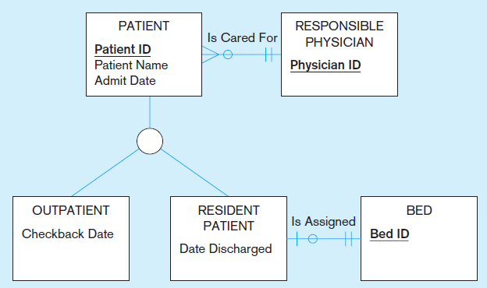
Supertype/subtype relationships in a hospital

Slide 10
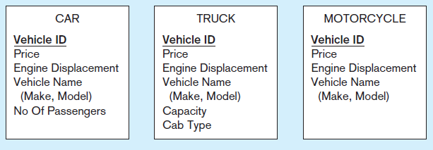
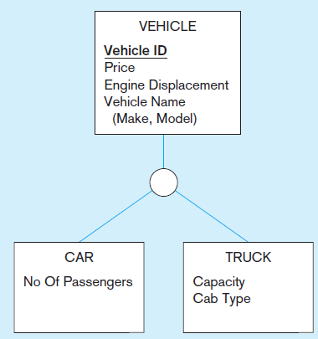
Generalization
Generalization The process of defining a more general entity type from a set of more specialized entity types.

Slide 11
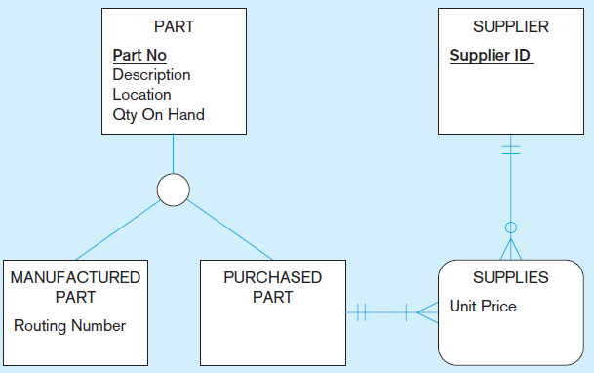
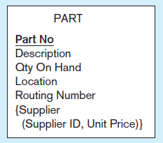
Specialization
Specialization The process of defining one or more subtypes of the supertype and forming supertype/subtype relationships.

Slide 12
Specifying Completeness Constraints
Completeness constraint A type of constraint that addresses whether an instance of a supertype must also be a member of at least one subtype.
Total specialization rule A rule that specifies that each entity instance of a supertype must be a member of some subtype in the relationship.
Partial specialization rule A rule that specifies that an entity instance of a supertype is allowed not to belong to any subtype.

Slide 13
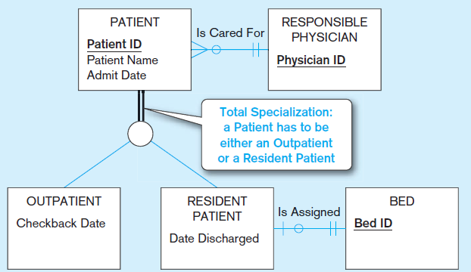
Total specialization rule

Slide 14
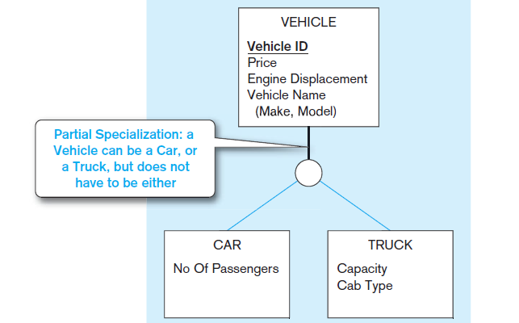
Partial specialization rule

Slide 15
Specifying Disjointness Constraints
Disjointness constraint A constraint that addresses whether an instance of a supertype may simultaneously be a member of two (or more) subtypes.
Disjoint rule A rule that specifies that an instance of a supertype may not simultaneously be a member of two (or more) subtypes.
Overlap rule A rule that specifies that an instance of a supertype may simultaneously be a member of two (or more) subtypes.

Slide 16
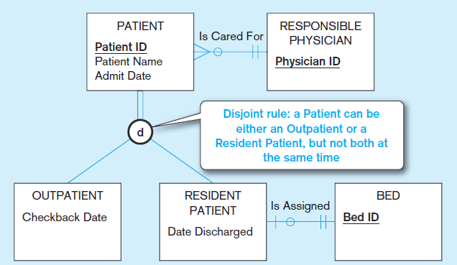
Disjoint rule

Slide 17
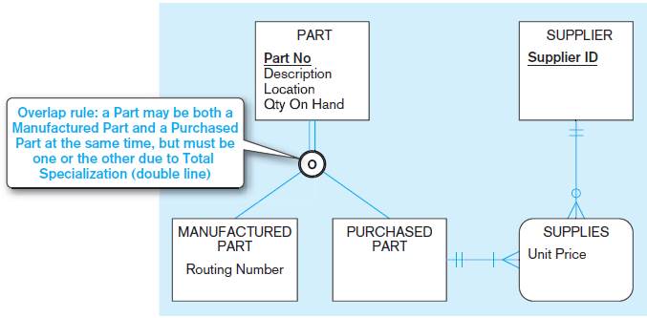
Overlap rule

Slide 18
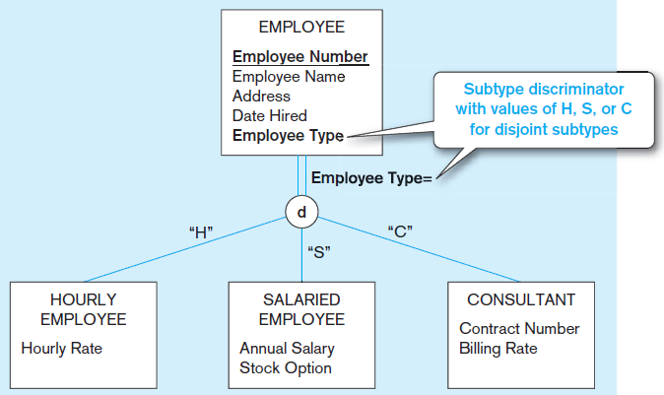
Defining Subtype Discriminators
Subtype discriminator An attribute of a supertype whose values determine the target subtype or subtypes.

Slide 19
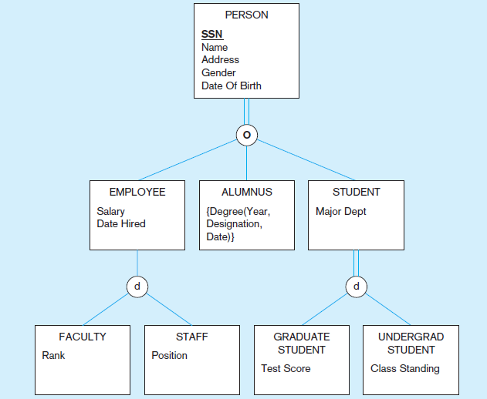
Supertype/subtype hierarchy
A hierarchical arrangement of supertypes and subtypes in which each subtype has only one supertype.

Slide 20
Entity cluster
Some enterprise-wide information systems have more than 1,000 entity types and relationships.
How this model can be reduced?
Entity cluster: A set of one or more entity types and associated relationships grouped into a single abstract entity type.

Slide 21
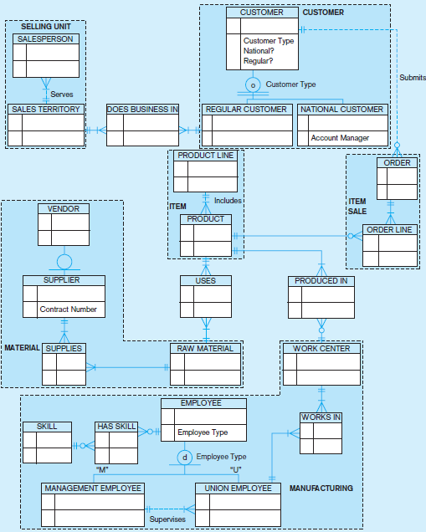

Slide 22
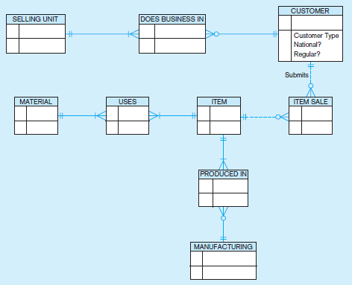

Slide 23
Thank You

