Slide 1
System Analysis Tools and Techniques
CSE
Department of
Computer
Science
&
Engineering
CSC 401: Database Management System

Slide 2
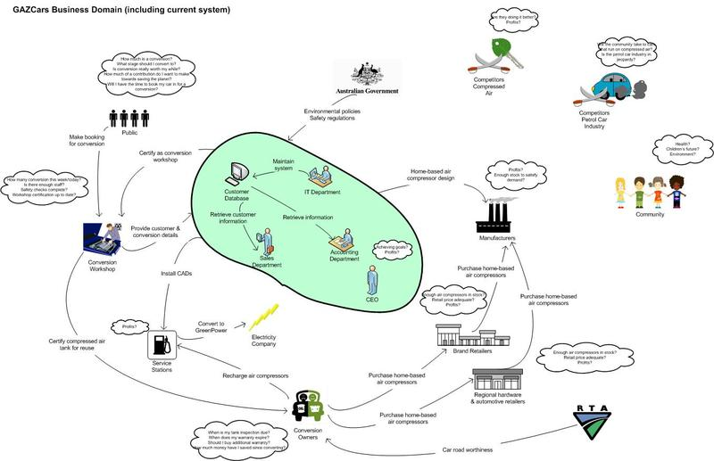
Rich picture Example

Slide 3
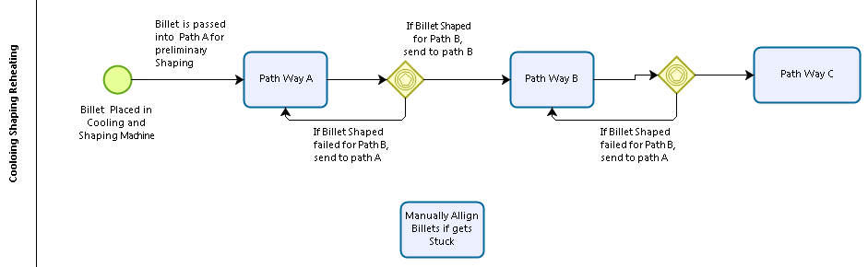
Process Model with BPMN 2.0

Slide 4
Six Element Analysis
Process | System Roles
 | Human | Non-Computing Hardware | Computing Hardware | Soft- ware | Database | Comm. Network

Slide 5
Problem Analysis Template
Process Name | Stakeholders | Concerns (Problems) | Analysis (Reason of the Problem) | Proposed Solution

Slide 6
Entity Relationship Diagram

Slide 7
Preliminary data model

Slide 8
Data Dictionary
Product Prior Year Sales Goal
Product Current Year Sales Goal
Product Line Prior Year Sales Goal
Product Line Current Year Sales Goal
Order Number of Shipments

Slide 9
Data model

Slide 10
SQL query
SELECT Product.ProductID, Product.ProductDescription, Product.PRCurrentYearSalesGoal, (OrderQuantity * ProductPrice) AS SalesToDate
FROM Order.OrderLine, Product.ProductLine
WHERE Order.OrderNumber = OrderLine.OrderNumber
AND Product.ProductID = OrderedProduct.ProductID
AND Product.ProductID = ProductLine.ProductID
AND Product.ProductLineName = “Home Office”;

Slide 11
Thank You

