Slide 1
Logical Database Design and the Relational Model - II
CSE
Department of
Computer
Science
&
Engineering
Lecture 08
CSC 401: Database Management System

Slide 2
Basic Definitions
Normalization The process of decomposing relations with anomalies to produce smaller, well-structured relations.
During logical database design You should use normalization concepts as a quality check for the relations that are obtained from mapping E-R diagrams.
When reverse-engineering older systems Many of the tables and user views for older systems are redundant and subject to the anomalies
Normal form A state of a relation that requires that certain rules regarding relationships between attributes (or functional dependencies) are satisfied.

Slide 3
Basic Definitions
Functional dependency A constraint between two attributes in which the value of one attribute is determined by the value of another attribute.
Determinant The attribute on the left side of the arrow in a functional dependency.
For any relation R, attribute B is functionally dependent (A→B) on attribute A if, for every valid instance of A, that value of A uniquely determines the value of B.
A functional dependency is not a mathematical dependency: B cannot be computed from A. Rather, if you know the value of A, there can be only one value for B.
An attribute may be functionally dependent on a combination of two (or more) attributes rather than on a single attribute.

Slide 4
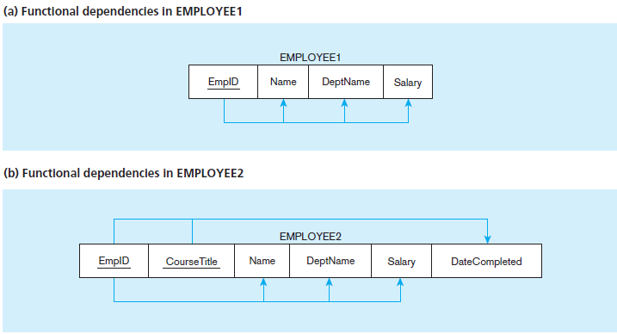

Slide 5
Basic Definitions
Candidate key An attribute, or combination of attributes, that uniquely identifies a row in a relation.
Unique identification For every row, the value of the key must uniquely identify that row. This property implies that each nonkey attribute is functionally dependent on that key.
Nonredundancy No attribute in the key can be deleted without destroying the property of unique identification.
A candidate key is always a determinant, whereas a determinant may or may not be a candidate key. For example, in EMPLOYEE2, EmpID is a determinant but not a candidate key.

Slide 6
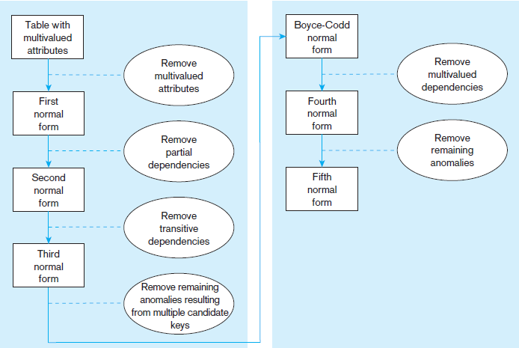
Steps in normalization

Slide 7
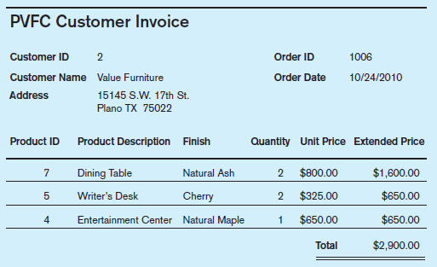
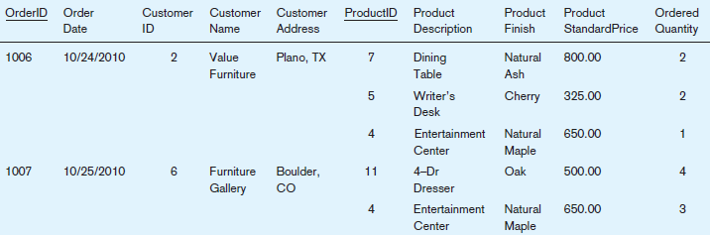
Step 0: Represent the View in Tabular Form

Slide 8
Step 1: Convert to First Normal Form
First normal form (1NF) A relation that has a primary key and in which there are no repeating groups.
There are no repeating groups in the relation (thus, there is a single fact at the intersection of each row and column of the table).
A primary key has been defined, which uniquely identifies each row in the relation.
Normalization Steps
Repeating groups can be removed by filling relevant data values into previously vacant cells.
Primary key can be formed using the functional dependencies of the case study.

Slide 9
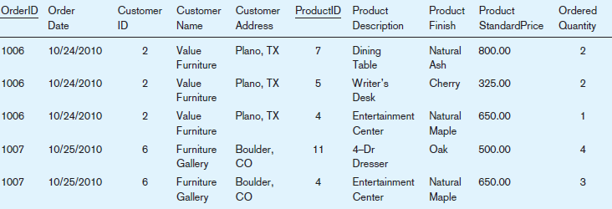
Step 1.1: Removing repeating groups

Slide 10
Step 1.2: Selection of primary key
Primary key should determine all the attributes. Below we have the functional dependencies.
OrderID → OrderDate, CustomerID, CustomerName, CustomerAddress
CustomerID → CustomerName, CustomerAddress
ProductID → ProductDescription, ProductFinish, ProductStandardPrice
OrderID, ProductID → OrderedQuantity
Thus OrderID and ProductID would be the primary key.
OrderID
ProductID

Slide 11
Step 1.2: Selection of primary key

Slide 12
Anomalies in 1NF
Insertion – can’t enter a new product without having the order from a customer
Deletion – if we remove a order then some product detail would be lost.
Modification – changing price of a single product forces to update multiple records.
Why do these anomalies exist?
Because we’ve combined two themes (entity types) into one relation. This results in duplication, and an unnecessary dependency between the entities

Slide 13
Step 2: Convert to Second Normal Form
Second normal form (2NF) A relation in first normal form in which every nonkey attribute is fully functionally dependent on the primary key.
Partial functional dependency A functional dependency in which one or more nonkey attributes are functionally dependent on part (but not all) of the primary key.
Normalization steps
Create a new relation for each primary key attribute (or combination of attributes) that is a determinant in a partial dependency. That attribute is the primary key in the new relation.
Move the nonkey attributes that are dependent on this primary key attribute (or attributes) from the old relation to the new relation.

Slide 14
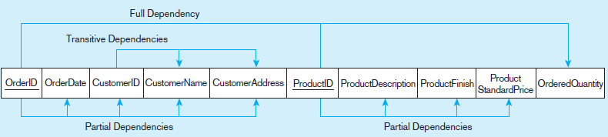


Step 2: Convert to Second Normal Form

Slide 15
Step 2: Convert to Second Normal Form
A relation that is in first normal form will be in second normal form if any one of the following conditions applies:
The primary key consists of only one attribute. By definition, there cannot be a partial dependency in such a relation.
No nonkey attributes exist in the relation (thus all of the attributes in the relation are components of the primary key). There are no functional dependencies in such a relation.
Every nonkey attribute is functionally dependent on the full set of primary key attributes (e.g., the attribute OrderedQuantity in the ORDER LINE relation).

Slide 16
Step 3: Convert to Third Normal Form
Third normal form (3NF) A relation that is in second normal form and has no transitive dependencies.
Transitive dependency A functional dependency between the primary key and one or more nonkey attributes that are dependent on the primary key via another nonkey attribute.
Steps of removing Transitive dependencies.
For each nonkey attribute (or set of attributes) that is a determinant in a relation, create a new relation. That attribute (or set of attributes) becomes the primary key of the new relation.
Move all of the attributes that are functionally dependent on the primary key of the new relation from the old to the new relation.
Leave the attribute that serves as a primary key in the new relation in the old relation to serve as a foreign key that allows you to associate the two relations.

Slide 17

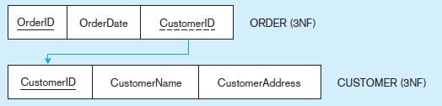
Step 3: Convert to Third Normal Form

Slide 18
Example (non-normalized relation)
ID | Name | Add | Dept | Dept_Head | Advisor | C_No | C_Name | C_Credit | GPA
1 | Ihtesham | Baridhara | CSE | M. A. Amin | Mr. ABC | C401 | DB Mgt | 3 | 3.0
 |  |  |  |  |  | C203 | Data struct | 3 | 2.0
 |  |  |  |  |  | C212 | Micro Proc. | 3 | 3.3
2 | Muntaser | Uttara | CSE | M. A. Amin | Mr. DEF | C401 | DB Mgt | 3 | 3.0
 |  |  |  |  |  | C203 | Data struct | 3 | 2.0
 |  |  |  |  |  | C212 | Micro Proc. | 3 | 3.3
3 | Karim | Malibag | CSE | M. A. Amin | Mr. XYZ | C203 | Data struct | 3 | 2.0
 |  |  |  |  |  | C212 | Micro Proc. | 3 | 3.3
Functional Dependencies:
ID → Name, Add, Dept, Dept_Head, Advisor
Dept → Dept_Head
C_No → C_Name, C_Credit
ID, C_No → GPA

Slide 19

1NF
ID | Name | Add | Dept | Dept_Head | Advisor | C_No | C_Name | C_Credit | GPA
1 | Ihtesham | Baridhara | CSE | M. A. Amin | Mr. ABC | C401 | DB Mgt | 3 | 3.0
1 | Ihtesham | Baridhara | CSE | M. A. Amin | Mr. ABC | C203 | Data struct | 3 | 2.0
1 | Ihtesham | Baridhara | CSE | M. A. Amin | Mr. ABC | C212 | Micro Proc. | 3 | 3.3
2 | Muntaser | Uttara | CSE | M. A. Amin | Mr. DEF | C401 | DB Mgt | 3 | 3.0
2 | Muntaser | Uttara | CSE | M. A. Amin | Mr. DEF | C203 | Data struct | 3 | 2.0
2 | Muntaser | Uttara | CSE | M. A. Amin | Mr. DEF | C212 | Micro Proc. | 3 | 3.3
3 | Karim | Malibag | CSE | M. A. Amin | Mr. XYZ | C203 | Data struct | 3 | 2.0
3 | Karim | Malibag | CSE | M. A. Amin | Mr. XYZ | C212 | Micro Proc. | 3 | 3.3
ID → Name, Add, Dept, Dept_Head, Advisor
C_No → C_Name, C_Credit
ID, C_No → GPA

Slide 20
2NF
STUDENT(ID, Name, Address, Dept, Dept_Head, Advisor, C_No, C_Name, C_Credit, GPA)
STUDENT(ID, Name, Address, Dept, Dept_Head, Advisor)
COURSE(C_No, C_Name, C_Credit)
GRADE(ID, C_No, GPA)

Slide 21
3NF
STUDENT(ID, Name, Address, Dept, Dept_Head, Advisor)
STUDENT(ID, Name, Address, Dept, Advisor)
DEPT(Dept, Dept_Head)
Dept → Dept_Head

Slide 22
Thank You

