Slide 1
Binary Search Trees
Objectives
Upon completion you will be able to:
Create and implement binary search trees
Understand the operation of the binary search tree ADT
Write application programs using the binary search tree ADT
Design and implement a list using a BST
Design and implement threaded trees

Slide 2
A Binary Search Tree is a binary tree with the following properties:
All items in the left subtree are less than the root.
All items in the right subtree are greater or equal to the root.
Each subtree is itself a binary search tree.

Slide 3
Basic Property
In a binary search tree,
the left subtree contains key values less than the root
the right subtree contains key values greater than or equal to the root.

Slide 4
7-1 Basic Concepts
Binary search trees provide an excellent structure for searching a list and at the same time for inserting and deleting data into the list.

Slide 5
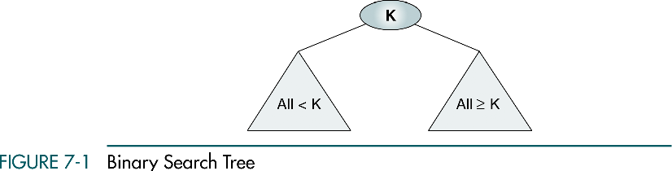

Slide 6
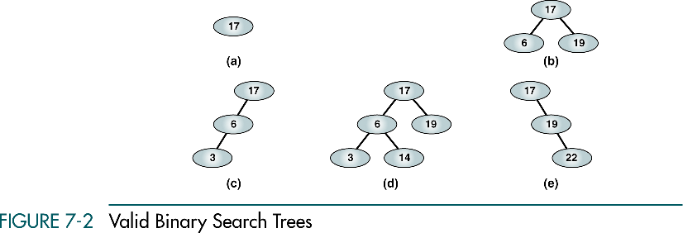
(a), (b) - complete and balanced trees;
(d) – nearly complete and balanced tree;
(c), (e) – neither complete nor balanced trees

Slide 7
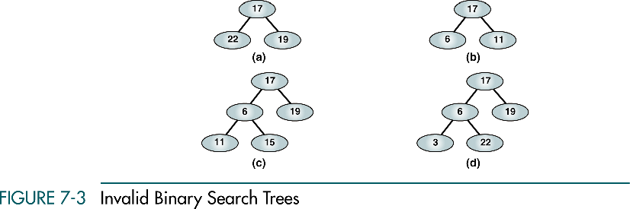

Slide 8
7-2 BST Operations
We discuss four basic BST operations: traversal, search, insert, and delete; and develop algorithms for searches, insertion, and deletion.
Traversals
Searches
Insertion
Deletion

Slide 9
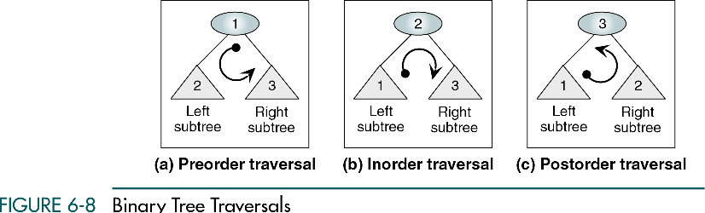

Slide 10
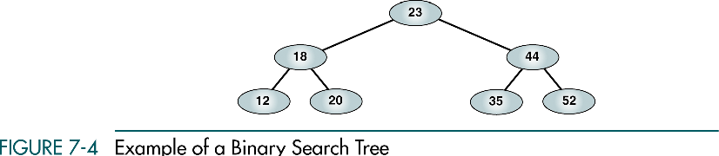

Slide 11
Preorder Traversal
23 18 12 20 44 35 52

Slide 12
Postorder Traversal
12 20 18 35 52 44 23

Slide 13
Inorder Traversal
12 18 20 23 35 44 52
Inorder traversal of a binary search tree produces a sequenced list

Slide 14
Right-Node-Left Traversal
52 44 35 23 20 18 12
Right-node-left traversal of a binary search tree produces a descending sequence

Slide 15
Three BST search algorithms:
Find the smallest node
Find the largest node
Find a requested node

Slide 16
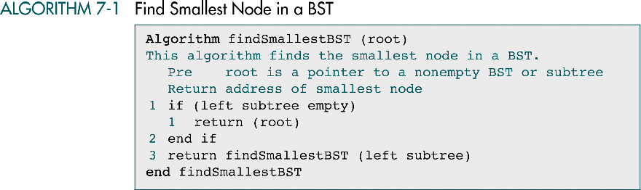

Slide 17
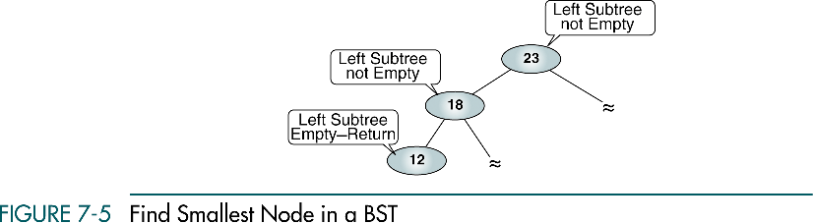

Slide 18
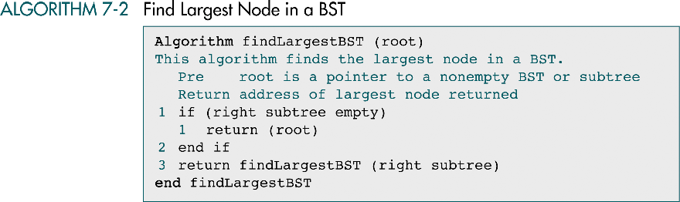

Slide 19
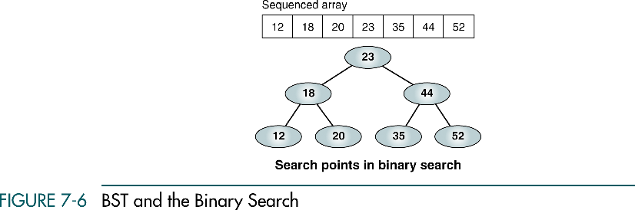

Slide 20
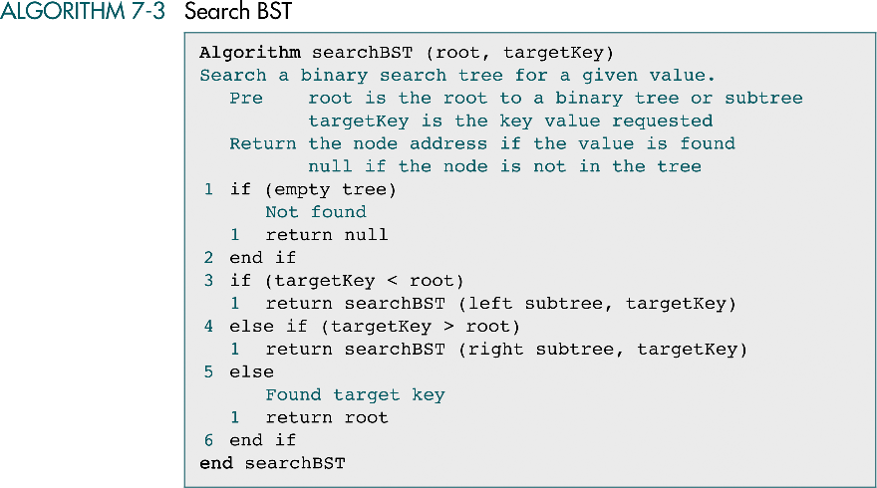

Slide 21
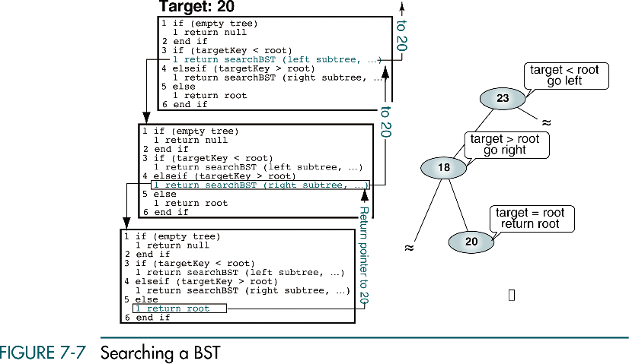

Slide 22
BST Insertion
To insert data all we need to do is follow the branches to an empty subtree and then insert the new node.
In other words, all inserts take place at a leaf or at a leaflike node – a node that has only one null subtree.

Slide 23
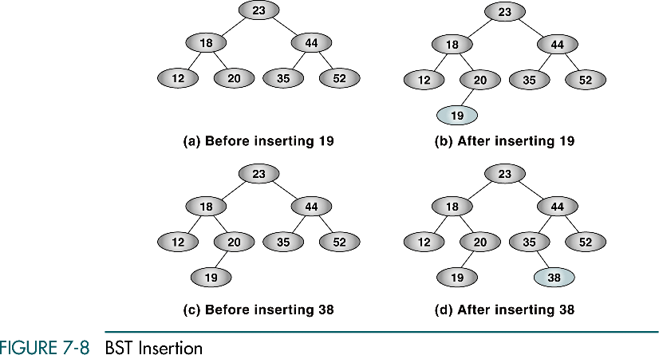

Slide 24
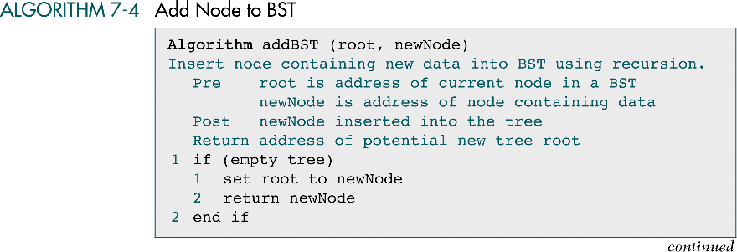

Slide 25
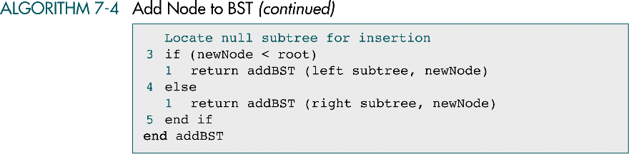

Slide 26
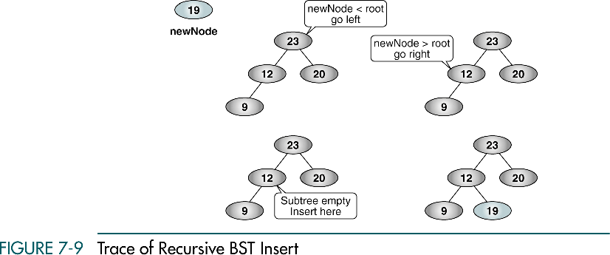
30
30
30
30

Slide 27
Deletion
There are the following possible cases when we delete a node:
The node to be deleted has no children. In this case, all we need to do is delete the node.
The node to be deleted has only a right subtree. We delete the node and attach the right subtree to the deleted node’s parent.
The node to be deleted has only a left subtree. We delete the node and attach the left subtree to the deleted node’s parent.
The node to be deleted has two subtrees. It is possible to delete a node from the middle of a tree, but the result tends to create very unbalanced trees.

Slide 28
Deletion from the middle of a tree
Rather than simply delete the node, we try to maintain the existing structure as much as possible by finding data to take the place of the deleted data. This can be done in one of two ways.

Slide 29
Deletion from the middle of a tree
We can find the largest node in the deleted node’s left subtree and move its data to replace the deleted node’s data.
We can find the smallest node on the deleted node’s right subtree and move its data to replace the deleted node’s data.
Either of these moves preserves the integrity of the binary search tree.

Slide 30
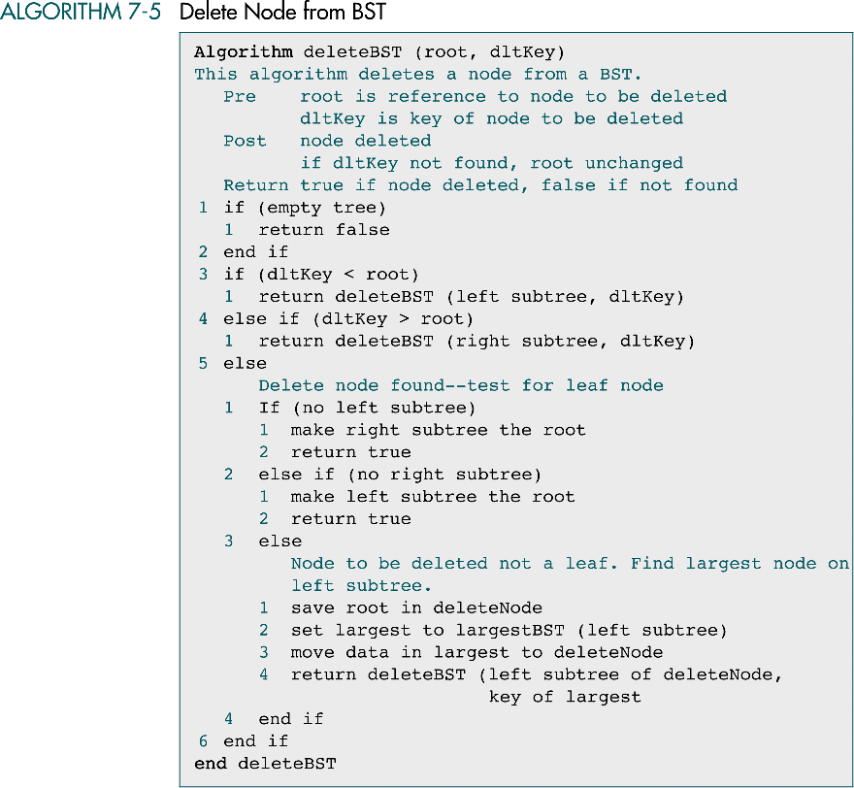

Slide 31
(continued)

Slide 32
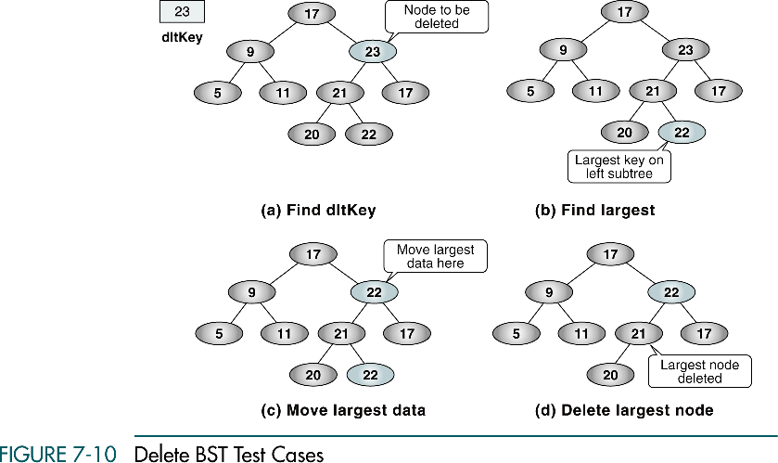
27
27
27
27

Slide 33
7-3 Binary Search Tree ADT
We begin this section with a discussion of the BST data structure and write the header file for the ADT. We then develop 14 programs that we include in the ADT.
Data Structure
Algorithms

Slide 34
