Slide 1
CSC 203
Data Structures
Heaps

Slide 2
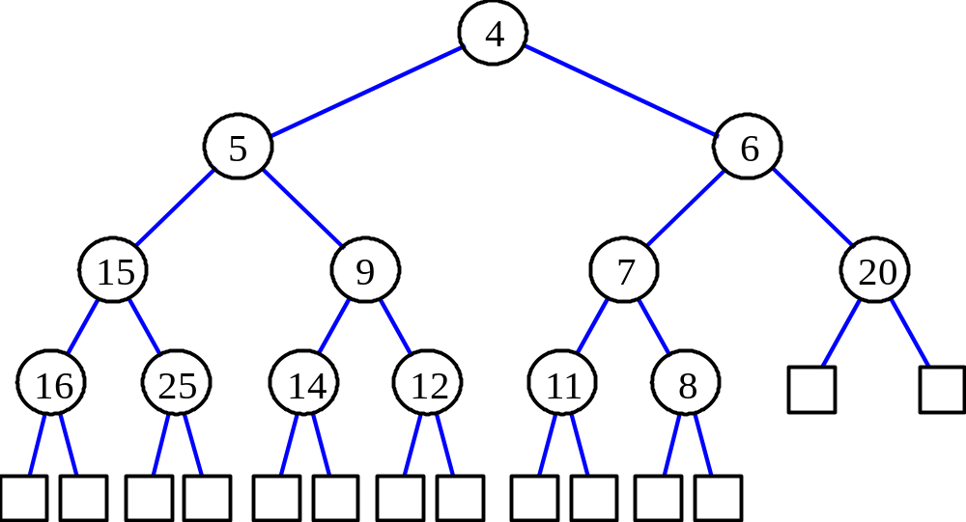
Heaps
A heap is a binary tree T that stores a key-element pairs at its internal nodes
It satisfies two properties:
  MinHeap: key(parent) ≤ key(child)
  [OR MaxHeap: key(parent) ≥ key(child)]
  all levels are full, except
  the last one, which is
  left-filled

Slide 3

What are Heaps Useful for?
To implement priority queues
Priority queue = a queue where all elements have a “priority” associated with them
Remove in a priority queue removes the element with the smallest priority
  insert
  removeMin

Slide 4
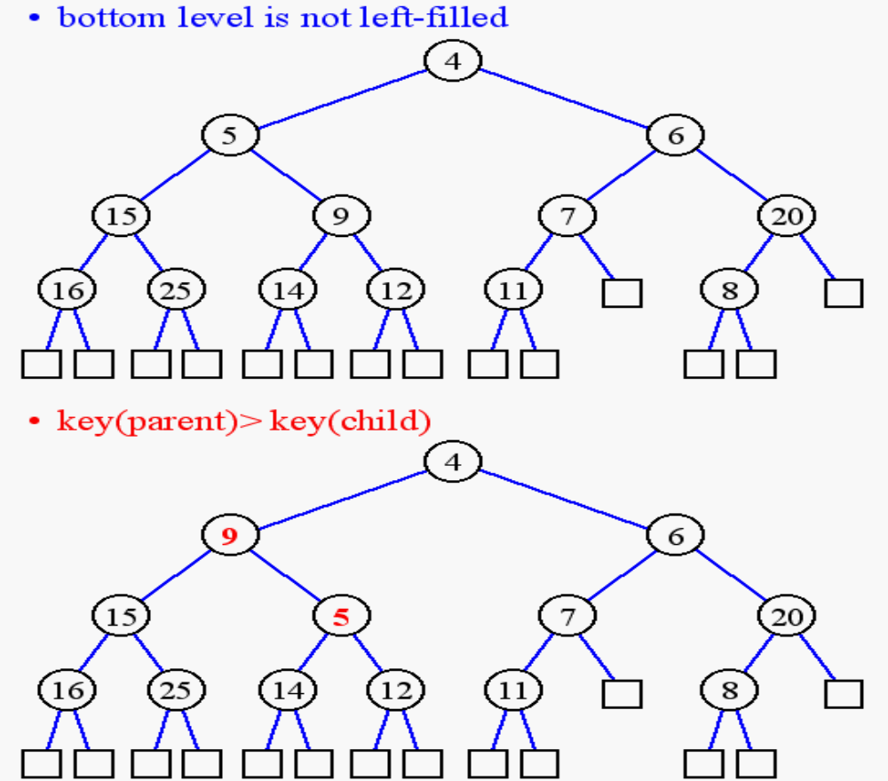
Heap or Not a Heap?

Slide 5
Heap Properties
A heap T storing n keys has height h = ⎣log(n + 1)⎦, which is O(log n)

Slide 6
ADT for Min Heap
objects: n > 0 elements organized in a binary tree so that the value in each
node is at least as large as those in its children
method:
Heap Create(MAX_SIZE)::= create an empty heap that can
hold a maximum of max_size elements
Boolean HeapFull(heap, n)::= if (n==max_size) return TRUE
else return FALSE
Heap Insert(heap, item, n)::= if (!HeapFull(heap,n)) insert
item into heap and return the resulting heap
else return error
Boolean HeapEmpty(heap, n)::= if (n>0) return FALSE
else return TRUE
Element Delete(heap,n)::= if (!HeapEmpty(heap,n)) return one
instance of the smallest element in the heap
and remove it from the heap
else return error

Slide 7
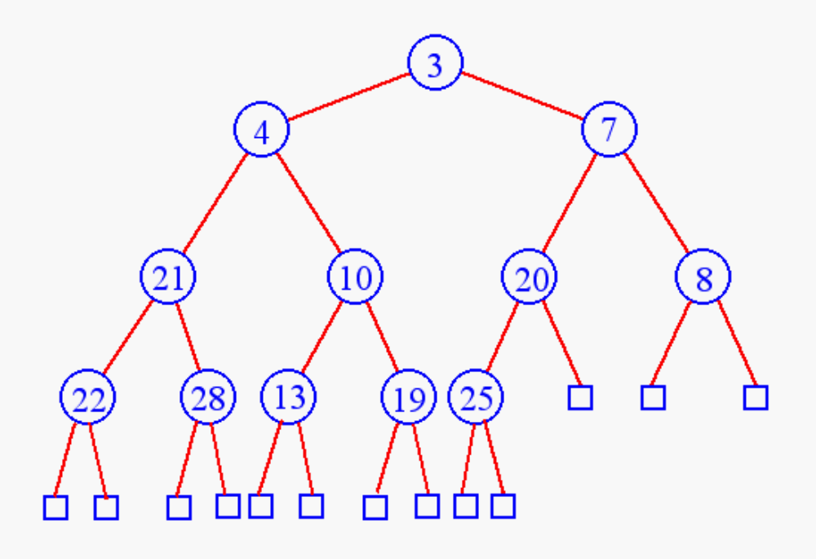
Heap Insertion
Insert 6

Slide 8
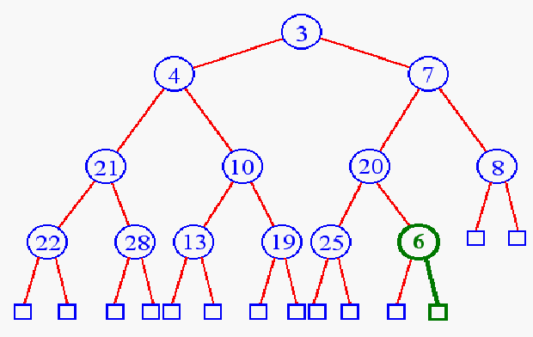
Heap Insertion
Add key in next available position

Slide 9
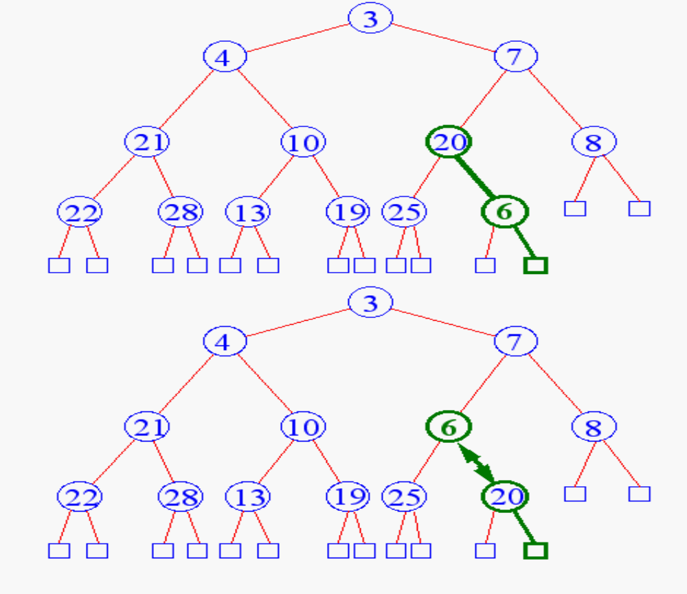
Heap Insertion
Begin Unheap

Slide 10
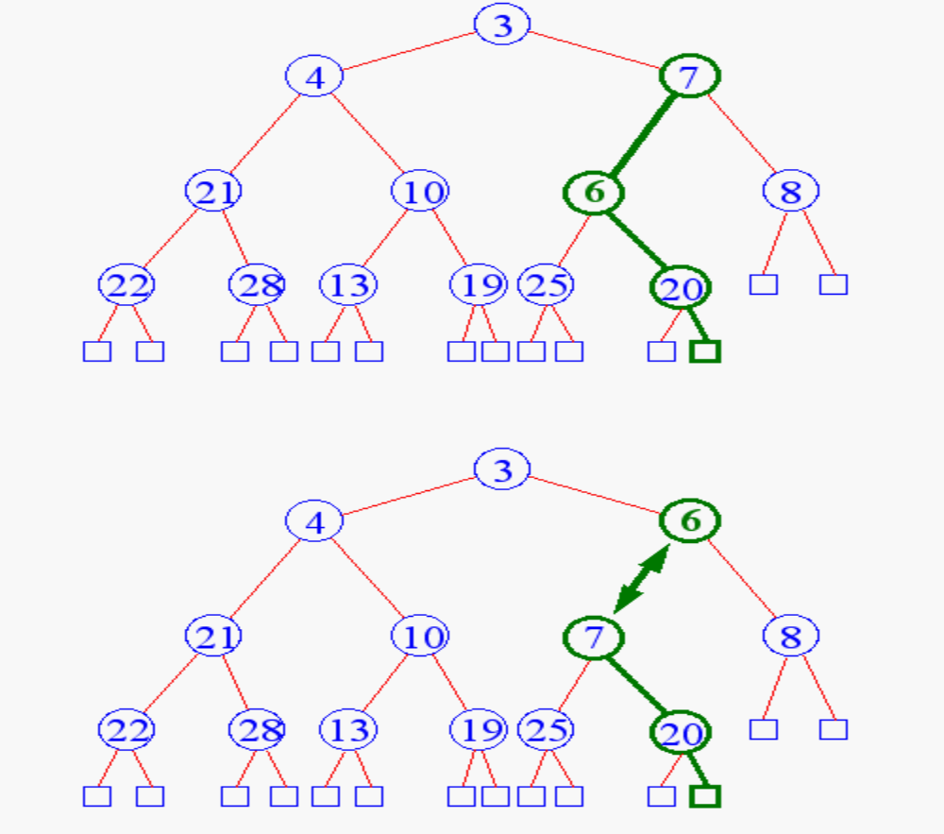
Heap Insertion

Slide 11
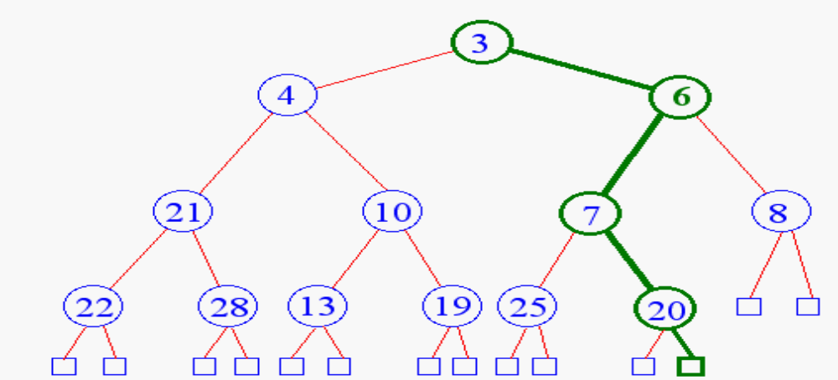
Heap Insertion
Terminate unheap when
  reach root
  key child is greater than key parent

Slide 12
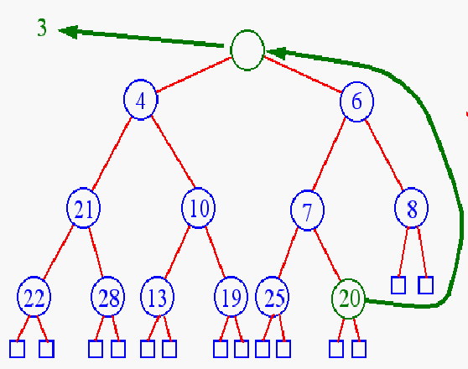
Heap Removal
Remove element
from priority queues?
removeMin( )

Slide 13
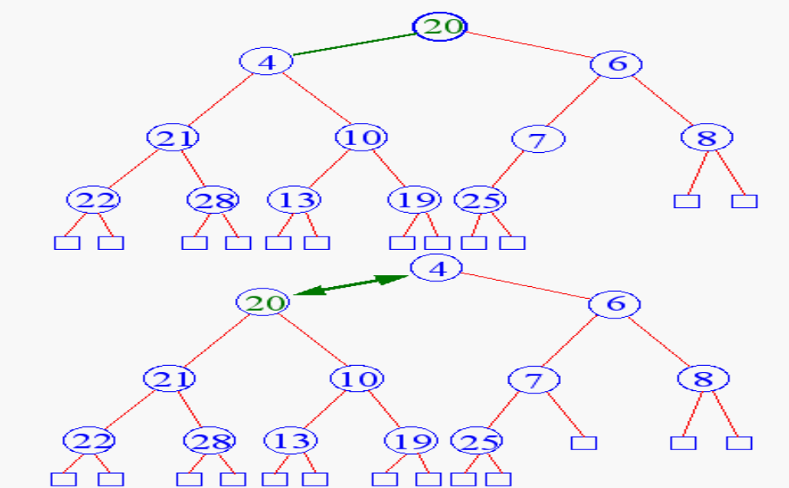
Heap Removal
Begin downheap

Slide 14
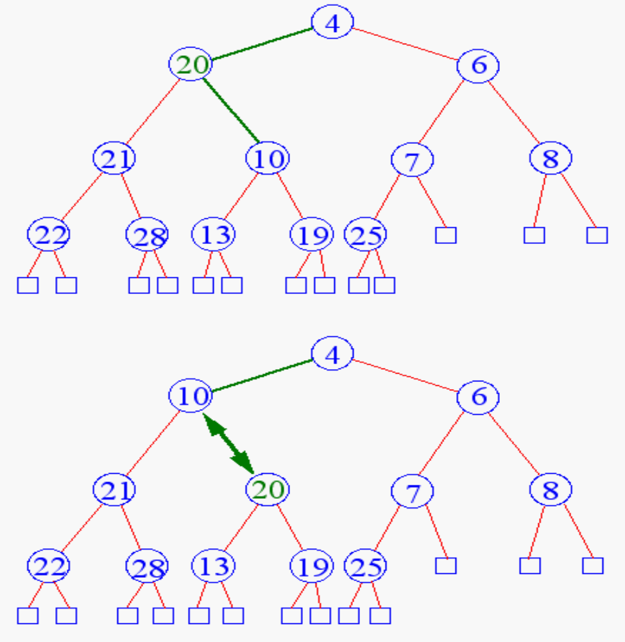
Heap Removal

Slide 15
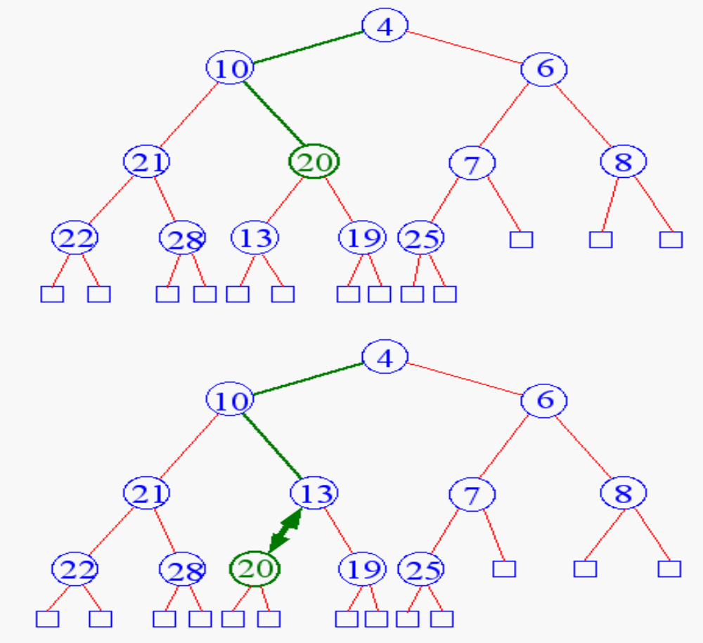
Heap Removal

Slide 16
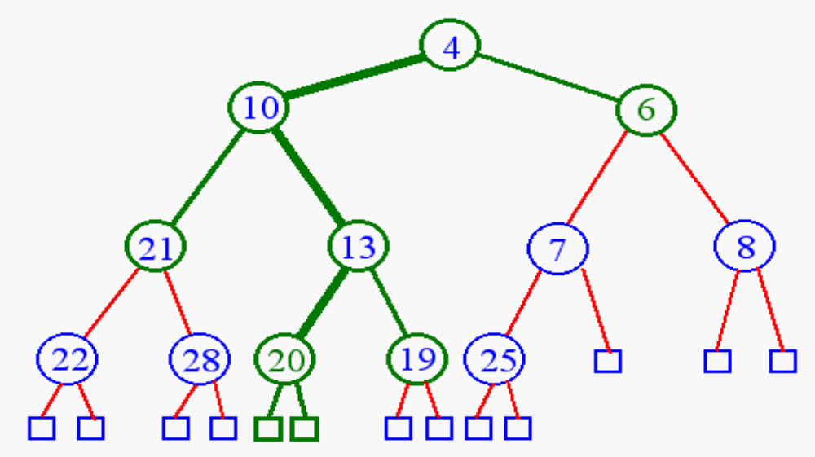
Heap Removal
Terminate downheap when
  reach leaf level
  key parent is greater than key child

Slide 17
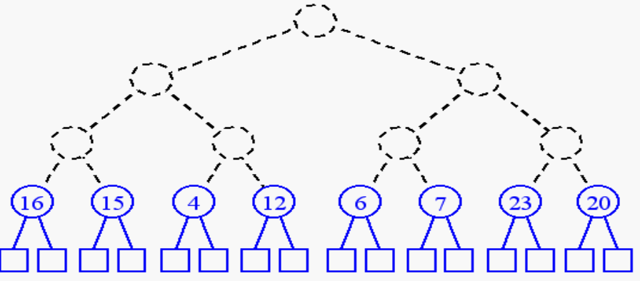
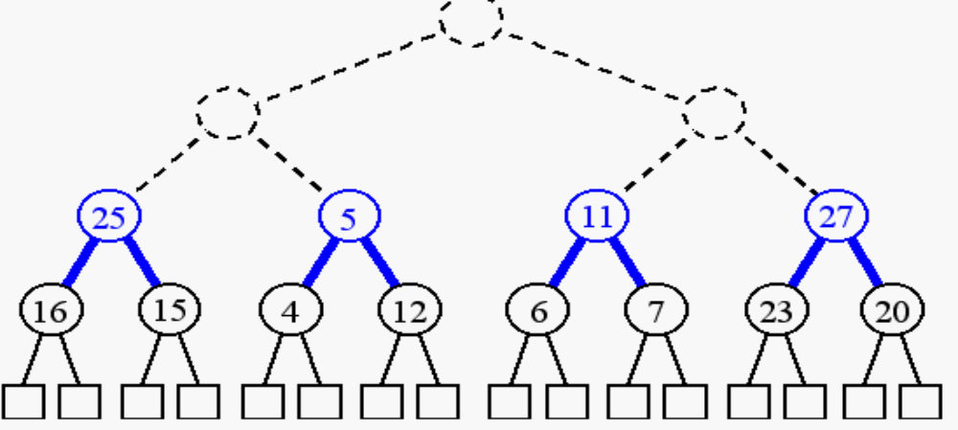
Building a Heap
build (n + 1)/2 trivial one-element heaps
build three-element heaps on top of them

Slide 18
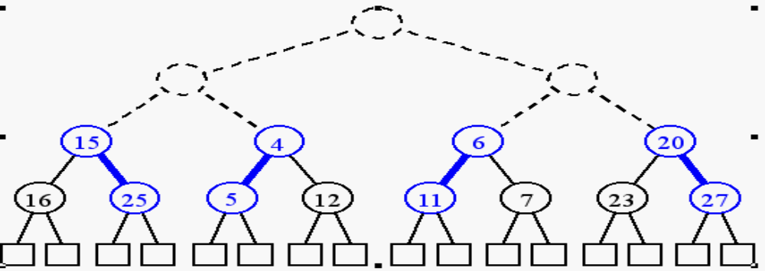
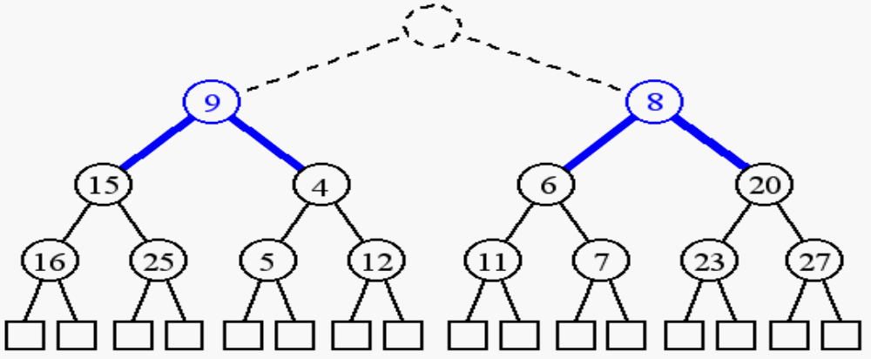
Building a Heap
downheap to preserve the order property
now form seven-element heaps

Slide 19
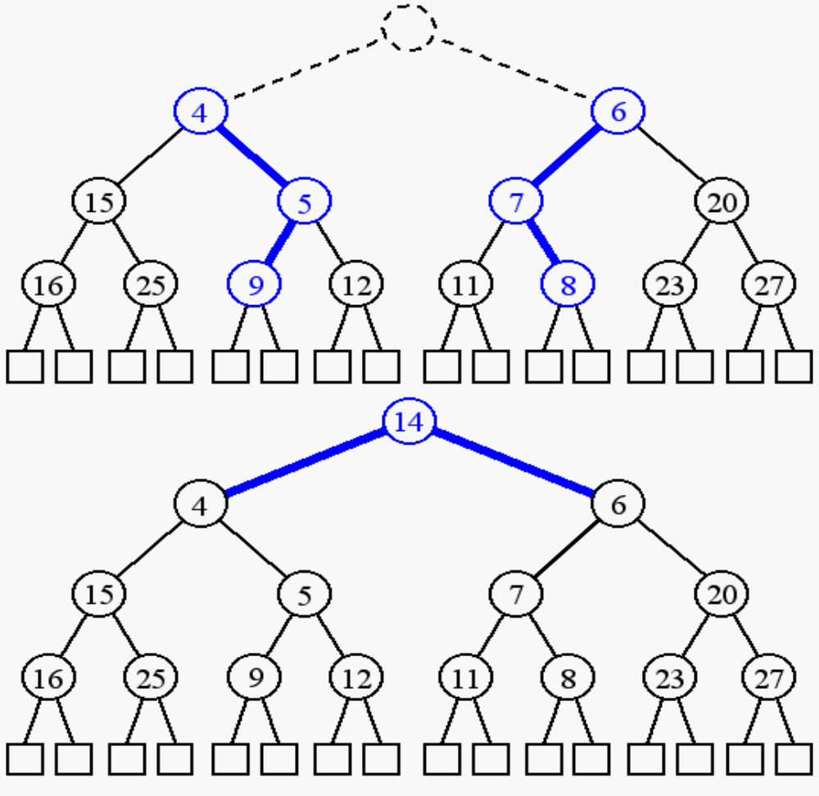
Building a Heap

Slide 20
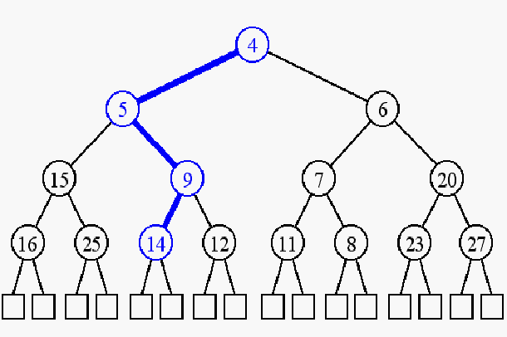
Building a Heap

Slide 21
Heap Implementation
Using arrays
Parent = k ; Children = 2k , 2k+1
Why is it efficient?
[1]
6
[1]
6
[1]
30
[2]
12
[3]
7
[2]
9
[3]
7
[2]
31
[5]
[6]
[4]
[4]
18
19
9
10

Slide 22
Insertion into a Heap
void insertHeap(element item, int *n)
{
int i;
if (HEAP_FULL(*n)) {
fprintf(stderr, “the heap is full.\n”);
exit(1);
}
i = ++(*n);
while ((i!=1)&&(item.key>heap[i/2].key)) {
heap[i] = heap[i/2];
i /= 2;
}
heap[i]= item;
}
2^{k}-1=n ==> k=⎡log₂(n+1)⎤
O(log₂n)

Slide 23
Deletion from a Heap
element deleteHeap(int *n)
{
int parent, child;
element item, temp;
if (HEAP_EMPTY(*n)) {
fprintf(stderr, “The heap is empty\n”);
exit(1);
}
/* save value of the element with the
highest key */
item = heap[1];
/* use last element in heap to adjust heap */
temp = heap[(*n)--];
parent = 1;
child = 2;

Slide 24
Deletion from a Heap (cont’d)
while (child <= *n) {
/* find the larger child of the current
parent */
if ((child < *n)&&
(heap[child].key<heap[child+1].key))
child++;
if (temp.key >= heap[child].key) break;
/* move to the next lower level */
heap[parent] = heap[child];
child *= 2;
}
heap[parent] = temp;
return item;
}

Slide 25
Heap Sorting
Step 1: Build a heap
Step 2: removeMin( )
Running time?

