Slide 1
BPMN (Business Process Model and Notation)

Slide 2
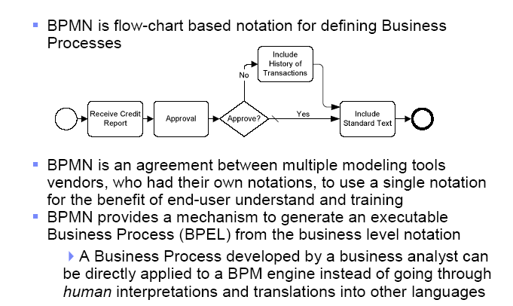
What is BPMN ?

Slide 3
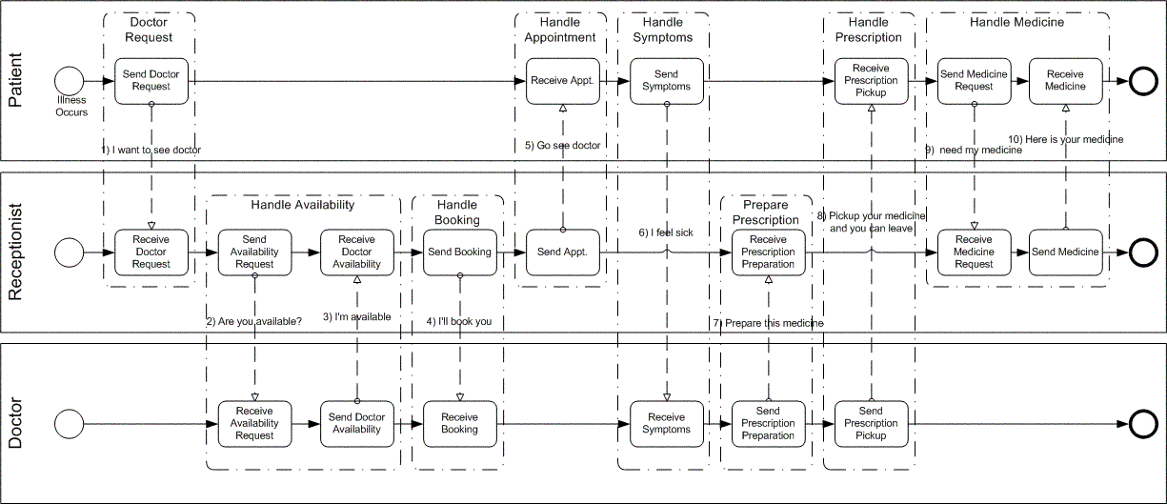
BPMN example

Slide 4
BPMN History
BPMN 1.0 (BPMI) – Mai 2004
BPMN1.x
BPMN 1.1 (OMG) – Januar 2008
BPMN 1.2 (OMG) – Januar 2009
BPMN 2.0 final Juni 2010
http://www.omg.org/spec/BPMN/2.0/

Slide 5
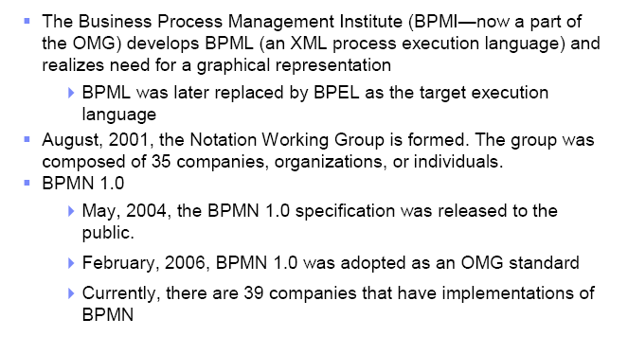
History for BPMN

Slide 6
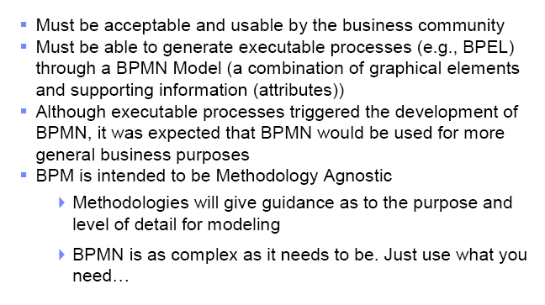
BPMN requirements

Slide 7
Core Set of Diagram Elements
The core set of modeling elements enable the easy development simple Business Process Diagrams that will look familiar to most Business Analysts (a flowchart diagram)

Slide 8
Complete Set of Diagram Elements, Events
An Event is something that “happens” during the course of a business process. These Events affect the flow of the Process and usually have a trigger or a result. They can start, interrupt, or end the flow.

Slide 9
Complete Set of Diagram Elements, Activities, Cont.
A Sub-Process can be in an expanded form that shows the process details of the a lower-level set of activities.

Slide 10
Complete Set of Diagram Elements, Gateways
Gateways are modeling elements that are used to control how Sequence Flows interact as they converge and diverge within a Process. If the flow does not need to be controlled, then a Gateway is not needed.

Slide 11
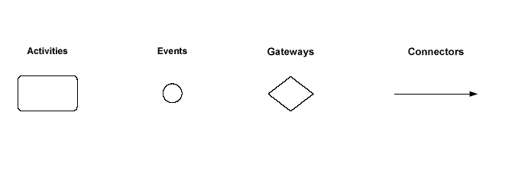
BPMN Diagram elements

Slide 12
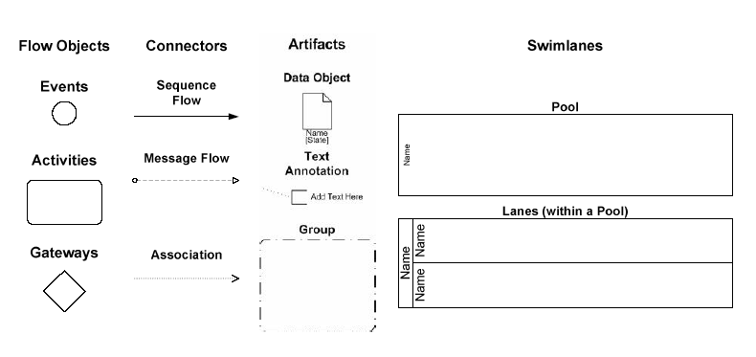
Diagram elements (2)

Slide 13
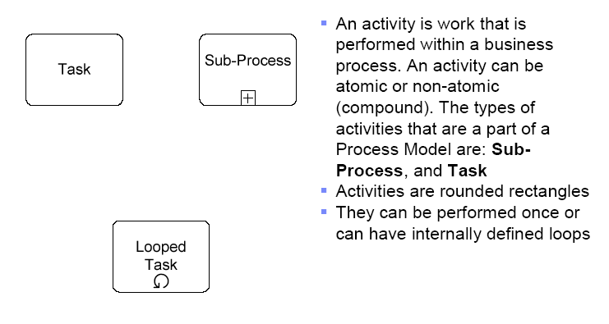
Activities

Slide 14
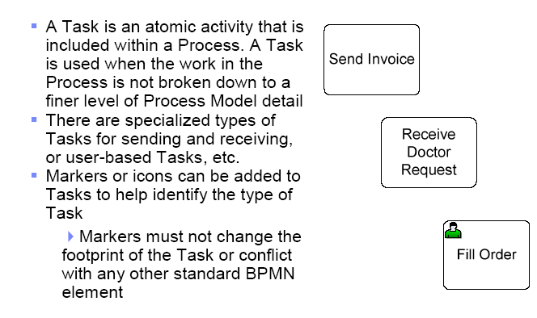
Task

Slide 15
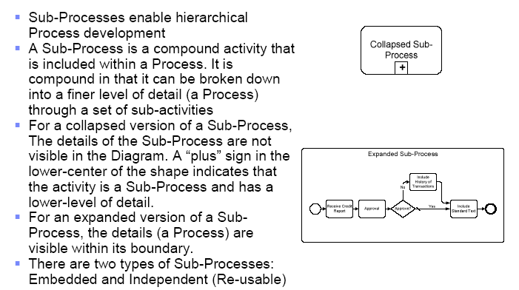
Sub-processes

Slide 16
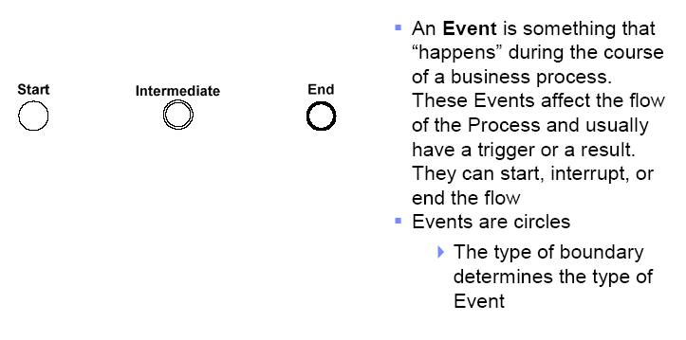
Events

Slide 17
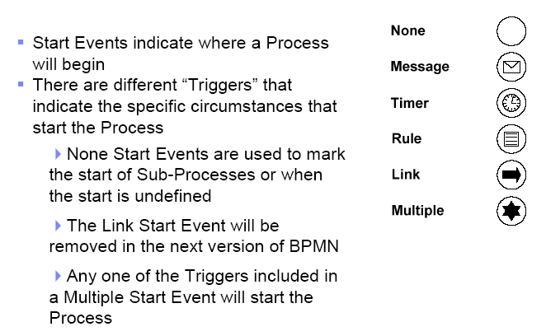
Start Events

Slide 18
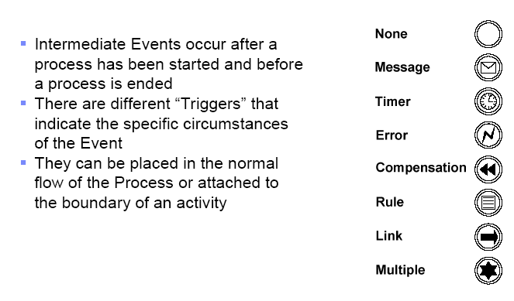
Intermediate Events

Slide 19
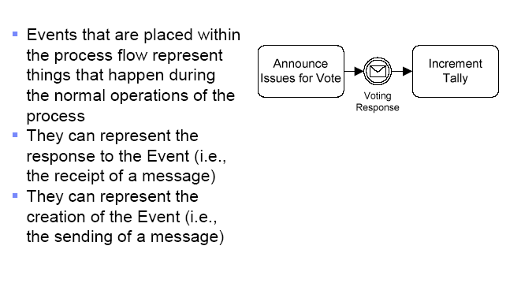
Intermediate events (normal flow)

Slide 20
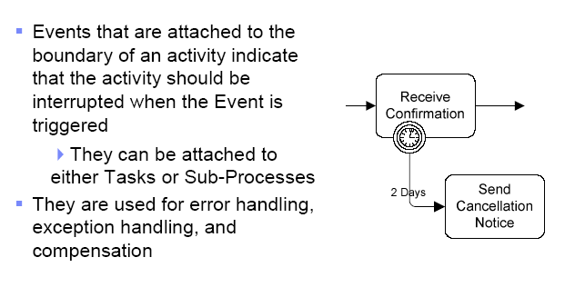
Intermediate events (linked to Boundary)

Slide 21
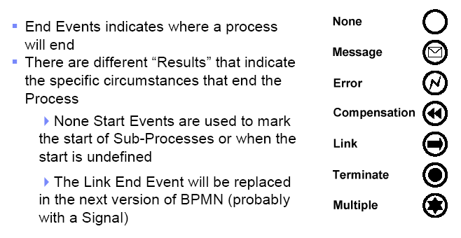
End events

Slide 22
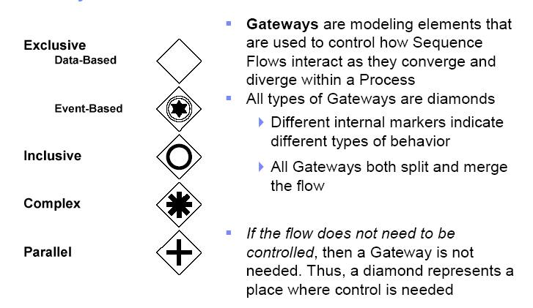
Gateways

Slide 23
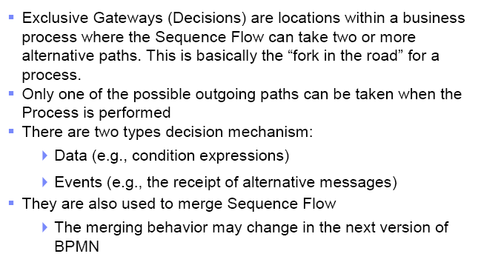
Exclusive Gateways

Slide 24
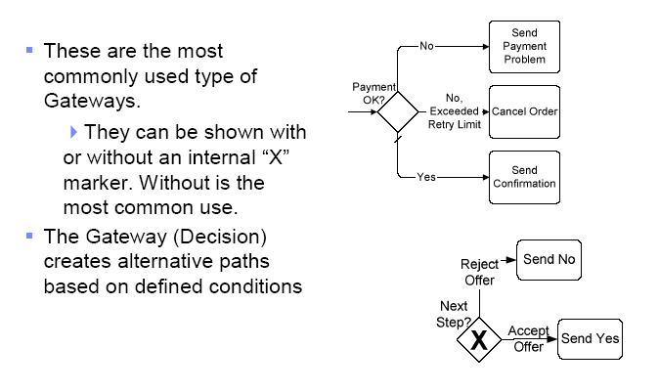
Exclusive Gateways, based on data

Slide 25
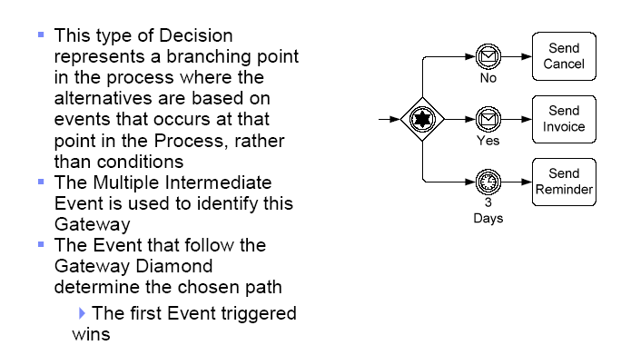
Exclusive Gateways, based on events

Slide 26
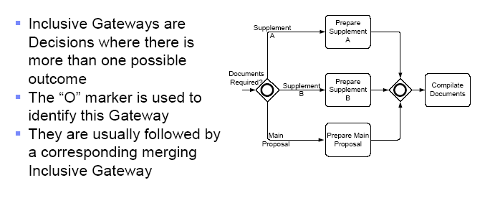
Inclusive Gateways

Slide 27
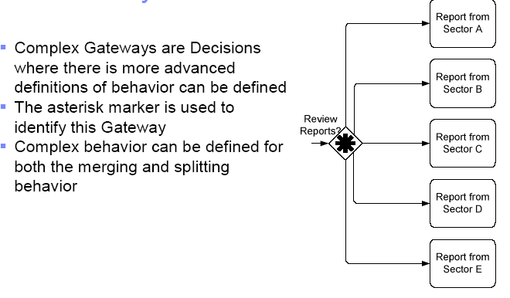
Complex Gateways

Slide 28
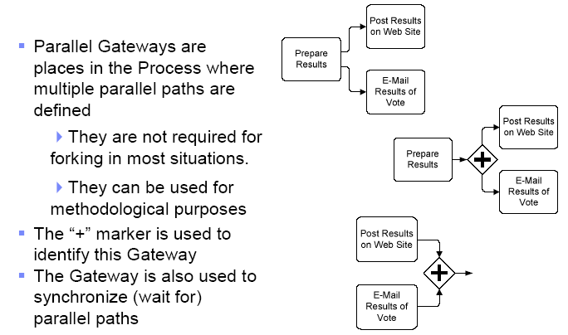
Complex Gateways

Slide 29
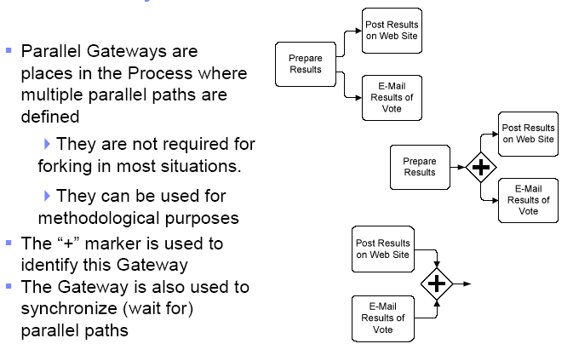
Parallell Gateways

Slide 30
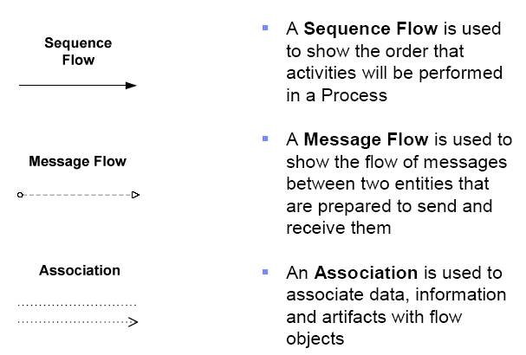
Conectors

Slide 31
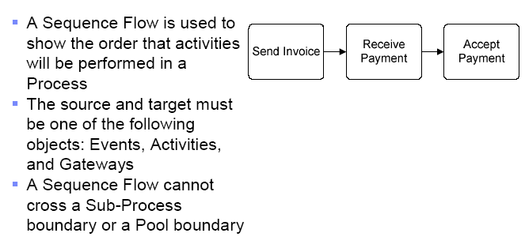
Sequence flow

Slide 32
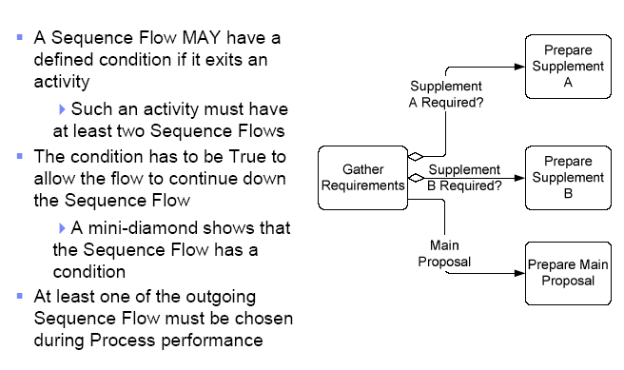
Conditions in sequence flow

Slide 33
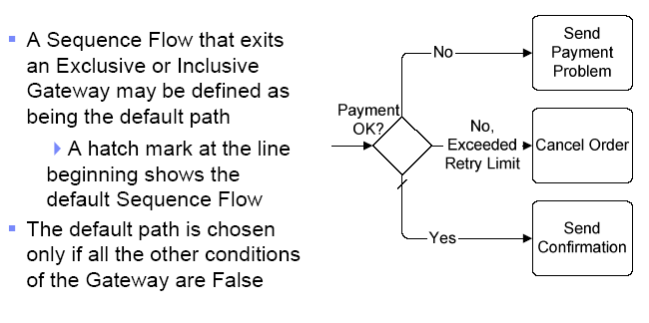
Default sequence flow

Slide 34
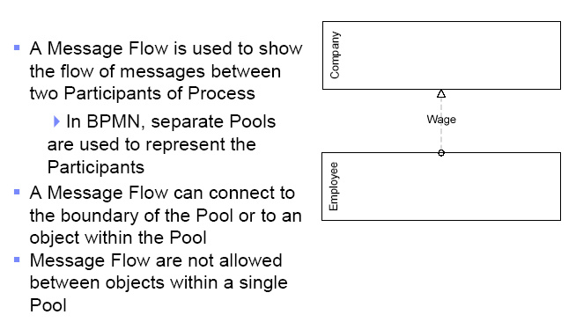
Message flow

Slide 35
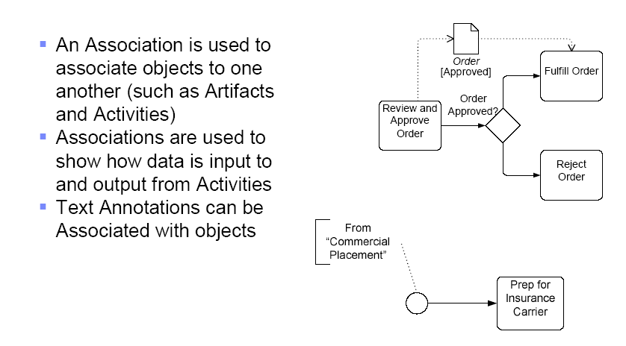
Associations

Slide 36
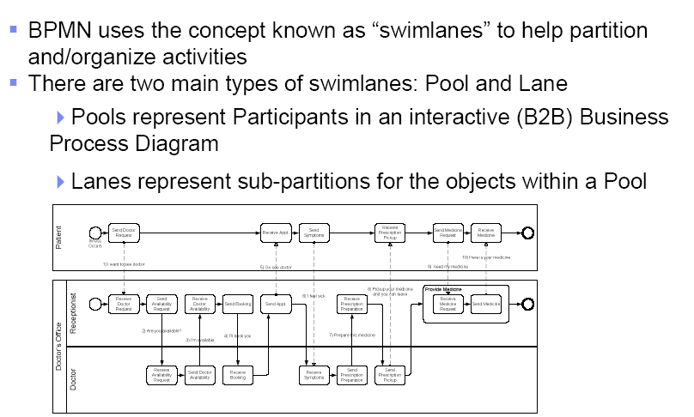
Swim lanes

Slide 37
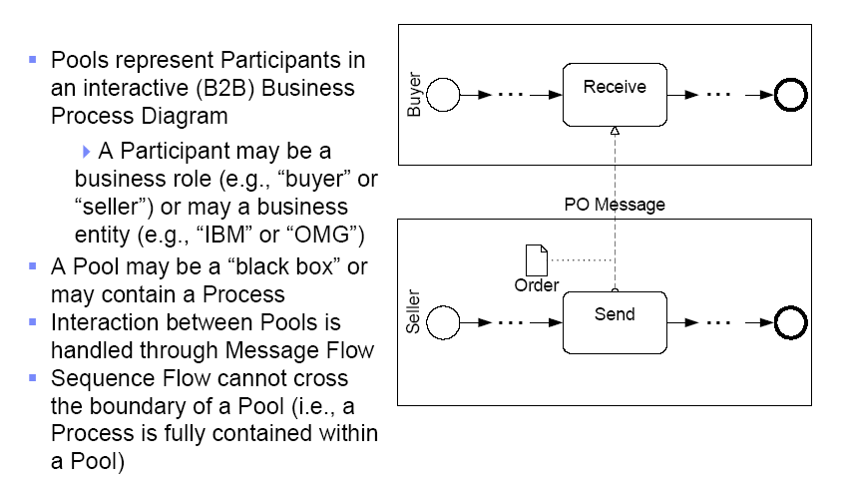
Pool

Slide 38
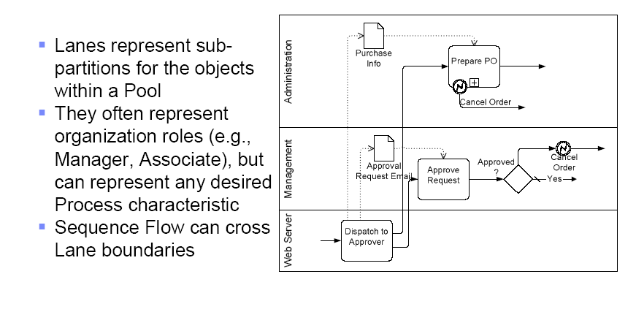
Lanes

Slide 39
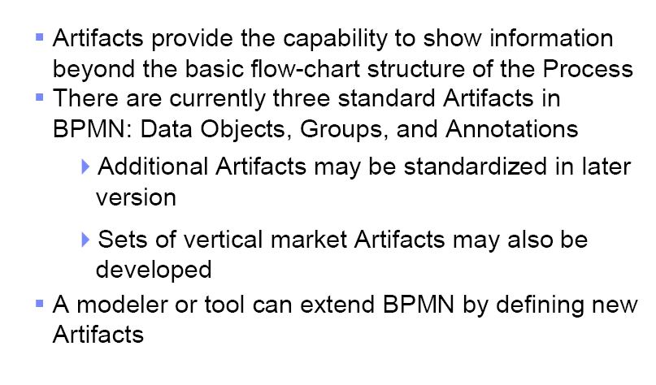
Artifacts

Slide 40
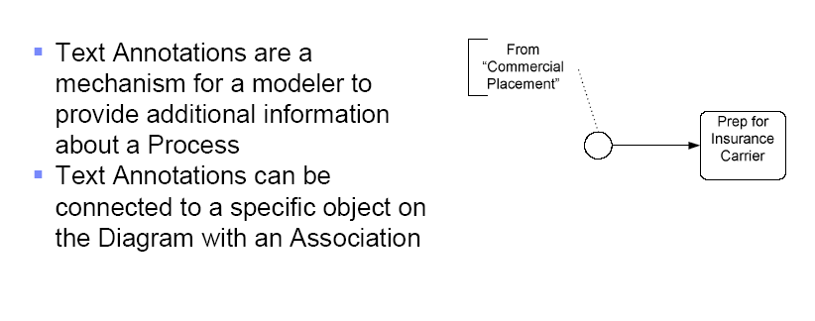
Text annotations

Slide 41
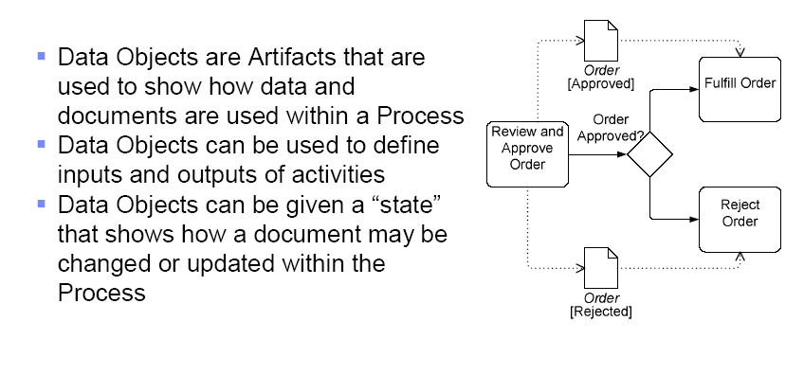
Data objects

Slide 42
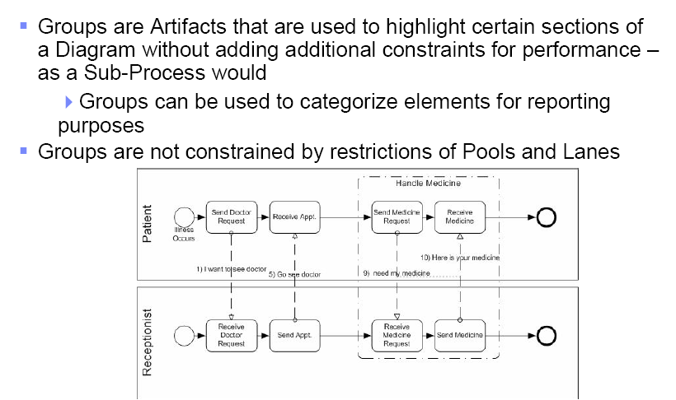
Groups

Slide 43
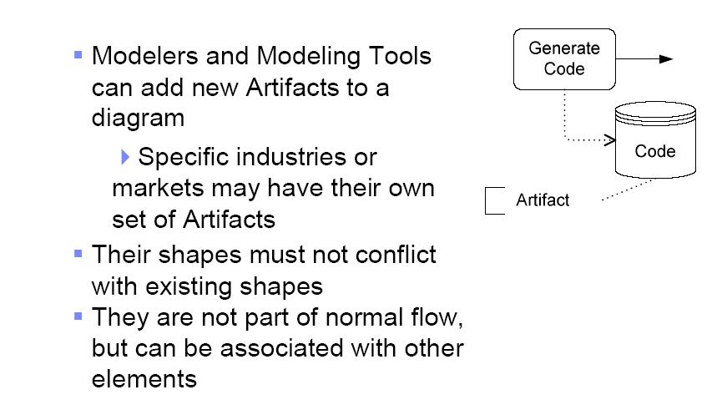
Extended artifacts

Slide 44
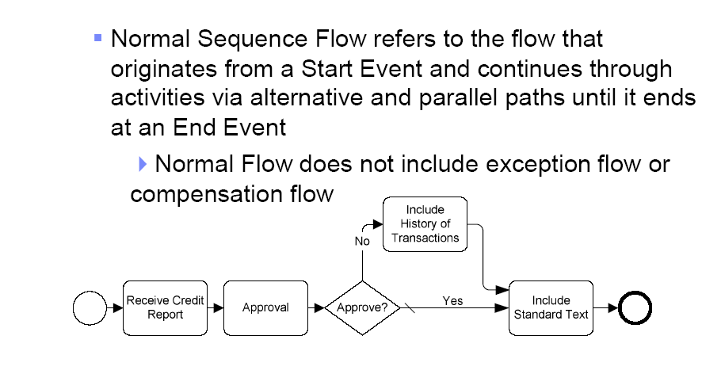
Normal flow

Slide 45
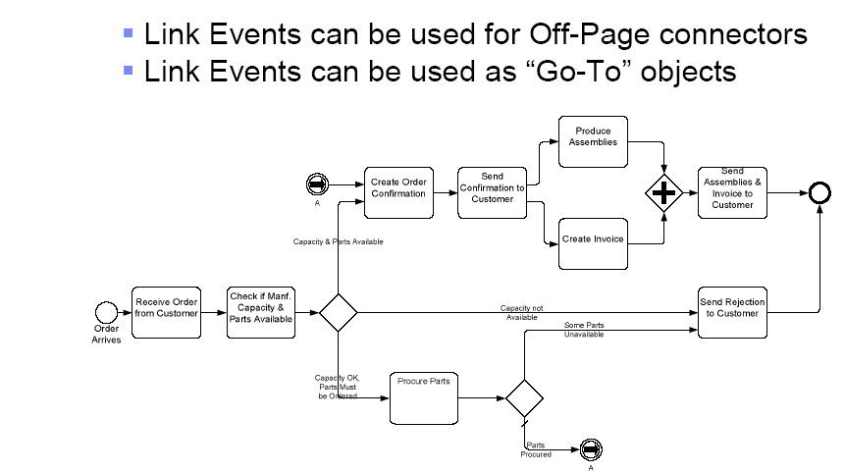
Link events

Slide 46
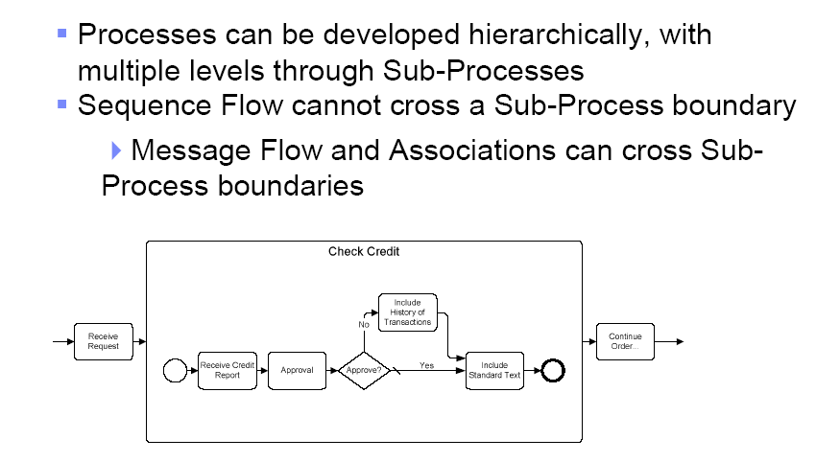
Process leves

Slide 47
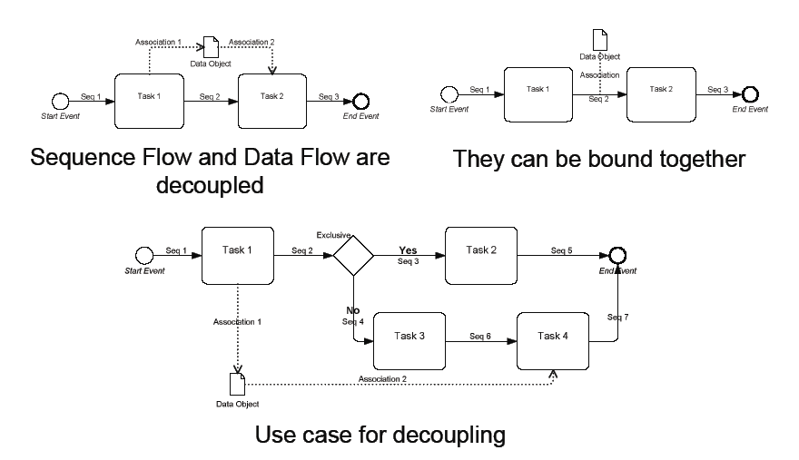
Data flow

Slide 48
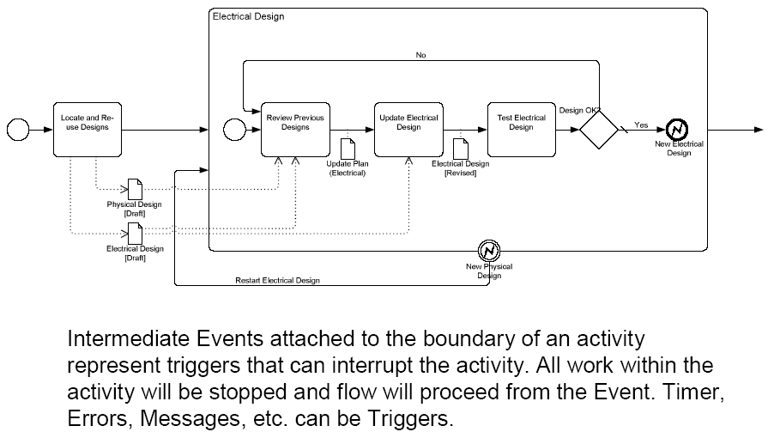
Exceptions

Slide 49
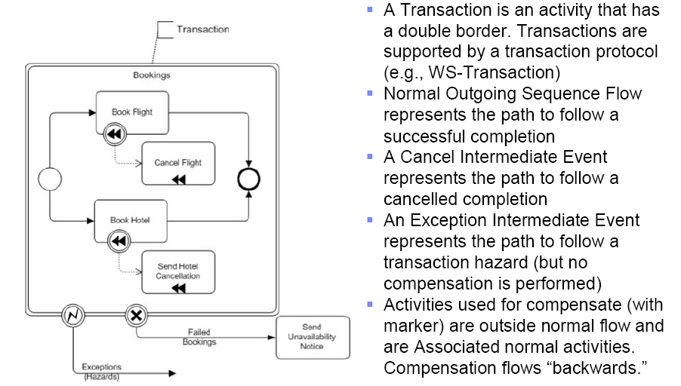
Compenations and transacations

Slide 50
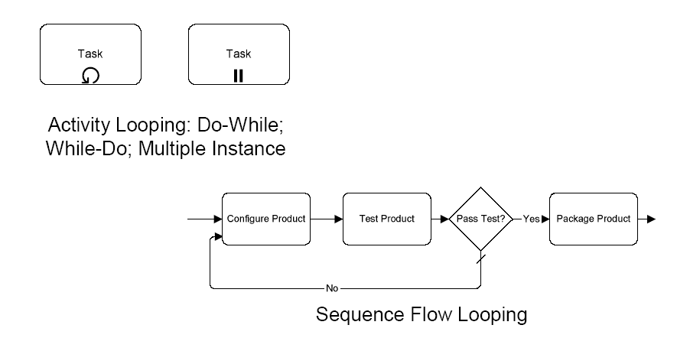
Loops

Slide 51
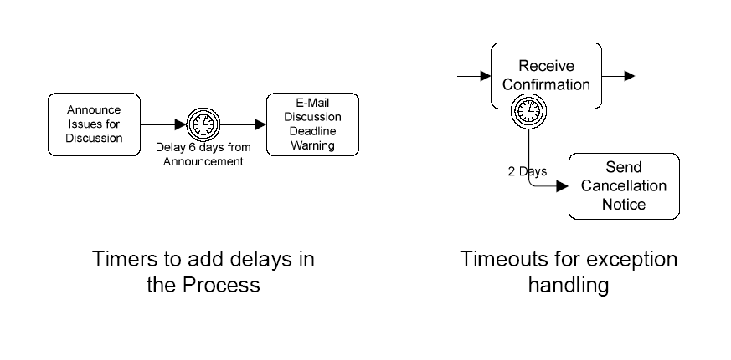
Timers

Slide 52
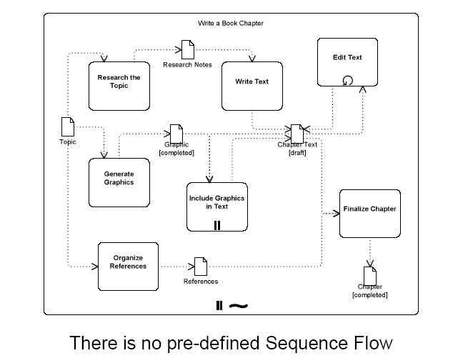
Ad hoc processes

Slide 53
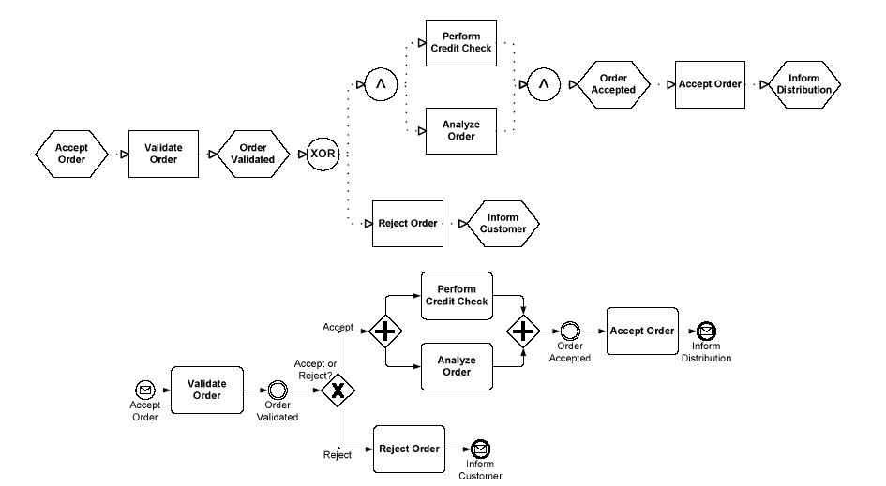
EPC og BPMN
EPC
EPC
BPMN

Slide 54
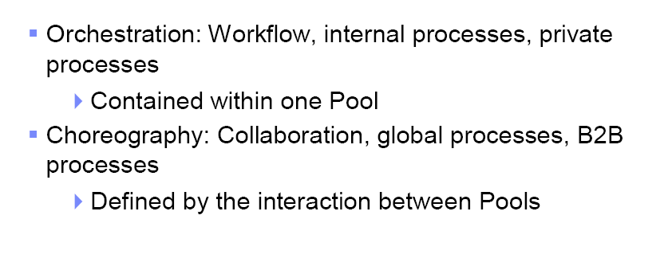
Orchestration versus Choreography

Slide 55
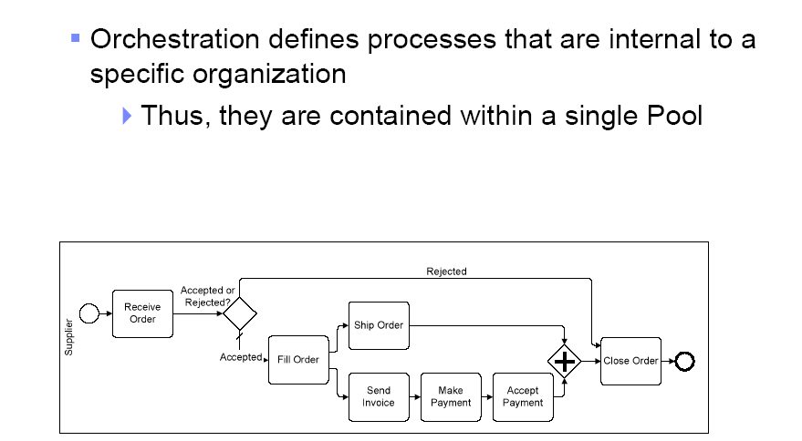
Orkestrering

Slide 56
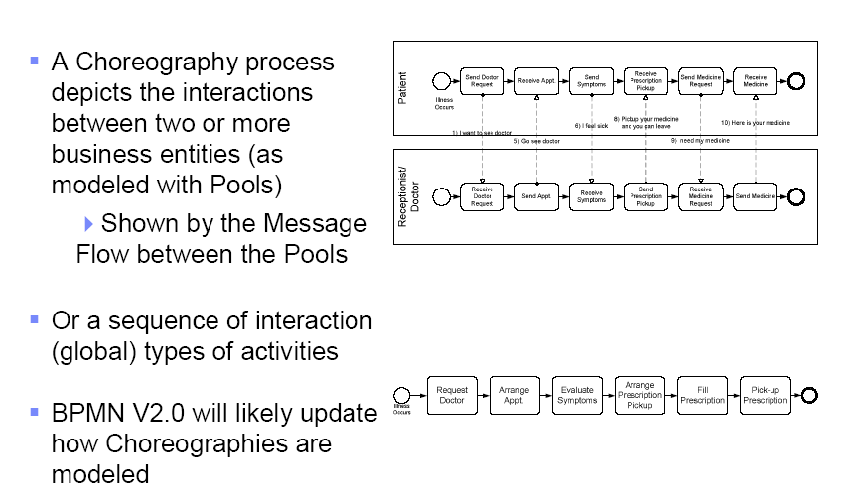
Koreografi

Slide 57

Eksempel

Slide 58

Prosess informasjon

Slide 59


Slide 60


Slide 61


Slide 62


Slide 63


Slide 64
Example – doctor’s office
A text description of the choreography was presented as so:
1) Patient send a "I want to see doctor" message to the Receptionist
2) Receptionist send a "Are you available ?" message to a a list of Doctors
3) One doctor send a "I'm available" message to the Receptionist.
4) Receptionist send a "I'll book you" message to the Doctor.
5) Receptionist send a "Go see doctor" message to the Patient
6) Patient send a "I feel sick" message to Doctor
7) Doctor send a "Prepare this medicine" message to Receptionist
8) Doctor send a "Pickup your medicine and you can leave" message to Patient
9) Patient send a "I need my medicine" message to Receptionist
10) Receptionist send a "Here is your medicine" message to Patient

Slide 65


Slide 66


Slide 68


Slide 69


Slide 70
BPMN 2.0: Major changes from BPMN1.x
Notational changes
New diagrams for Choreography and Conversation
New event-types (escalation, …)
Non-interrupting events
Event sub-process
Call Activity– replaces linked/reusable activity
Technical changes
Formal metamodel – specified in UML
Interchange formats for semantic model interchange (XMI, XSD)
Interchange formats for diagram interchange (XMI, XSD)
XSLT transformations between XMI and XSD formats

Slide 71

Process diagram
Flowchart view to sequence activities within an organization
Support the modeling of simple processes
Enhanced by BPMN to handle more complex concepts, such as exception handling, transactions, and compensation.

Slide 72

Collaboration diagram
Provides a view of the interactions (flow of messages) between two or more business partners (Participants).
Collaborations can be combined with Processes to show how the interactions are related to the internal Process activities.

Slide 73

Collaboration diagram example

Slide 74

Conversation diagram
Allows a modeler to group Collaboration interactions between two or more Participants, which together achieve a common goal, e.g. “negotiate delivery”
The grouping can be based on business keys such as customer id or shipping id.

Slide 75

Corresponding choreography example
Provides a flowchart view to sequence interactions between Participants
Choreographies define a “business contract” or protocol to which the Participants agree to follow during real-time interactions.

Slide 76

Choreography diagram
Provides a flowchart view to sequence interactions between Participants
Choreographies define a “business contract” or protocol to which the Participants agree to follow during real-time interactions.

Slide 77

Activity types - visualised

Slide 78

Multi-instance activites - visualised
Parallel
Serial

Slide 79





New Artifact Shapes
Data Artifact
Data Artifact Collection
Data Artifact Input
Data Artifact Output
Data Source Artifact

Slide 80





New Event Gateways
Current event-based gateway
Event Based Exclusive Intermediate
Event Based Exclusive Start Gateway
Event Based Inclusive Start
Event Based Inclusive Intermediate

Slide 81



Non-interrupting Intermediate Events
Boundary intermediate events in BPMN 1.0-1.2 are interrupting
BPMN2.0 introduces new non-interrupting intermediate events
Boundary events
Catching
Example of use

Slide 82

Non-interrupting Event Sub-process (expanded)

Slide 83

Non-interrupting Event Sub-process (collapsed)

Slide 84

Interrupting Event Sub-process

Slide 85

BPMN 2.0 Event Gallery

Slide 86
Sources
The (beta) BPMN 2.0 specification - http://www.omg.org/spec/BPMN/2.0/
Bruce Silver – http://www.bpmnstyle.com
Rick Geneva – http://processmodeling.info
Stephen White - https://apps.lotuslive.com/bpmblueworks/community/?p=902
BPMN 0.9, 1.0, 1.1, 1.2, …..

Slide 87
Thank You

