Slide 2
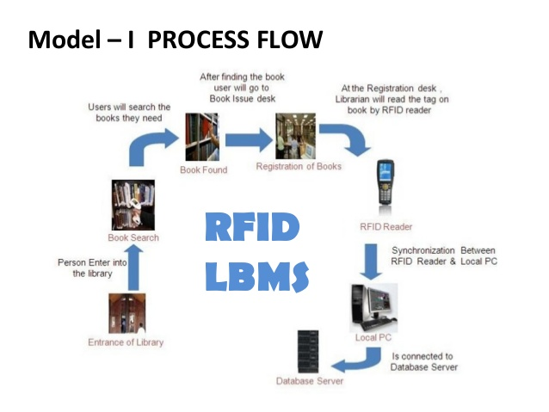

Slide 3
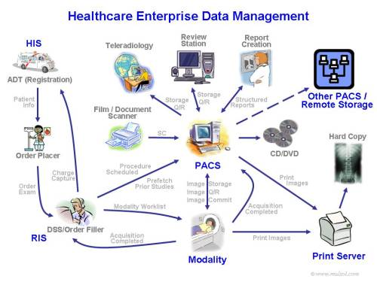

Slide 4
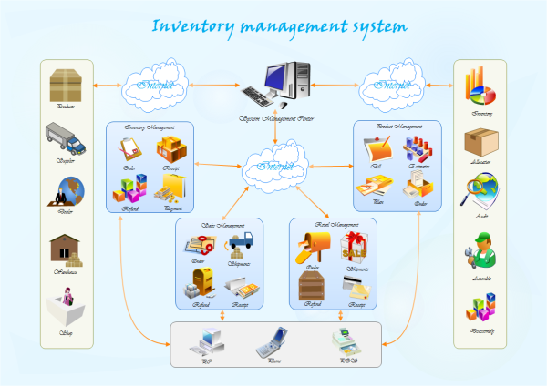
Rich picture Example

Slide 5
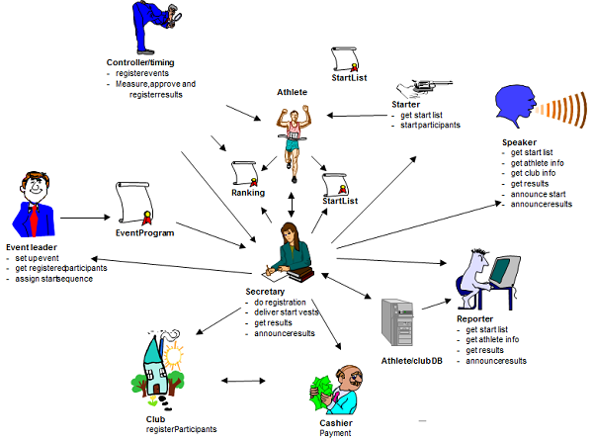
Rich Picture Example

Slide 6
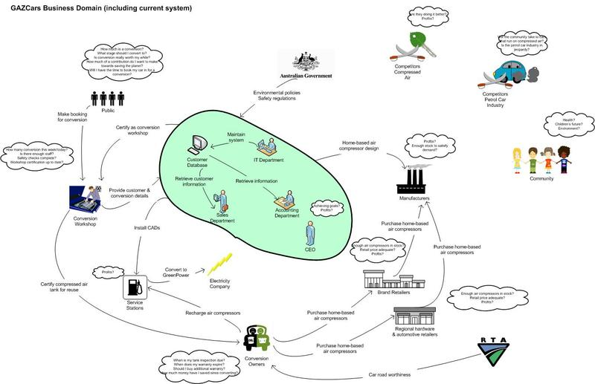
Rich picture Example

Slide 7
Six Element Analysis
Process | System Roles
 | Human | Non-Computing Hardware | Computing Hardware | Soft- ware | Database | Comm. Network

Slide 8
Problem Analysis Template
Process Name | Stakeholders | Concerns (Problems) | Analysis (Reason of the Problem) | Proposed Solution

Slide 9
Data model

Slide 10
Preliminary data model

Slide 11
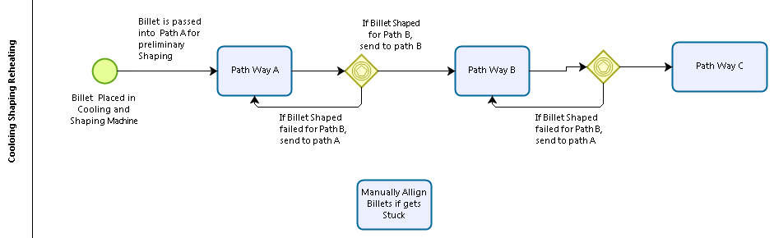
Process Model with BPMN 2.0

Slide 12
Data Dictionary Example
STUDENT:
Name | Data Type | Size | Remark
Student ID | Text | 7 | This is the primary key of this relation. This contain the ID of the students. Example: ‘9710780’
Cgpa | Number |  | This contains cumulative grade point average of the students. Example: ‘3.92’
Date of Birth | Datetime | “dd/mm/yy” | This contains date of birth of the students. Example: 29/01/81
Dept ID | Text | 5 | Department ID of the student. This is a foreign key from Table DEPARTMENT. Example: ‘CSE’

Slide 13
Data Dictionary: Conventional way
tblstudent:
Name | Data Type | Size | Remark
cstudentID | Text | 7 | This is the primary key of this relation. This contain the ID of the students. Example: ‘9710780’
ncgpa | Number |  | This contains cumulative grade point average of the students. Example: ‘3.92’
ddob | Datetime | “dd/mm/yy” | This contains date of birth of the students. Example: 29/01/81
cDeptID | Text | 5 | Department ID of the student. This is a foreign key from Table DEPARTMENT. Example: ‘CSE’

Slide 14
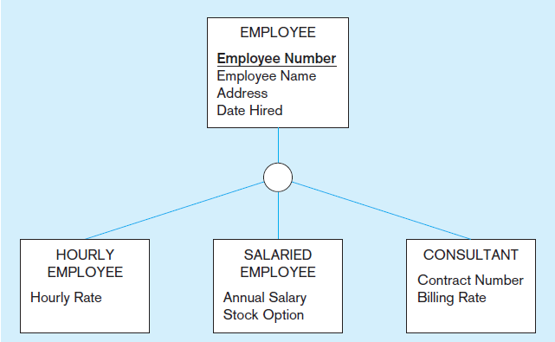
Employee supertype with three subtypes

Slide 15
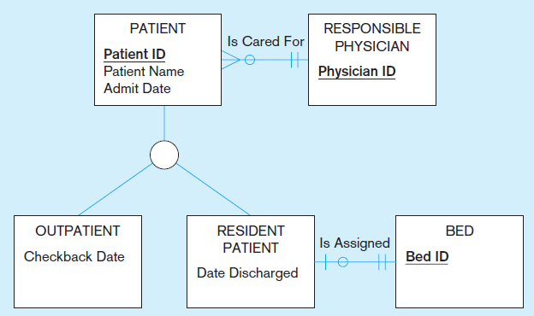
Supertype/subtype relationships in a hospital

Slide 16
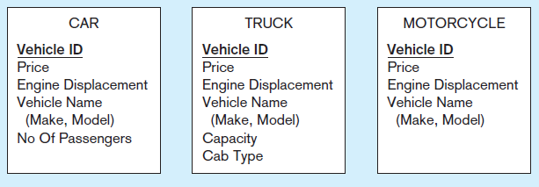
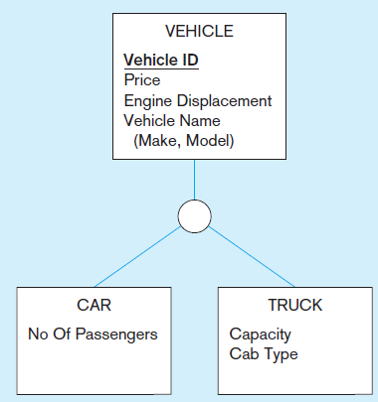
Generalization
Generalization The process of defining a more general entity type from a set of more specialized entity types.

Slide 17
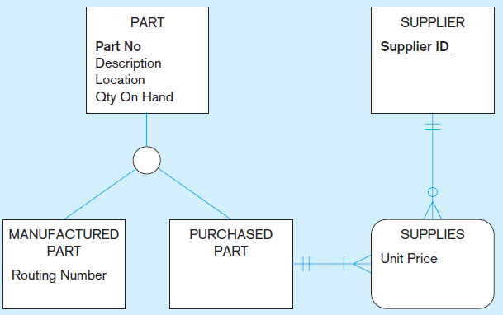
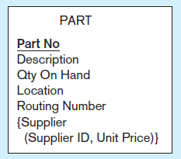
Specialization
Specialization The process of defining one or more subtypes of the supertype and forming supertype/subtype relationships.

Slide 18
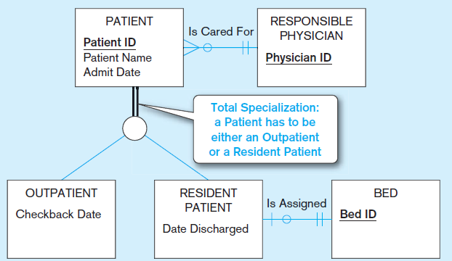
Total specialization rule

Slide 19
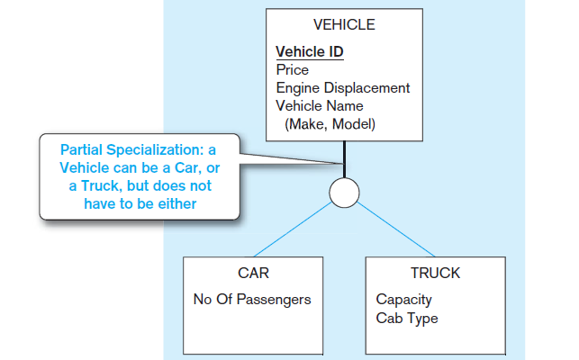
Partial specialization rule

Slide 20
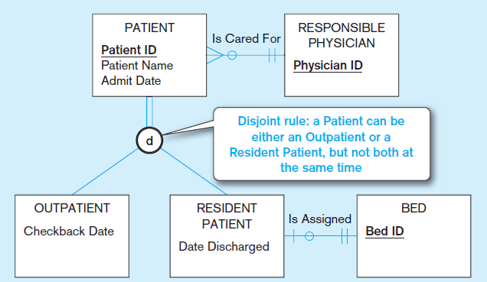
Disjoint rule

Slide 21
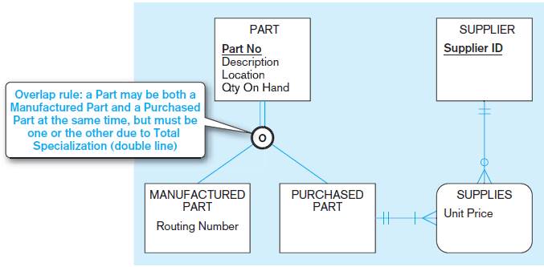
Overlap rule

Slide 22
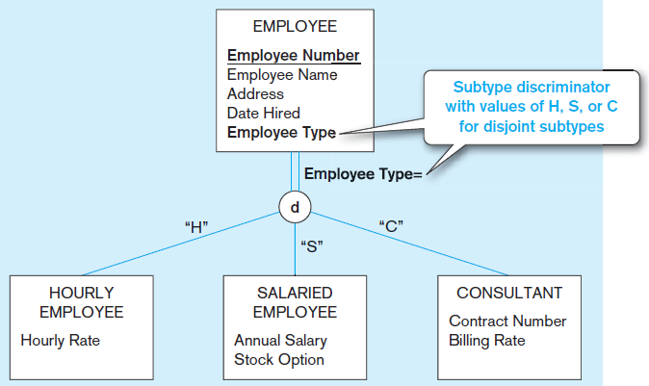
Defining Subtype Discriminators
Subtype discriminator An attribute of a supertype whose values determine the target subtype or subtypes.

Slide 23
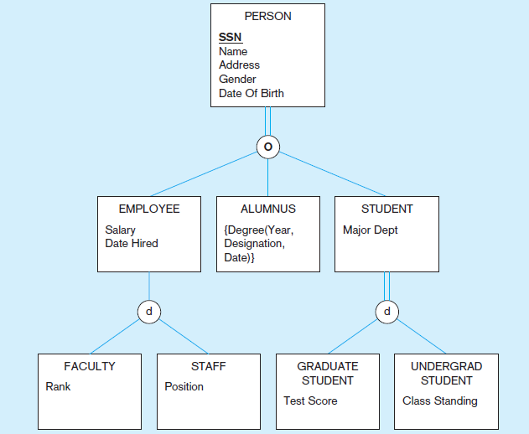
Supertype/subtype hierarchy
A hierarchical arrangement of supertypes and subtypes in which each subtype has only one supertype.

Slide 24
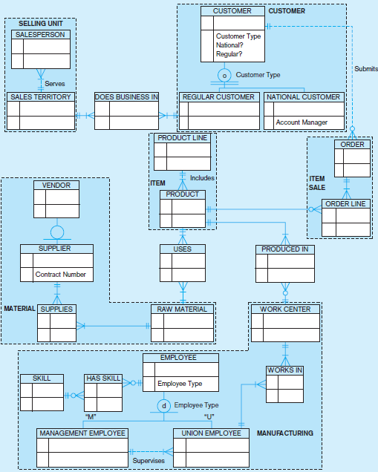

Slide 25
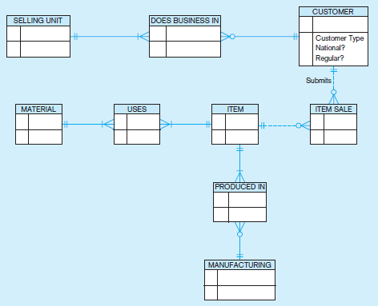

Slide 26
Unary Relation

Slide 27
Binary Relation

Slide 28
Ternary Relation

Slide 29
Relationship cardinality
Mandatory One
Optional One
Mandatory Many
Optional Many

Slide 35
Cardinality constraints in a ternary relationship

Slide 36
Modeling Multiple Relationships Between Entity Types

Slide 37
An associative attribute

Slide 38
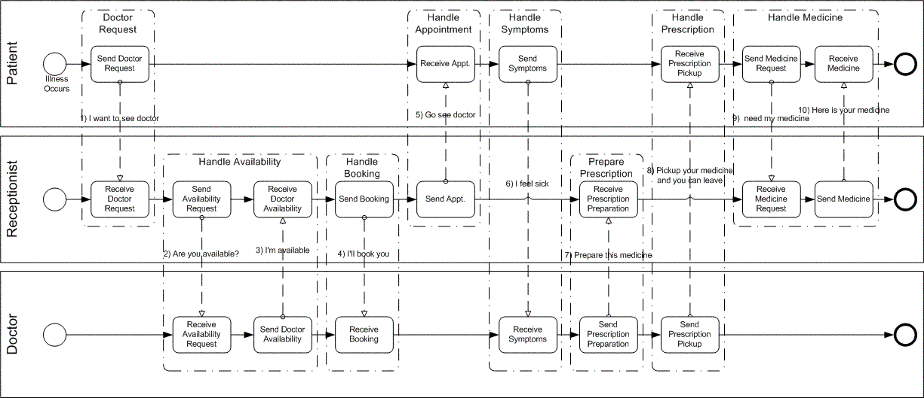
BPMN example

