Slide 1
Introduction to Database Concepts
CSE
Department of
Computer
Science
&
Engineering
Lecture 02
CSC 401: Database Management System

Slide 2
DATABASE DEVELOPMENT PROCESS
A data-oriented methodology to create and maintain information systems
Top-down planning approach.
Four steps:
Planning
Results in an Information Systems Architecture
Analysis
Results in functional specifications…i.e. what we want
Design
Results in design specifications…i.e. how we’ll do it
Implementation
Results in final operational system

Slide 3
DATABASE DEVELOPMENT PROCESS
Planning:
Purpose: To develop a preliminary understanding of a business situation and how information systems might help solve a problem or make an opportunity possible
Enterprise modeling
Analyze current data processing
Analyze the general business functions and their database needs
Justify need for new data and databases in support of business
Conceptual data modeling
Identify scope of database requirements for proposed information system
Analyze overall data requirements for business function(s) supported by database

Slide 4
DATABASE DEVELOPMENT PROCESS
Analysis
Purpose: To analyze the business situation thoroughly to determine requirements, to structure those requirements, and to select among competing system features.
Conceptual data modeling, cont’d.
Develop preliminary conceptual data model, including entities and relationships
Compare preliminary conceptual data model with enterprise data model
Develop detailed conceptual data model, including all entities, relationships, attributes, and business rules
Make conceptual data model consistent with other models of information system
Populate repository with all conceptual database specifications

Slide 5
DATABASE DEVELOPMENT PROCESS
Design
Purpose: To elicit and structure all information requirements; to develop all technology and organizational specifications.
Logical database design
Analyze in detail the transactions, forms, displays, and inquiries (database views) required by the business functions supported by the database
Integrate database views into conceptual data model
Identify data integrity and security requirements, and populate repository
Physical database design and definition
Define database to DBMS (often generated from repository)
Decide on physical organization of data
Design database processing programs

Slide 6
DATABASE DEVELOPMENT PROCESS
Implementation
Purpose: To write programs, build databases, test and install the new system, train users, and finalize documentation
Database implementation
Code and test database processing programs
Complete database documentation and training materials
Install database and convert data from prior systems

Slide 7
DATABASE DEVELOPMENT PROCESS
Maintenance
Purpose: To monitor the operation and usefulness of the system, and to repair and enhance the system
Database maintenance
Analyze database and database applications to ensure that evolving information requirements are met
Tune database for improved performance
Fix errors in database and database applications and recover database when it is contaminated

Slide 8
Alternative Approaches to Database and IS Development
SDLC
System Development Life cycle
Detailed, well-planned development process
Time-consuming, but comprehensive
Long development cycle
Prototyping
Rapid application development (RAD)
Cursory attempt at conceptual data modeling.
Define database during development of initial prototype.
Repeat implementation and maintenance activities with new prototype versions.

Slide 9
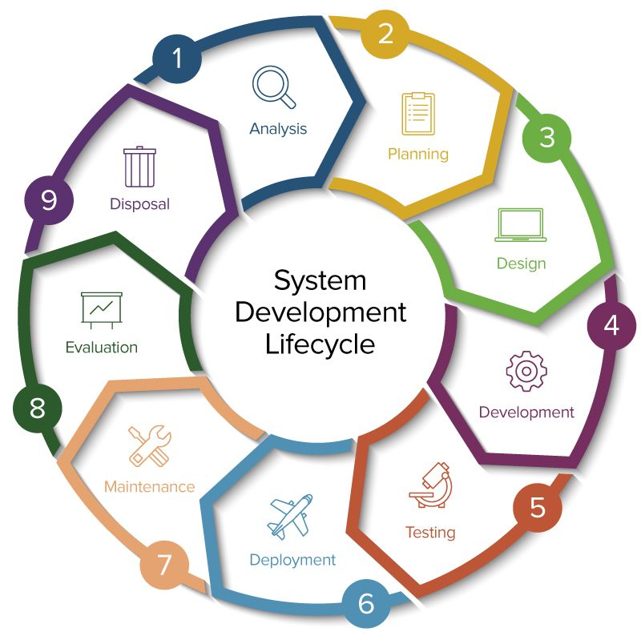
SDLC

Slide 10
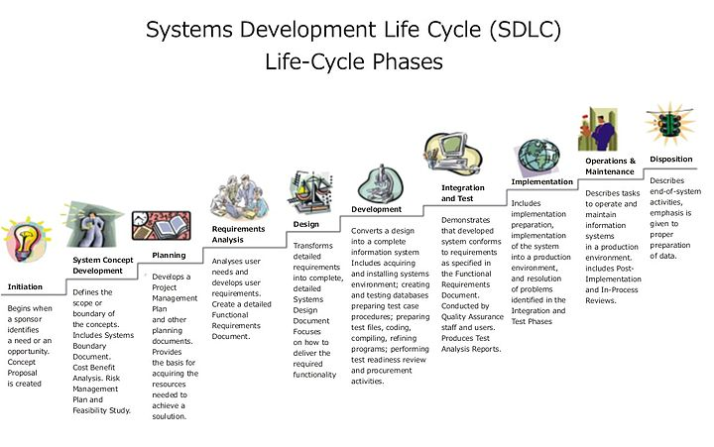

Slide 11
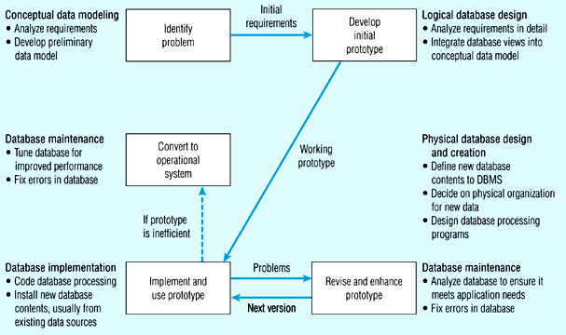
Prototype method

Slide 12
Prototype method

Slide 13
Prototype method

Slide 14
Prototype method

Slide 15
Prototype method

Slide 16
Agile
Agile software development
An approach to database and software development that emphasizes “individuals and interactions over processes and tools, working software over comprehensive documentation, customer collaboration over contract negotiation, and response to change over following a plan.”

Slide 17
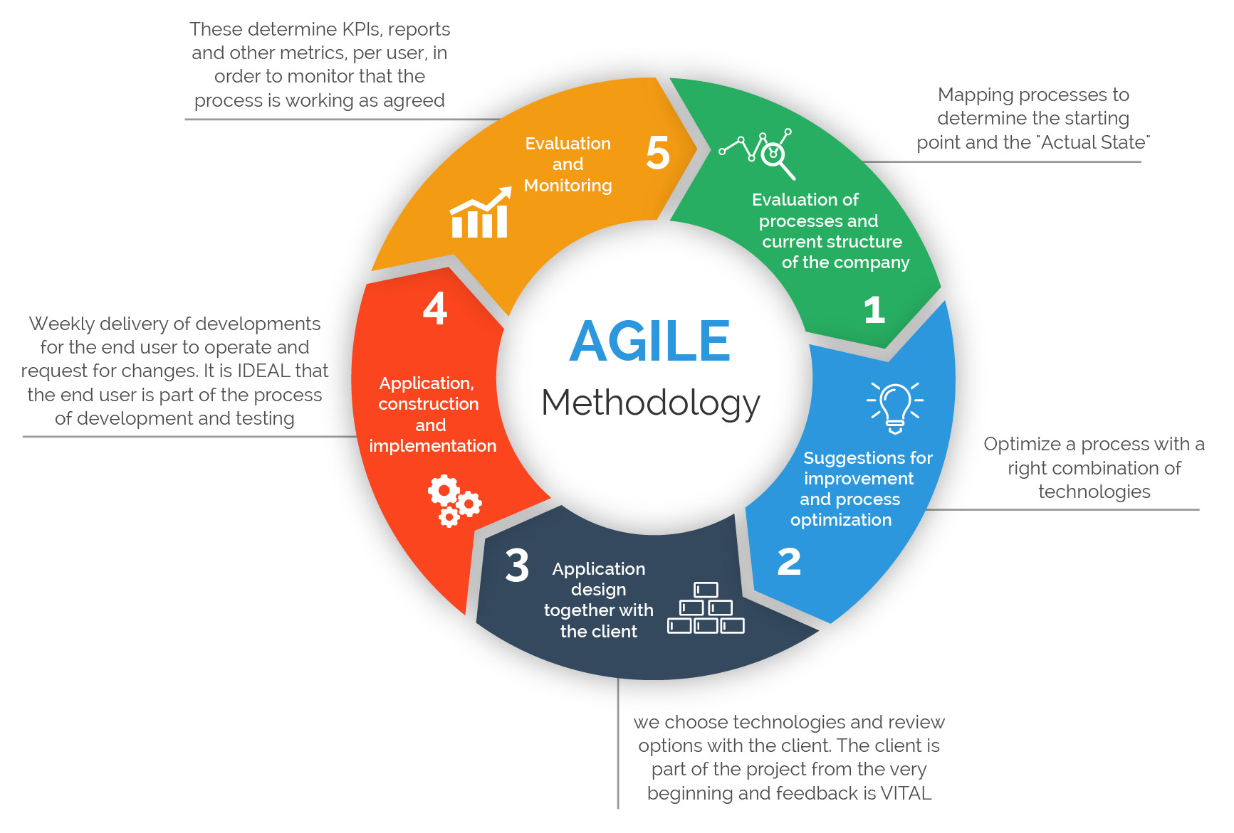
Agile Method

Slide 18
People Involved in Database Development
Project A planned undertaking of related activities to reach an objective that has a beginning and an end.
Business analysts
Systems analysts
Database analysts and data modeler
Users
Programmers
Database architects
Database/data administrators
Project manager
Other technical experts

Slide 19
IS Structure

Slide 20
Database Architecture
Three Schema Architecture.
Internal Level (Physical Level) closest to physical storage, describe the physical storage structure of database.
External Level (Logical Level) closest to users, describe a part of database that a particular user is interested in.
Conceptual Level indirection between the others describe the whole database for a community user.

Slide 21
Three Schema Database Architecture
End Users
External
View 1
External
View n
External Level
external/conceptual Mapping
Conceptual schema
Conceptual Level
Conceptual/internal Mapping
Internal Schema
Internal Level
Stored Database

Slide 22
Database Language
Data Definition Language (DDL) used by DBA, DB designer.
Storage Definition Language (SDL), used for internal schema.
View Definition Language (VDL) specify users’ views.
Data Manipulation Language (DML) used for manipulating the data.

Slide 23
DBMS Interface
Menu based Interface
Graphics Interface
Forms-based Interface
Natural Language Interface
Interfaces for parametric Users
Interfaces for DBA

Slide 24
The Elements of the Analysis Model
The Analysis Model must achieve 3 primary objectives:
Describe what the customer requires
Establish a basis for the creation of a software design
Define a set of requirements that can be validated once the software is built.

Slide 25
Data Modeling
Answers specific questions about:
primary data objects Entity.
composition and attributes of each data object
relationships between different objects.

Slide 26
Thank You

