Slide 1
Rich Picture
CSE
Department of
Computer
Science
&
Engineering
Lecture 03
CSC 401: Database Management System

Slide 2
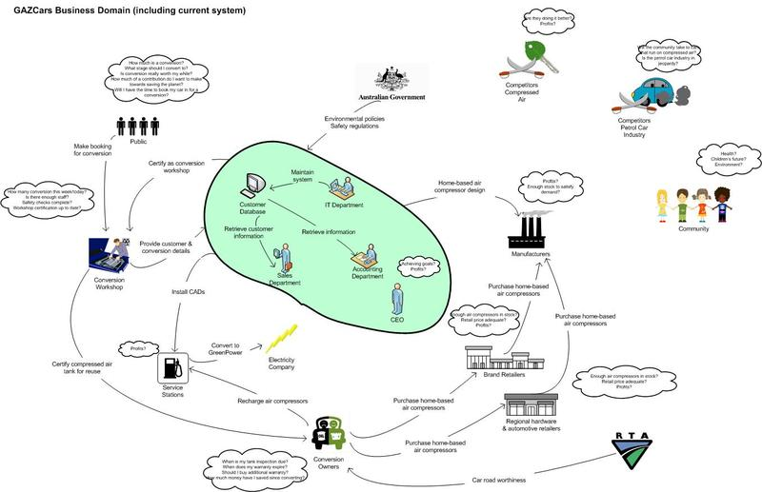
Rich picture Example

Slide 3
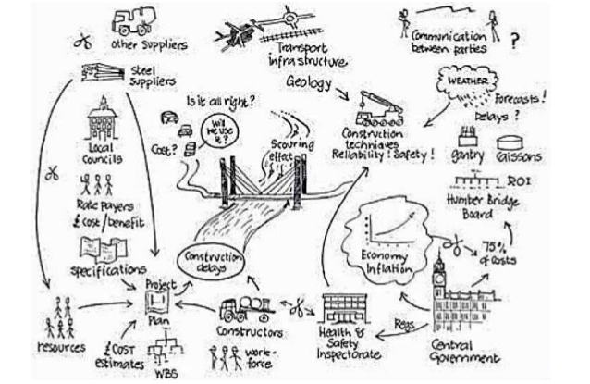
Rich Picture Example

Slide 4
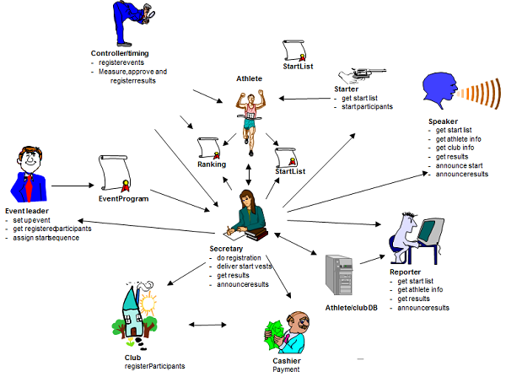
Rich Picture Example

Slide 5
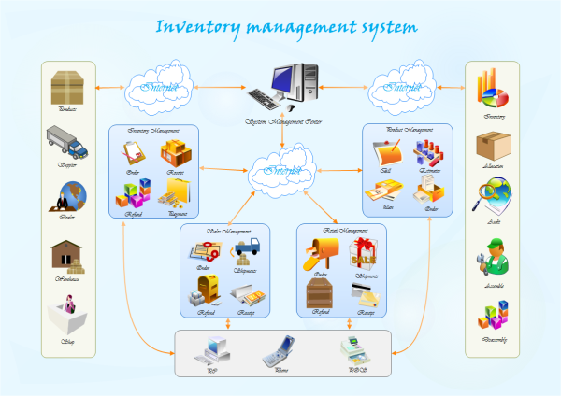
Rich picture Example

Slide 6
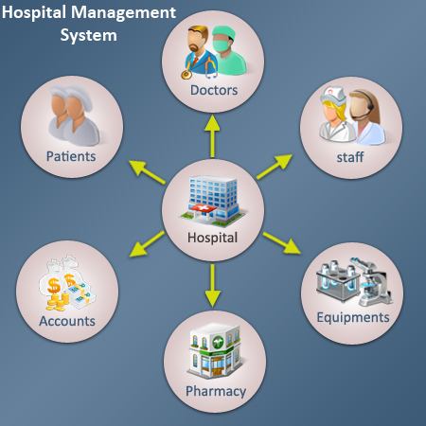

Slide 7
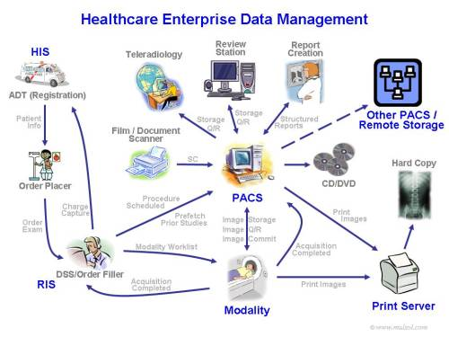

Slide 8
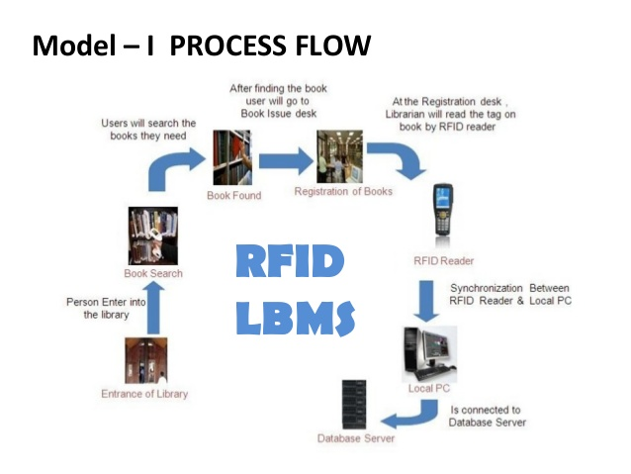

Slide 9
Thank You

