Slide 1
System Analysis Tools and Techniques
CSE
Department of
Computer
Science
&
Engineering
Lecture 03
CSC 401: Database Management System

Slide 2
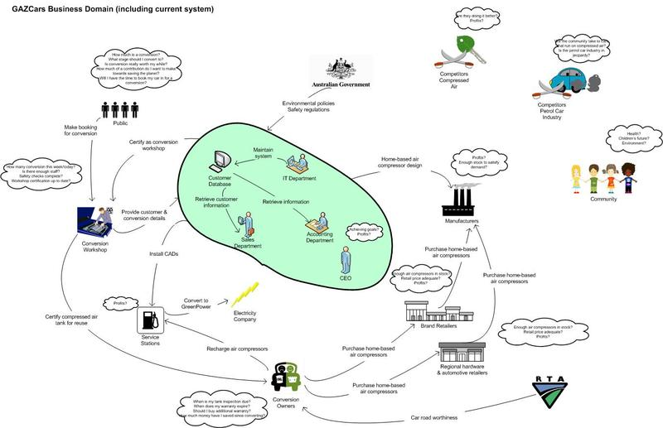
Rich picture Example

Slide 3
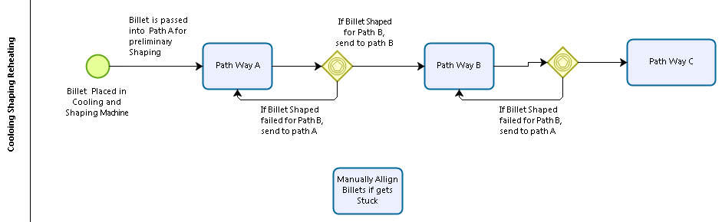
Process Model with BPMN 2.0

Slide 4
Six Element Analysis
Process | System Roles
 | Human | Non-Computing Hardware | Computing Hardware | Soft- ware | Database | Comm. Network

Slide 5
Problem Analysis Template
Process Name | Stakeholders | Concerns (Problems) | Analysis (Reason of the Problem) | Proposed Solution

Slide 6
Entity Relationship Diagram

Slide 7
Preliminary data model

Slide 8
Data Attributes for Entities in the Preliminary Data Model
Product Prior Year Sales Goal
Product Current Year Sales Goal
Product Line Prior Year Sales Goal
Product Line Current Year Sales Goal
Order Number of Shipments

Slide 9
Data model

Slide 10
SQL query
SELECT Product.ProductID, Product.ProductDescription, Product.PRCurrentYearSalesGoal, (OrderQuantity * ProductPrice) AS SalesToDate
FROM Order.OrderLine, Product.ProductLine
WHERE Order.OrderNumber = OrderLine.OrderNumber
AND Product.ProductID = OrderedProduct.ProductID
AND Product.ProductID = ProductLine.ProductID
AND Product.ProductLineName = “Home Office”;

Slide 11
Thank You

