Slide 1
Logical Database Design and the Relational Model - I
CSE
Department of
Computer
Science
&
Engineering
Lecture 07
CSC 401: Database Management System

Slide 2
Basic Definitions
Data structure Data are organized in the form of tables, with rows and columns.
Data manipulation Powerful operations (using the SQL language) are used to manipulate data stored in the relations.
Data integrity The model includes mechanisms to specify business rules that maintain the integrity of data when they are manipulated.

Slide 3

RELATIONAL DATA STRUCTURE
Relation A named two-dimensional table of data.
Primary key An attribute or a combination of attributes that uniquely identifies each row in a relation.
Composite key A primary key that consists of more than one attribute.
Foreign key An attribute in a relation that serves as the primary key of another relation in the same database.

Slide 4
PROPERTIES OF RELATIONS
Each relation (or table) in a database has a unique name.
An entry at the intersection of each row and column is atomic, i.e, no multivalued attributes are allowed in a relation.
Each row is unique.
Each attribute (or column) within a table has a unique name.
The sequence of columns (left to right) is insignificant.
The sequence of rows (top to bottom) is insignificant.

Slide 5
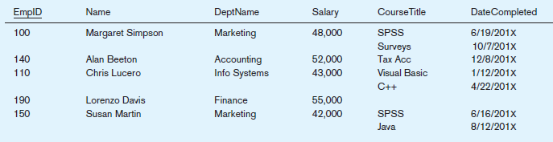
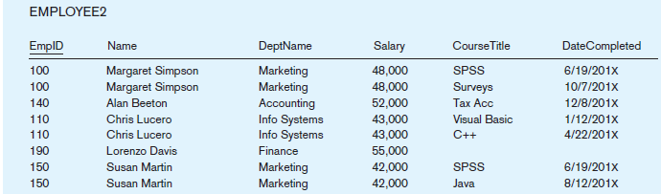
Eliminating multi-valued attributes

Slide 6
INTEGRITY CONSTRAINTS
Domain Constraints All of the values that appear in a column of a relation must be from the same domain.
Entity Integrity The entity integrity rule is designed to ensure that every relation has a primary key and that the data values for that primary key are all valid.
Null A value that may be assigned to an attribute when no other value applies or when the applicable value is unknown.
Entity integrity rule A rule that states that no primary key attribute (or component of a primary key attribute) may be null.

Slide 7
INTEGRITY CONSTRAINTS
Referential integrity constraint A rule that states that either each foreign key value must match a primary key value in another relation or the foreign key value must be null.
Whether a foreign key can be null is more complex to model on an E-R diagram. For example, what happens to order data if we choose to delete a customer who has submitted orders?
Cascade: Delete the associated orders.
Restrict: Prohibit deletion of the customer until all associated orders are first deleted
Set-to-Null: Place a null value in the foreign key

Slide 8
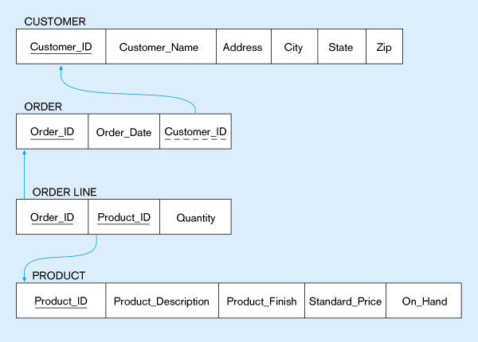
Referential integrity constraints (Pine Valley Furniture)
Referential integrity constraints are drawn via arrows from dependent to parent table

Slide 9
Well-structured relation
A relation that contains minimal redundancy and allows users to insert, modify, and delete the rows in a table without errors or inconsistencies.
Anomaly An error or inconsistency that may result when a user attempts to update a table that contains redundant data. The three types of anomalies are insertion, deletion, and modification anomalies.
Insertion anomaly
Deletion anomaly
Modification anomaly

Slide 10
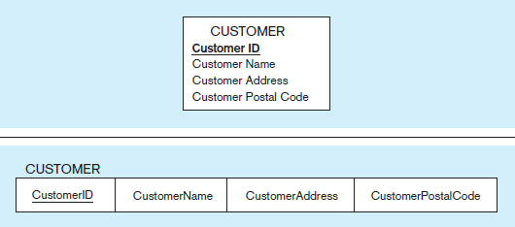
Step01: Mapping the regular entity CUSTOMER

Slide 11
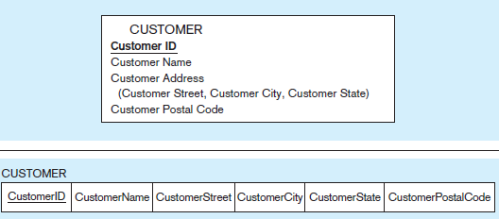
Step01: Mapping a composite attribute

Slide 12
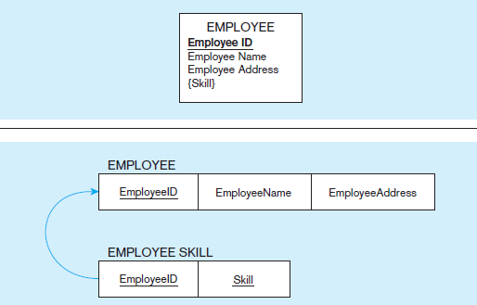
Step01: Mapping an entity with a multivalued attribute

Slide 13
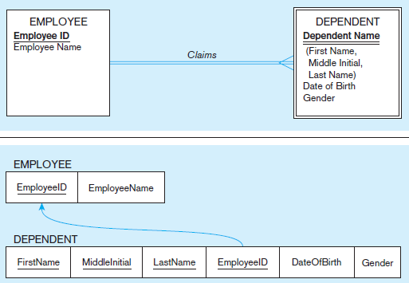
Step 2: Mapping a weak entity

Slide 14
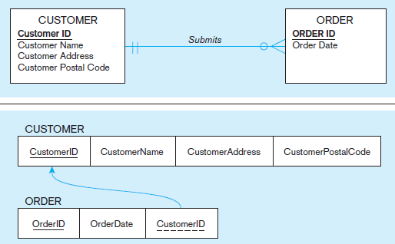
Step 3: Mapping a Binary 1:M relationship

Slide 15
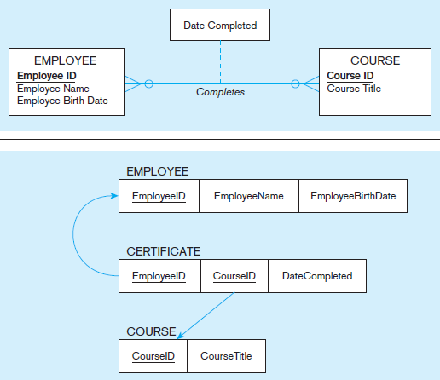
Step 3: Mapping a M:N relationship

Slide 16
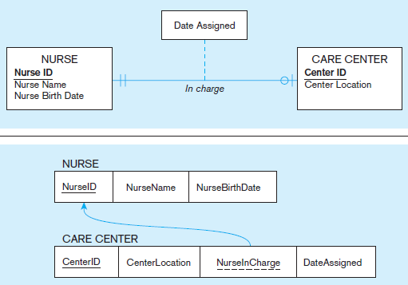
Step 3: Mapping a binary 1:1

Slide 17
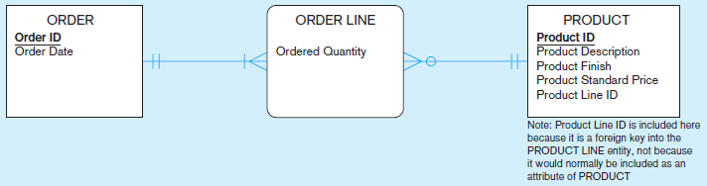
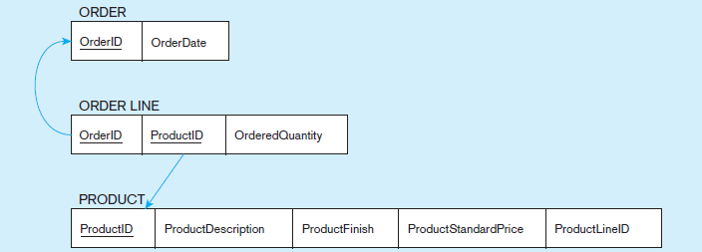
Step 4: Map Associative Entities

Slide 18
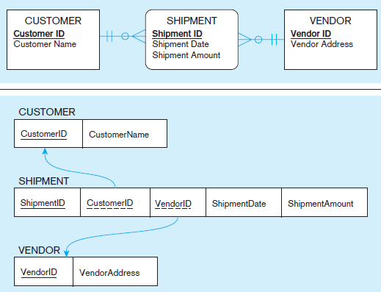
Step 4: Map Associative Entities

Slide 19
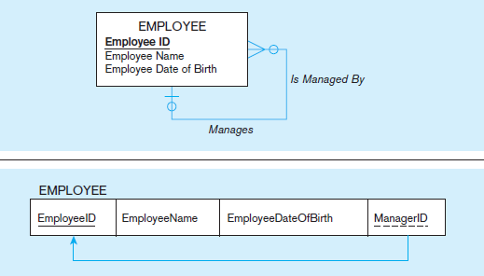
Step 5: Map Unary Relationships

Slide 20
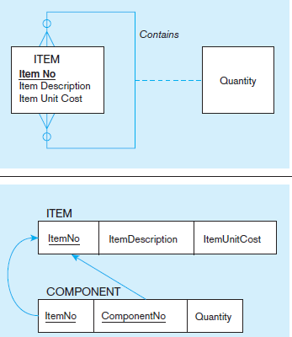
Step 5: Mapping a unary M:N relationship

Slide 21
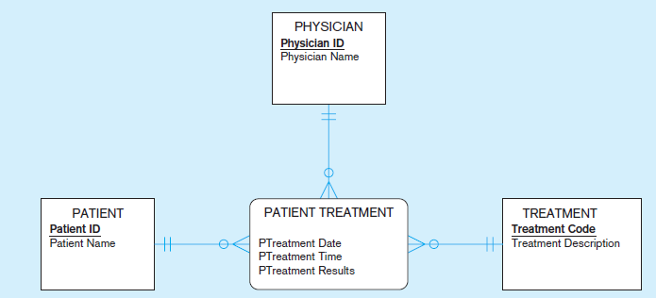
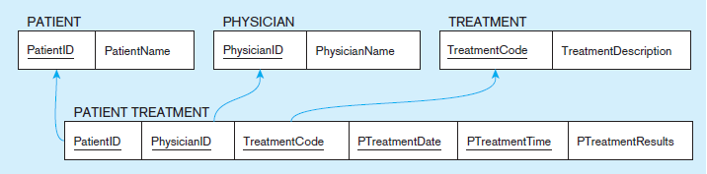
Step 6: Mapping a ternary relationship

Slide 22
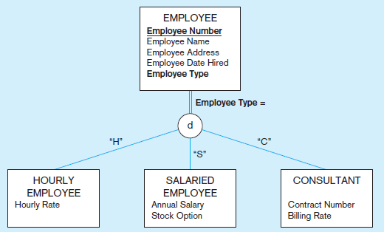
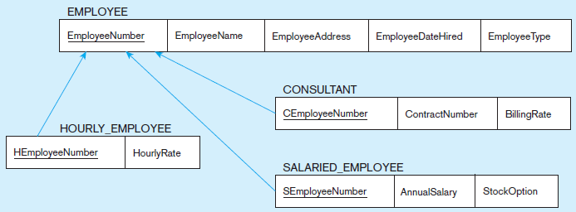
Step 7: Map Supertype/Subtype Relationships

Slide 23
Thank You

