Slide 1
Stack and Queue
CSC-203, Data Structure

Slide 2
Stack Overview
Stack ADT
Basic operations of stack
  Pushing, popping etc.
Implementations of stacks using
  array
  linked list

Slide 3
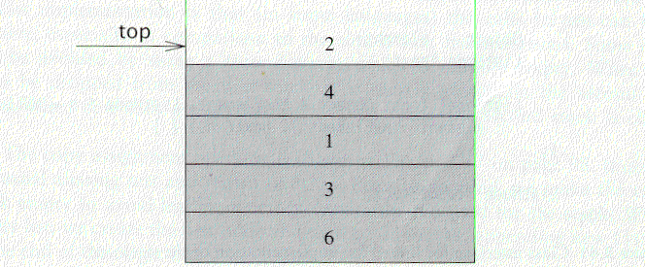
The Stack ADT
A stack is a list with the restriction
  that insertions and deletions can only be performed at the top of the list
  The other end is called bottom
Fundamental operations:
  Push: Equivalent to an insert
  Pop: Deletes the most recently inserted element
  Top: Examines the most recently inserted element

Slide 4
Stack ADT
Stacks are less flexible
  but are more efficient and easy to implement
Stacks are known as LIFO (Last In, First Out) lists.
  The last element inserted will be the first to be retrieved

Slide 5
Push and Pop
Primary operations: Push and Pop
Push
  Add an element to the top of the stack
Pop
  Remove the element at the top of the stack
empty stack
push an element
push another
pop
top
B
top
top
top
A
A
A

Slide 6
Implementation of Stacks
Any list implementation could be used to implement a stack
  Arrays (static: the size of stack is given initially)
  Linked lists (dynamic: never become full)
We will explore implementations based on array and linked list
Let’s see how to use an array to implement a stack first

Slide 7
Array Implementation
Need to declare an array size ahead of time
Associated with each stack is TopOfStack
  for an empty stack, set TopOfStack to -1
Push
  (1) Increment TopOfStack by 1.
  (2) Set Stack[TopOfStack] = X
Pop
  (1) Set return value to Stack[TopOfStack]
  (2) Decrement TopOfStack by 1
These operations are performed in very fast constant time

Slide 8
Stack class
class Stack {
public:
Stack(int size = 10); // constructor
~Stack() { delete [] values; } // destructor
bool IsEmpty() { return top == -1; }
bool IsFull() { return top == maxTop; }
double Top();
void Push(const double x);
double Pop();
void DisplayStack();
private:
int maxTop; // max stack size = size - 1
int top; // current top of stack
double* values; // element array
};

Slide 9
Stack class
Attributes of Stack
  maxTop: the max size of stack
  top: the index of the top element of stack
  values: point to an array which stores elements of stack
Operations of Stack
  IsEmpty: return true if stack is empty, return false otherwise
  IsFull: return true if stack is full, return false otherwise
  Top: return the element at the top of stack
  Push: add an element to the top of stack
  Pop: delete the element at the top of stack
  DisplayStack: print all the data in the stack

Slide 10
Create Stack
The constructor of Stack
  Allocate a stack array of size. By default,
  size = 10.
  When the stack is full, top will have its maximum value, i.e. size – 1.
  Initially top is set to -1. It means the stack is empty.
Stack::Stack(int size /*= 10*/) {
maxTop = size - 1;
values = new double[size];
top = -1;
}
Although the constructor dynamically allocates the stack array, the stack is still static. The size is fixed after the initialization.

Slide 11
Push Stack
void Push(const double x);
  Push an element onto the stack
  If the stack is full, print the error information.
  Note top always represents the index of the top element. After pushing an element, increment top.
void Stack::Push(const double x) {
if (IsFull())
cout << "Error: the stack is full." << endl;
else
values[++top] = x;
}

Slide 12
Pop Stack
double Pop()
  Pop and return the element at the top of the stack
  If the stack is empty, print the error information. (In this case, the return value is useless.)
  Don’t forgot to decrement top
double Stack::Pop() {
if (IsEmpty()) {
cout << "Error: the stack is empty." << endl;
return -1;
}
else {
return values[top--];
}
}

Slide 13
Stack Top
double Top()
  Return the top element of the stack
  Unlike Pop, this function does not remove the top element
double Stack::Top() {
if (IsEmpty()) {
cout << "Error: the stack is empty." << endl;
return -1;
}
else
return values[top];
}

Slide 14

Printing all the elements
void DisplayStack()
  Print all the elements
void Stack::DisplayStack() {
cout << "top -->";
for (int i = top; i >= 0; i--)
cout << "\t|\t" << values[i] << "\t|" << endl;
cout << "\t|---------------|" << endl;
}

Slide 15
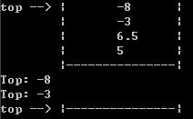
Using Stack
result
int main(void) {
Stack stack(5);
stack.Push(5.0);
stack.Push(6.5);
stack.Push(-3.0);
stack.Push(-8.0);
stack.DisplayStack();
cout << "Top: " << stack.Top() << endl;
stack.Pop();
cout << "Top: " << stack.Top() << endl;
while (!stack.IsEmpty()) stack.Pop();
stack.DisplayStack();
return 0;
}

Slide 16
Implementation based on Linked List
Now let us implement a stack based on a linked list
To make the best out of the code of List, we implement Stack by inheriting List
  To let Stack access private member head, we make Stack as a friend of List
class List {
public:
List(void) { head = NULL; } // constructor
~List(void); // destructor
bool IsEmpty() { return head == NULL; }
Node* InsertNode(int index, double x);
int FindNode(double x);
int DeleteNode(double x);
void DisplayList(void);
private:
Node* head;
friend class Stack;
};

Slide 17
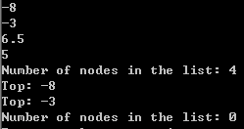
Implementation based on Linked List
class Stack : public List {
public:
Stack() {} // constructor
~Stack() {} // destructor
double Top() {
if (head == NULL) {
cout << "Error: the stack is empty." << endl;
return -1;
}
else
return head->data;
}
void Push(const double x) { InsertNode(0, x); }
double Pop() {
if (head == NULL) {
cout << "Error: the stack is empty." << endl;
return -1;
}
else {
double val = head->data;
DeleteNode(val);
return val;
}
}
void DisplayStack() { DisplayList(); }
};
Note: the stack implementation based on a linked list will never be full.

Slide 18
Balancing Symbols
To check that every right brace, bracket, and parentheses must correspond to its left counterpart
  e.g. [( )] is legal, but [( ] ) is illegal
Algorithm
  (1) Make an empty stack.
  (2) Read characters until end of file
    i. If the character is an opening symbol, push it onto the stack
    ii. If it is a closing symbol, then if the stack is empty, report an error
    iii. Otherwise, pop the stack. If the symbol popped is not the
    corresponding opening symbol, then report an error
  (3) At end of file, if the stack is not empty, report an error

Slide 19
Queue Overview
Queue ADT
Basic operations of queue
  Enqueuing, dequeuing etc.
Implementation of queue
  Array
  Linked list

Slide 20
Queue ADT
Like a stack, a queue is also a list. However, with a queue, insertion is done at one end, while deletion is performed at the other end.
Accessing the elements of queues follows a First In, First Out (FIFO) order.
  Like customers standing in a check-out line in a store, the first customer in is the first customer served.

Slide 21
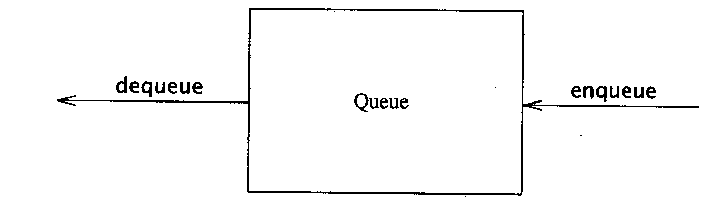
The Queue ADT
Another form of restricted list
  Insertion is done at one end, whereas deletion is performed at the other end
Basic operations:
  enqueue: insert an element at the rear of the list
  dequeue: delete the element at the front of the list
First-in First-out (FIFO) list

Slide 22
Enqueue and Dequeue
Primary queue operations: Enqueue and Dequeue
Like check-out lines in a store, a queue has a front and a rear.
Enqueue
  Insert an element at the rear of the queue
Dequeue
  Remove an element from the front of the queue
Remove
(Dequeue)
Insert
(Enqueue)
front
rear

Slide 23
Implementation of Queue
Just as stacks can be implemented as arrays or linked lists, so with queues.
Dynamic queues have the same advantages over static queues as dynamic stacks have over static stacks

Slide 24
Queue Implementation of Array
There are several different algorithms to implement Enqueue and Dequeue
Naïve way
  When enqueuing, the front index is always fixed and the rear index moves forward in the array.
rear
rear
rear
3
3
6
3
6
9
front
front
front
Enqueue(3)
Enqueue(6)
Enqueue(9)

Slide 25
Queue Implementation of Array
Naïve way
  When enqueuing, the front index is always fixed and the rear index moves forward in the array.
  When dequeuing, the element at the front the queue is removed. Move all the elements after it by one position. (Inefficient!!!)
rear
rear
rear = -1
6
9
9
front
front
front
Dequeue()
Dequeue()
Dequeue()

Slide 26
Queue Implementation of Array
Better way
  When an item is enqueued, make the rear index move forward.
  When an item is dequeued, the front index moves by one element towards the back of the queue (thus removing the front item, so no copying to neighboring elements is needed).
(front)
XXXXOOOOO (rear)
OXXXXOOOO (after 1 dequeue, and 1 enqueue)
OOXXXXXOO (after another dequeue, and 2 enqueues)
OOOOXXXXX (after 2 more dequeues, and 2 enqueues)
The problem here is that the rear index cannot move beyond the last element in the array.

Slide 27
Implementation using Circular Array
Using a circular array
When an element moves past the end of a circular array, it wraps around to the beginning, e.g.
  OOOOO7963 → 4OOOO7963 (after Enqueue(4))
  After Enqueue(4), the rear index moves from 3 to 4.

Slide 28
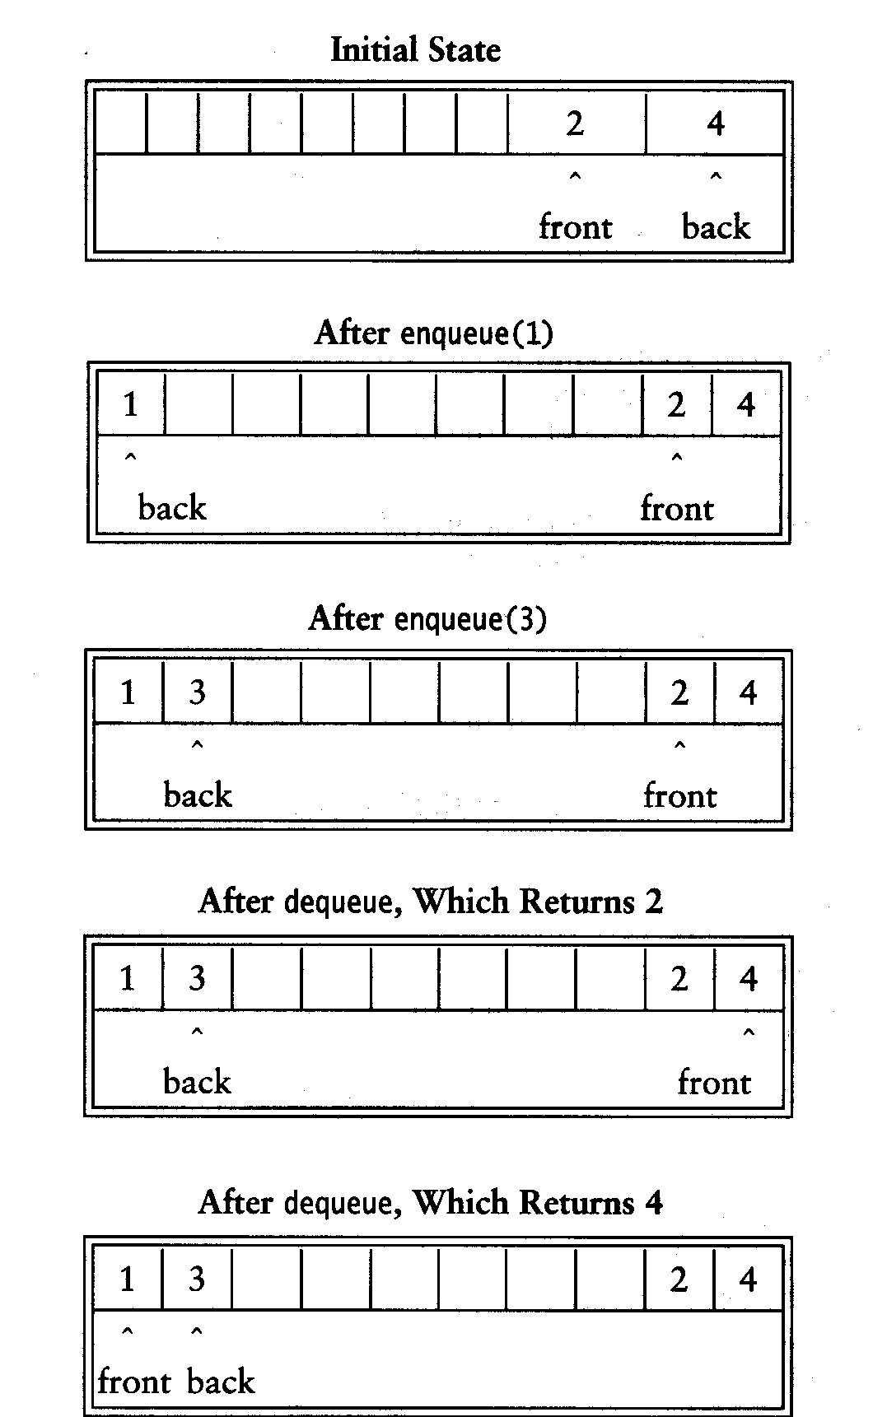
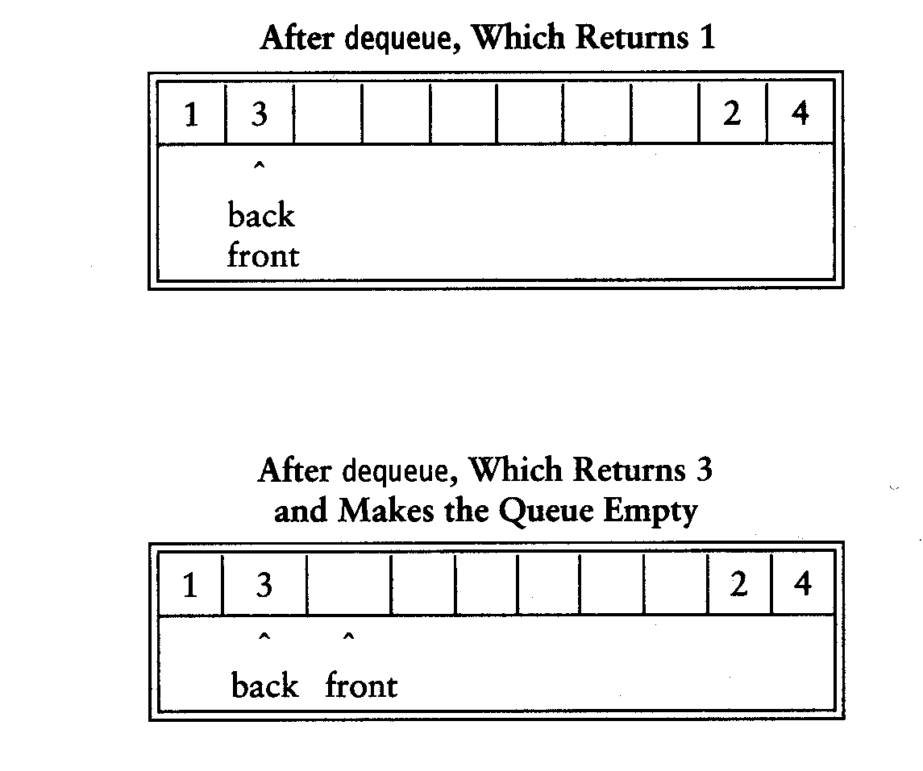

Slide 29
Empty or Full?
Empty queue
  back = front - 1
Full queue?
  the same!
  Reason: n values to represent n+1 states
Solutions
  Use a boolean variable to say explicitly whether the queue is empty or not
  Make the array of size n+1 and only allow n elements to be stored
  Use a counter of the number of elements in the queue

Slide 30
Queue Implementation
class Queue {
public:
Queue(int size = 10); // constructor
~Queue() { delete [] values; } // destructor
bool IsEmpty(void);
bool IsFull(void);
bool Enqueue(double x);
bool Dequeue(double & x);
void DisplayQueue(void);
private:
int front; // front index
int rear; // rear index
int counter; // number of elements
int maxSize; // size of array queue
double* values; // element array
};

Slide 31
Queue Class
Attributes of Queue
  front/rear: front/rear index
  counter: number of elements in the queue
  maxSize: capacity of the queue
  values: point to an array which stores elements of the queue
Operations of Queue
  IsEmpty: return true if queue is empty, return false otherwise
  IsFull: return true if queue is full, return false otherwise
  Enqueue: add an element to the rear of queue
  Dequeue: delete the element at the front of queue
  DisplayQueue: print all the data

Slide 32
Create Queue
Queue(int size = 10)
  Allocate a queue array of size. By default, size = 10.
  front is set to 0, pointing to the first element of the array
  rear is set to -1. The queue is empty initially.
Queue::Queue(int size /* = 10 */) {
values = new double[size];
maxSize = size;
front = 0;
rear = -1;
counter = 0;
}

Slide 33
IsEmpty & IsFull
Since we keep track of the number of elements that are actually in the queue: counter, it is easy to check if the queue is empty or full.
bool Queue::IsEmpty() {
if (counter) return false;
else return true;
}
bool Queue::IsFull() {
if (counter < maxSize) return false;
else return true;
}

Slide 34
Enqueue
bool Queue::Enqueue(double x) {
if (IsFull()) {
cout << "Error: the queue is full." << endl;
return false;
}
else {
// calculate the new rear position (circular)
rear = (rear + 1) % maxSize;
// insert new item
values[rear] = x;
// update counter
counter++;
return true;
}
}

Slide 35
Dequeue
bool Queue::Dequeue(double & x) {
if (IsEmpty()) {
cout << "Error: the queue is empty." << endl;
return false;
}
else {
// retrieve the front item
x = values[front];
// move front
front = (front + 1) % maxSize;
// update counter
counter--;
return true;
}
}

Slide 36

Printing the elements
void Queue::DisplayQueue() {
cout << "front -->";
for (int i = 0; i < counter; i++) {
if (i == 0) cout << "\t";
else cout << "\t\t";
cout << values[(front + i) % maxSize];
if (i != counter - 1)
cout << endl;
else
cout << "\t<-- rear" << endl;
}
}

Slide 37
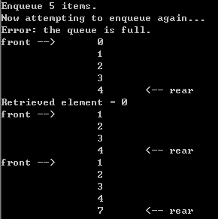
Using Queue
int main(void) {
Queue queue(5);
cout << "Enqueue 5 items." << endl;
for (int x = 0; x < 5; x++)
queue.Enqueue(x);
cout << "Now attempting to enqueue again..." << endl;
queue.Enqueue(5);
queue.DisplayQueue();
double value;
queue.Dequeue(value);
cout << "Retrieved element = " << value << endl;
queue.DisplayQueue();
queue.Enqueue(7);
queue.DisplayQueue();
return 0;
}

Slide 38
Queue Implementation based on Linked List
class Queue {
public:
Queue() { // constructor
front = rear = NULL;
counter = 0;
}
~Queue() { // destructor
double value;
while (!IsEmpty()) Dequeue(value);
}
bool IsEmpty() {
if (counter) return false;
else return true;
}
void Enqueue(double x);
bool Dequeue(double & x);
void DisplayQueue(void);
private:
Node* front; // pointer to front node
Node* rear; // pointer to last node
int counter; // number of elements
};

Slide 39
Enqueue
void Queue::Enqueue(double x) {
Node* newNode = new Node;
newNode->data = x;
newNode->next = NULL;
if (IsEmpty()) {
front = newNode;
rear = newNode;
}
else {
rear->next = newNode;
rear = newNode;
}
counter++;
}
rear
8
5
rear
8
5
newNode

Slide 40
Dequeue
bool Queue::Dequeue(double & x) {
if (IsEmpty()) {
cout << "Error: the queue is empty." << endl;
return false;
}
else {
x = front->data;
Node* nextNode = front->next;
delete front;
front = nextNode;
counter--;
}
}
front
3
8
5
front
8
5

Slide 41
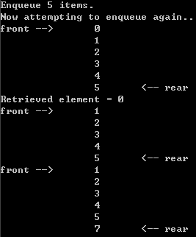
Printing all the elements
void Queue::DisplayQueue() {
cout << "front -->";
Node* currNode = front;
for (int i = 0; i < counter; i++) {
if (i == 0) cout << "\t";
else cout << "\t\t";
cout << currNode->data;
if (i != counter - 1)
cout << endl;
else
cout << "\t<-- rear" << endl;
currNode = currNode->next;
}
}

Slide 42
Result
Queue implemented using linked list will be never full
based on array
based on linked list

