Slide 1


The Market Eden Lifecycle Context
?
Play
Delay
‘Prey’
Stay
Flay
This is an ideal innovation lifecycle, but in reality, things tend to be a bit more fluid, volatile, and at times even wild, with pops, splurges, spins, loops, jumps, repetitions, duplications, getting stuck, zooming out of control, and a whole host of other similarly bizarre behaviours!
‘Display’ and ‘Cast Away’
Limited By Invention
‘Inhibited’ By Tension
‘Exhibited’ Ascension
‘Unlimited’ Extension
Ideation
Enthusiast
Early Adoption
Disruption
Exponential
Growth
Saturation
Ubiquity
Maturity
Decline

Slide 2


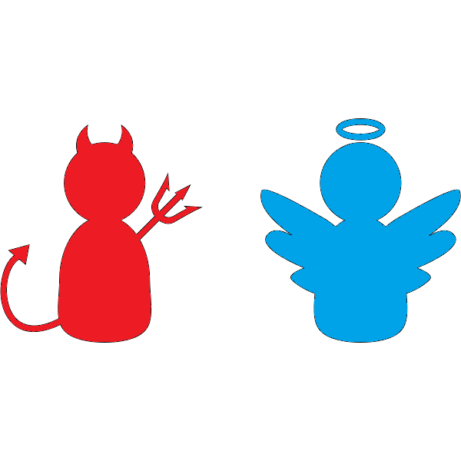
The Stagnation Babel Comms Model
Management Officer Team
Executive Club
Leadership Officer Team
Health
Power
Security
Mental Illness
Assets
Sex
Obedience
Money
Pleasure
Influence
Emotional Illness
Here is an organisational Babel Comms situation, it being very common in the business world, to greater or lesser extents, and the Babel Comms density map is varied to say the least, and worst of all it is often misunderstood!
Internal Forces
External Forces
Ideological Thugs
Ideological Thugs
Cultural Tribes
Cultural Tribes
Cultural Tribes
Cultural Tribes
Opportunistic Gangs
Opportunistic Gangs
Opportunistic Gangs
Opportunistic Gangs
Opportunistic Gangs
Opportunistic Gangs
Constraint
Calm
Dullness
Restriction
Flow
Move
Quiescence
Growth
Activity
Sluggishness
Development
Sloth
Dormancy
Stasis
Torpor
Status

Slide 3
The Disruption Jerusalem Salve Plan
Beware the Gruffalo! (Unfounded Fears)
Beware the Jabberwocky! (Nonsensical Words)
Lenses
Assumptions
Needs
Opinions
Perspectives
Viewpoints
Implications
Prohibitions
Learnings
Understandings
Situations
Angles
Solutions
Dimensions
Realities
Problems
Beware the Nazgûl! (Confusing Opposition)
Beware the Flood! (Inexplicable Departures)

Slide 4
The Innovation Zion Optimal Process
Optimally Engaged Pivot
Mentoring
Advisory
Mandate
+Individual – Theory Ideations – PowerPoint Slides – 1 Day +Pair – Research Prototype – 1 Fortnight +Team – Development Demonstrator – 1 Month +Office – Marketing Sandbox – 1 Quarter +Business Unit – Engineering IOC-Solution – 1 Season (6 Months)
+Organisation – World-Event Exposés – 1 Year
+Partnership – Phased Roll-Outs – 1 Horizon (3 Years) +Federation – Automated Self-Service – 1 Cycle (8 Years) +Standard – Commoditised Smart-Contracts – Multiple Super-Cycles (15+ Years)
Interventionism
Autonomy
Kickback
Dangerous Ignored Burnout
Dangerous Shifting Requirements

Slide 5


The Creative Empire State Of Being
The major trick here, in order to increase your state of innovativeness, is to think, say, do, and be, that which you have never before manifested, or at least not in the last long while… In novel spaces, at novel times, with novel beings, using novel things, and through novel ways… Please remember to weave in your work-related ‘blue-sky-decisioning’ and ‘green-field-collaborating’!
Bucket List

Slide 6
The Next-Gen Discontinuity Dilemma
ASK YOURSELF: Must I cannibalise my own existing revenue stream, by focusing on the launch of an next generation product/service/experience, while not knowing whether the ‘overlapping’ target market is premature for any of a number of reasons; or, can I afford to wait for the disruption to die down, and then guarantee success in the next generation market as well, because I have premeditatively aligned any critical competitive advantages, and/or I have erected any barriers to entry in the target market?
Align Advantages Pre-Dilemma
Erect Barriers Post-Dilemma
Dilemma
Rapid Rise and Uncertain Timing
Inexorable Fall

