Slide 2
Dataset context

Slide 3
#The data used in this project is biological data, the analysis of this kind of data using computational tools is also know as bioinformatics.
#Machine learnijng models applied in bioinformatics are also known as "quantitive structure activity relationship" and is applied for drug discover efforts.
#Machine learning models in this bioinformatics area allows to understand the origins of the bioactivity (how chemical components interact with microorganisms and proteins).
#In less words, this analizis help on the drug design improvement.

Slide 4
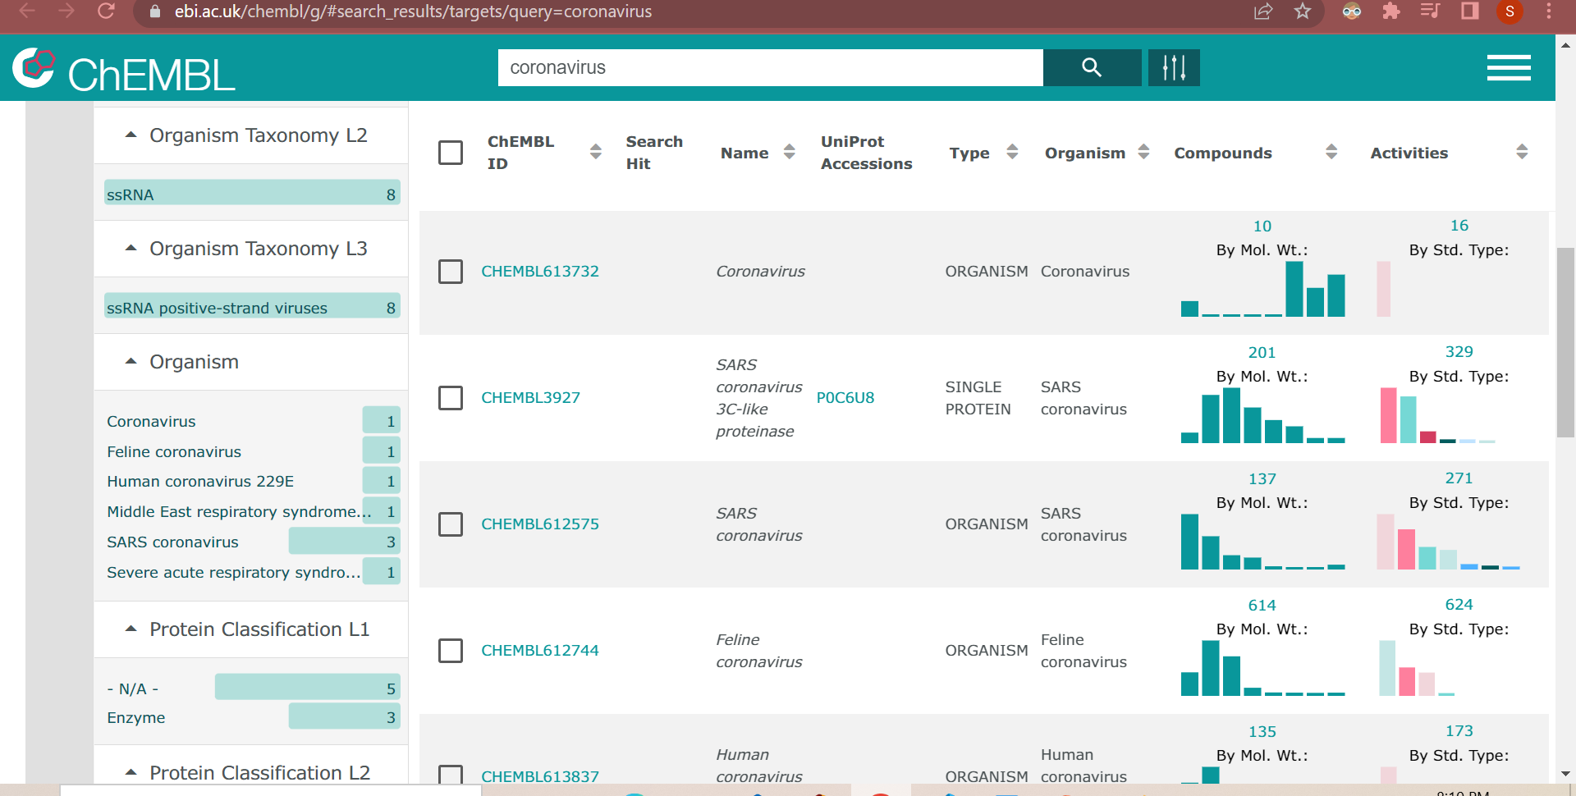
#The dataset used in this project is calles 'Coronavirus', downloaded form CHEMBL Database.
# ChEMBL Database contains curated bioactivity data.
#The data base has 7 targets. Targets make reference to te Target organism or Target protein that the drug would act on (it can activate or inhibit the biological activity).

Slide 5
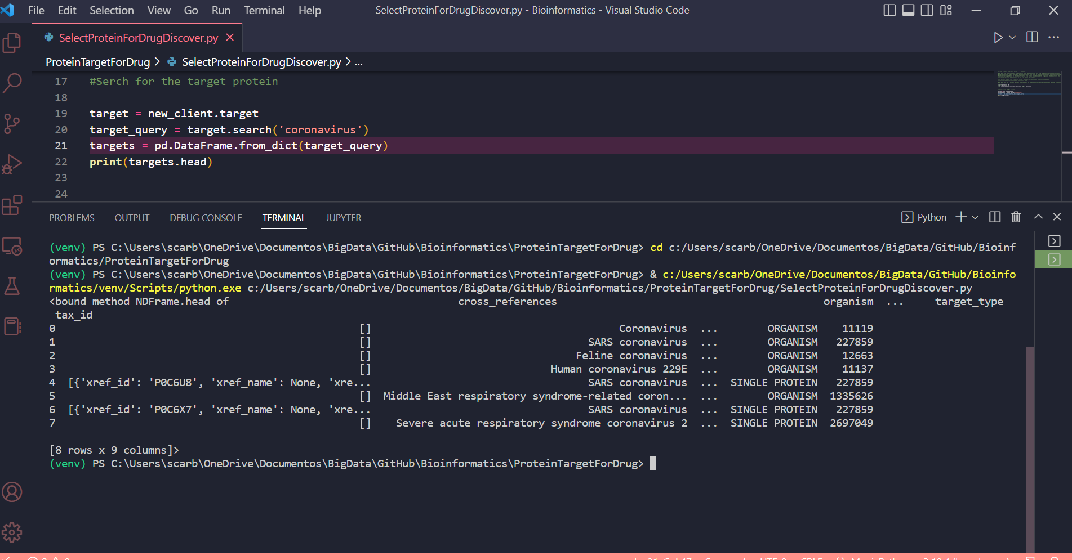
#Serch for the target protein
#There are 7 targents, two are “Single protein” and the rest are “Organism
# The Single protein target is chosen to analyse in this project

Slide 6
Targets variables

Slide 7
# The target_protein(bioactivity_class) is chosen to analyse in this project; it is a categorical value. It has to be transformed to Boolean.
#The Independent variables are:
#-standard_value:It refers to the potency of the drug; the lower is the value, the better potency it has. The aim is get the lowest value. It is numerical continuous data.

Slide 8
Preprocessing

Slide 9
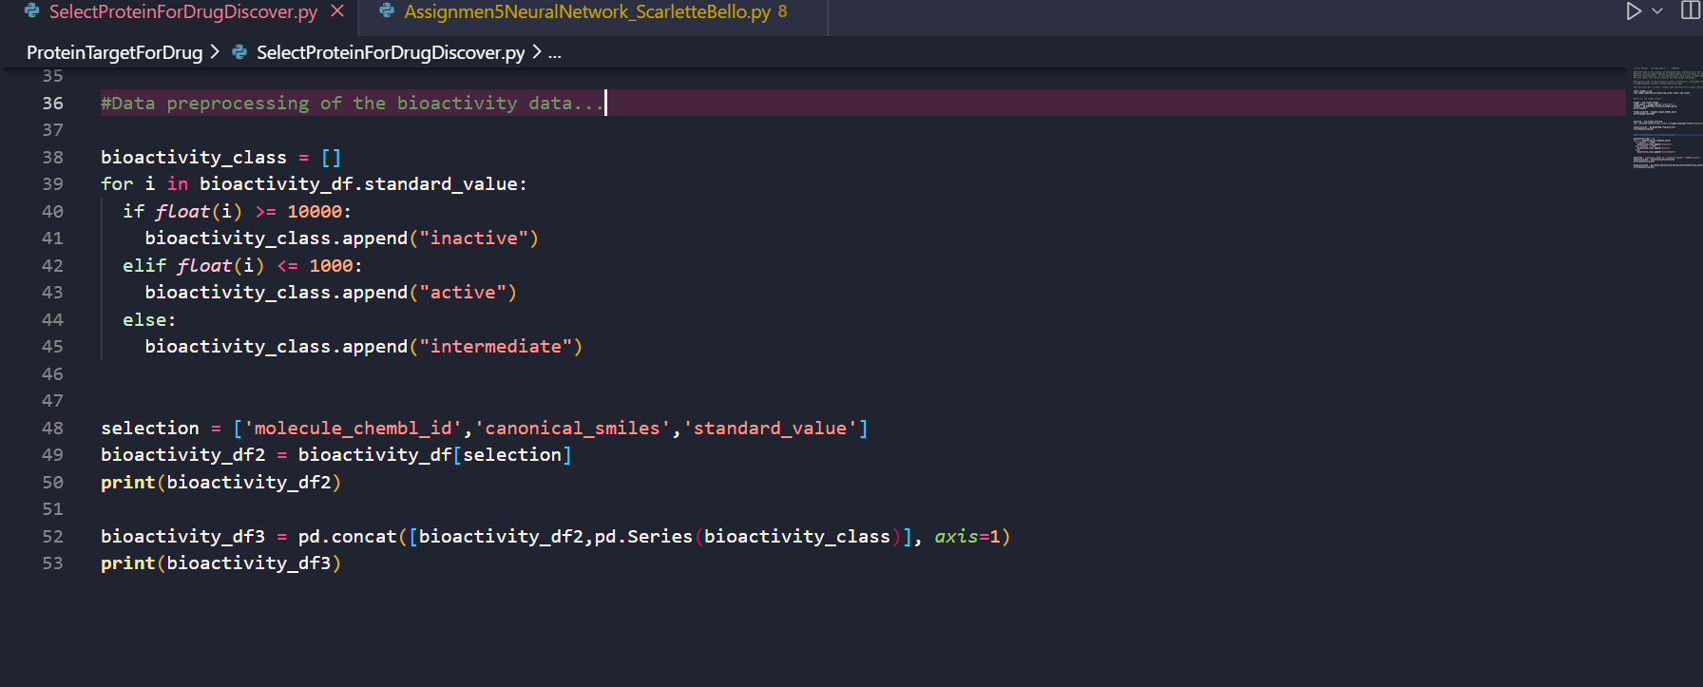
#Data preprocessing of the bioactivity data...
#There is a preprocess applied in the bioactivity data, related to the standard_type. For the analysing of the data, the compound is classified as… “active”, “inactive” and “intermediate”
#There are no missing values in this data set, usually in this kind of data there are.
#For the independent values, was necessary to convert in lists by iterations.

Slide 10
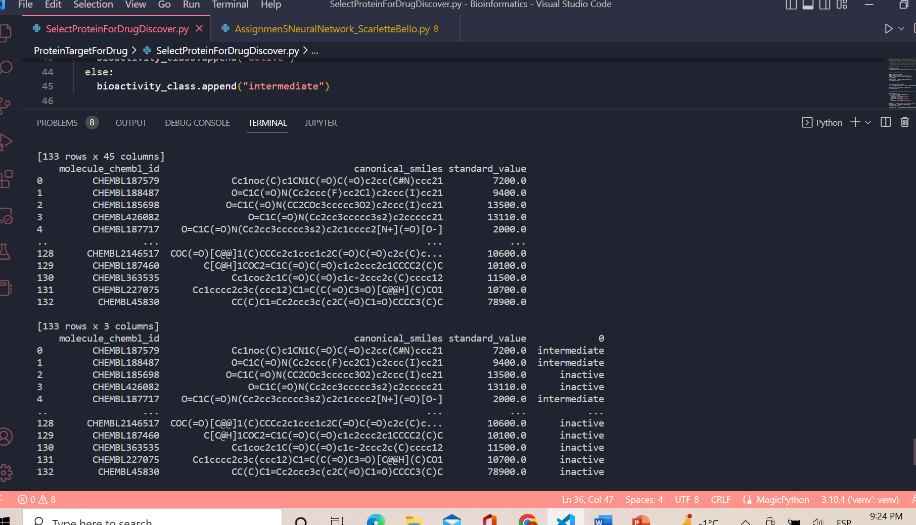

Slide 11
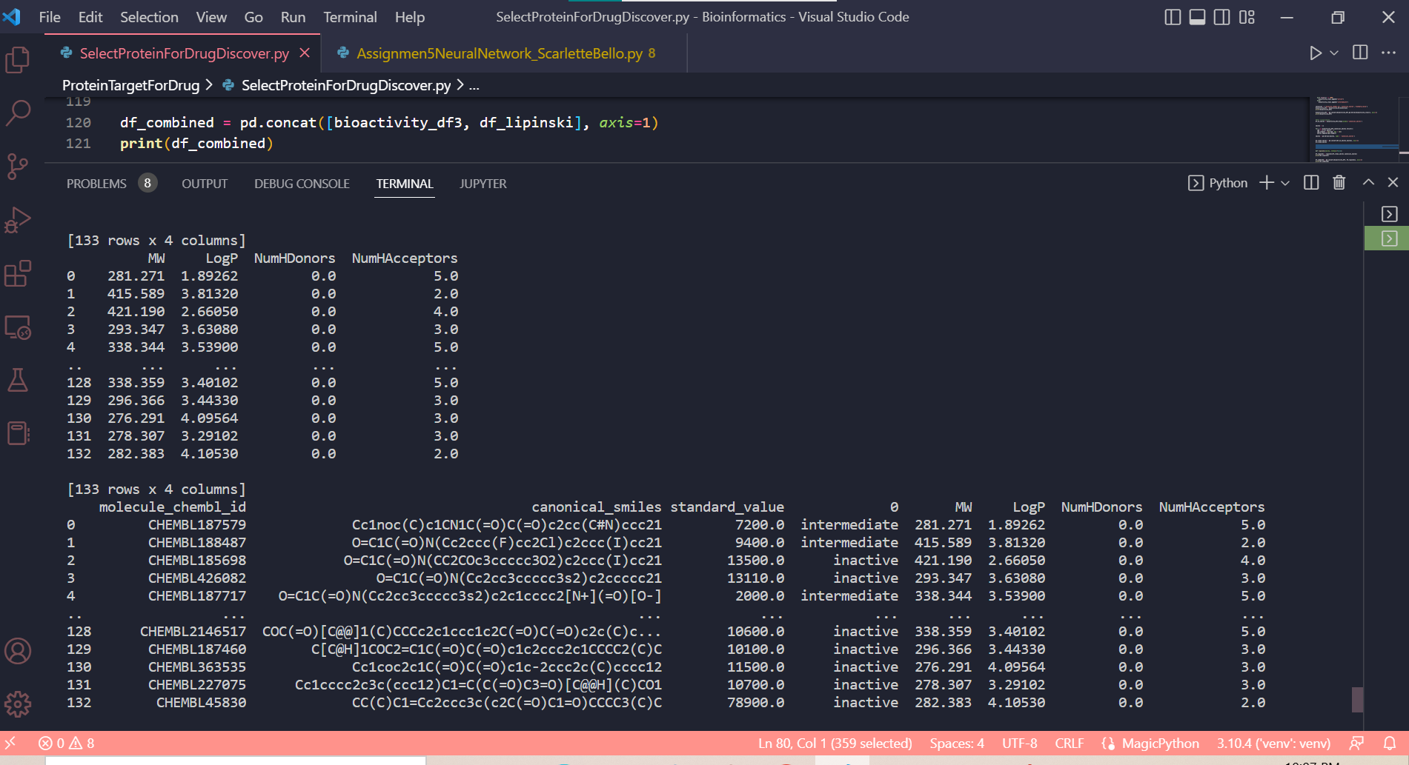
##....For analyzing this data, it is required to calculate the Lipinski descriptors, which make reference to the drug's kenetic properties.
##....pharmaceutical kinetic profiles Absortion, Distribution, Metabolism, Excretion(ADMI)
##... The Lipinski calculation code (lipinski function) was based from https://codeocean.com/, open source library resource

