Slide 1
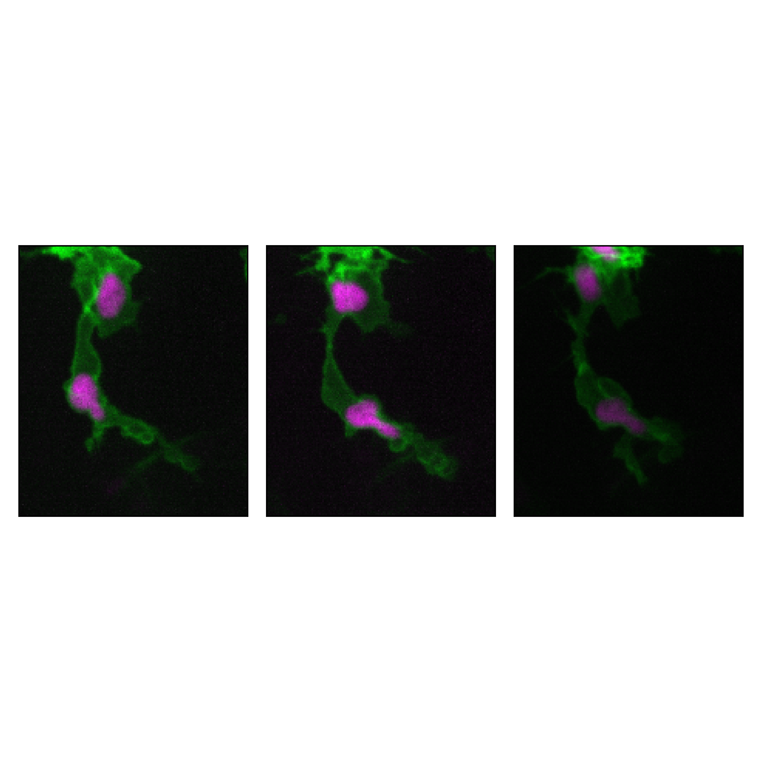
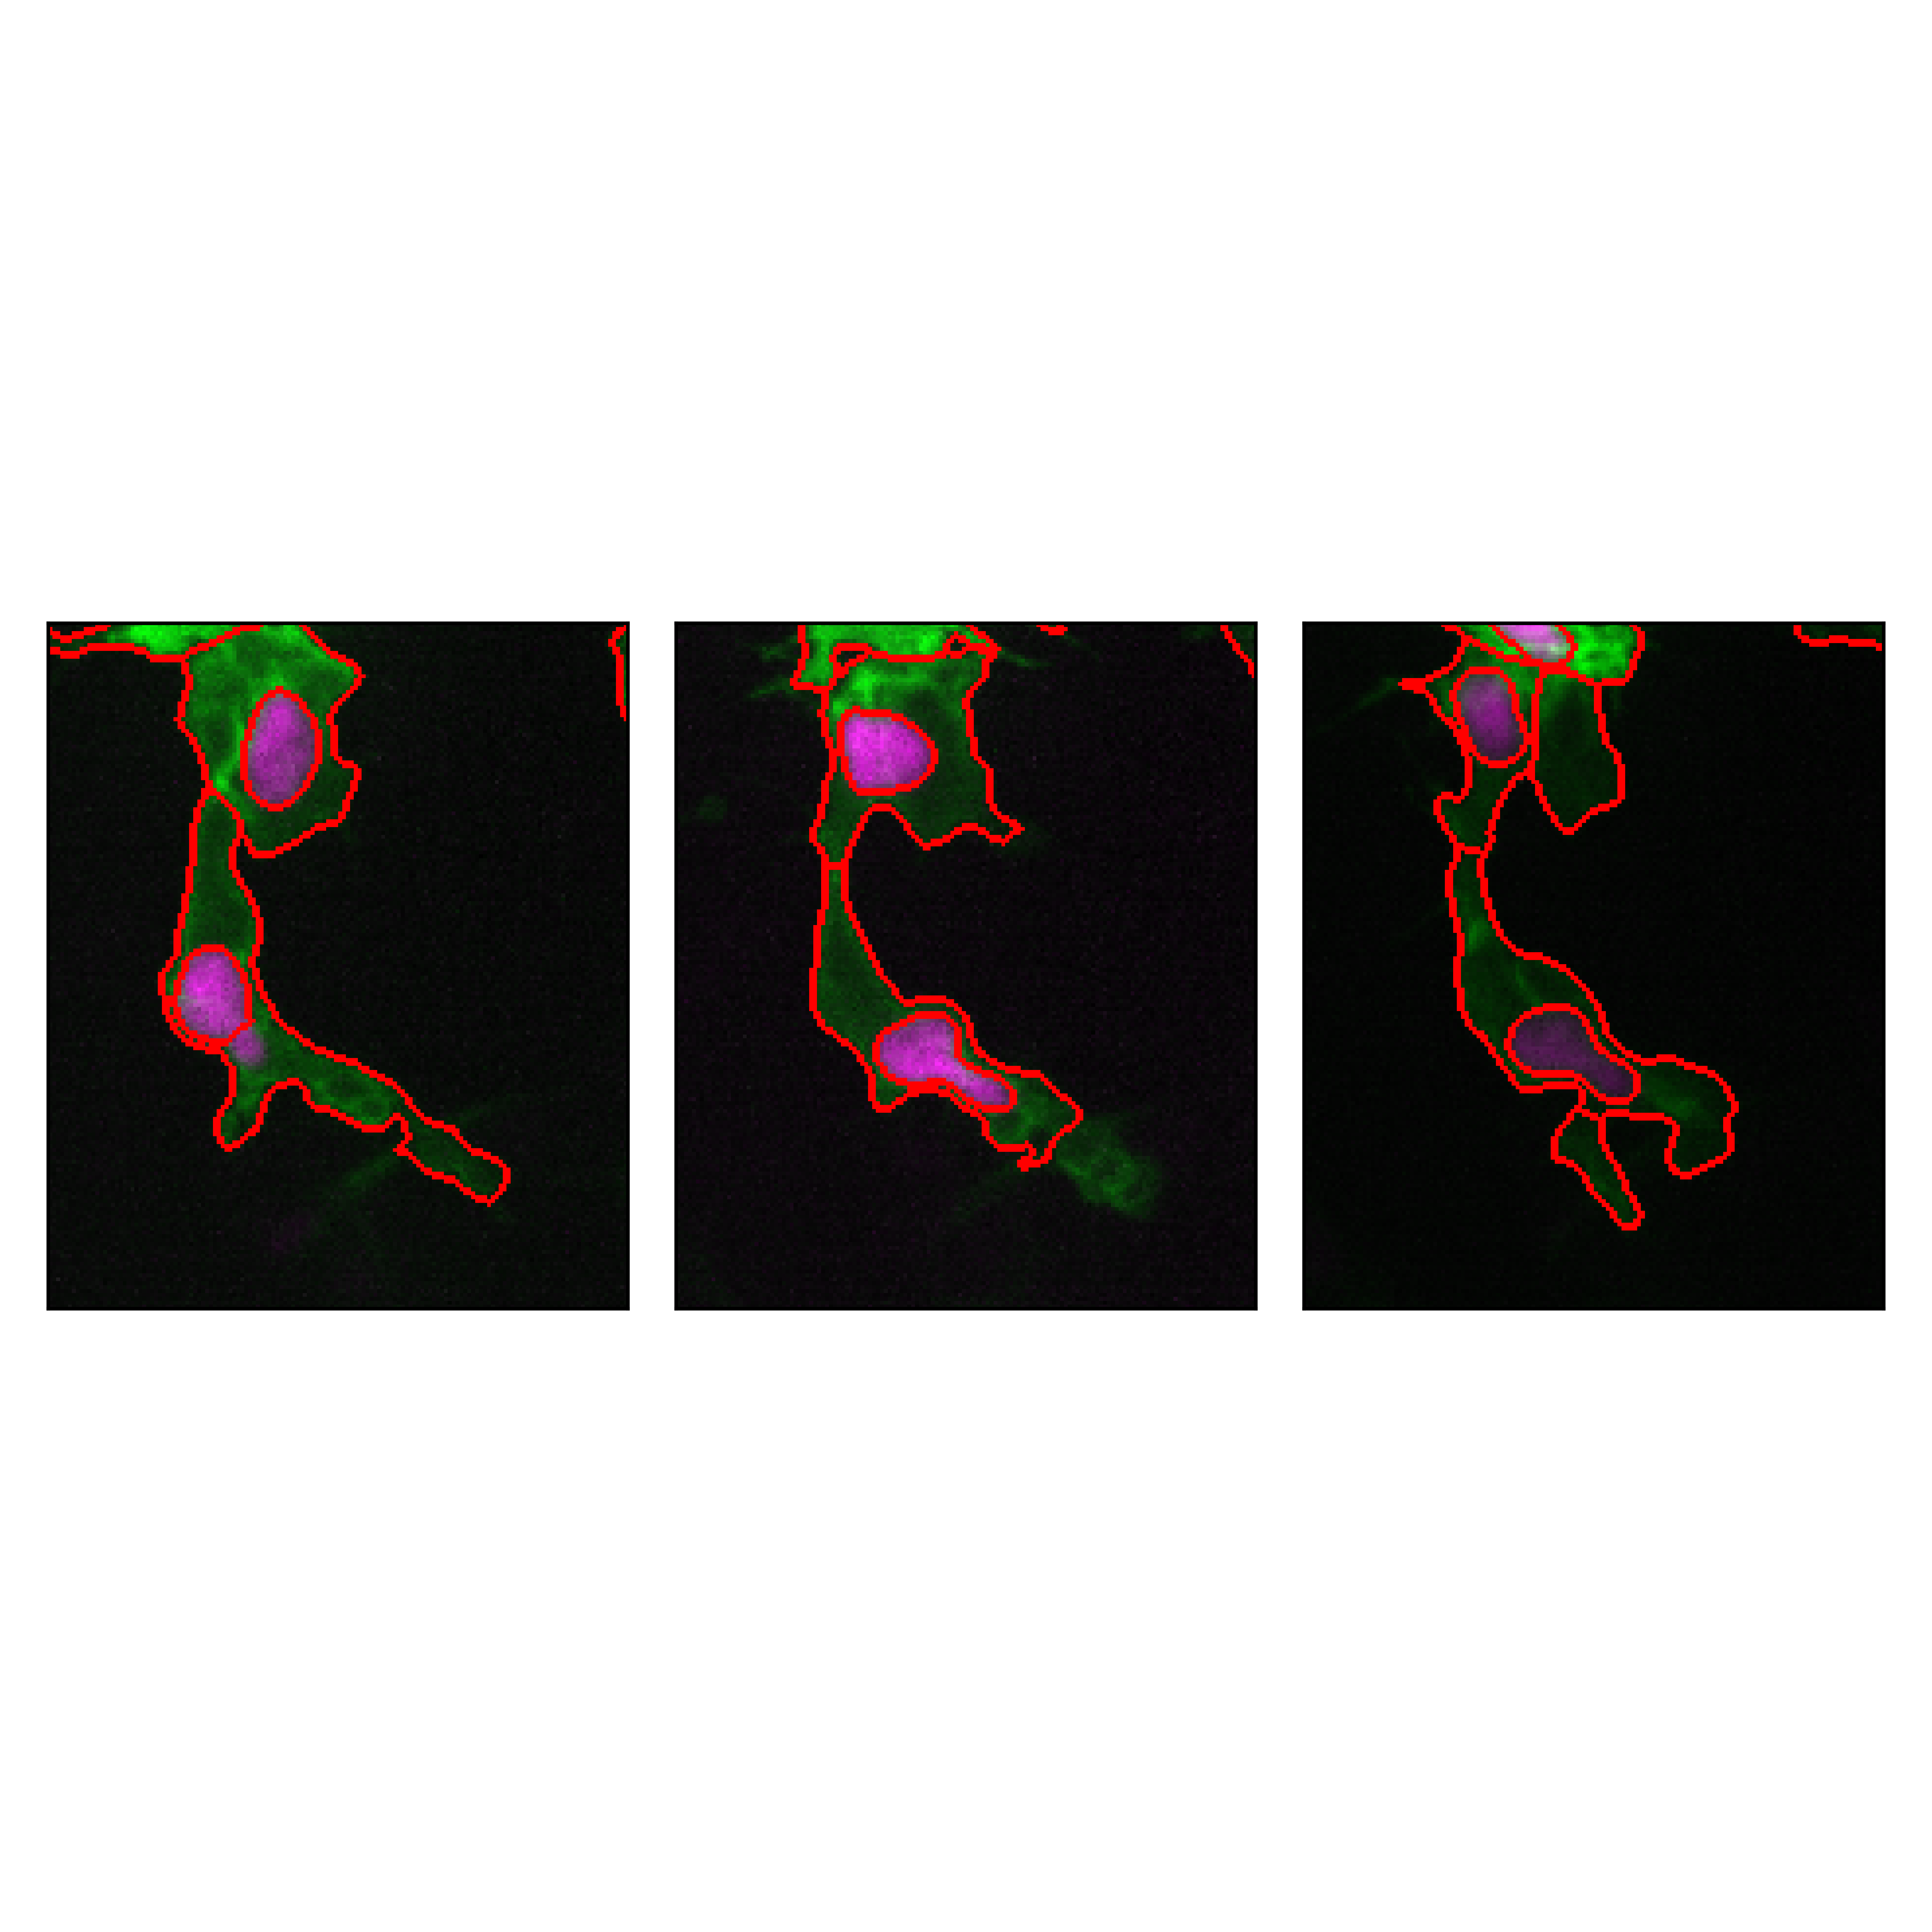
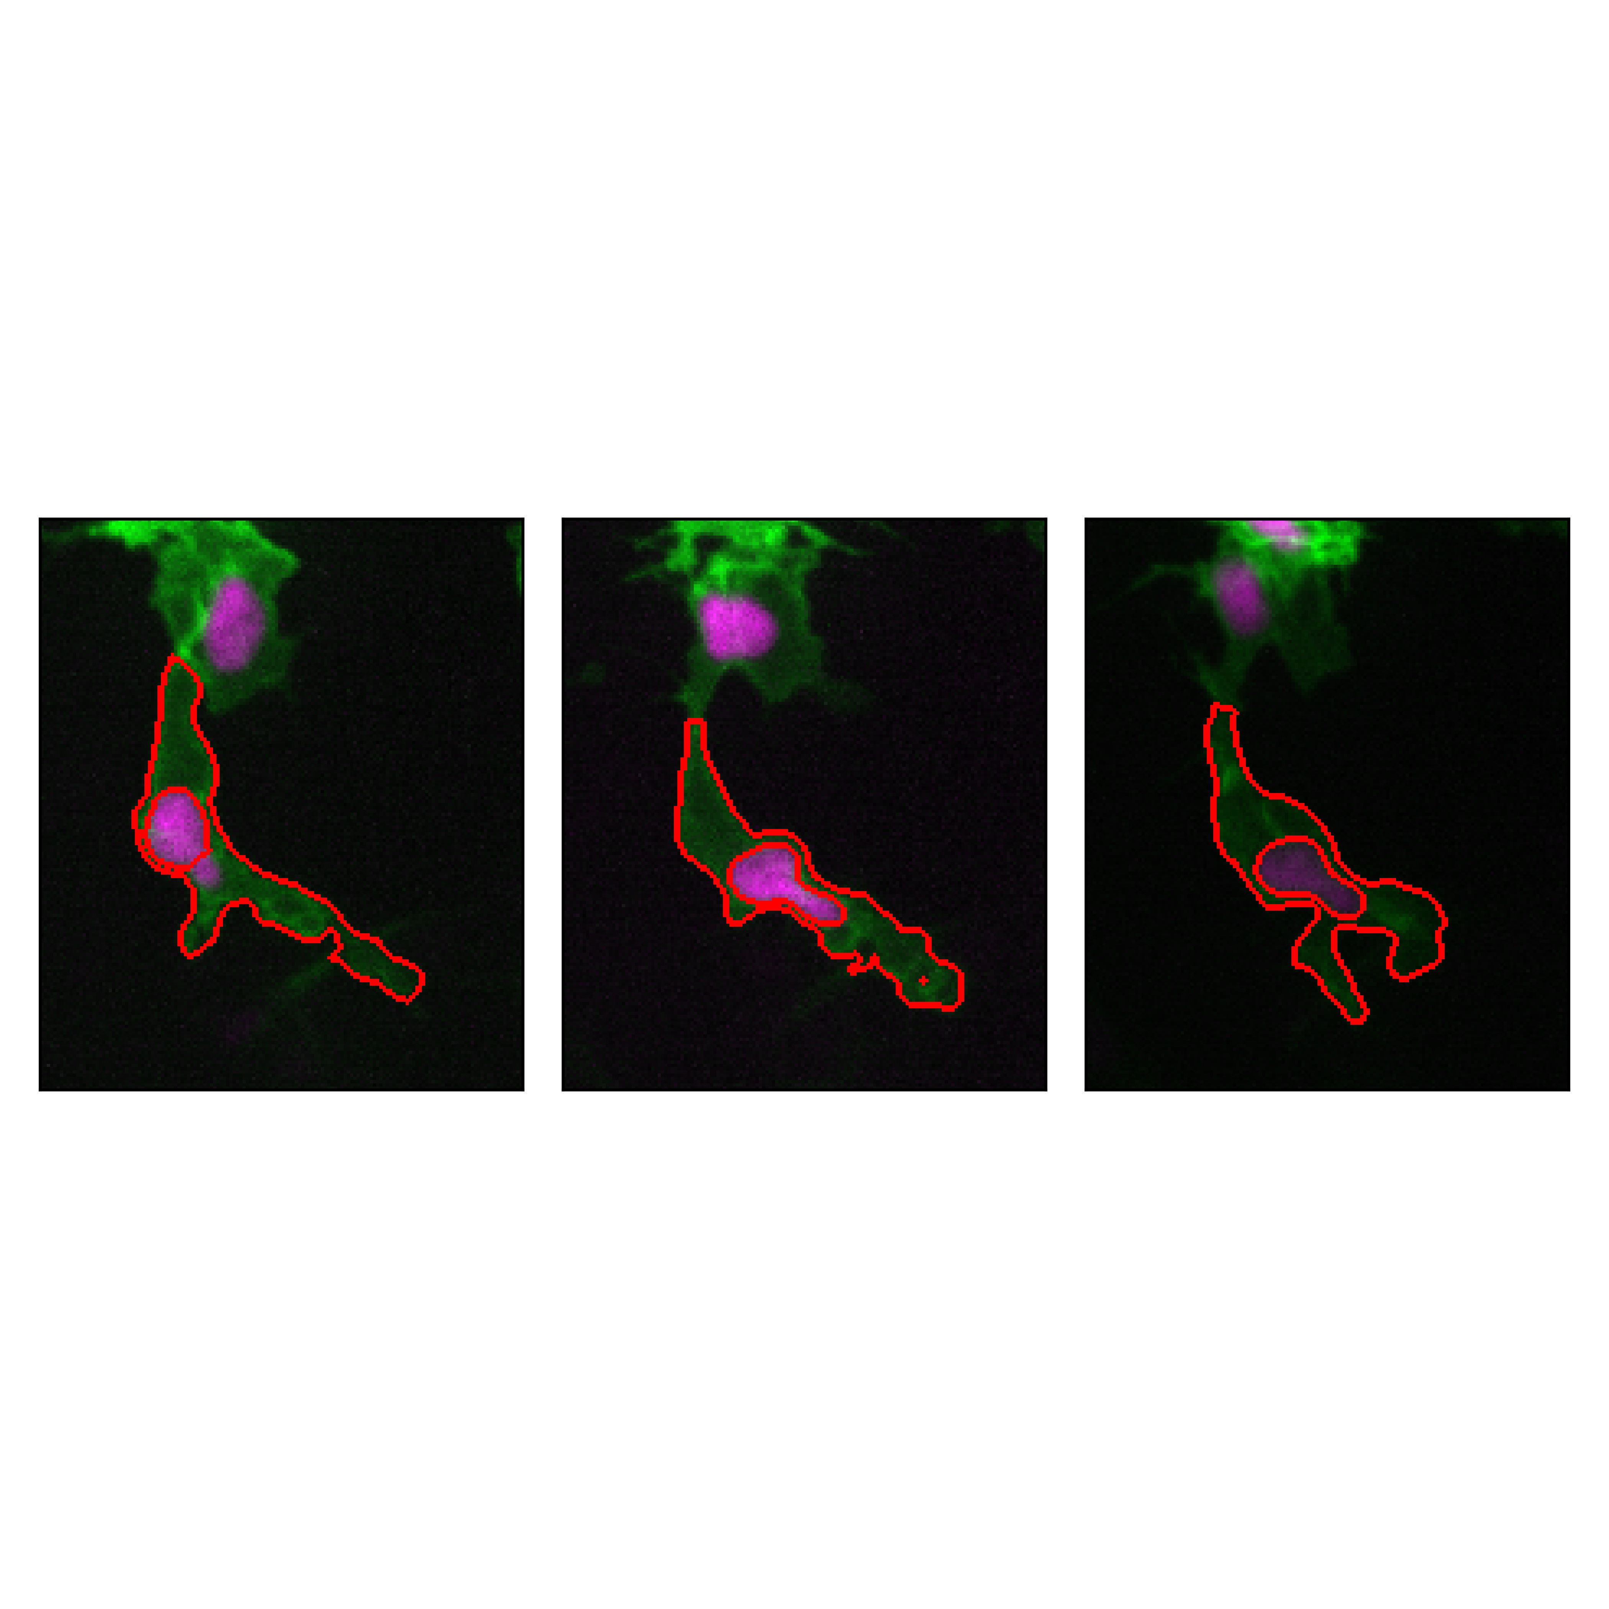
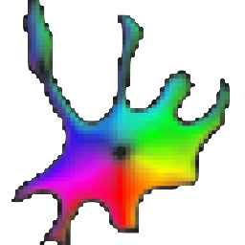
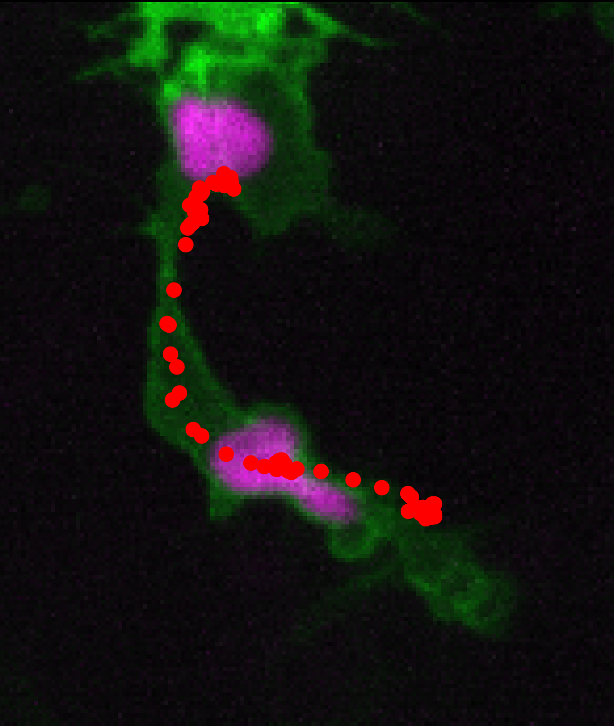
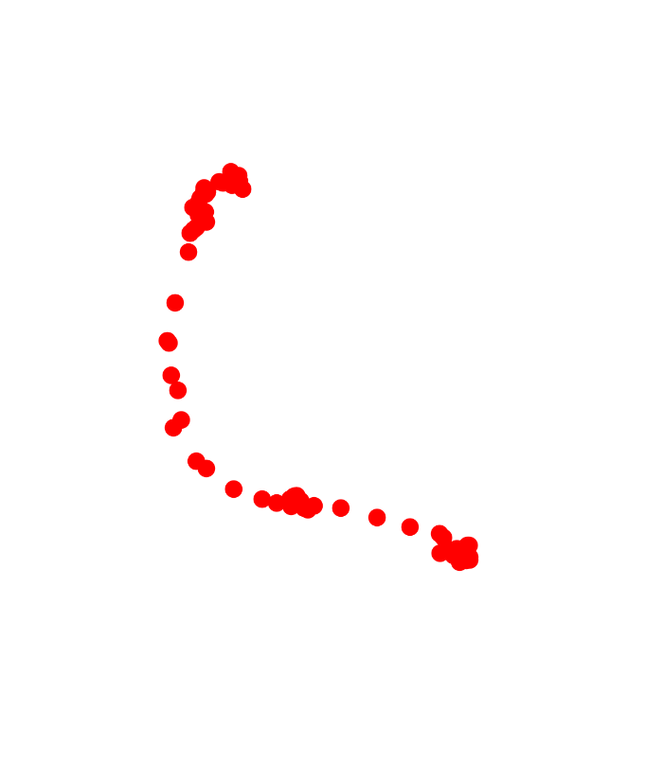

✍️
Drift
Correction
$$\overset{⃑}{v}$$
Nuclei centroid extraction
Spline Interpolation for
cell track extraction
Motion vector definition &
Line projection profile extraction
Back
Back
Front
Front
Nuclear centroid

