Slide 1


Using Redgate SQL Monitor to Solve Database Problems, Everywhere!

Slide 2





About me
Grant Fritchey
DevOps Advocate
Microsoft Data Platform MVP
AWS Community Builder
@gfritchey
Grant.Fritchey@Red-Gate.com
scarydba.com

Slide 3
Most Common Database Problems
Performance
Scalability
Security
Multiple platforms
Data integration & integrity
Notes:
Study Identifies Top Five Most Challenging Database Management Issues (datavail.com)
5 Common Database Management Challenges & How to Solve Them (hackread.com)
Blog: 9 Common Database Management Challenges and How to Fix Them | Tudip
Top 10 Big Data Challenges and How to Address Them (techtarget.com)

Slide 4
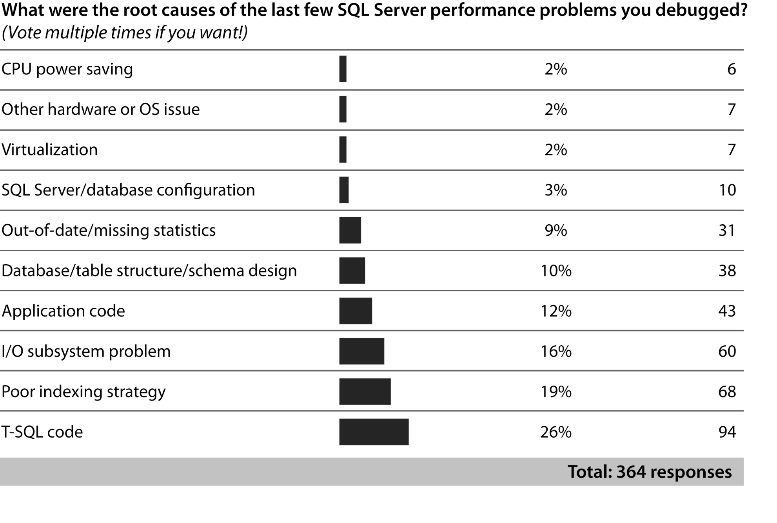
Why Tune Queries?
http://sqlskills.com/blogs/paul/post/survey-results-common-causes-of-performance-problems.aspx

Slide 5

Easy Query Tuning

Slide 6
Actual Query Tuning

Slide 7
Tools to Identify Poor Performance: SQL Server
Dynamic Management Views (DMV)
Trace/Profiler
Extended Events
Query Store

Slide 8
Tools to Identify Poor Performance: PostgreSQL

Slide 9
Introducing SQL Monitor
Uses previous mechanisms to gather data (there is no magic)
Aggregation of metrics
Analysis of metrics
Guidance

Slide 10
Common Performance Issues
Bad or missing indexes
Recompiles
Bad parameter sniffing
Columnstore/Hash
JSON
Blocking
Statistics

Slide 11
Bad or Missing Indexes
Second most common performance problem, behind bad code
100% cross platform issue
Write SQL to use existing indexes
Add/modify indexes as needed

Slide 12
Bad or Missing Indexes
Use execution/explain plan to diagnose
Testing is your friend
Slow performance
Blocking
Resource contention

Slide 13
Recompiles
Technically, not a problem in PostgreSQL
SQL Server is built around plan reuse
Solutions depend on cause of recompile

Slide 14
Recompiles
Compile/recompile count
High CPU
Changing execution plans

Slide 15
Bad Parameter Sniffing
Technically, not a problem in PostgreSQL
Solutions vary:
Parameter Sensitive Plan Optimization
Query Store plan forcing
RECOMPILE
KEEP FIXED PLAN
OPTIMIZE FOR
Local variables (until recompile)
Turn off parameter sniffing

Slide 16
Bad Parameter Sniffing
Wildly varying performance metrics
Changes in execution plans

Slide 17
Columnstore/Hash
Aggregation and analytic queries
Generally poor performance
Poor/no index use

Slide 18
Columnstore/Hash
Poor execution/explain plans
High CPU
Very high I/O
Generally poor performance

Slide 19
JSON
VARCHAR(MAX) in SQL Server
JSON/JSONB in PostgreSQL
Performance matters when querying
Modifying data generally not an issue

Slide 20
JSON
What are the indications for poor performance here?

Slide 21
Blocking
Common across platforms
Smaller transactions
Faster transactions
Performance tuning
Bigger, better, faster, more hardware
Higher service tiers

Slide 22
Blocking
Long running queries
Blocked queries
Alerts
High everything

Slide 23
Statistics
Fundamental to optimization across platforms
More frequent updates
Targeted updates

Slide 24
Statistics
Bad execution/explain plans
Poor performance
Degradation over time
Changes to execution plans

Slide 25
Wrap-up

Slide 26

Questions?
Notes:
Big question mark | in Ipswich | Benjamin Reay | Flickr

Slide 27
About me
Grant Fritchey
DevOps Advocate
Microsoft Data Platform MVP
AWS Community Builder
@gfritchey
Grant.Fritchey@Red-Gate.com
scarydba.com

