Slide 1
PROJECT DOCUMENTATION
PROJECT FLOW
Power BI Portfolio Project
1
DATA SOURCES
CSV datasets + optional API
Architecture & Diagram
2
AIRFLOW
Tests, staging, dimensions, facts
Technology stack: Docker, Apache Airflow, Postgres, MySQL, Power BI, AI agents (Ollama).
3
DATA PLATFORM
PostgreSQL staging → MySQL DW
Repository
4
POWER BI
github.com/Scastnijs/andrejs_powerbi_portfolio_project
Semantic model, DAX, Python visuals
Prepared from the main branch • 13 July 2026
5
PORTFOLIO OUTPUT
PBIX, screenshots, documentation

Slide 2
End-to-end project architecture
Main data flow, runtime components, storage layers, and analytical outputs
1
Sources
2
Orchestration
3
Staging
4
Warehouse
5
Analytics
FILES
DOCKER DESKTOP
STAGING
DW
REPORTING
CSV datasets
Apache Airflow 3.1.6
PostgreSQL 16
MySQL data warehouse
Power BI Desktop
countries • subdivisions • drinks • expectancy • happiness • vehicles • worldcities • country_alias
CeleryExecutor cluster
staging schema
drinks
expectancy
worldcities
vehicles_country
happiness
country_alias
countries
subdivisions
dw.dim_geo
dw.dim_city
dw.dim_time
dw.dim_unit
dw.dim_indicator
dw.fact_observation_country
dw.fact_observation_city
dw.v_country_alcohol_summary
Semantic model
DAX measures
Map, line and column visuals
PBIX reports and screenshots
API server
Scheduler
DAG processor
Celery worker
Triggerer
Redis broker
API
Optional API enrichment
master_dag.py
PYTHON
Python 3.12 environment
Local Ollama endpoint can normalize country aliases.
Libraries support Power BI Python visuals.
RUN
git clone
docker compose up -d
create & activate venv
pip install requirements
open PBIX
Refresh

Slide 3
Docker runtime and docker-compose.yaml
Local services, exposed ports, shared volumes, and how Airflow connects the project together
docker-compose.yaml
x-airflow-common:
image: apache/airflow:3.1.6
env_file: .env
executor: CeleryExecutor
volumes:
./dags -> /opt/airflow/dags
./data -> /opt/airflow/data
./logs -> /opt/airflow/logs
services:
postgres: 5433:5432
redis: expose 6379
airflow-apiserver: 8083:8080
scheduler / worker / triggerer
flower: 5555:5555 (profile)
Docker Compose local stack
Exposed ports &
external services
One YAML file starts the Airflow cluster and shared dependencies
8083 → Airflow API/UI
5433 → PostgreSQL container
6379 → Redis broker (internal)
5555 → Flower monitor (optional)
3306 → MySQL warehouse connection
11434 → local Ollama API
airflow-apiserver
airflow-scheduler
UI/API on host :8083
schedules and triggers DAGs
airflow-worker
dag-processor
Celery task execution
parses DAG files
airflow-triggerer
airflow-init
Shared volumes
async trigger support
DB migrate + admin user
dags, data, logs, config, plugins
mounted under /opt/airflow
postgres
redis
metadata / staging :5433
Celery broker :6379 internal
.env settings
Airflow image, UID, credentials
provider requirements / connections
Design note
Compose owns the Airflow runtime; MySQL warehouse and Ollama can run as local/external services reached through Airflow connections.

Slide 4
Airflow master DAG orchestration
The project runs tests and staging in parallel, then dimensions and facts in dependency order
2
Staging
1
Test
3
Dimensions
4
Facts
PARALLEL
PARALLEL
SEQUENTIAL
SEQUENTIAL
staging_countries
staging_country_alias
mysql_test
dw_d_geo
dw_f_country_drinks
staging_drinks
staging_expectancy
postgres_test
dw_d_cities
dw_f_country_happiness
START
staging_happiness
staging_subdivisions
END
dw_d_drinks
dw_f_country_vehicles
Only a failed child task is retried.
staging_vehicles
staging_worldcities
dw_d_happiness
dw_f_observation_city
Each source load is represented by its own task.
Retry behavior: parallel sections rerun only the failed child DAG task; sequential sections retain one task per child DAG and retry from the failed step.

Slide 5
Fuzzy matching country aliases with Ollama
dw_country_alias.py uses database-first checks, then a local LLM fallback to normalize country names
Raw aliases
DB-first checks
Ollama fallback
New alias registry
Warehouse load
SELECT DISTINCT country
from selected staging table
drinks / vehicles / happiness
staging.countries
staging.country_alias
fast exact/known mapping
Airflow HttpHook
conn_id = Ollama
POST /api/chat
insert into
staging.country_alias
ON CONFLICT DO NOTHING
MySqlHook
upsert dw.dim_geo
canonical names only
LLM request/response contract
Why this is fuzzy matching
Input alias: "Czech Republic"
Allowed values: staging.countries.name_short
Expected JSON: { canonical_name, is_newly_discovered, reasoning }
Example output: "Czechia" + register alias when new
Not just text similarity: it can handle old names, abbreviations, translations, and informal spellings.
The LLM is constrained by the canonical country list, so output stays warehouse-safe.
New mappings are persisted, making later runs faster and more deterministic.
DAG parameters: source_table enum = staging.drinks / staging.expectancy / staging.worldcities / staging.vehicles_country / staging.happiness | llm_model default = gemma4
Local runtime dependency
Ollama runs outside or beside the Airflow stack; Airflow reaches it through the saved HTTP connection named “Ollama”.

Slide 6
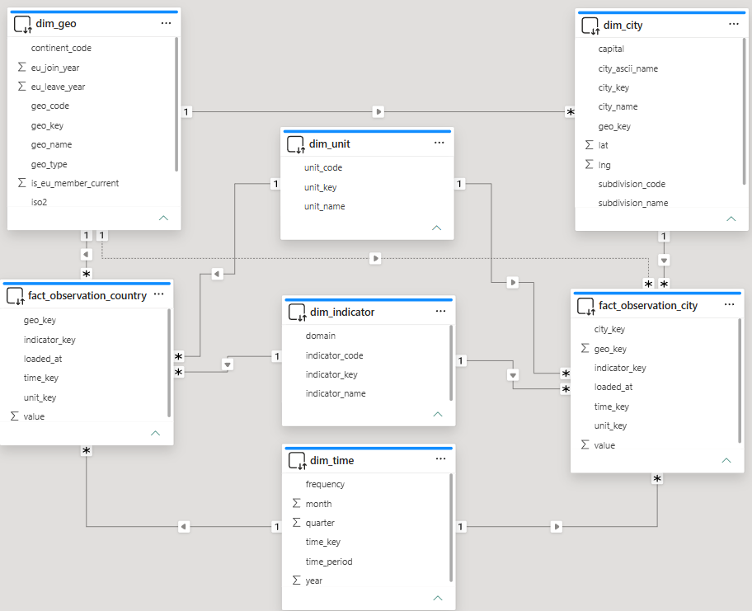
Data lineage and analytical model
How staged source data becomes reusable dimensions, facts, views, and Power BI measures
1
PostgreSQL staging
2
Transform
3
MySQL dimensional warehouse
4
Power BI outputs
staging.countries
Airflow Python DAGs
v_country_alcohol_summary
staging.subdivisions
LOOKUPS
Semantic model
staging.worldcities
country aliases
ISO codes
year keys
unit keys
indicator keys
staging.drinks
DAX measures
staging.vehicles_country
Maps & charts
staging.happiness
LOAD PATTERN
staging.expectancy
update if exists
insert if not exists
Python visuals
staging.country_alias
PBIX + screenshots

