Slide 1
PANDORA
Topic- Pandemics

Slide 2
TABLE OF CONTENTS
01
02
About the Disease
Read about the current Pandemic. Don’t forget to visit our history page.
World Statistics
Some worldwide statistics of the number of active, recovered and deceased cases.

Slide 3
04
Ration Calculator
03
Calculate your groceries instead of panic buying loads.
BLOG
Read about the genuine , verified articles on COVID-19 and recent progress in tackling the same

Slide 4
INTRODUCTION
WHO(World Health Organization) declared COVID-19 also known as the Corona Virus as a pandemic. This created a panic situation in the whole world since we have no idea how to tackle this situation. So lets see what we can do :

Slide 5
01
About the disease
Lets see what all we know about the corona virus :

Slide 6
ABOUT THE DISEASE
The Virus
The Target
What do we do?
The Concern
The virus looks like a hull enclosing genetic data.
It targets the epithelial cells inside our lungs.
Most cases recover with no problem since the immune system is sufficient to tackle
Since we don’t have a vaccine, the mortality rate is increasing rapidly

Slide 7
SYMPTOMS OF THE DISEASE
Headache
Fever
Dry Cough
Lack of sense of taste
Mild headache.
High fevers and cold often lead to pneumonia.
Dry cough and soar throat.
No food tastes the same.

Slide 8
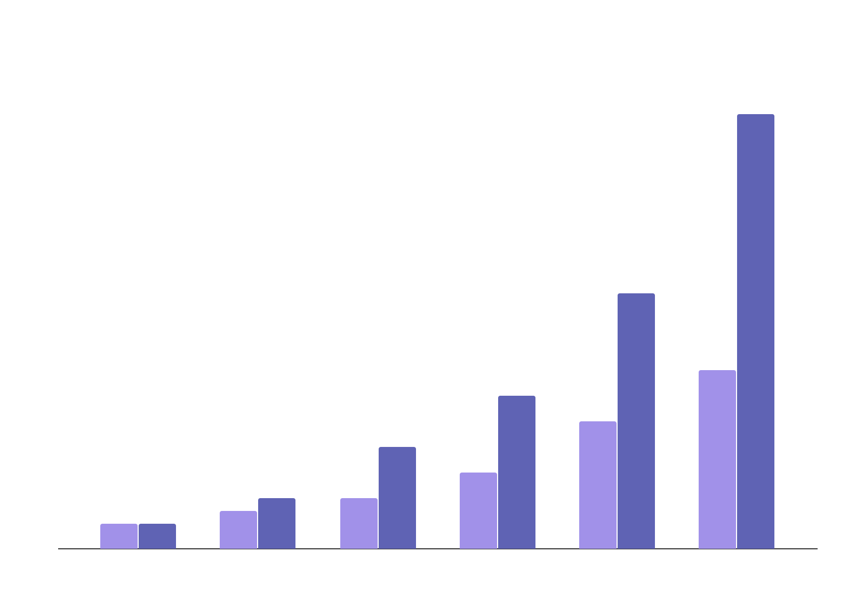
RISK FACTORS
Factors
Evolution
0-12 y/o
60+ y/o
Available medical facilities
Number of Medical and paramedical staff

Slide 9
18,64,629+
213
Cases confirmed
Countries affected

Slide 10
We need to do something till we come up with a vaccine. Lets see what all can we do instead of panicking or spreading this pandemic :

Slide 11
Symptoms
Instead of panicking over a common cold lets compare if you actually need medical attention.

Slide 12
Common Symptoms
Headache
Breathing Problem
FEVER
Cold
Headache and body pain are one of the first symptoms.
Breath becomes heavy and difficult
Mild to high fever
Cold and shivering which often turns into pneumonia.

Slide 13
World Statistics
02
Some worldwide statistics of the number of active, recovered and deceased cases.

Slide 14
WORLD STATISTICS
CONFIRMED CASES
18,64,689 +
CONFIRMED DEATHS
1,15,286
COUNTRIES AFFECTED
213

Slide 15
03
Ration Calculator
Accurately calculate your groceries instead of panic buying loads.

Slide 16
RATION CALCULATOR
Enter the number of family members.
Enter quantities of ration you have
Select period for calculation
Know what and how much to buy instead of panic buying!!

Slide 17
04
Blog
Read about the genuine , verified articles on COVID-19 and recent progress in tackling the same

Slide 18
Some tips on prevention
Use Facemasks
Only sneeze in a tissue
Wash Hands regularly
Consult
Social Distancing
Sanitize regularly

Slide 19

THANKS
Do you have any questions?
youremail@freepik.com
+91 620 421 838
yourcompany.com
1. Sarthak Khandelwal – USICT (1st YEAR)
2. Himanshu Goel – MSIT (1st YEAR)
3. Madhav Malhotra – MSIT (1st YEAR)

