Slide 1
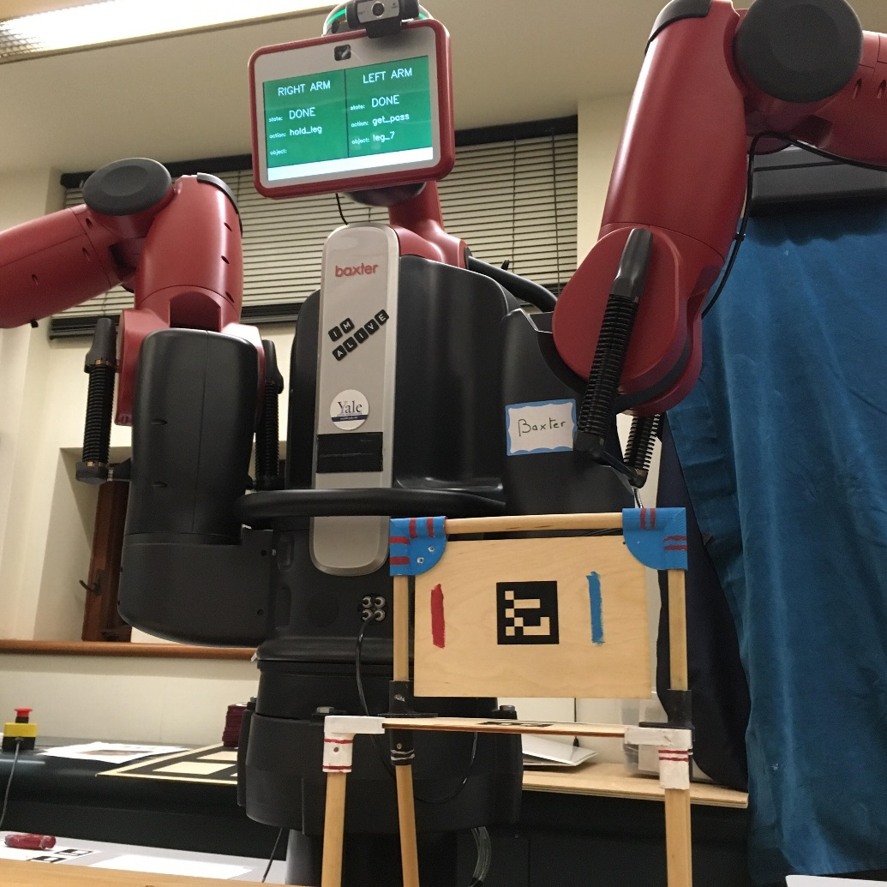
Training a Robot to Collaborate with a Human Partner Michael Van der Linden, Elena Corina Grigore, Brian Scasselatti
Human-robot collaboration increasingly important
Task: Assemble a chair with certain rules and human preferences
Robot starts with no domain knowledge, or training data; must learn only from human feedback
Q-learning with varying bandit strategies
Fast online training: “Decent first, refined later”
Baxter and the completed chair

Slide 2
Introduction
Our model task is assembling a chair
Robot hands components to human or holds subassemblies in place for human to work on
Task has rules for sequence of subassemblies, and human has preferences within those rules
Robot starts with zero knowledge of rules or preferences
No training data or offline learning; must learn on the job through human interactions while still being productive (completing the task)
I chose Q learning for its simplicity in representing discrete states and actions, and its steep early improvement curve
Q[state, action] = reward(state, action) + ɣ*max(Q[next state])
Rules:
Chair assembly is Hierarchical Task Model
Examples:
Back subassembly must be finished before seat subassembly can begin, or vice versa
All chair legs must be gathered before assembly into seat
Preferences:
Examples:
Back subassembly before seat
Brackets before dowels
In legs, back brackets before front brackets

Slide 3
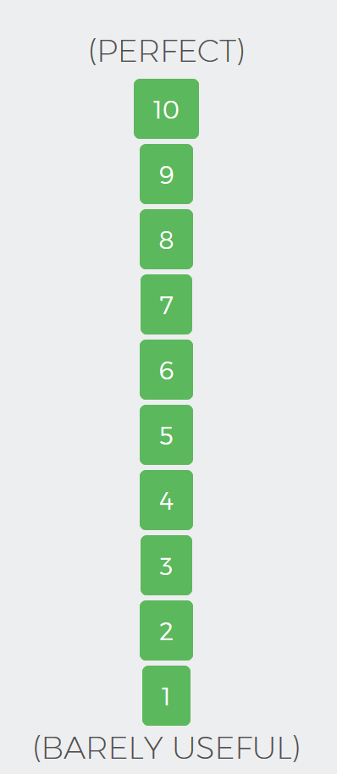
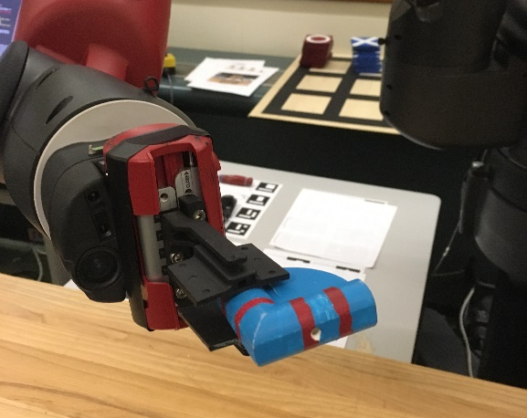
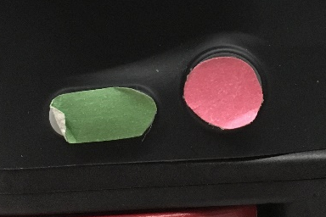
Procedure
Online learning – task is completed with every trial
Successive trials build on previous knowledge to increase speed and performance
Robot learns to avoid rejected actions early and later optimizes for human preferences
For each trial:
while task is not finished:
action = e(Q[state], trial)
Human accepts
Robot completes action (releases object) and determines next state
Human binary feedback
Robot begins action
(offers object)
Human rejects
Human provides nuanced feedback through web interface
Robot cancels action (returns object); state stays the same
Q[state, action] = -1
Q[state, action] = feedback + ɣ*max(Q[next state])
Advance to next state

Slide 4
The Multi-Armed Bandit
Fundamental problem in machine learning: balancing exploitation of actions with a proven reward against exploration of new actions
I compared four different exploitation-exploration functions, with three different variations to the explore term
Explore First
If there is an unexplored action, try it. Otherwise, exploit the best.
Epsilon-Greedy
Randomly choose an action (explore) with some small probability e.
e = 0.2
Epsilon-Decreasing
Set e (prob. of exploration) to decrease as trials continue.
e = max(0.1, (10 - trial) / 10)
Epsilon-Proportional
Set e (prob. of exploration) as inversely proportional to quality of best option.
e = max(0, (10 – max(options)) / 10)
Variant A: When exploring, choose randomly from all options.
Variant B: When exploring, choose randomly from unexplored options. If none, choose randomly from all.
Variant C: When exploring, choose randomly from unexplored options. If none, exploit best.

Slide 5
Results
I simulated 12 different 80-trial runs, 250 times each, and tracked the average performance of the robot in each trial (shown here as a percentage of a perfect score, which the robot would earn by following every rule and maximizing every user preference).
Each of the 4 exploit-explore strategies improves logarithmically, but there are subtle differences reflecting trade-offs between initial rate of growth and peak performance. The A, B, and C variants have little effect.
I ran 3 consecutive trials on the robot using epsilon-greedy, chosen for its fast early growth. The robot improved dramatically after just 1 trial.
n = 250

