Slide 1
Docker
Basic-setup
Docs

Slide 2
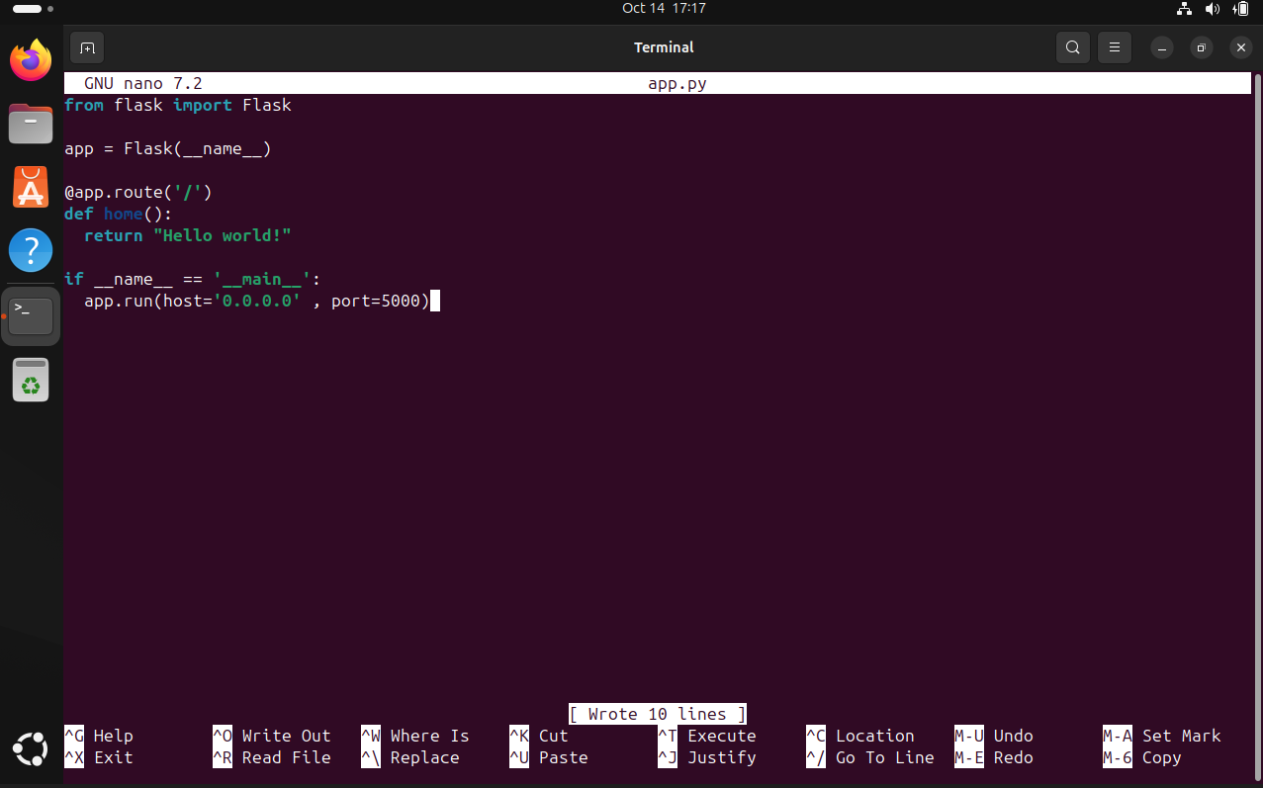
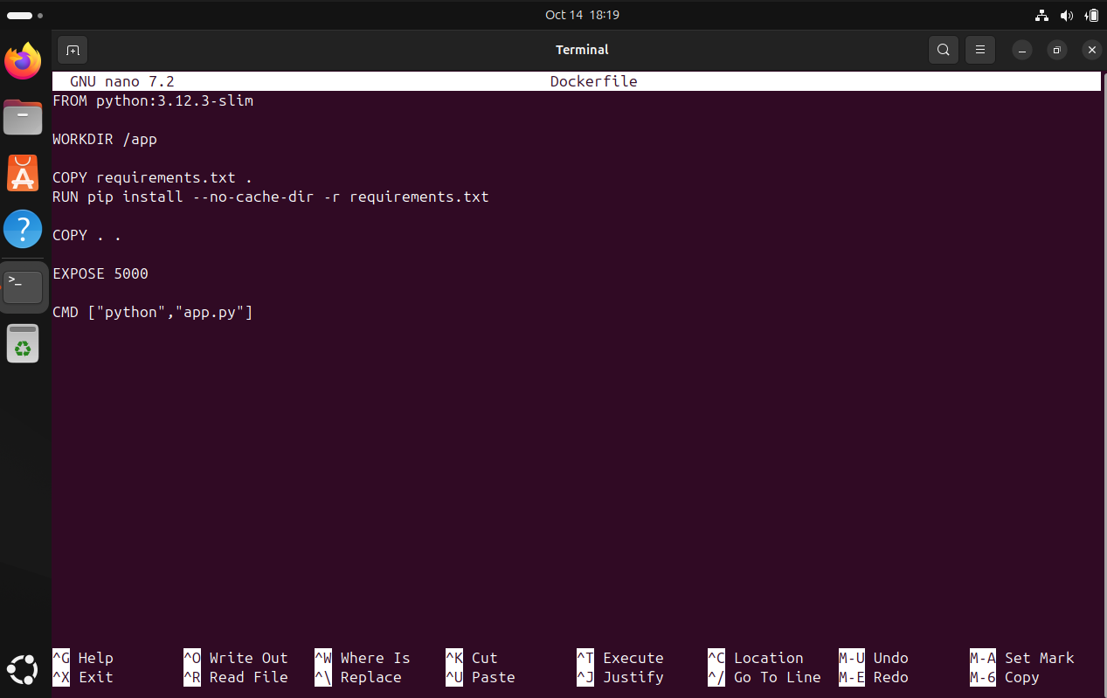
Machines:
1) Ubuntu-24.04.01-desktop-amd64
Testing app:
- Python + flask
Docker config:

Slide 3
Typical problems:
1) Permissions setting
2) Libraries management (script’s libraries)
3) Broken/bugged script
4) Not defying language to preload in container
5) Not exposing & redirecting ports for container and machine OS

