Slide 1
Basic_setup
Docker
Results

Slide 2
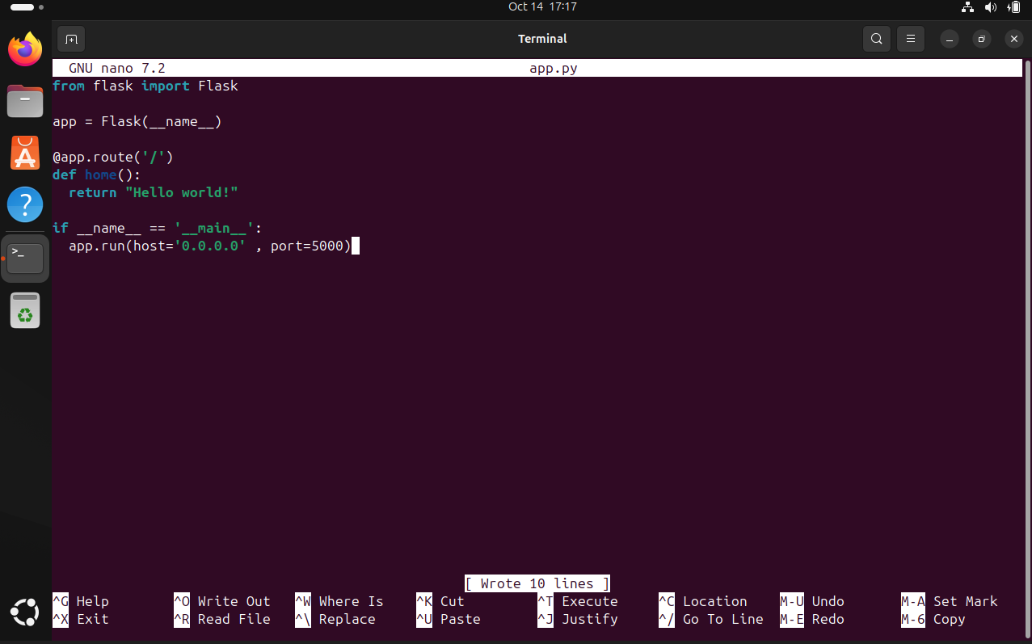
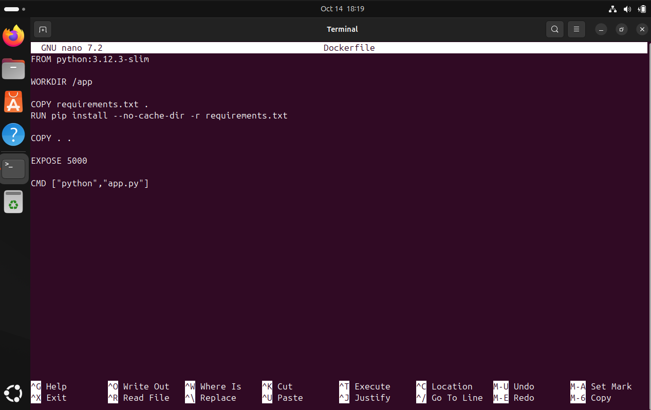
Python testing app
Docker setup file

Slide 3
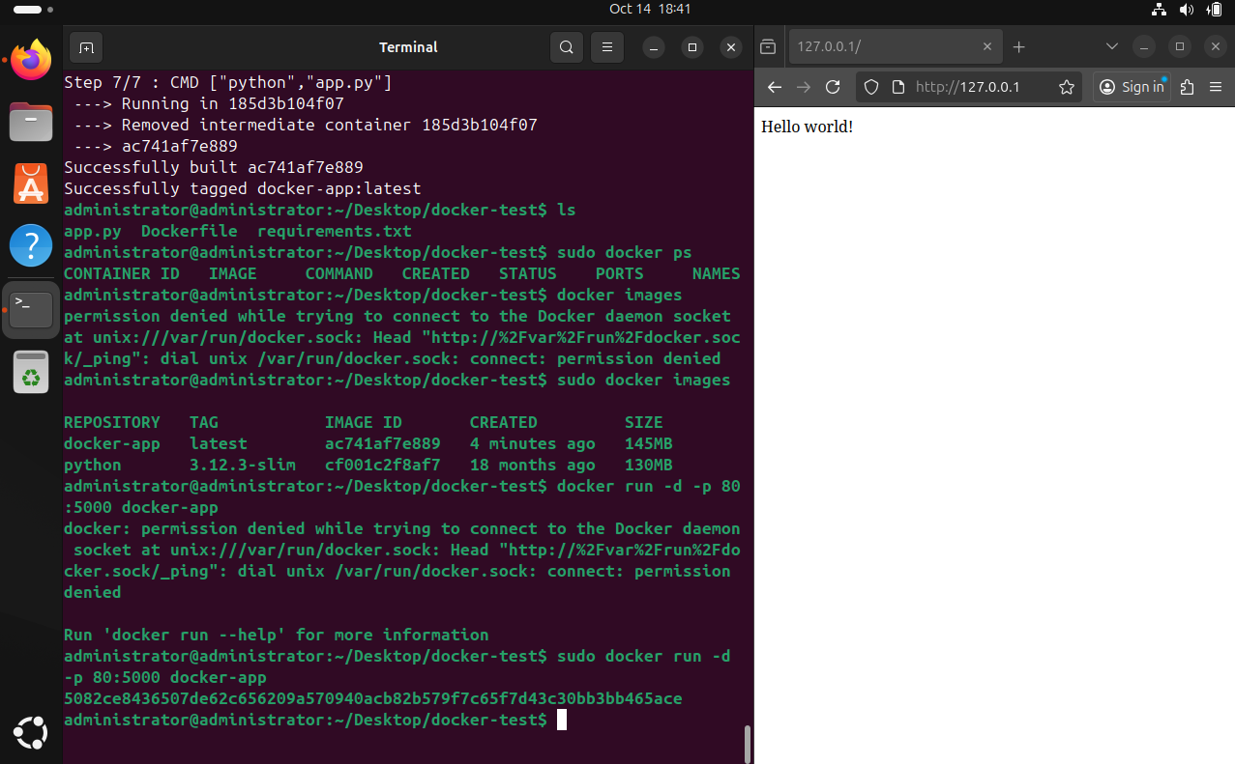
Working result
- On left side – terminal with started docker container and port redirecting
- On right side – successfully connected to the python app(web page in the browser) that is initialised inside of the docker container

