Slide 1
Docker
Basic setup
-
Full logs

Slide 2
Using: Oracle VirtualBox
Virtual Machine 1(SERVER): ubuntu-24.04.1-desktop-amd64
Test program: Python/flask app(basic)

Slide 3
1) sudo apt install docker.io - had little problems with instalation , but i just
forgot to do 'sudo apt-get update' , after that everything installed correctly.
2) sudo systemctl enable docker
3) sudo systemctl start docker
4) sudo systemctl status docker - checked the status , docker service works.
5) mkdir docker-test - created folder for docker app in
'/home/administrator/Desktop/docker-test'
6) cd /home/administrator/Desktop/docker-test
7) touch app.py

Slide 4
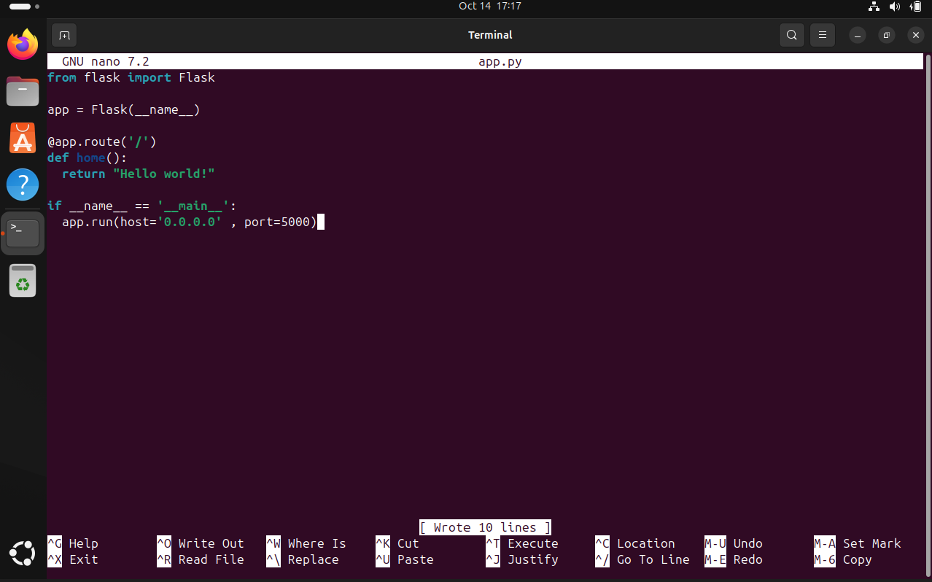
8) nano app.py - created basic Python/flask code
9) touch requirements.txt - making requirements list, dependencies for python that
needed to be installed in the docker in order for app to work
10) nano requirements.txt - adding just one line 'flask' , we don't need more for
that project to work
11) touch Dockerfile

Slide 5
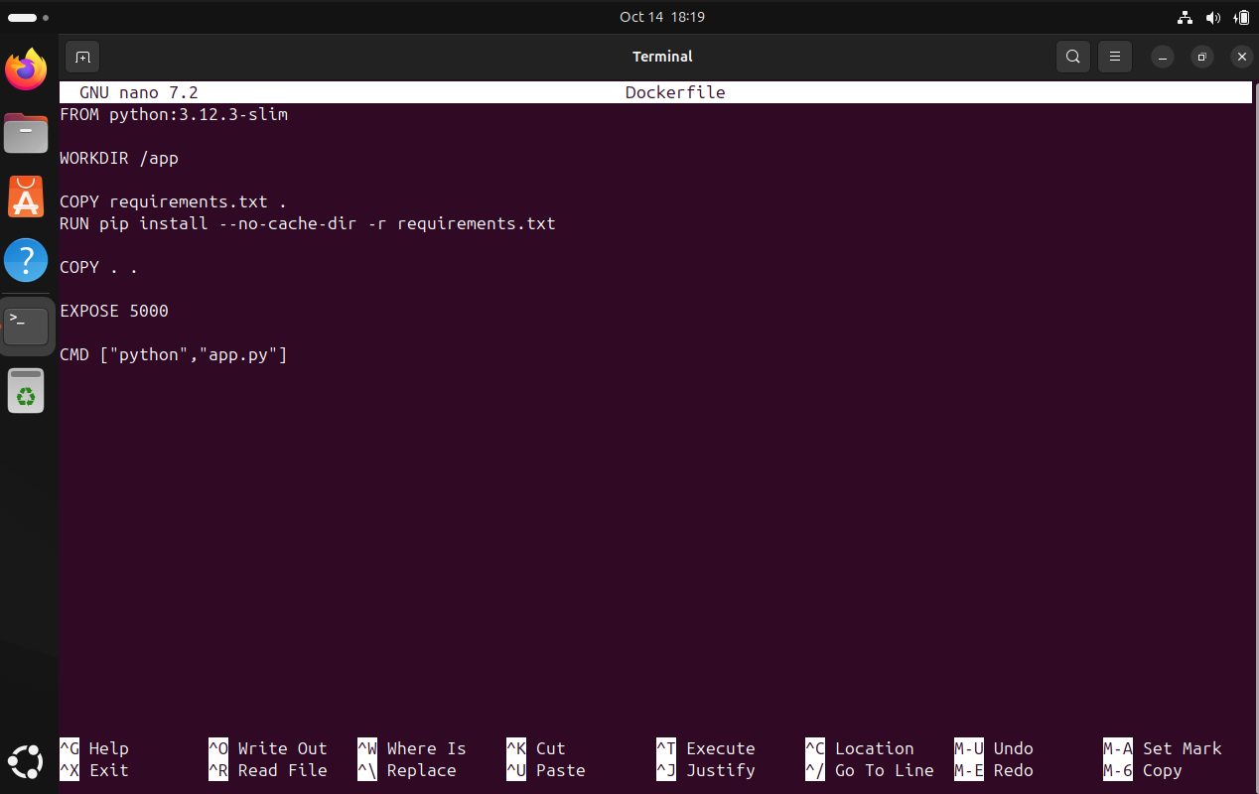
12) nano Dockerfile
13) <appDir$> docker build -t docker-app . - tried to build image but got error,
something with permissions for user
14) sudo docker build -t docker-app . - seems to work now , image is building
15) sudo docker images - docker-app is in the list of docker images
16) sudo docker run -d -p 80:5000 docker-app - starting the image

Slide 6
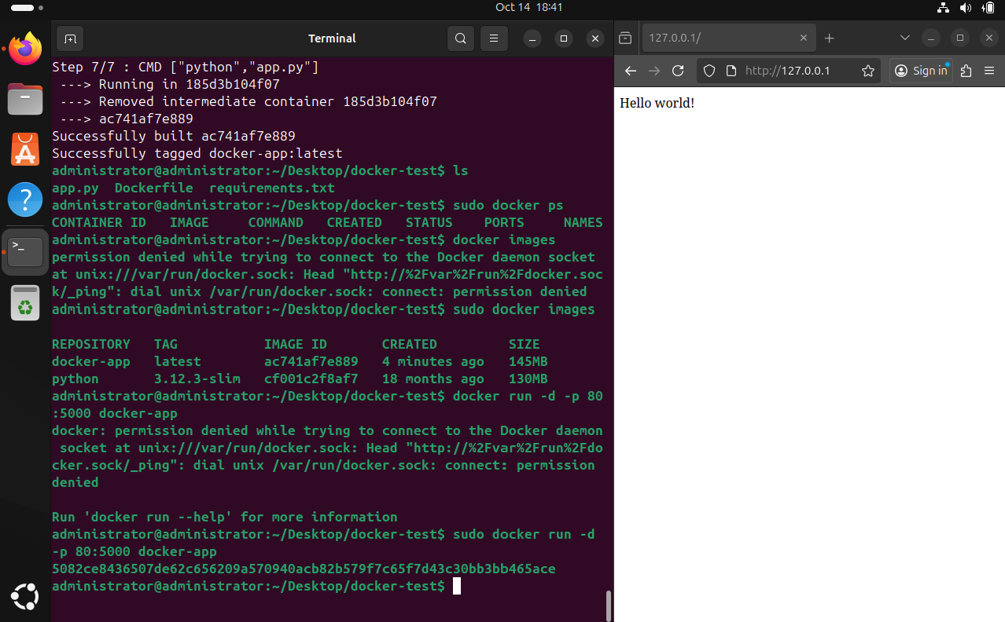
17) <ANY BROWSER> 127.0.0.1:80/ - Everything work as expected , i can see my web page

