Slide 1
Ansible setup 01 docs

Slide 2
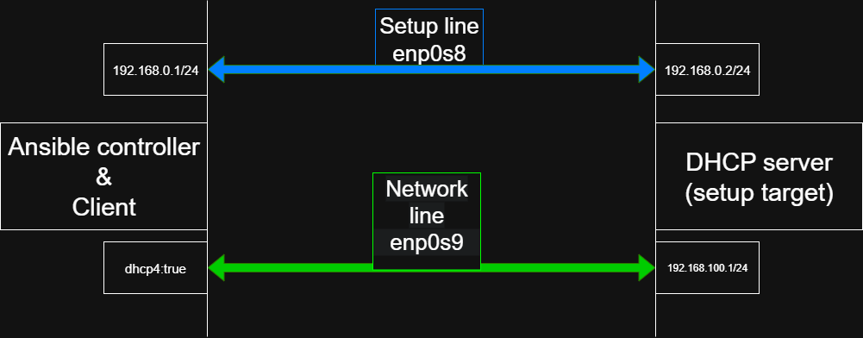
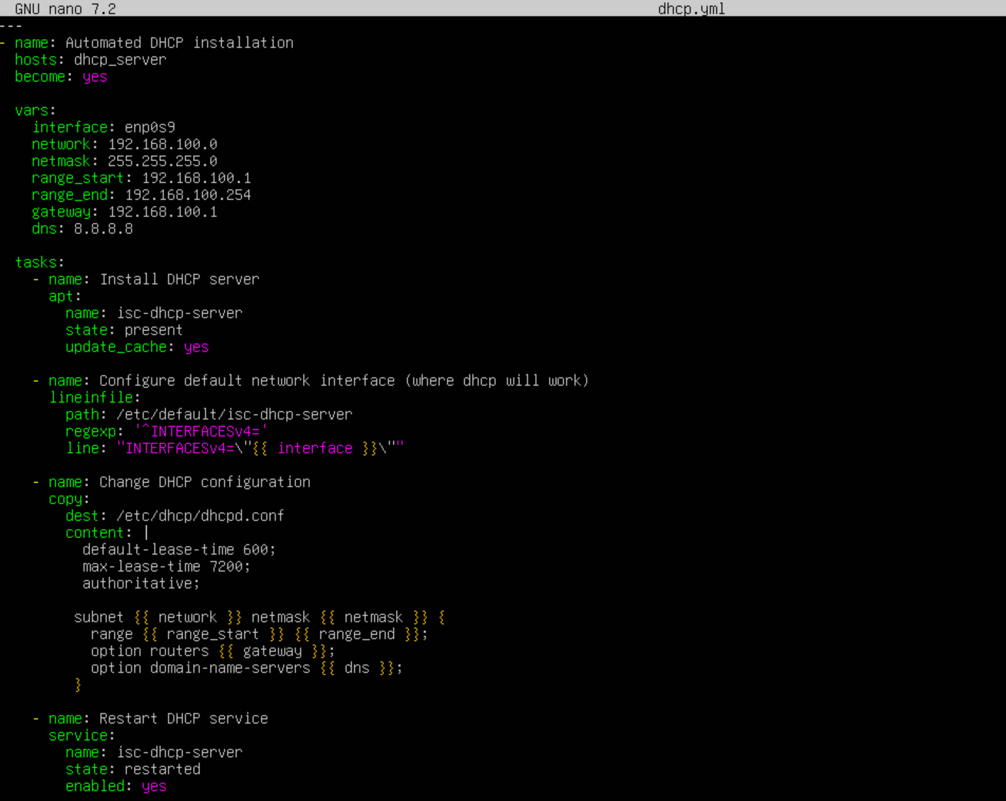
Project info
Ansible controller: Ubuntu 24.04.3 LTS
DHCP server: Ubuntu 24.04.3 LTS
DHCP server login method – password
Ansible playbook:

Slide 3
- Additionally:
*) While current lab setup uses Linux DHCP server it is
recommended to use routers for DHCP functionality,
They are:
- More stable
- More predictable
- Can’t be broken by packet update
- Not slowed down by system interruptions
*) For production environments it is recommended to
use public key auth instead of password auth, it is:
- Less complicated for large production environments
- More secure because can’t be brute forced
*) While lab has two virtual network lines “setup”
and “network” it is better for physical networks to use
VLAN network configuration to merge them in only one physical connection , while it also preserves stability and accessibility of two separate lines.
- Common errors:
*) Wrong playbook configuration
*) SSH turned off on target server
*) Broken or not installed Python on target server
*) User doesn’t exist on target server
*) For public key auth: wrong public&private key loaded inside of target server or ansible server

