Slide 1
01_Ansible
Lab results
The results file contains only a brief subset of the overall lab and provides limited insight into the setup process and final outcome. While it is suitable for a quick overview, readers seeking a deeper understanding of the implementation should refer to the other files included in the lab.

Slide 2
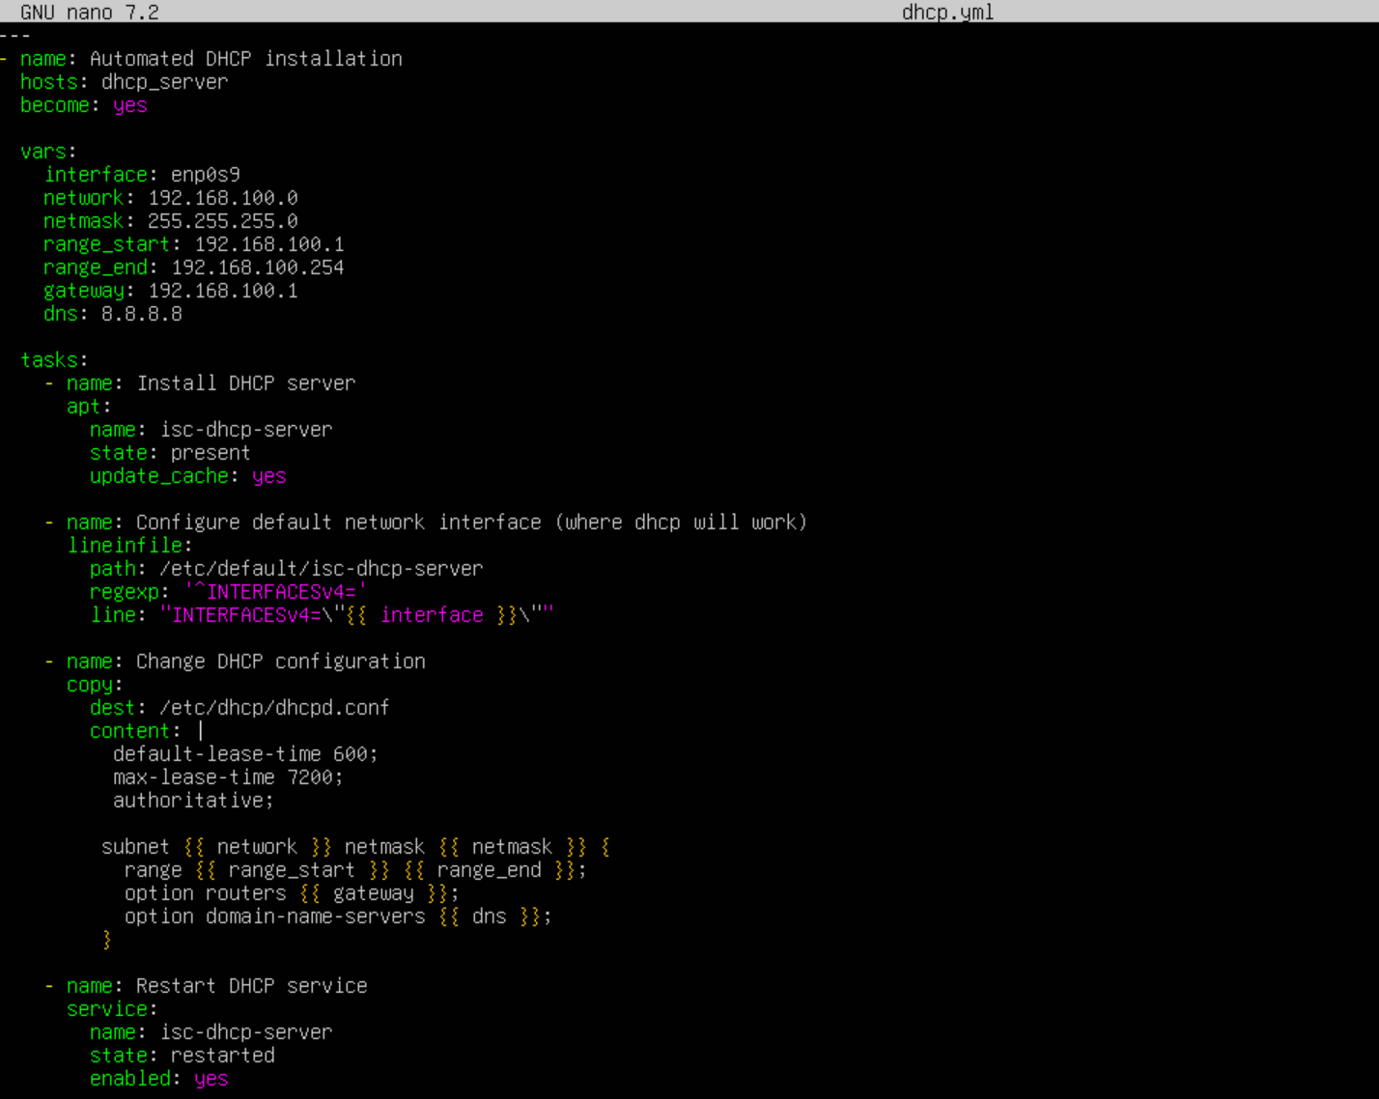
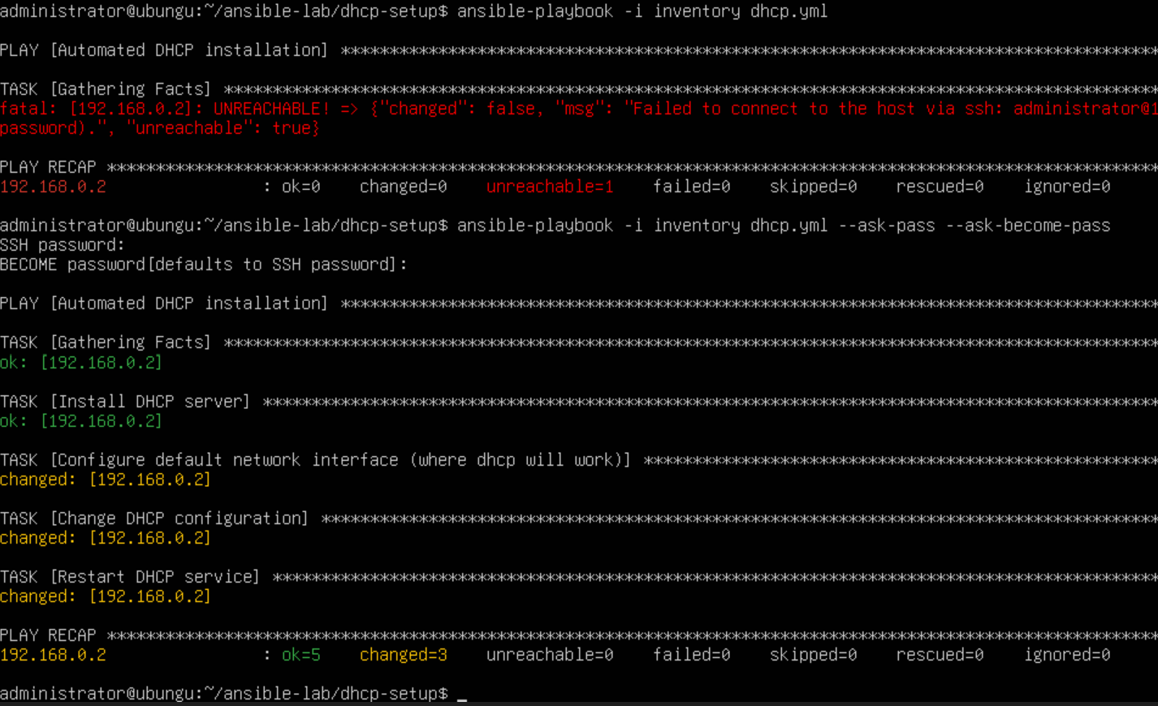
Ansible - DHCP setup playbook
Ansible - DHCP setup playbook
Ansible – DHCP setup process

Slide 3
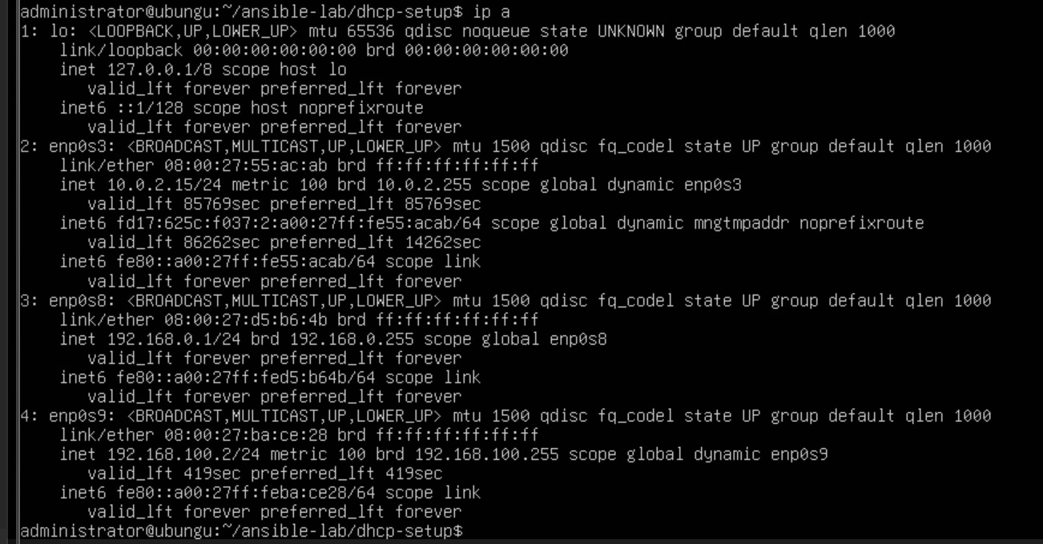
Result of setup , client machine has received IP address(enp0s9) from previously setted up DHCP server by Ansible server

