Slide 1
01_Ansible
Lab logs

Slide 2
Setup:
- Ansible controller: Ubuntu 24.04.3 LTS
(enp0s8: 192.168.0.1/24)
(enp0s9: dhcp4: true)
Additionally works as client
- DHCP server: Ubuntu 24.04.3 LTS
(enp0s8: 192.168.0.2/24)
(enp0s9: 192.168.100.1/24)
Networks (for both machines):
- enp0s3 – NAT (Access to the internet)
- enp0s8 - Internal network (For configurations - static IPs)
- enp0s9 - Internal network (Where DHCP server will work and we will see the results of setup)
Additionaly:
- SSH access to the DHCP server currently relies on password-based authentication. For production environments, public key authentication should be used instead to reduce the attack surface and to simplify secure automation and configuration management.
Task:
1) install Ansible on the Ansible controller server
2) enable SSH on the DHCP server
3) configure static IPs on enp0s8
4) make playbook on Ansible controller to setup DHCP server on enp0s9

Slide 3
Steps taken:
--- Ansible controller configuration ---
1) sudo apt update
sudo apt install ansible -y
2) Building structure in user directory:
ansible-lab:
--- dhcp-setup:
--- inventory
--- dhcp.yml
or
mkdir ansible-lab
cd ansible-lab
mkdir dhcp-setup
cd dhcp-setup
touch inventory
touch dhcp.yml
3) sudo nano inventory and adding lines:
[dhcp_server]
192.168.0.2 ansible_user=administrator
--- Where 192.168.0.2 DHCP server IP on enp0s8 and ansible_user=administrator is user on DHCP server

Slide 4
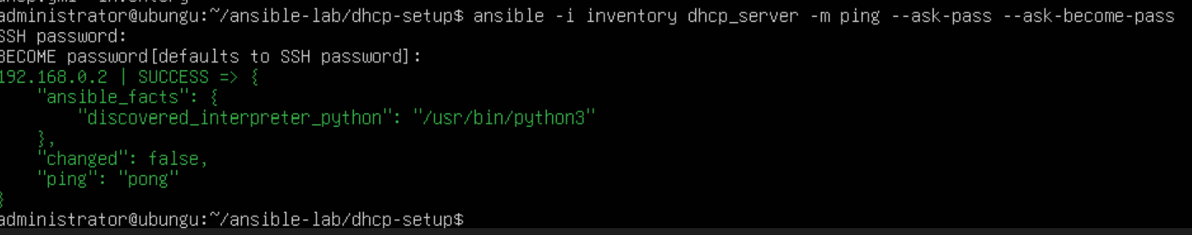
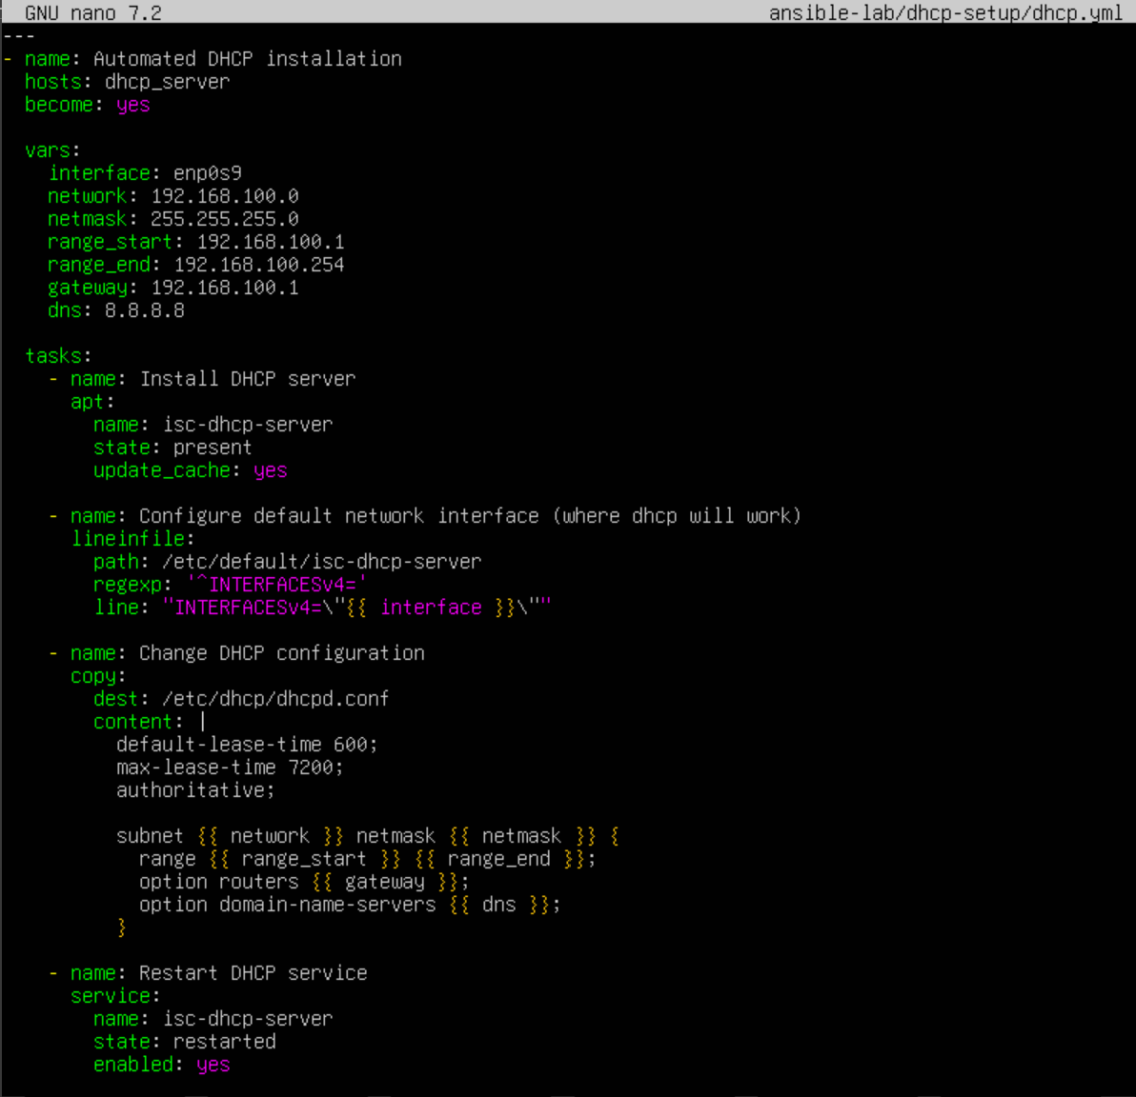
4) ansible -i inventory dhcp_server -m ping --ask-pass --ask-become-pass
--- Testing the connection , made sure ssh is working on DHCP server with:
sudo apt install ssh
sudo systemctl start ssh
--- Because we are using passwords for login, Ansible controller must have installed sshpass:
sudo apt install sshpass
--- Received answer "pong", pinged DHCP server successfully using Ansible
5) sudo nano dhcp.yml
- now setting up execution file:

Slide 5
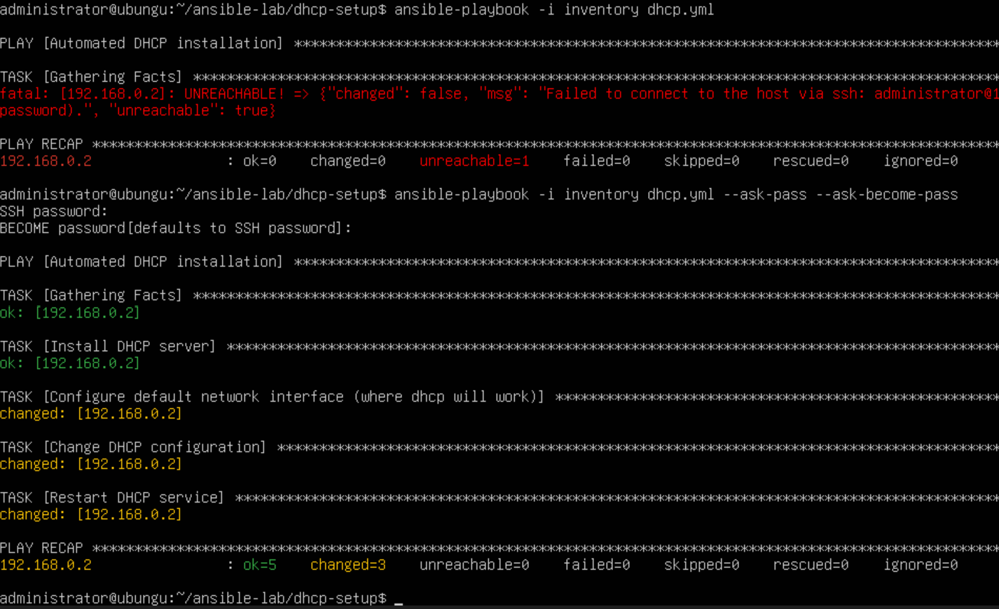
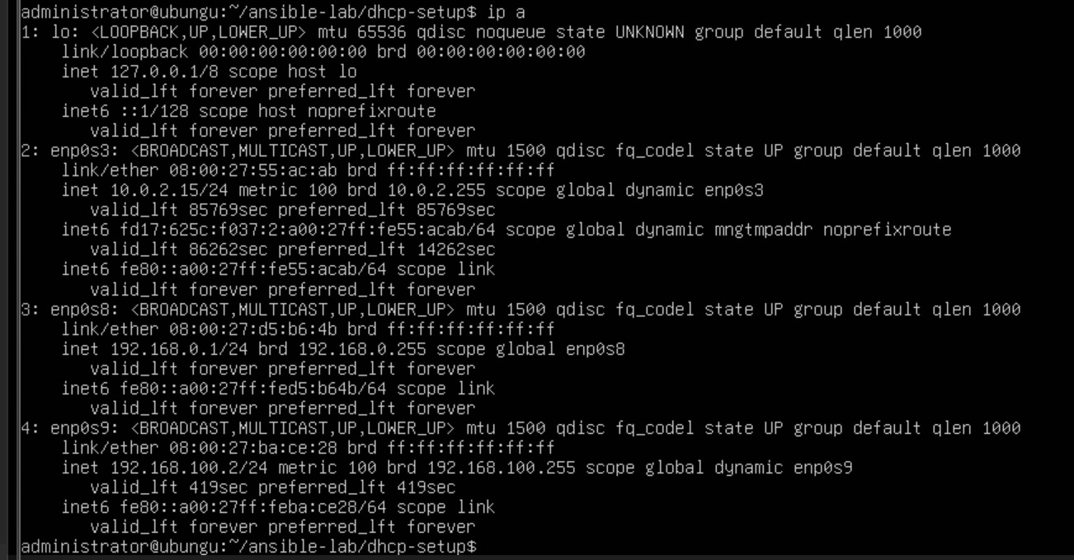
6) ansible-playbook -i inventory dhcp.yml --ask-pass --ask-become-pass
- Seems to work just fine , DHCP server was set up
7) ip a
- Checking if DHCP server started working and provided Ansible controller IP address. Ansible controller has received IP address from DHCP server on enp0s9 , everything works as planned.

