Slide 1
Networks
Slide:
2 - MAC
3 - Broadcast
4 - Limited Broadcast
5 - Multicast

Slide 2
MAC addresses
Mainly used in Layer 2(or local) communications so devices can send information directly in local network. MAC addresses is also being used in Layer 3 but it’s mostly about “point to point” of sending data , like from your router to provider’s switch and from provider’s switch up to provider’s network so it’s hard to say that we’re really using MAC addresses there – we mostly rely on IP routings in Layer 3(Global internet).

Slide 3
Broadcast address – find other hosts
- A broadcast address is used when a device wants to find the MAC address of another device on the same network , it sends requesting package to every host in local network and sender of the broadcast requesting package is waiting if someone answers with his mac. Usually the broadcast address is the last address of the IP range(ex. 192.168.0.255/24) and mac is FF:FF:FF:FF:FF:FF , we can also configure our own broadcast address but it’s not recommended because of instability and need to configure every device for that , basically not practical approach.

Slide 4
Limited Broadcast address – Get information about network
-Typically used when host doesn’t know network configuration , mostly used to discover DHCP servers Limited broadcast addresses ip 255.255.255.255 and mac FF:FF:FF:FF:FF:FF

Slide 5
Multicast address – broadcast groups
Multicast works the similar way as broadcast but hosts divided by groups. It uses IGMP protocol header and if IGMP snooping is activated on switch it will look for header and add him to the group. Host initiates request to join the multicast group , sends packet with IGMP header , specified multicast mac and IP , switch checks for header and if it’s there – he signs host to the group like: 01:00:5e:e0:20:03 → Port 3
Multicast range ipv4 range: 224.0.0.0 to 239.255.255.255
Multicast mac prefix: 01:00:5e
Multicast mac address is being calculated from multicast Ipv4 like that:
1)239 = 11101111 (Ipv4 is 239.1.2.3)
1 = 00000001
2 = 00000010
3 = 00000011
Together: 11101111 00000001 00000010 00000011
2) Drop first 9 bits and convert result to HEX
11100000 00100000 00011 → E0:20:03
Calculated multicast mac is: 01:00:5e:e0:20:03
Important note: if we use such method , 1 mac will be sharing 32 ips because we dropped first 9 bits of IP, that’s why we have IGMP snooping that makes switch use IP’s for multicast grouping and instead of macs:
Instead of on switch
01:00:5e:e0:20:03 → Port 3
We will have
239.1.2.3 → Port 3
Without IGMP snooping we would have 2^(23) addresses , with it 2^(28) addresses. And most important – it’s a lot easier to debug and you won’t be thinking why 2 different groups 239.1.1.1 and 239.1.1.2 hear each other’s packets

Slide 6
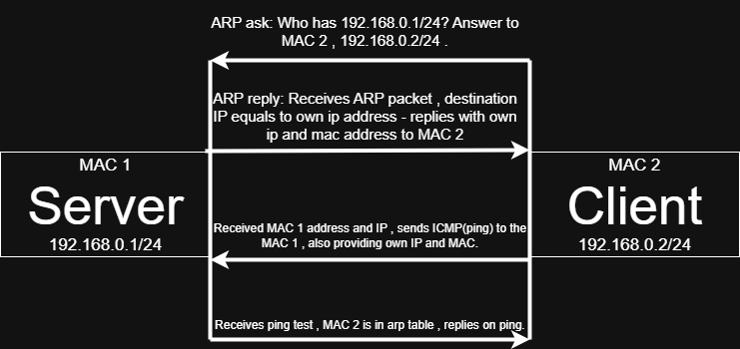
Physical level of communication

