Slide 1
ISC_DHCP setup Docs

Slide 2
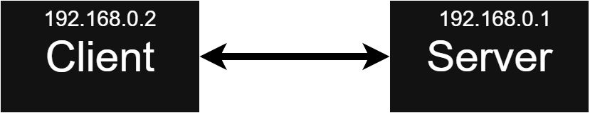
Connection scheme

Slide 3
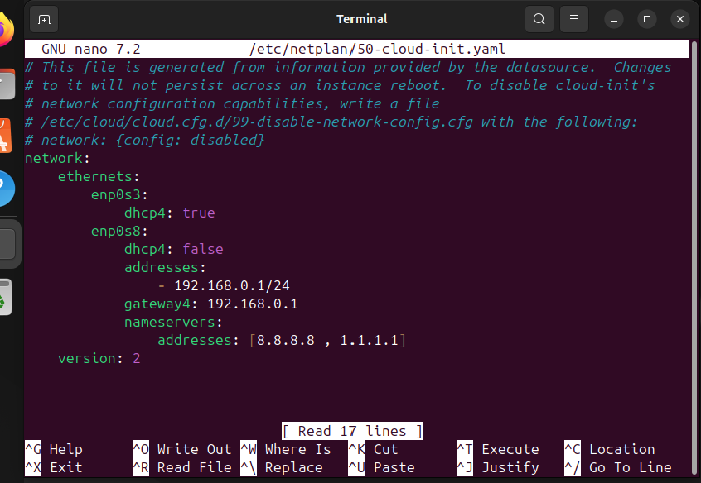
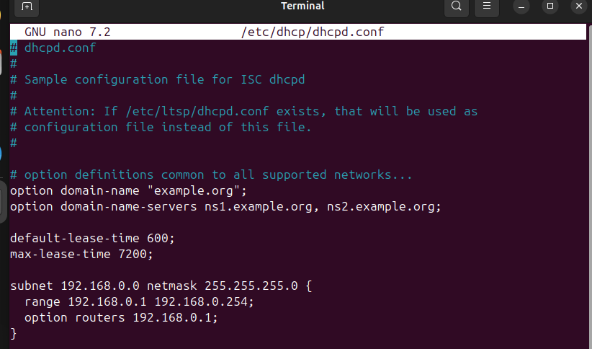
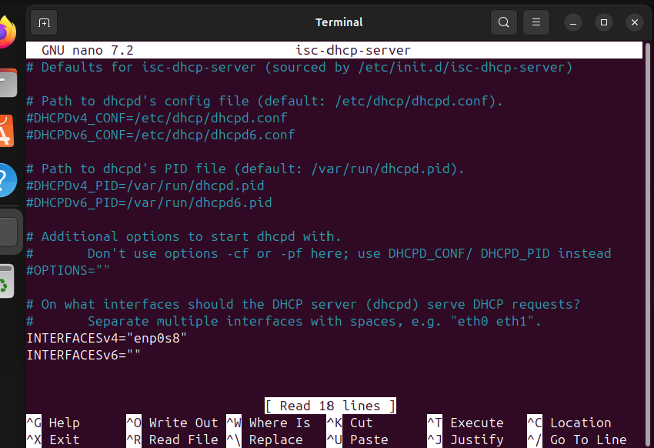
Config - server
enp0s8 – internal network
enp0s3 - NAT
Netplan static IP (enp0s8):
DHCP(dhcpd.conf) config:
Interface for dhcp to use ( /etc/default/isc-dhcp-server ):

Slide 4
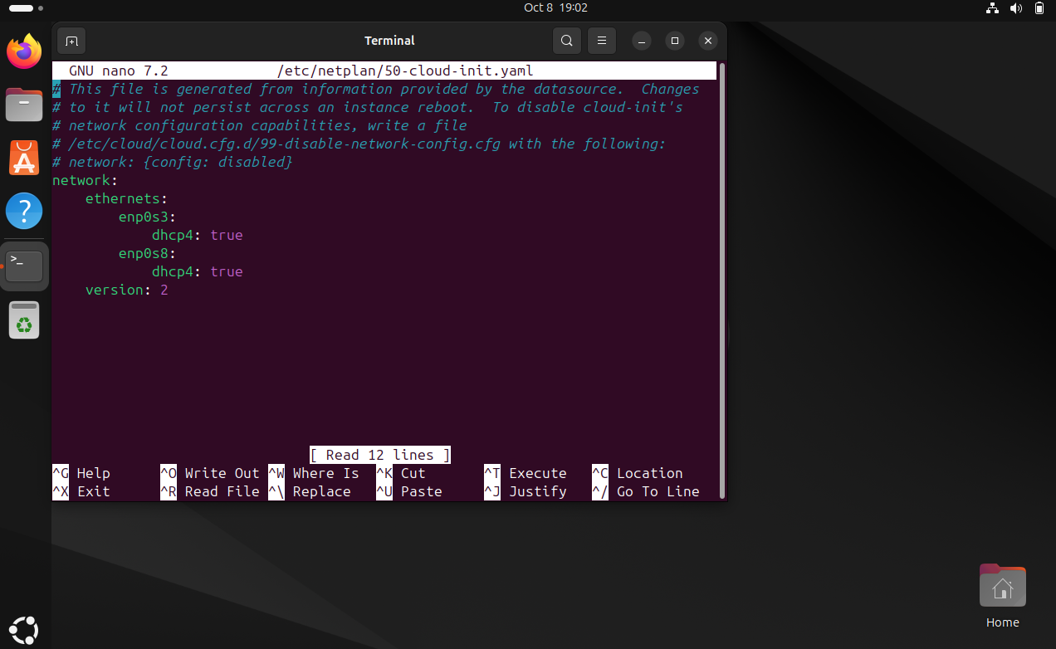
Config - client
enp0s8 – internal network
enp0s3 - NAT
Netplan (enp0s8):

Slide 5
Typical Problems
1) Misspelling in commands
2) Same network already exists which may bug both of the networks
3) Not using local netowork’s reserved range of ips (For example – using global IP’s , which also can bug the network)

Slide 6
Problems occurred
- Incorrectly set range of IP’s

