Slide 1
ISC_DHCP_SERVER demo

Slide 2
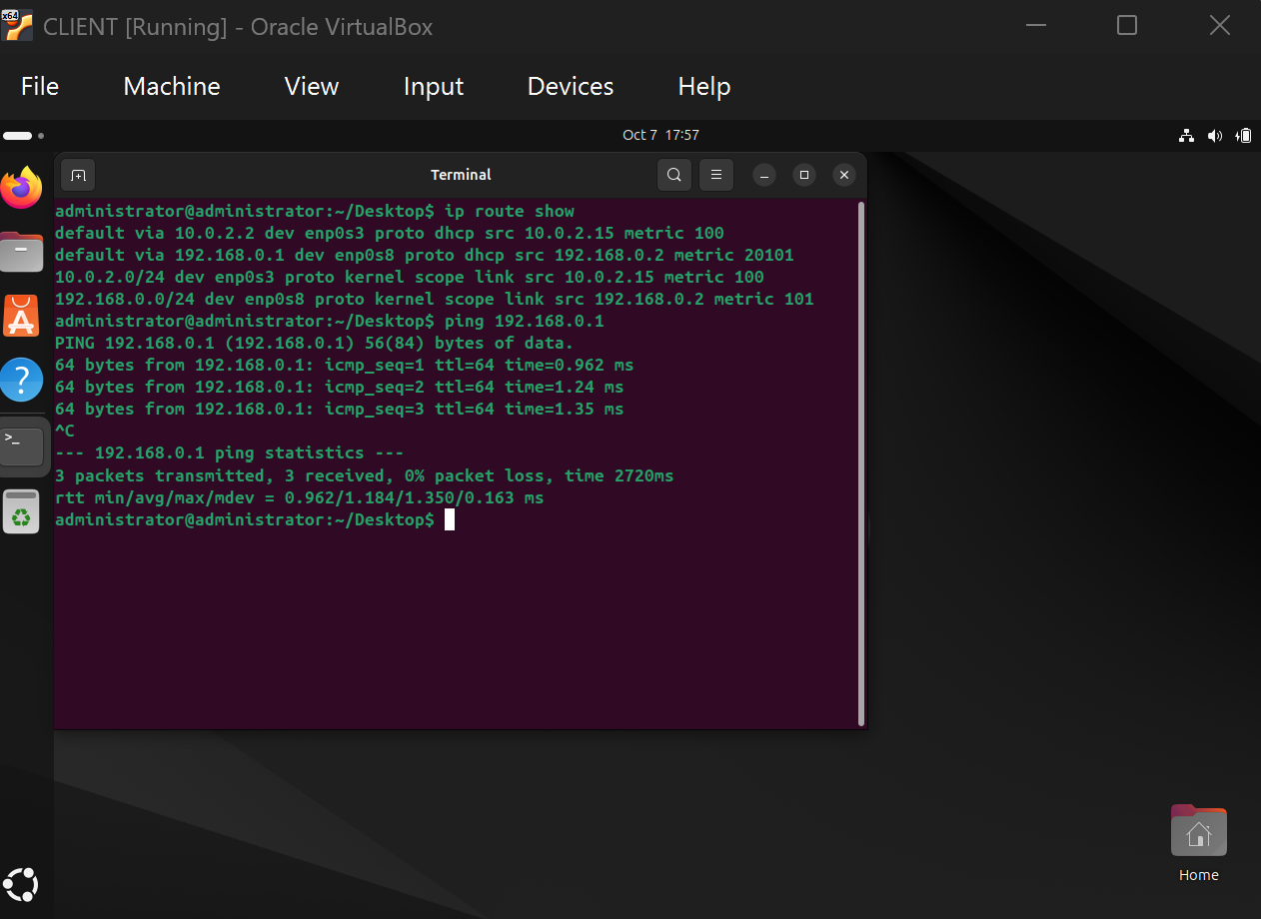
Screenshot of working dhcp server. Where
‘default via 192.168.0.1 dev enp0s8’ is our dhcp
server(gateway) , 192.168.0.2 is client’s ip
on the screenshot and successful pinging
gateway(server;192.168.0.1)

