Slide 1
SSH 02
Docs

Slide 2
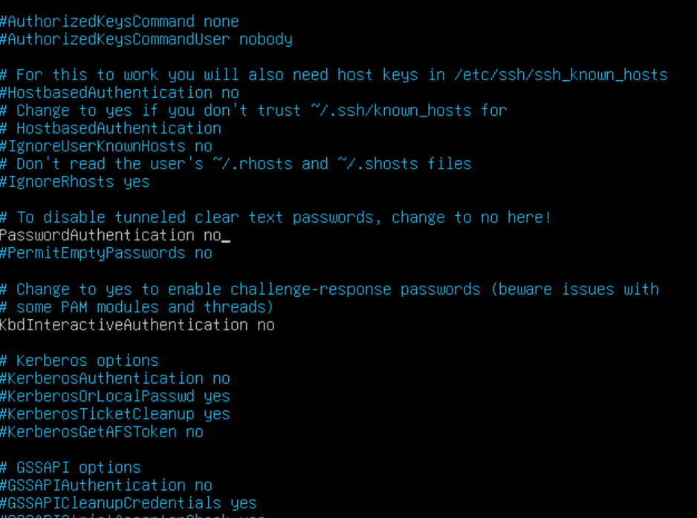
Project info:
Client: Ubuntu 24.04.3 LTS
SSH server: Ubuntu 24.04.3 LTS
SSH server sshd_config (after public key auth
setup):
--- While “Publickeyauth yes” in same settings

Slide 3
- Common mistakes:
*) Turning off password auth on server without making sure Public key auth works correcly
*) Not following SSH’s strict file access policy

