Slide 1
02_SSH
Lab results
The results file contains only a brief subset of the overall
lab and provides limited insight into the setup process and
final outcome. While it is suitable for a quick overview,
readers seeking a deeper understanding of the
implementation should refer to the other files included in
the lab

Slide 2
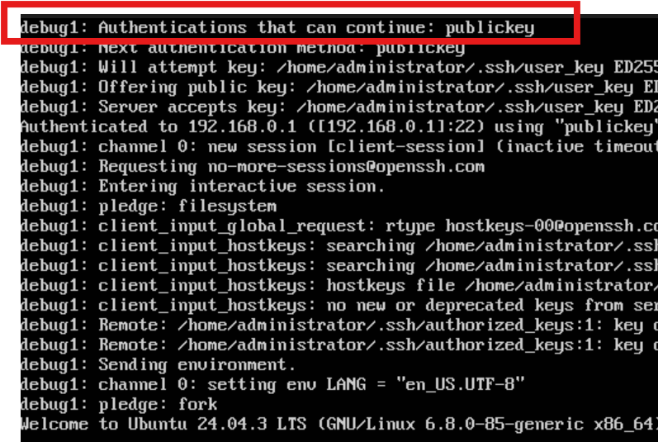
Working lab: client connects to the SSH server , SSH
server requires ONLY authentication with a public key
(Red box)

