Slide 1
02_SSH
Lab logs
Full process of setting public key auth onto
SSH server
Github: github.com/Sceptic700

Slide 2
Setup:
SSH server : Ubuntu 24.04.3 LTS (enp0s8: 192.168.0.1/24)
Client : Ubuntu 24.04.3 LTS (enp0s8: 192.168.0.2/24)
Networks (for both machines):
enp0s3 - NAT
enp0s8 - Internal network
Task:
Install SSH , configure public key auth and provide public client key for the SSH server.

Slide 3
Steps taken:
--- SSH server ---
0) "sudo apt install ssh"
--- Client ---
1) ssh-keygen -t ed25519
2) cp user_key /home/administrator/.ssh
Sending user public key to the SSH server
3) “scp user_key.pub administrator@192.168.0.1:/home/administrator”
--- SSH server ---
4) sudo cat user_key.pub > .ssh/authorized_keys
5)SSH requires some files to be protected by system:
“chmod 700 .ssh”
“chmod 600 .ssh/authorized_keys”
“sudo chown -R administrator:administrator .ssh”
--- Client ---
6) Same as step ‘5’:
“chmod 700 .ssh”
“chmod 600 .ssh/user_key”
“chmod 600 .ssh/authorized_keys”
“chown -R administrator:administrator .ssh”

Slide 4
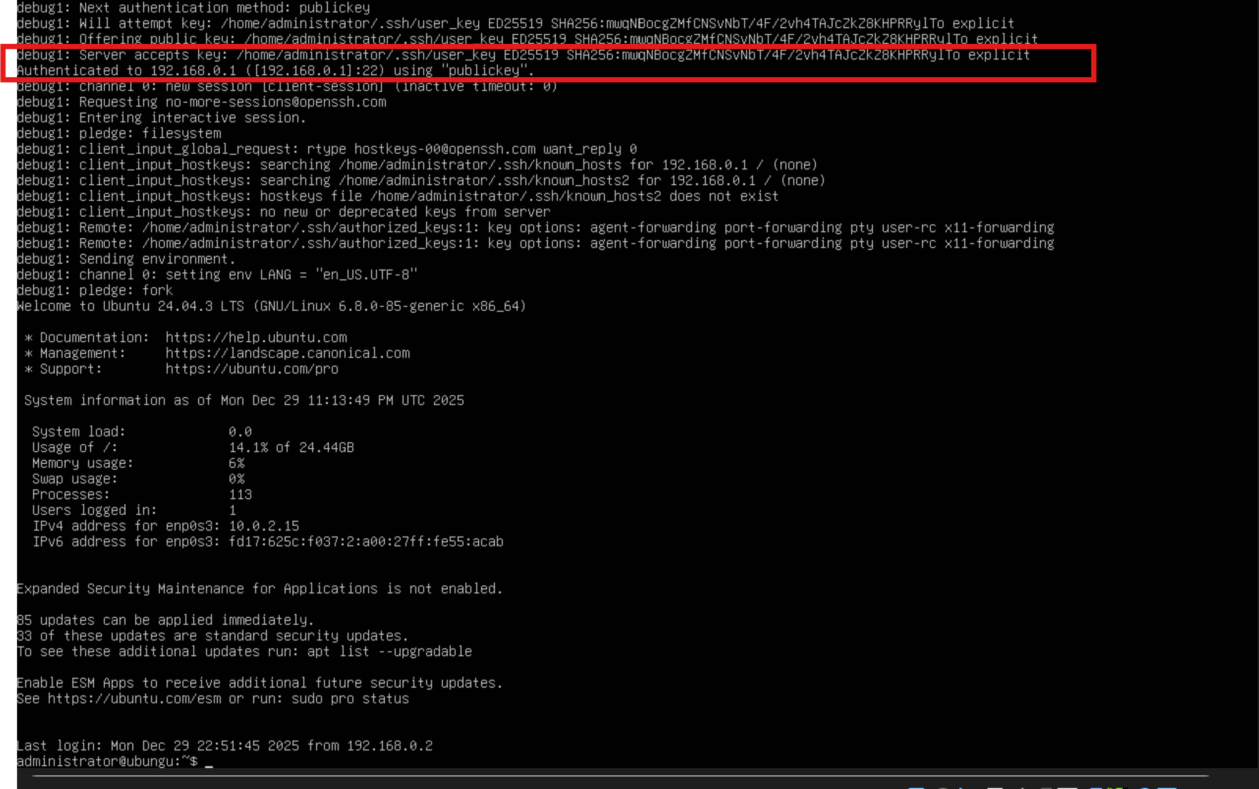
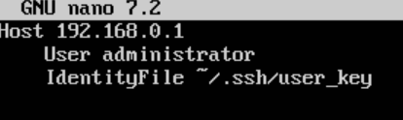
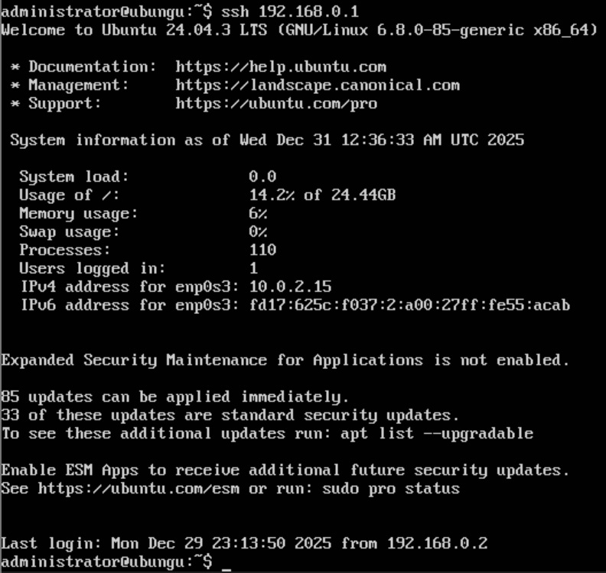
7) ssh -i ~/.ssh/user_key -v administrator@192.168.0.1
- Connection succeeds
8) For more automatic connect , so we don't write private key location each time,
we can write client side config file.
touch .ssh/config
9) Now we can connect just by writing:
ssh 192.168.0.1

Slide 5
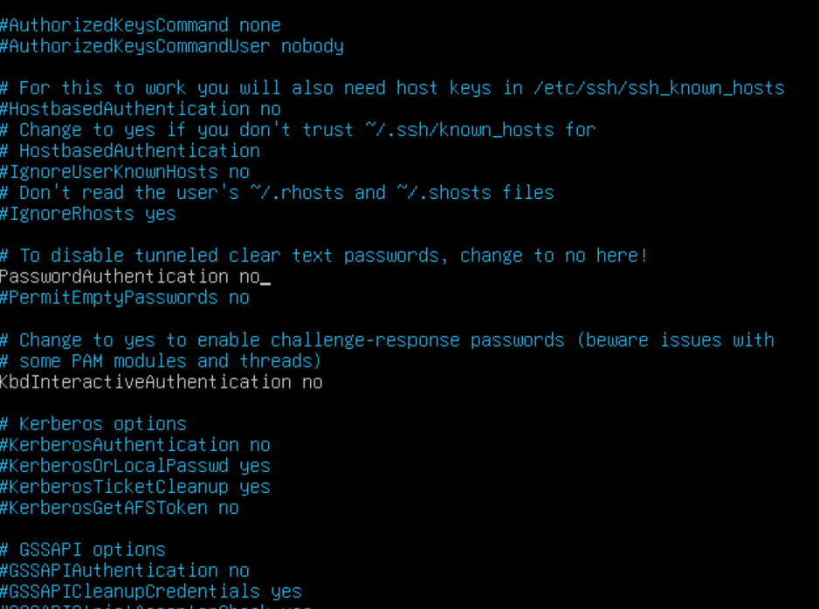
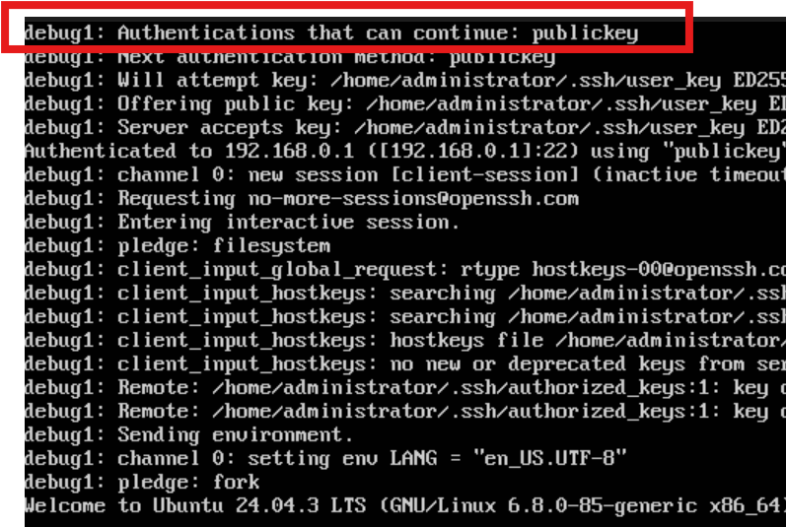
--- SSH server ---
10) For better security we can now turn off password auth.
"sudo nano /etc/ssh/sshd_config"
PasswordAuthentication no
--- Client ---
11) ssh -v 192.168.0.1
- Now the only way to log in is public key auth

