Slide 1
Discussion: Using Reinforcement Learning to improve the social media simulation
Aurélien Bück-Kaeffer, 20/03/2025

Slide 2
Main goal: Realistic emergent behavior
Currently, agents in the simulation have no incentives. They just do what we tell them to do and remain fixed
Designing every aspect of the sim necessarily introduces bias in ways that may be difficult to identify.
Combining both facts together means we lose a lot of the accuracy our model should be able to allow
RL is a paradigm that has proved its ability to produce emergent behavior: By giving agents simple reward functions to optimize, we may expect complex real-world dynamics to appear
RL is fairly unbiased compared to other ML methods
Downsides:
Its kinda difficult to do RL for all the agents in the sim, as not all of them have easily quantifiable goals. But we can for at least the election candidates and malicious agents. Could look into non-verifiable rewards in GRPO, in fact it may become a hot topic real soon in the AI landscape
Additional overhead: Training RL agents is not trivial. However once we have them, we could simply substitute them into the simulation (Note: depends on the method, not true for continuous learning)

Slide 3
Papers
Build An Influential Bot In Social Media Simulations With Large Language Models
Human-level play in the game of Diplomacy by combining language models with strategic reasoning
DeepSeek-R1: Incentivizing Reasoning Capability in LLMs via Reinforcement Learning
How social reinforcement learning can lead to metastable polarisation and the voter model
Socialbots on Fire: Modeling Adversarial Behaviors of Socialbots via Multi-Agent Hierarchical Reinforcement Learning

Slide 4
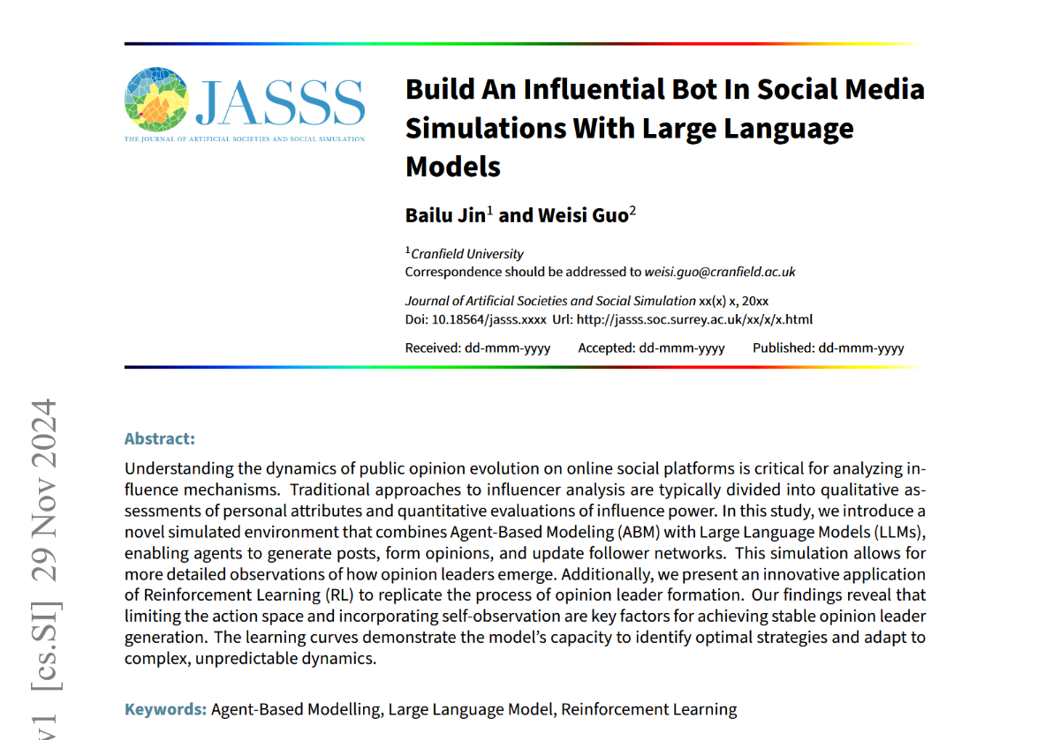
Social media simulation, very similar to what we’ve got but with visibly less budget
Use Q-learning to reward and encourage follower acquisition
“Can RL algorithms identify an optimal strategy that enables the target agent to maximize its follower count within a predetermined number of steps?”
Paper says yes. Personally, I don’t find their results insanely convincing, but it’s still evidence that the concept is sound and doable.
What we could do: Use RL to incentivize getting more followers. Maybe add “influencer” agents whose goal is specifically to increase their following?
https://arxiv.org/abs/2411.19635

Slide 5
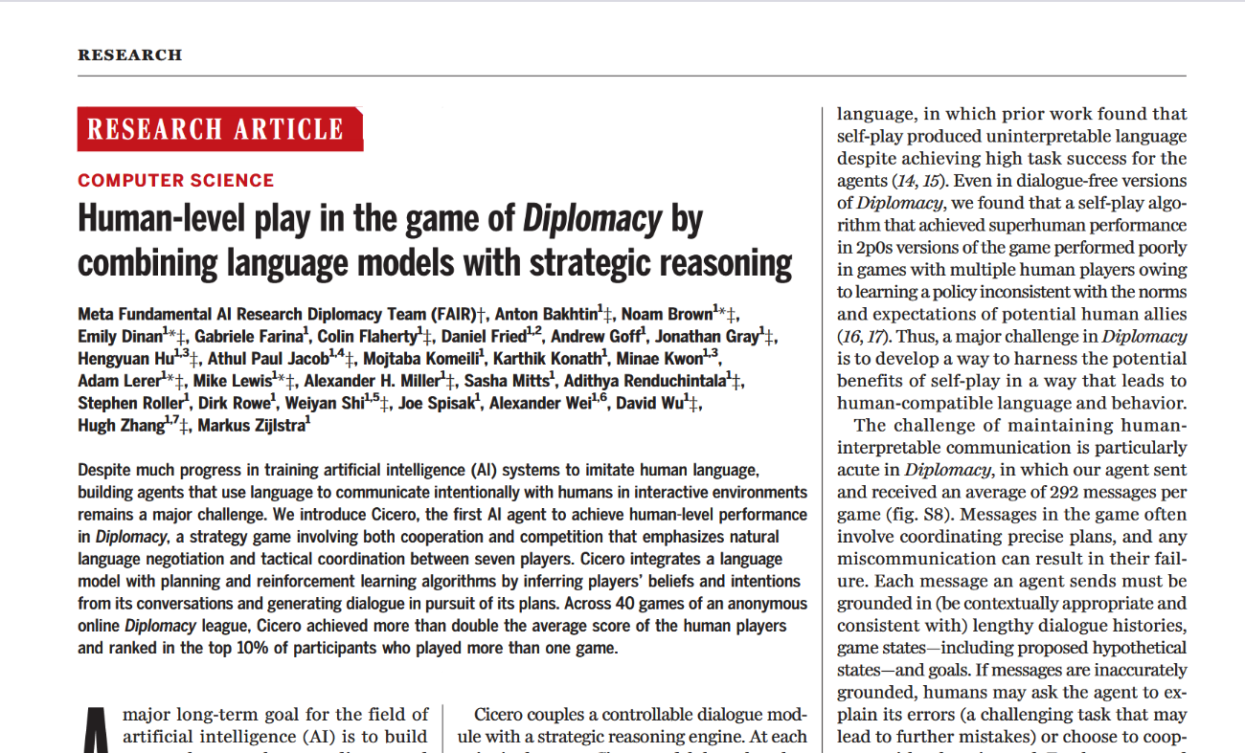
RL to play Diplomacy (strategy board game, similar to RISK. Each player is a country leader controlling armies, and has to negotiate alliances in order to eventually win the game)
More sophisticated. The agent consists in a dialogue module and a strategic reasoning module.
Human level performance in a game highly dependent on deception and negotiation skills.
What we could do: Apply the techniques they developed to the political candidates in our sim. Perhaps we could get human level politicians this way.
https://www.science.org/doi/10.1126/science.ade9097

Slide 6
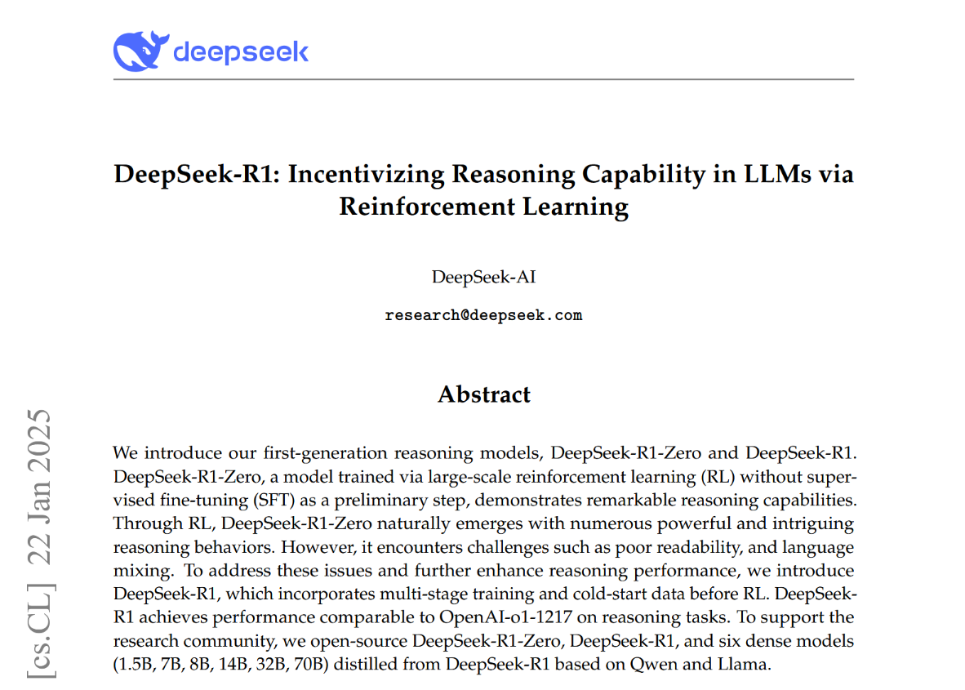
Explains how to do SOTA RL on LLMs when a verifiable reward is defined (GRPO: group relative policy optimization). (Verifiable reward: math, coding, … or in our case election results, number of followers, approval ratings, etc)
Demonstrates RL does lead to emergent behavior in LLMs (aha moment)
GRPO for unverifiable rewards will probably be an important research subject real soon. Dan suggests LLMs as judge for unverifiable reward functions (in our case, agents without clear goals in the sim).
What we could do: Use GRPO to make election candidates and malicious agents better. Research GRPO with unverifiable rewards for the other agents in the sim.
https://arxiv.org/abs/2501.12948

Slide 7
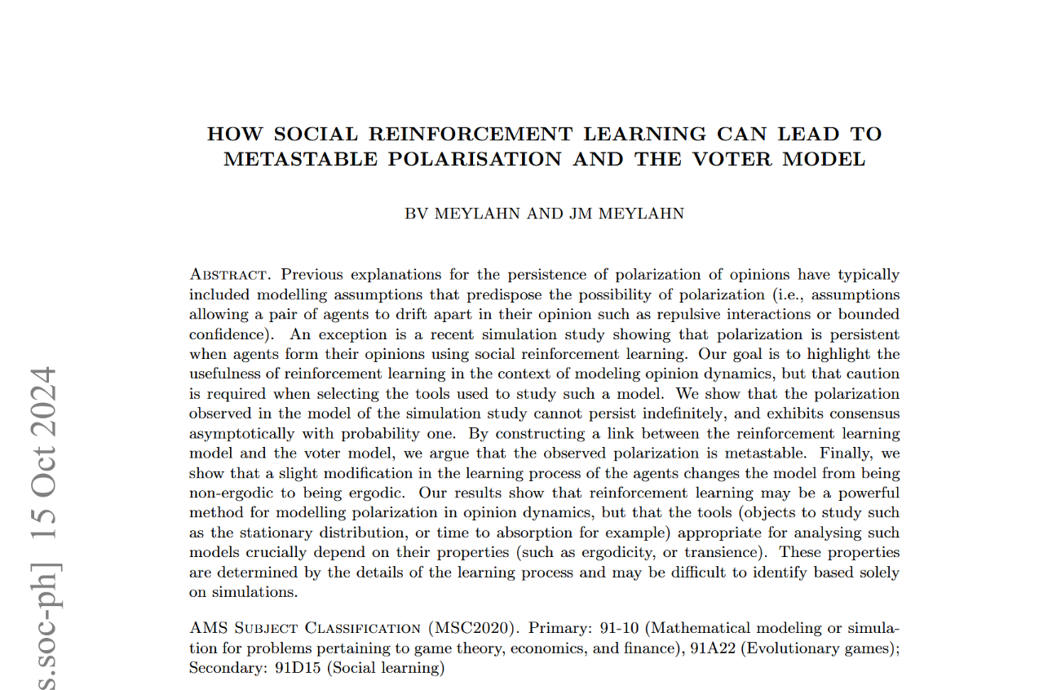
“Our goal is to highlight the usefulness of reinforcement learning in the context of modeling opinion dynamics” That’s exactly what we want to do
Use social reinforcement learning: Agents learn and adjust their opinions using their neighbor’s feedback
Other methods were to improve just the politicians or malicious agents. This is to improve the overall population’s realism.
What we could do: Implement social RL in the simulation to improve the realism of opinion dynamics. The sim already has likes, which can be used for this.
https://arxiv.org/abs/2406.07993

Slide 8
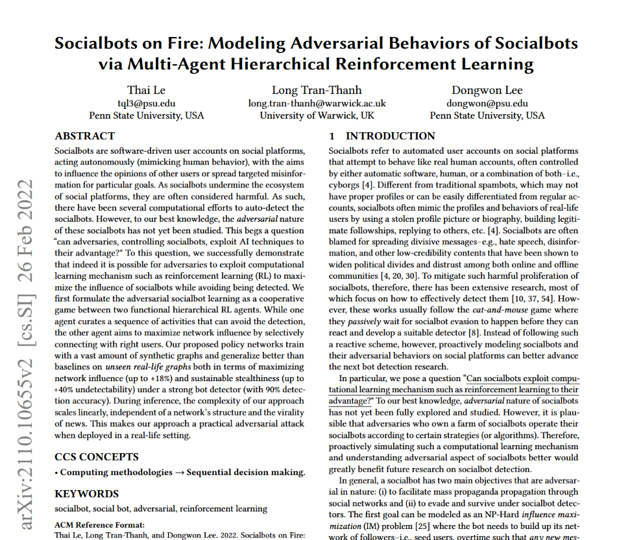
Socialbots: Bots on social media trying to influence opinion by spreading misinformation
In practice these bots are hunted down by the social media platform. Adversarial behaviors emerge from this
Techniques in this paper make better malicious agents, more influential and much less detectable
What we could do: Use their approach to get stronger malicious agents in the sim.
https://arxiv.org/abs/2110.10655

