Slide 1
Assignment-2
IBM as Service Integrator

Slide 2
AIR CANADA
Founded in 1937
Canada’s largest airline in 2011, serving over 32 million customers annually.
Headquartered in Montreal , Air Canada has hubs in Toronto, Montreal, Vancouver and Calgary.
Air Canada’s vision is to build loyalty through passion and innovation.

Slide 3
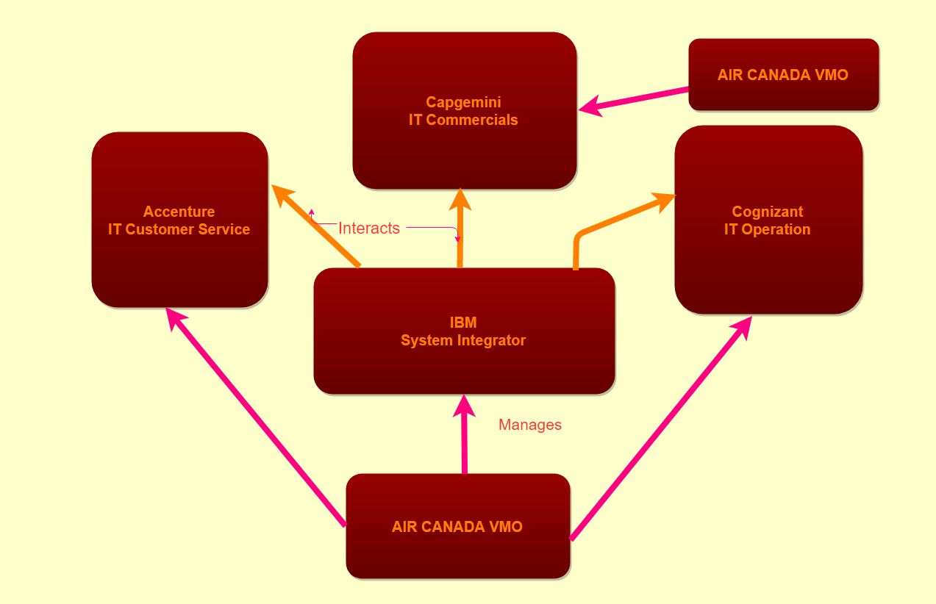
Organizational Chart
Here IBM is the SI that interacts with 3 critical vendors assigned to 3 new units of Air Canada and VMO Manages all the Vendors including IBM

Slide 4
Air Canada IT Units
Total 7 IT units.
4 IT units were already present In the head quarters- IT Sourcing, IT Transformation, Customer Solution and Innovation, Marketing and Customer Experience.
3 newly added IT units are present in all the locations of Air Canada’s Office - IT operations, IT commercials, IT Customer Service.
7 IT units have 7 senior directors and their group is called G7.
G7 participate in staff meeting every week with the CIO and also they have yearly budget meeting.

Slide 5
IT Units Details
IT Sourcing:
Group of six people
Responsible for the formulation and ongoing management of contracts between Air Canada and its major IT suppliers
One of the group’s main responsibilities is vendor selection
Vendor selection criteria: knowledge of and experience with the airline industry and 24/7 support for key applications and services.
Developed the right service level agreements (SLAs) for each vendor
Designed the governance structure for each supplier, which included the frequency of meetings between the parties, the frequency of performance reports and reviews of SLAs, identification of key players and identification of contact people in the supplier organization.

Slide 6
Continued…
Transformation IT
Comprises of 16 people distributed in five teams.
Two main teams were Architecture and Operations
The Architecture team was in charge of maintaining a solid and robust IT infrastructure for Air Canada and of modernizing the front-end applications.
The Architecture team was in charge of maintaining a solid and robust IT infrastructure for Air Canada and of modernizing the front-end applications and worked with IT sourcing in design of SLA’s
Set corporate IT policies and standards and communicates about the standards to the IBM
Set corporate IT policies and standards

Slide 7
Continued…
Customer Solution and Innovation
Group of 54 people manage 20 applications
The main applications were aircanada.com, the check-in system, the reservation system, and all of the self-service suites such as kiosks, web and mobile check-in.
Twelve people in the unit are responsible for innovation
The unit is in constant interaction with the business branches, especially Customer Service and Commercials for generating innovations

Slide 8
Continued…
Marketing and Customer Experience
Responsible for tracking and facilitating the customer’s experience on the Air Canada website.
There are 3 teams :
the customer experience team, including a web writer and two customer experience experts
a three-person web team
the Electronic Customer Relationship Management (e-CRM) team.
IT Commercials unit was an important internal source of changes, as it comes up with revenue-generating ideas for the website.

Slide 9
Continued…
IT Operation
Group of 70 people
Responsible for all the systems pertaining to the airline’s operations, such as flight operations and aircraft maintenance.
In 2010, the unit was in the middle of changing the aircraft maintenance system, which was 25 years old.
This team closely works with Transformation IT because all the new systems needed to be supported by the airline’s IT infrastructure and to fit into the current architecture.

Slide 10
Continued…
IT Commercials
Works closely with IT Customer Service to ensure that all needs were coordinated between the two branches.
They also works closely with Customer Solutions and Innovations to help the business side translate their needs and product definitions into IT solutions.
This unit is an important source of change for Marketing and Customer Experience.
Its success is measured in terms of customer satisfaction

Slide 11
Continued…
IT Customer Service
Group of 20 people
Responsible for IT needs across call centers, airports, in-flight services and customer relations.
Works closely with Customer Solutions and Innovations in a collaborative approach to source solutions for business requirements. Example: Developing mobile applications.
Also works closely with Transformation IT to ensure that their initiatives complied with corporate standards and policies.

Slide 12
Air Canada Vendors
There are 3 critical vendors assigned to IT Units of Air Canada that have same governance structure
Cognizant - IT operations
Capgemini - IT commercials
Accenture - IT Customer Service
Air Canada chose IBM to help their organization with the new innovative system which would result in cut costs.
IBM is the system integrator i.e. any new application offered by existing or new vendor needed to be integrated by IBM

Slide 13
Air Canada’s Trust on IBM(Guardian)
In 1994, Air Canada signed a seven-year contract with IBM
With motivation of cost reduction and to focus airline on its core business IBM took care of Air Canada’s systems and applications, certain equipment and computer assets.
Because corporate policy did not allow for contract renewal without going to the market, Air Canada prepared a request for proposals (RFP) to find a tier-one IT vendor with which to develop a partnership for innovation.
Air Canada received proposals from several potential suppliers but, IBM’s proposal was selected.
Air Canada partnered with IBM to include the innovation concept.
Air Canada assigned its IT partner, IBM, to act as the integrator because dealing with multiple vendors brings unique challenges.

Slide 14
SI And Vendor Management
IBM with Cognizant
VMO with IBM
Topic: Flight operation and Maintenance.
Meeting: Reports of Bi-weekly or weekly meeting
Amount of complexity in changing the air craft maintenance system
Budget requirement
Challenges faced while transferring the data from legacy to new application
Incidents raised or issue faced due the interface of new application with other applications.
Interaction of Cognizant with Transformation IT regarding the Change
Goes through the report shared by IBM in SharePoint
Checks whether the change that reported by Cognizant to IBM is valid in SLA’s
Tracks the cost spent by IBM to implement the maintenance Idea.
Validates how the decision of IBM to implement the idea is going to effect the business
Bi-weekly, weekly and quarterly meeting with IBM regarding the challenges faced in change management
Escalations handled by the IBM
Develop a long term view regarding the innovations with respect to the cut cost

Slide 15
SI And Vendor Management
IBM with Capgemini
VMO with IBM
Topic: Business needs and Product definition
Meeting: weekly staff meeting and monthly G7 meeting
Impact on the budget by introducing new class in the flight
Measure of profit by introducing the new idea
IBM to interact with other vendors incase of implementation of new idea
Challenges like application upgrade and issues expected from these changes
Staff training regarding the new class
Interaction of Capgemini with Marketing and customer experience to get the report on customer satisfaction which is measured as a success for Capgemini
Goes through the report shared by IBM in SharePoint
Checks whether the change that reported by Capgemini to IBM is valid in SLA’s
Tracks the cost spent by IBM to implement the new class Idea in flight
Validates how the decision of IBM to implement the idea is going to effect the business.(profit, loss)-Finance Management
Bi-weekly, weekly and quarterly meeting with IBM regarding the challenges faced in change management
Escalations that needs to be faced by the IBM and Air Canada
Develop a long term view regarding the innovations with respect to the cut cost

Slide 16
SI And Vendor Management
IBM with Accenture
VMO with IBM
Topic: Customer assistance with respect to call center
Meeting: Daily staff meeting in-order to get daily status report.
Challenge: To hire bilingual employee to communicate with customers in many different languages
These employees need to know the detail of both business and IT side
They need to get the details from all the units which requires co-ordination.
Critical issues raised by the customer will impact every other units which needs to be handled by IBM and come up with the solution
Goes through the report shared by IBM in SharePoint
Checks whether the change that reported by Accenture to IBM is valid in SLA’s
Tracks the cost spent by IBM to hire and train the employees.
Budget estimation
Bi-weekly, weekly and quarterly meeting with IBM regarding the challenges faced in relationship management and Finance management
Escalations handled by the IBM
Develop a long term view regarding the innovations with respect to the cut cost

Slide 17
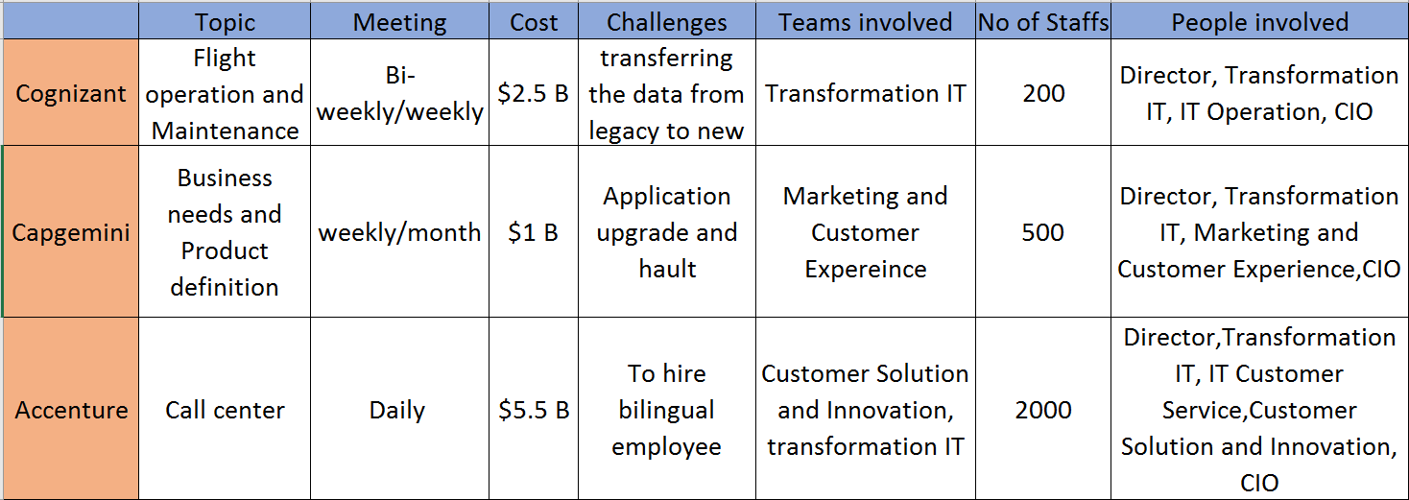
Overall Report by IBM on Critical Vendors

Slide 18
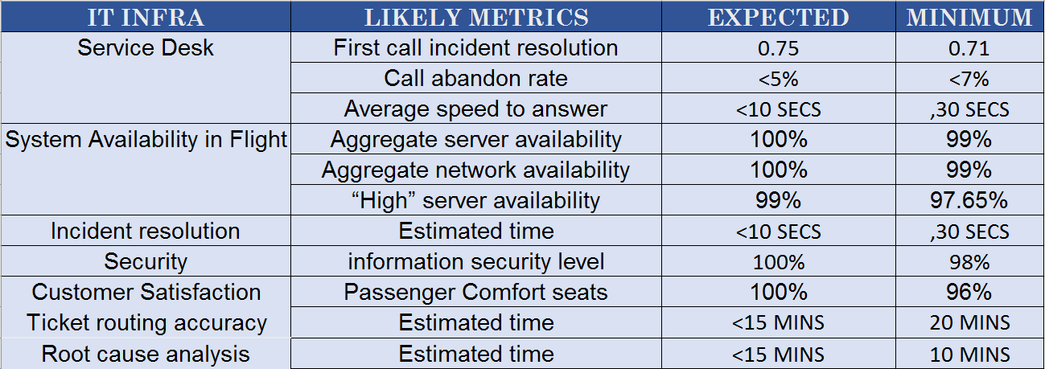
IBM Infrastructure Metric

Slide 19
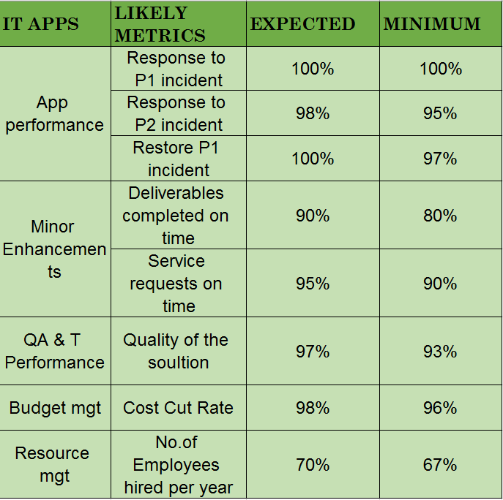
IBM APP& Maintenance Metric

Slide 20
Actions Taken to Manage IBM By VMO
Weekly Meetings:
Weekly Meeting:
Topics: New Product or new application launch, Customer Response, Sales,
Daily status report review, Root cause analysis of issues in other applications
Attendees: IBM, Director of IT Operation, Director of Transformation IT, Director of IT Customer Service, Director of Marketing, VMO.
Executive level Weekly Meeting :
Topics: High-level goals and strategies of Air Canada
Attendees: CEO, CIO, other Business Vice President
Bi-Weekly Meeting:
Topics: Flight operation and Maintenance, Customer response report, sales report, IBM performance report, Decision of Transition, Maintenance Budget, Other vendors co-ordination, Escalations
Attendees: VMO, IBM, Accenture, Capgemini, Cognizant,

Slide 21
Continued…
Monthly Status Meeting
Topics: Customer feedback and issues reported by IBM, Flight Maintenance change, Quality of the service provided in Flight, Passenger Satisfaction report, New Trend in Market, Monthly Budget Calculation.
Sample Questions asked:
What are you working on?
What's coming up ahead?
How can we provide support?
What are the Challenges being faced right now?
Attendees: IBM, VMO, G7, CIO of Air Canada

Slide 22
Continued…
Quarterly Review:
Quarterly Business Review
Topics: Executive Review, Escalation on IBM, Solution provided by IBM, Innovation implemented
Attendees: G7,IBM,VMO,CIO
Quarterly Vendor Performance Review
Topics: Support provided by IBM, Resolution to the Issues, Innovative ideas implemented, Budget used by IBM, Interaction and Co-operation with other Vendors, Contract Management.
Attendees: G7, IBM, VMO, CFO, CIO

Slide 23
Continued…
Yearly Meeting:
Yearly Budget Meeting:
Topics: Expenses on Flight Maintenance, Recruiting, Training, Call center, Electricity
Attendees: G7, CIO, IBM,VMO, CFO
Executive Review Meeting:
Topics: Vendor Relationship Management, Customer Satisfaction Rate, Air Canada Budget cut due to Innovation, Solution provided
Attendees: IBM, VMO, CIO,CEO

Slide 24
Executive Level Review on Financial Management
Financial Management:
IBM has successfully reduced the cost by their innovative Ideas(Expenses by Air Canada)

Slide 25
Executive Level Review on Success Rate
Customer Satisfaction had increased drastically with the implementation of new technologies which resulted in success of Air Canada

