Slide 1

K2 in Parallel
CS205 Final Project
Jody SCHECHTER
Aymen JAFFRY

Slide 2
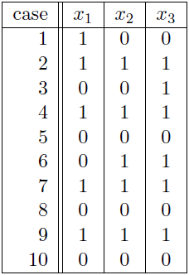

Definition & Application
The K2-algorithm learns the structure of a directed graphical model i.e. who are the parents of a given node
K2

Slide 3
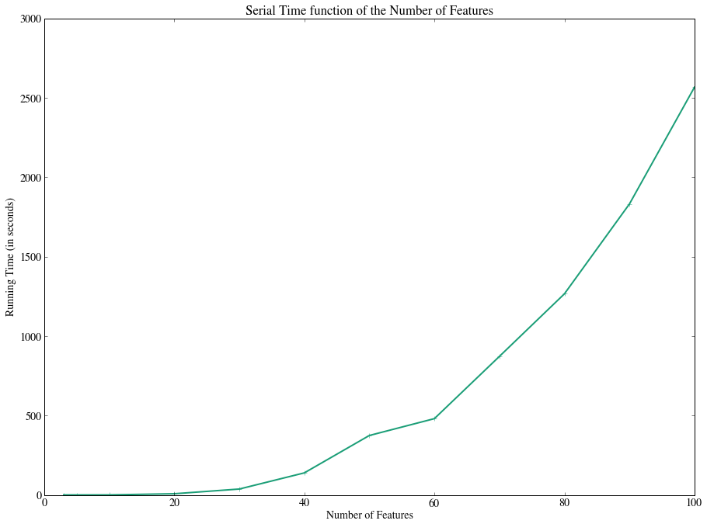
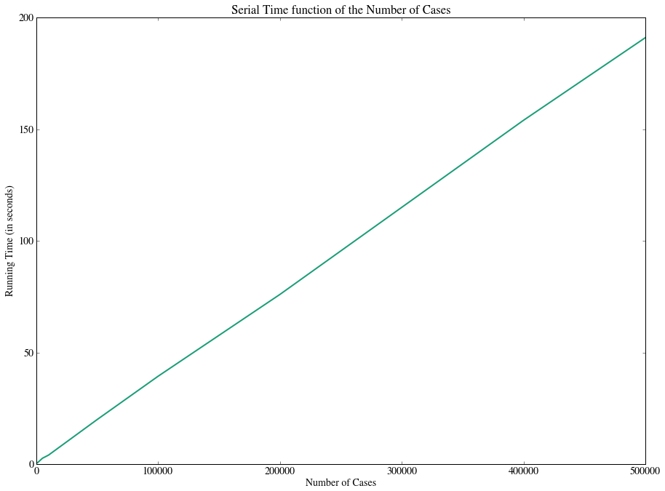
Serial Implementation
Time Complexity: O(

Slide 4

What is the most consuming part of the code? Why?
We have to evaluate the following function:
f = O( !
1st Step: Parallelize this part using CUDA

Slide 5
1st Improvement: Function Evaluation in CUDA
We perform each term of the first product in parallel on a thread

Slide 6
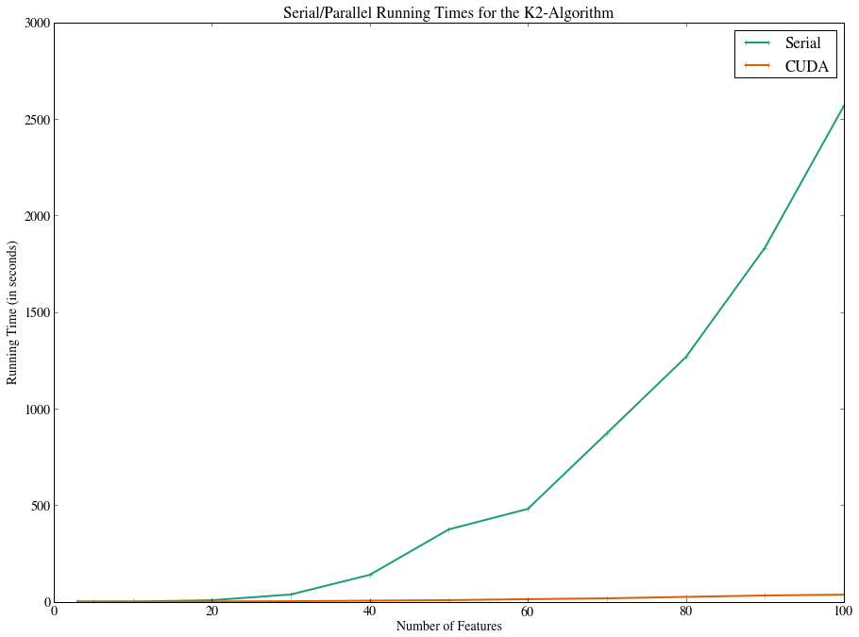
Speedup Results
Speedup for 100 features: 50,8

Slide 7
2nd Improvement: MPI for the big loop
Split up feature calculations among nodes
Experimented with different load balancing variants: independent nodes, master-slave, dynamic load balancing

Slide 8
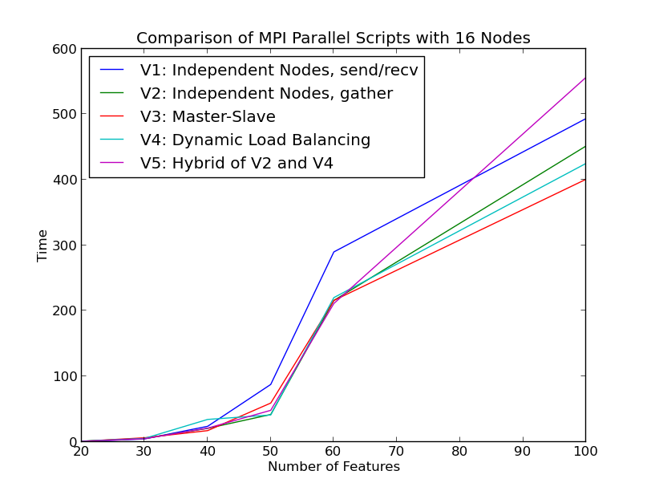
MPI Results

Slide 9
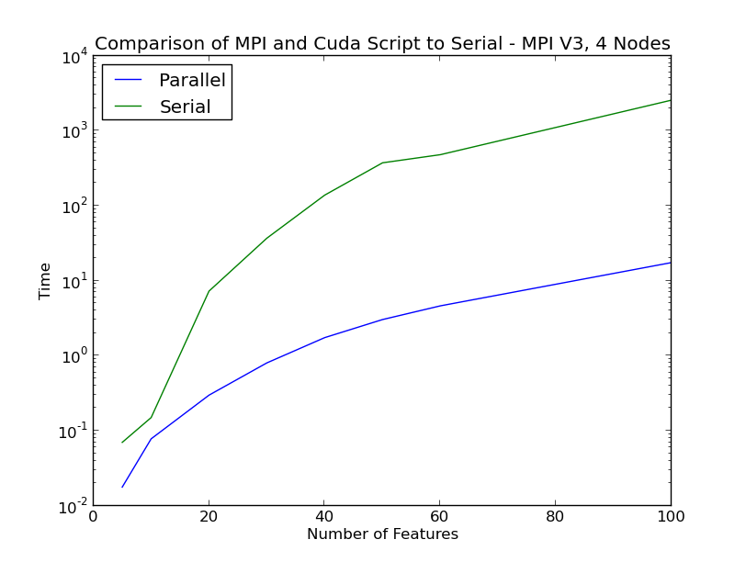
MPI + CUDA Results

Slide 10
Application: Efficient Large-Scale Sentiment Analysis

Slide 11
END
Thanks!

