Slide 1

K2 in Parallel
CS205 Final Project
Jody SCHECHTER
Aymen JAFFRY

Slide 2
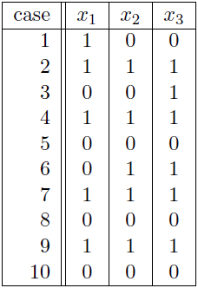

Definition & Application
The K2-algorithm learns the structure of a directed graphical model i.e. who are the parents of a given node
K2

Slide 3
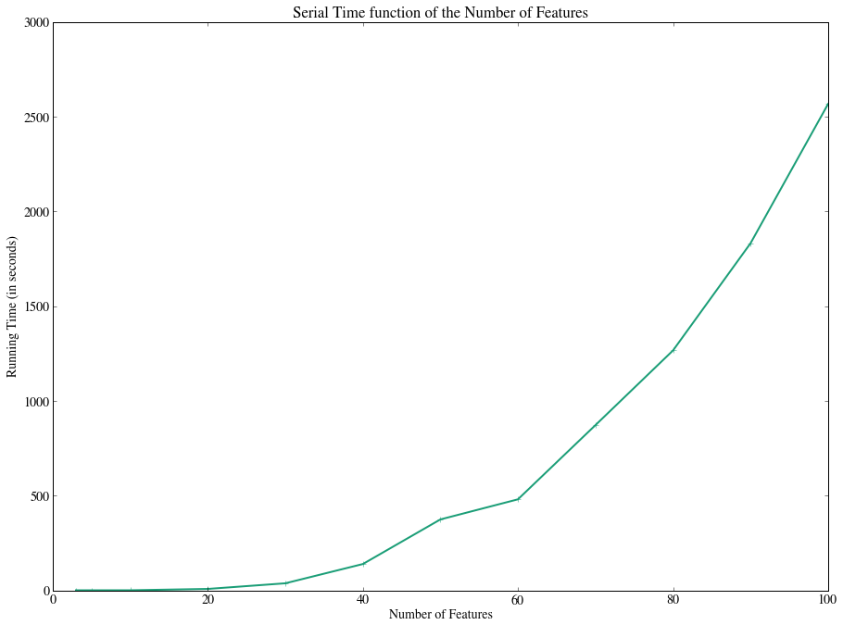
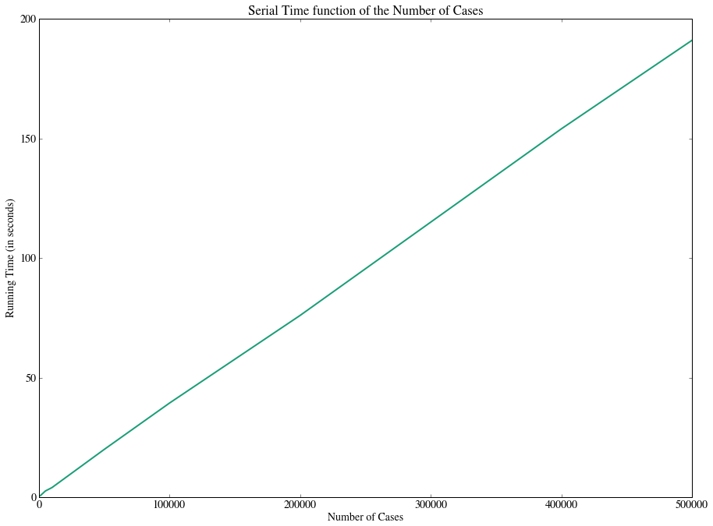

Serial Implementation
Time Complexity: O($n_{f}^{3}{n_{c}2}^{n_{f}})$
$$n_{f}:number of nodes$$
$$n_{c}:number of cases$$

Slide 4


What is the most consuming part of the code? Why?
We have to evaluate the following function:
f = O(${n_{c}2}^{n_{f}})$ !
1st Step: Parallelize this part using CUDA

Slide 5
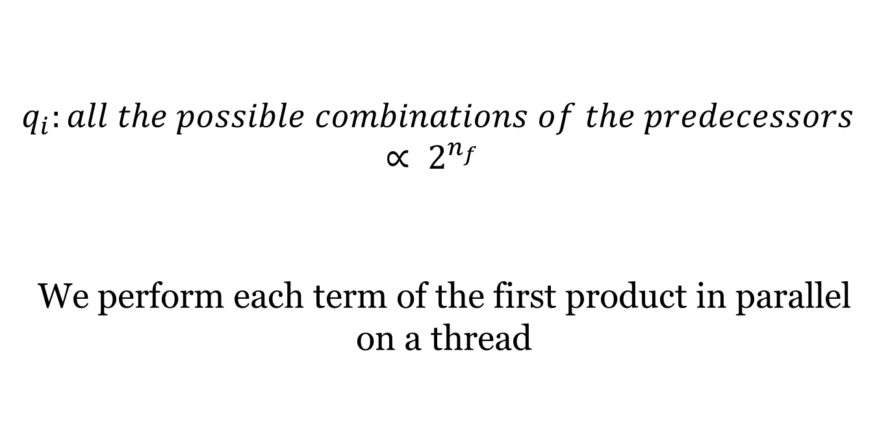
1st Improvement: Function Evaluation in CUDA
$$q_{i}:all the possible combinations of the predecessors ∝ 2^{n_{f}}$$
We perform each term of the first product in parallel on a thread

Slide 6
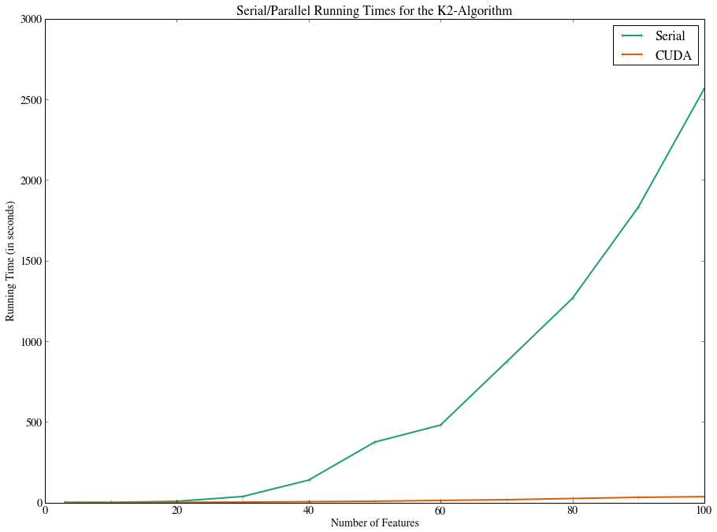
Speedup Results
Speedup for 100 features: 50,8

Slide 7
2nd Improvement: MPI for the big loop

Slide 8
MPI Results

Slide 9
MPI + CUDA Results

Slide 10
Application: Efficient Large-Scale Sentiment Analysis

Slide 11
END
Thanks!

