Slide 1
ScRNAseq analysis on longitudinal samples
BREJ40 MDS → sAML

Slide 2
Clustering & annotation

Slide 3
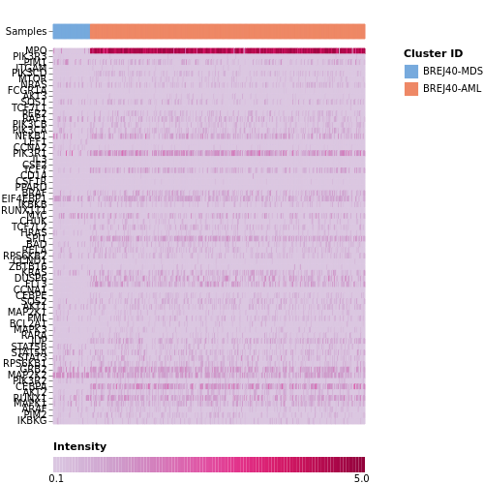
Pathological hematopoiesis – AML signature

Slide 4
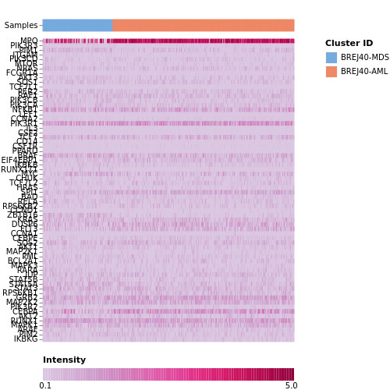
Normal hematopoiesis – AML signature

Slide 5
DEG by subgroup of cells

