Slide 1
Protecting Intellectual Property of Deep Neural Networks with Watermarking

Slide 2
目录 Contents
1
DNN Watermarking
2
Experiments
3
Shortcomings

Slide 3
contributions
support black-box verification
three watermark generation algorithms
negligible impact on normal inputs
robust against different counter-watermark mechanisms

Slide 4
目录 Contents
1
DNN Watermarking
2
Experiments
3
Shortcomings

Slide 5
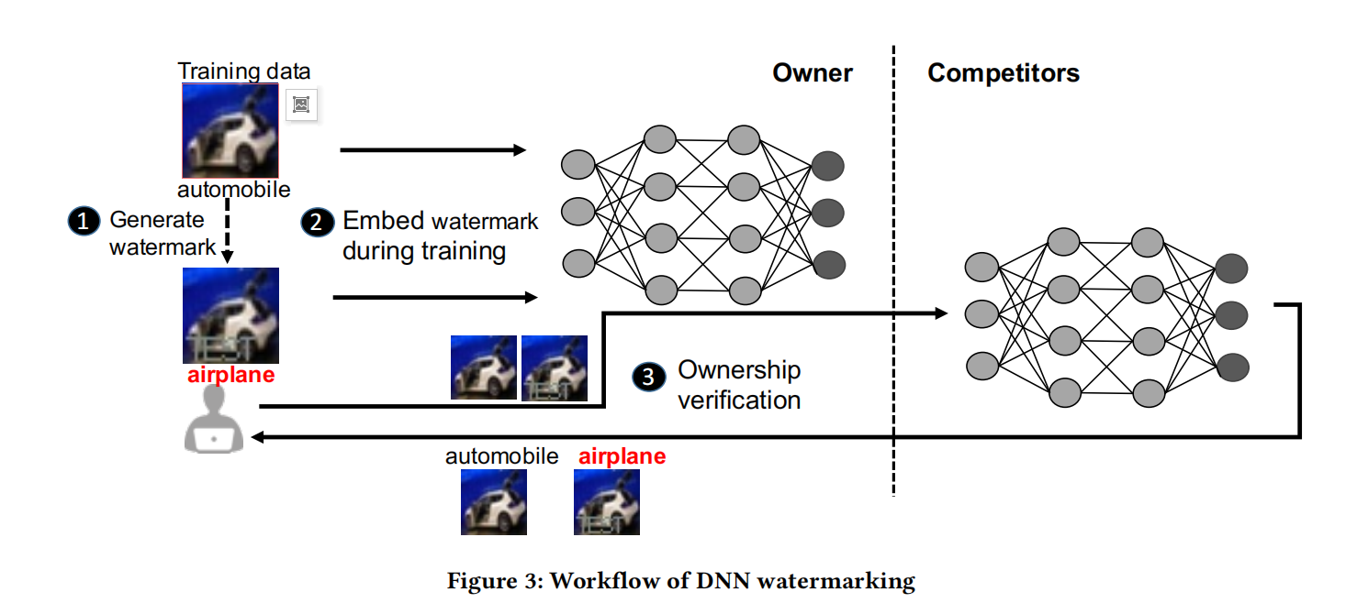

Slide 6
DNN watermark generation
Watermarks should be stealthy and difficult to be detected, or mutated by unauthorized parties.
WMcontent: Meaningful content embedded in original training data as watermarks
WMunrelated: Independent training data with unrelated classes as watermarks
WMnoise: Pre-specified Noise as watermarks

Slide 7
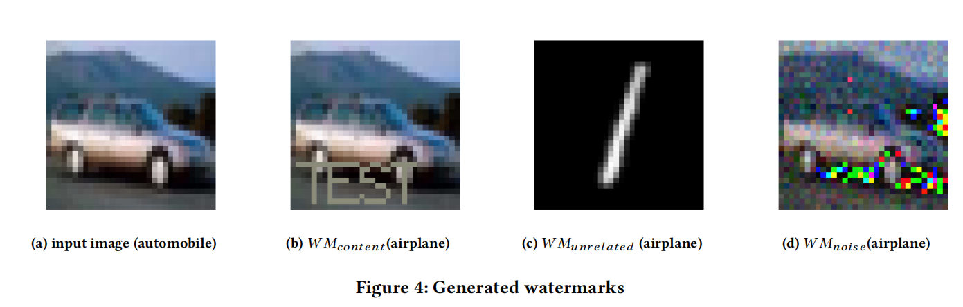

Slide 8
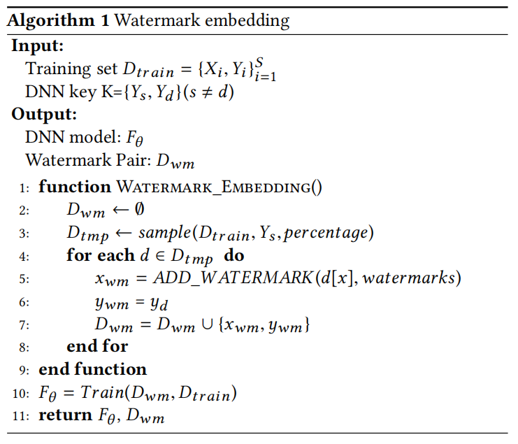
DNN watermark embedding

Slide 9
目录 Contents
1
DNN Watermarking
2
Experiments
3
Shortcomings

Slide 10
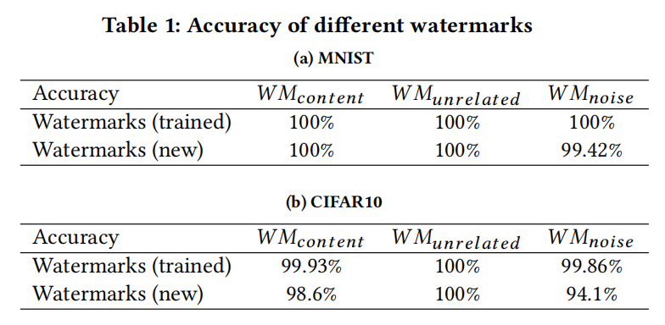
Effectiveness(watermark)

Slide 11
Side effects——training
train and validation accuracy
epochs to converge

Slide 12
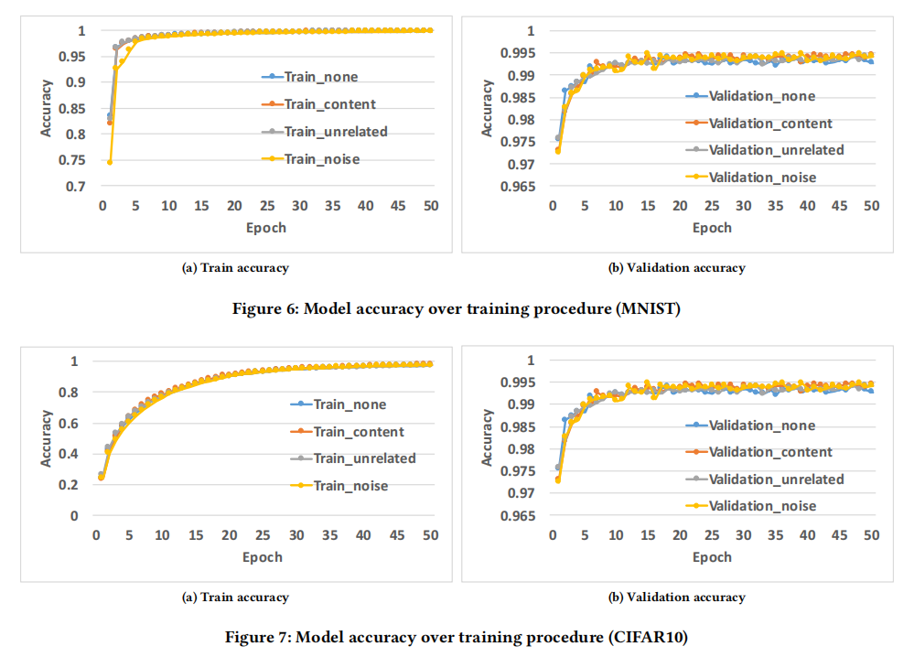

Slide 13
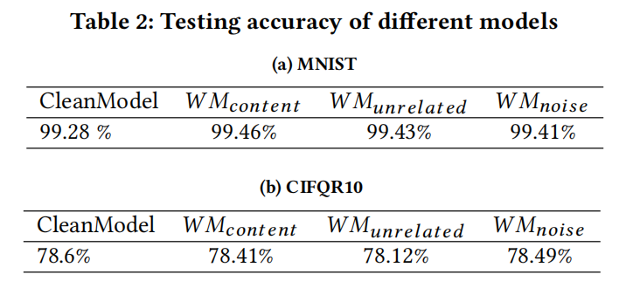
Side effects——functionality

Slide 14
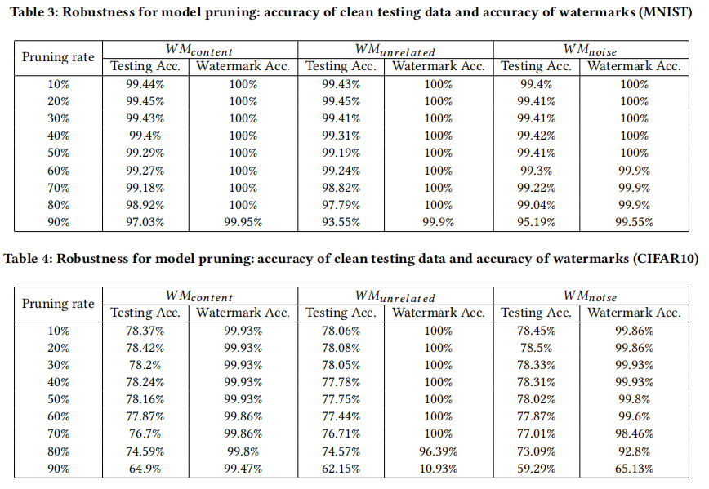
Robustness——Model pruning

Slide 15
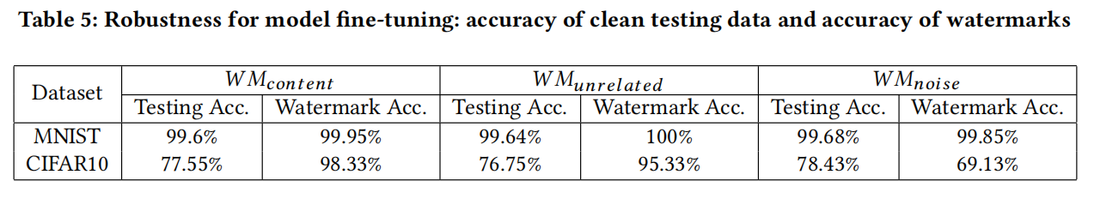
Robustness——Fine-tuning
Split the testing dataset into two halves.
The first half is used for fine-tuning previously trained DNNs while the second half is used for evaluating new models.

Slide 16
Security
whether our embedded watermarks can be easily identified or modified by unauthorized parties

Slide 17
The model inversion attack can recover images in the training dataset from deep neural networks.
It follows the gradient of prediction loss to modify the input image in order to reverse-engineer representative samples in the target class.

Slide 18
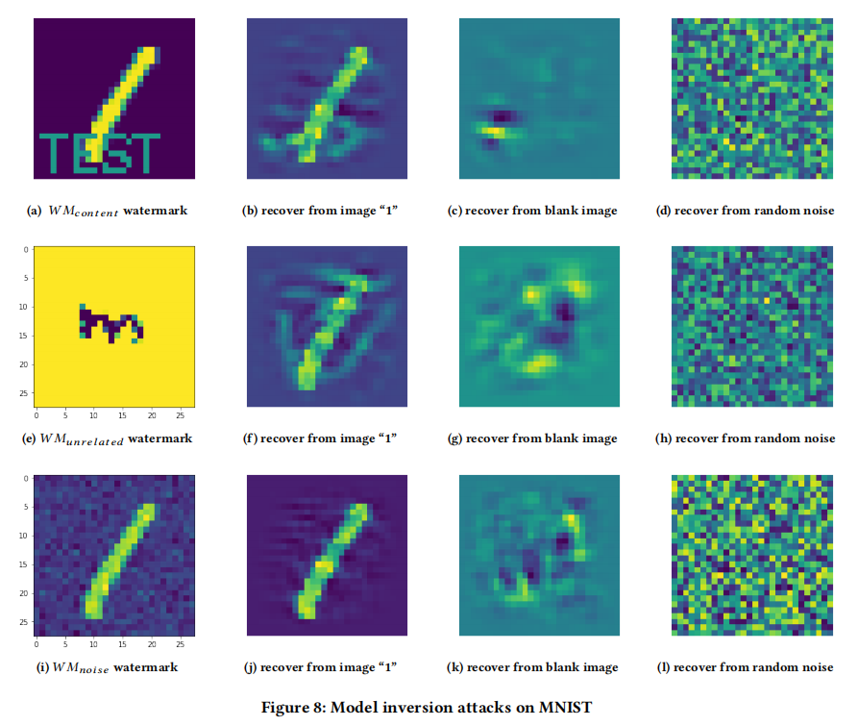

Slide 19
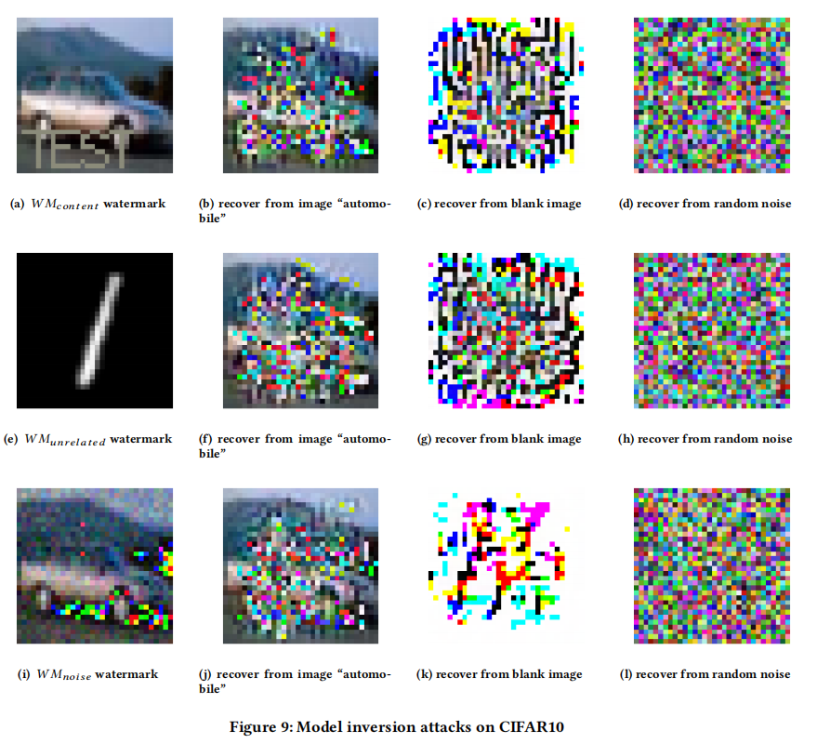

Slide 20
Comparison
Functionality
Usability: WMcontent > WMunrelated(WMnoise)
Security: WMnoise > WMcontent(WMunrelated)
Robustness: WMcontent > WMunrelated(WMnoise)

Slide 21
目录 Contents
1
DNN Watermarking
2
Experiments
3
Shortcomings

Slide 22
If the leaked model is not deployed as an online service but used as an internal service, then we cannot detect that.
The current watermarking framework cannot protect the DNN models from being stolen through prediction APIs.
MagNet trains multiple AutoEncoders with normal data to learn the representation of normal data and then use those AutoEncoders as abnormal detectors.
not returning confidences
not responding to incomplete queries

Slide 23
What can we do?
more complicated DNN
fine-tuning
other ways to generate watermarks

Slide 24
谢谢！

