Slide 1
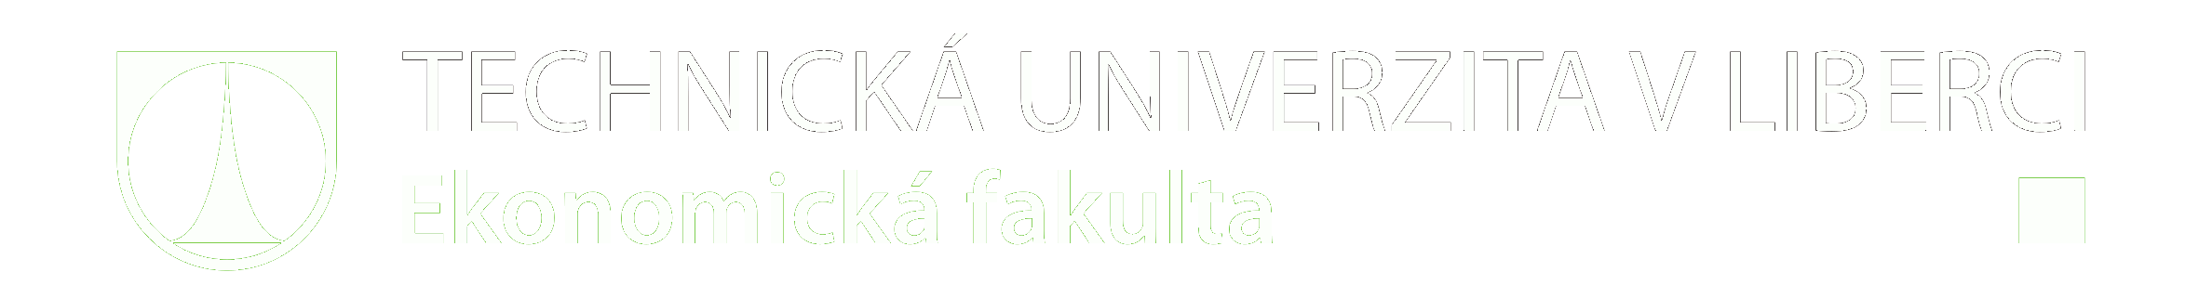

Use of Emotion in Designing BI Dashboards
The 16th International Symposium on Operations Research
22nd – 24th September 2021, Online
Petr Průcha, Petra Kašparová

Slide 2
Agenda
Introduction
Methodology
Results
Conclusion

Slide 3
Introduction
We tested the possibility of using of using emotion recognition software to test user-friendliness during software development

Slide 4
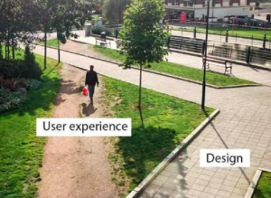
Introduction
It exists research gap of using emotion in designing UI&UX of software.
This study assumes that better UX & UI design is related to positive emotions such as happiness. Also, we suppose that confusing and ugly UX & UI designs can trigger negative emotions like sadness, anger, fear and disgust.

Slide 5
Methodology
We tested on six BI drafts the design of the UI&UX
The order of drafts was randomly selected
To participant have to find 2 values in the draft
We randomly selected 20 participants from information management (total population is 92)
Research was conduct only by ZOOM and OBS studio
Notes:
Random order to supres law of exercise because people were better at searching values

Slide 6
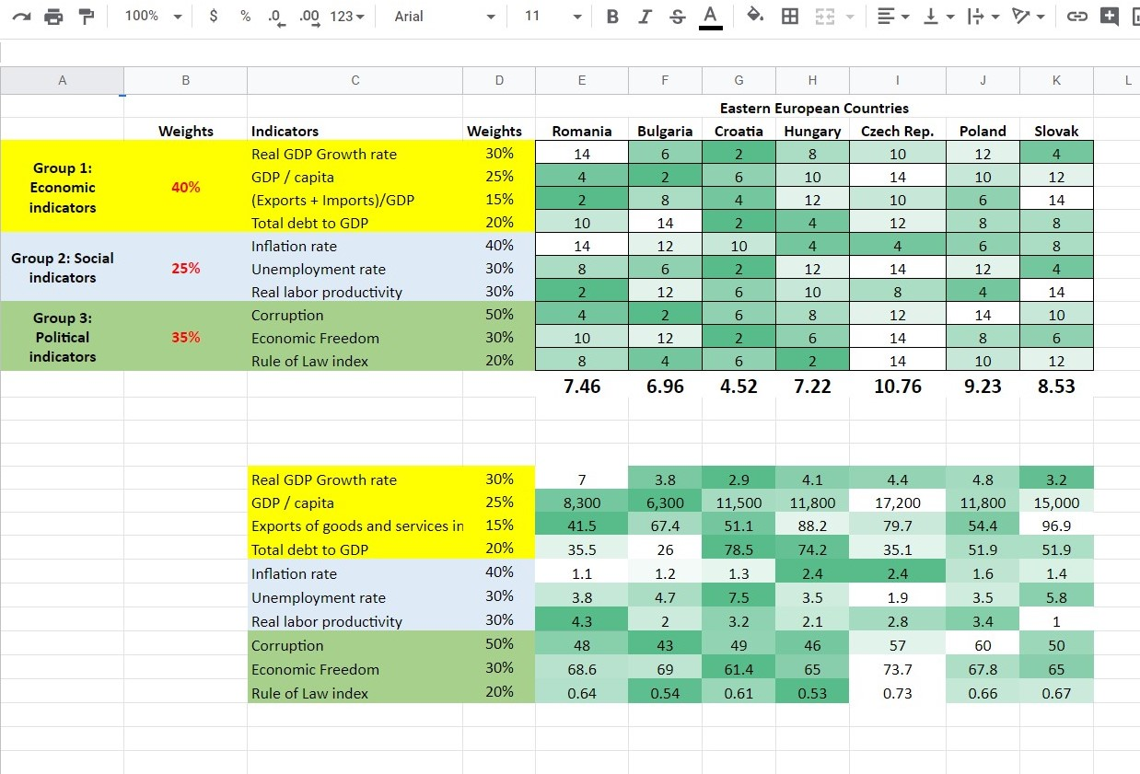
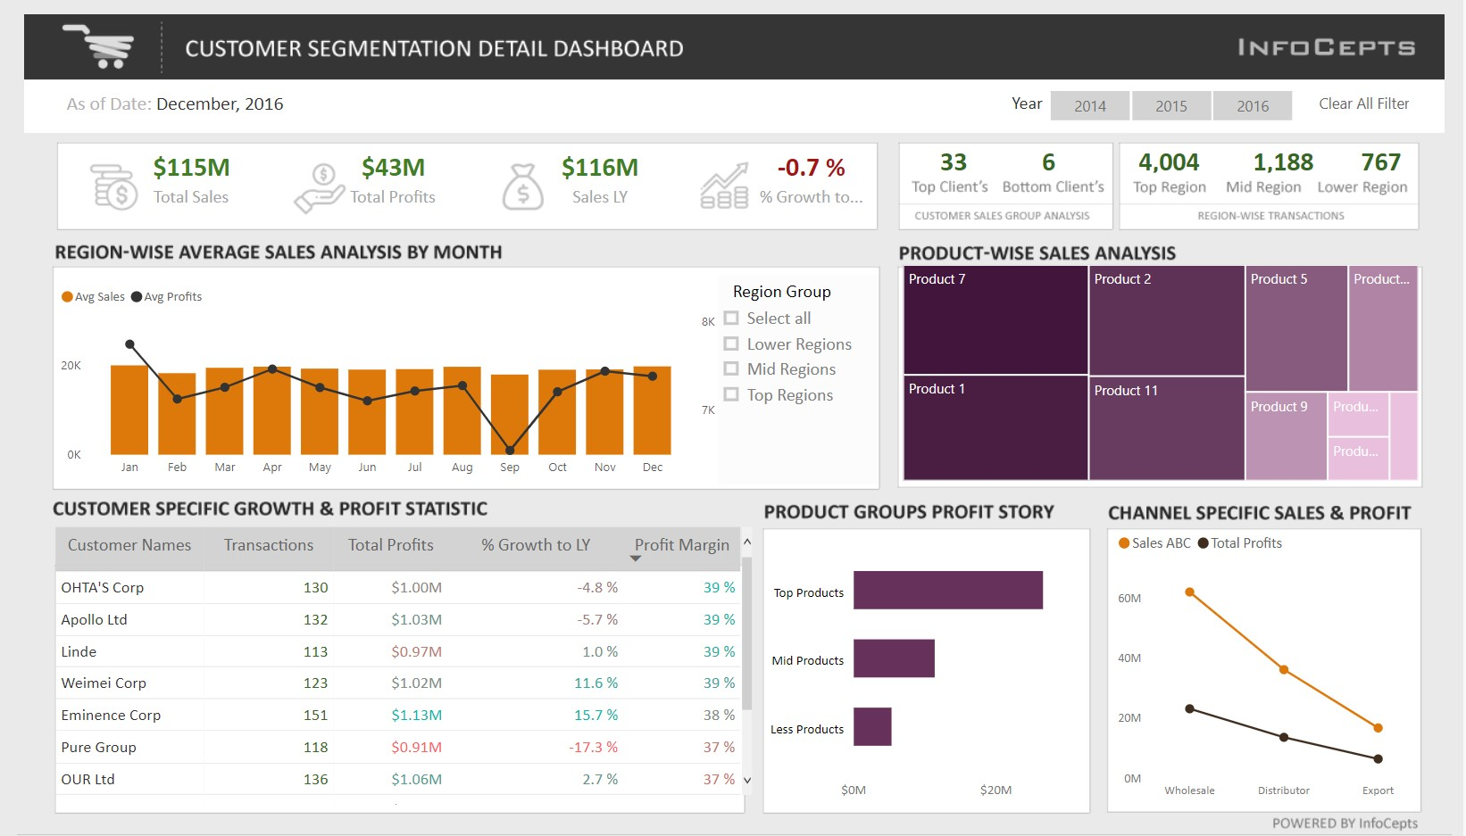
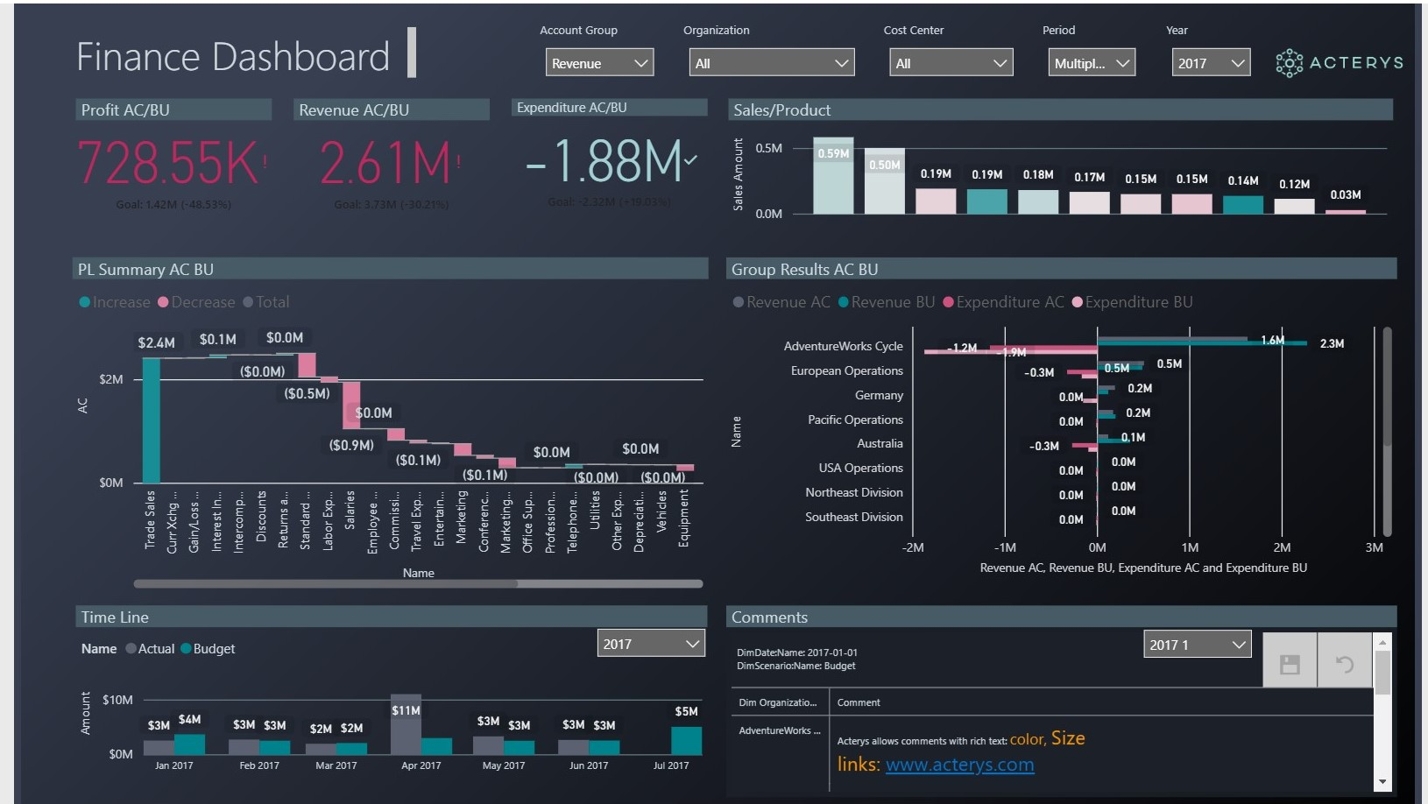
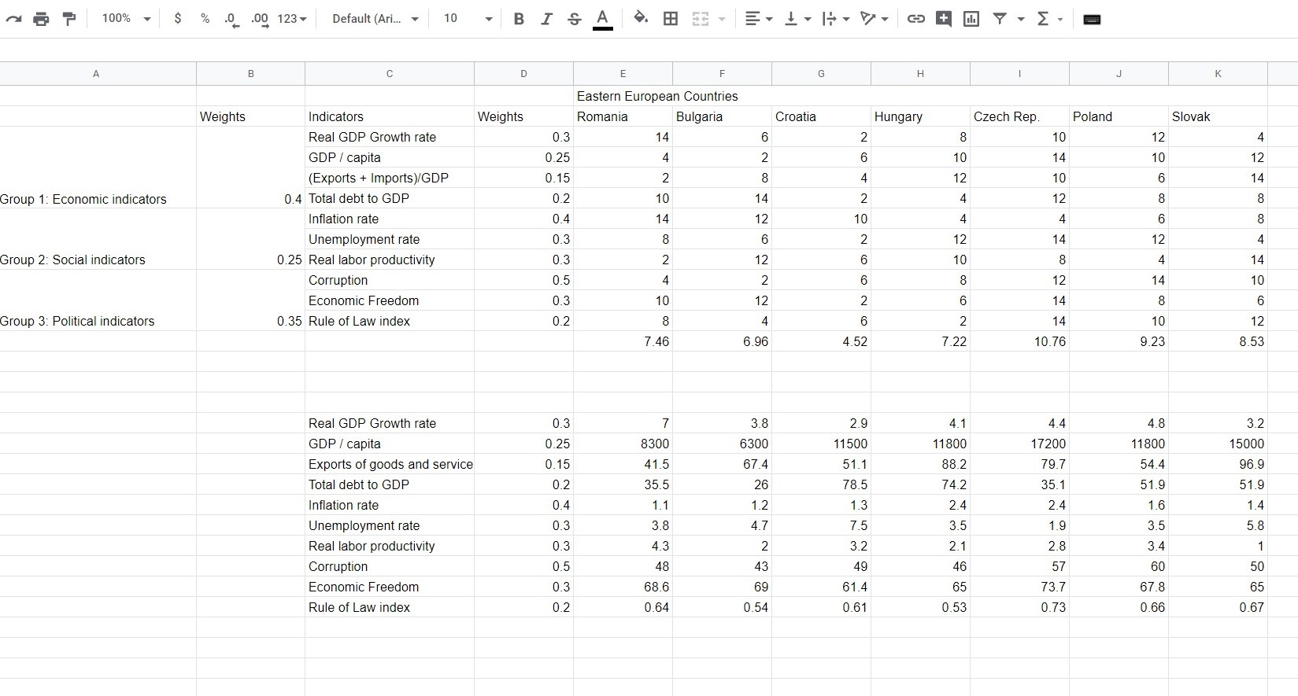
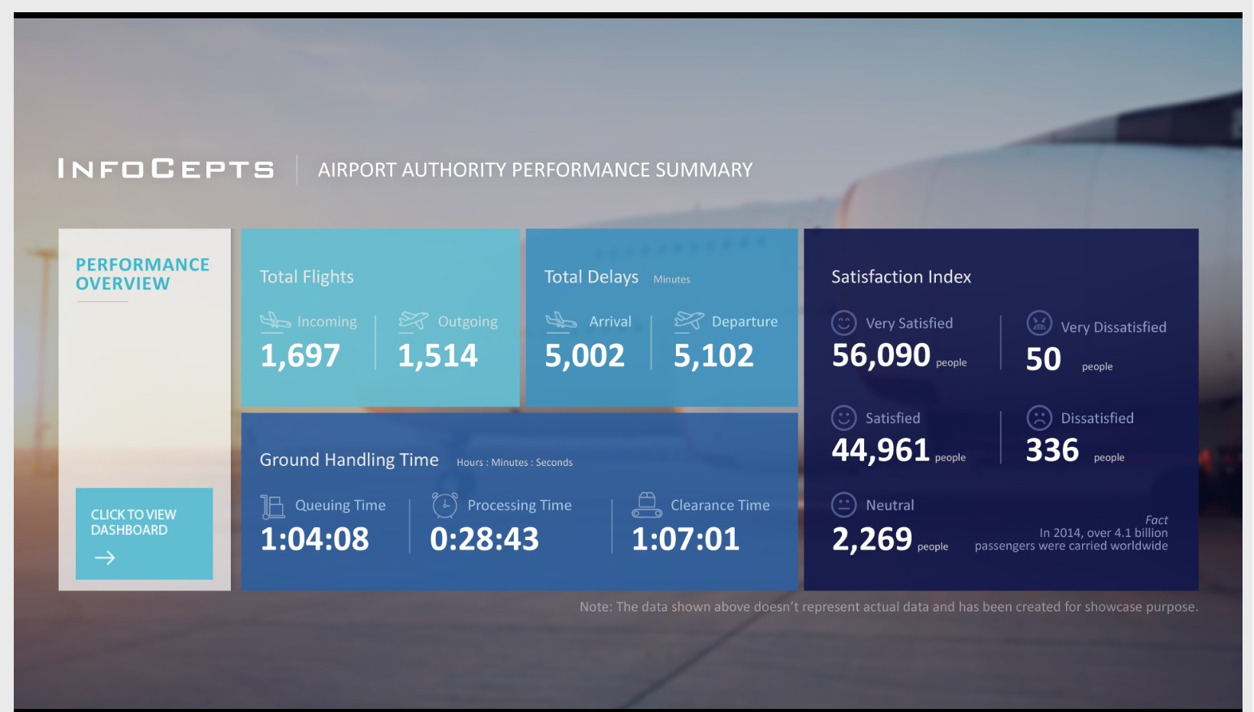
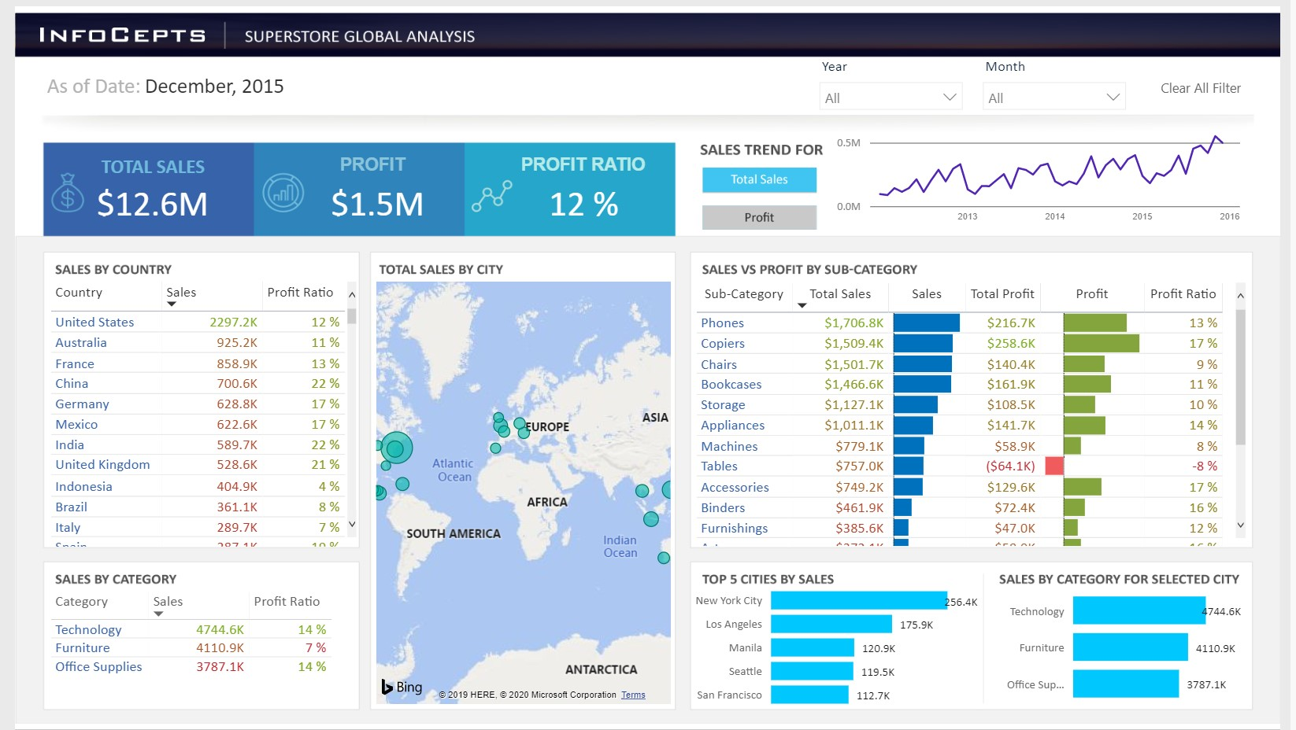

Slide 7
Results
Draft | Number of elements | Time ⌀ | Appearance ⌀ | Clarity ⌀ | Happy ⌀ | Sad ⌀ | Angry ⌀ | Surprised ⌀ | Scared ⌀ | Disgusted ⌀
Draft 1 | 223 | 33.25 | 4.9 | 4.35 | 0.104 | 0.049 | 0.100 | 0.028 | 0.011 | 0.039
Draft 2 | 215 | 22.55 | 3.45 | 5.75 | 0.094 | 0.059 | 0.080 | 0.021 | 0.024 | 0.043
Draft 3 | 215 | 17.4 | 5.1 | 6.7 | 0.079 | 0.054 | 0.116 | 0.020 | 0.025 | 0.024
Draft 4 | 159 | 18 | 7.2 | 7.3 | 0.074 | 0.049 | 0.055 | 0.028 | 0.014 | 0.027
Draft 5 | 42 | 14 | 8.925 | 8.85 | 0.152 | 0.038 | 0.067 | 0.019 | 0.016 | 0.037
Draft 6 | 173 | 22 | 7.1 | 6.7 | 0.060 | 0.058 | 0.074 | 0.029 | 0.020 | 0.026

Slide 8
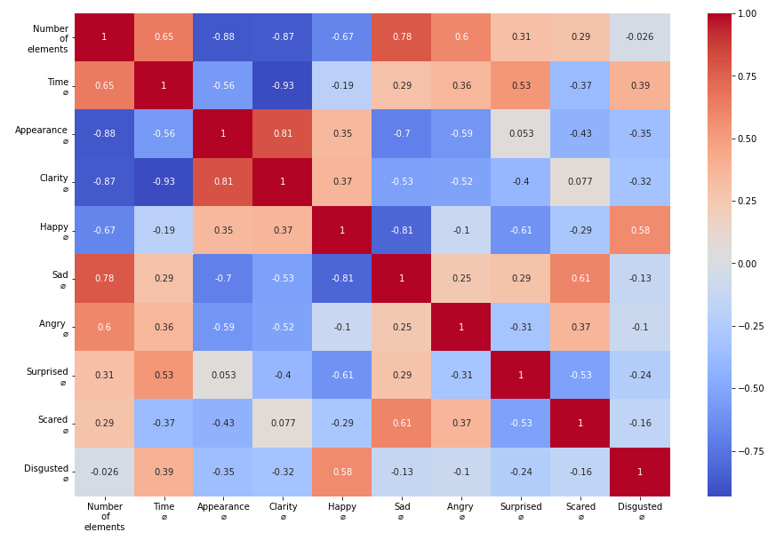

Slide 9
Conclusion
The results confirmed that metrics connected with good UX & UI positively influence the emotion of the user. On the other hand, metrics connected with confusing and ugly UX & UI negatively influence the users.
There is the correlation among metrics such as number of elements, appearance, clarity, and time to complete certain tasks and emotions.

Slide 10
Questions?

Slide 11

Thank you for your attention
Petr Průcha
24. 9. 2021 | Ing. Petr Průcha
9

