Slide 1
Angular Correlations in Gamma De-excitation
Jason Detwiler, Micah Buuck, Ian Guinn, Aobo Li
University of Washington
March 3, 2015

Slide 2
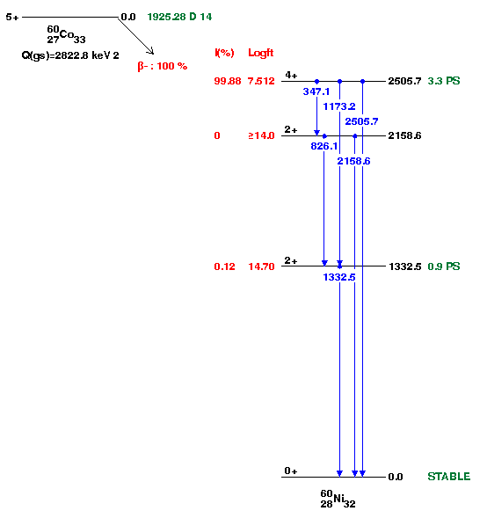
Motivation: ⁶⁰Co Decay
An important source of background in my experiment (Majorana neutrinoless double beta decay search)
Background rate depends on both gammas hitting one detector: angle between the gammas matter
Well-known angular dependence, used for thermometry (“nuclear orientation thermometry”)

Slide 3
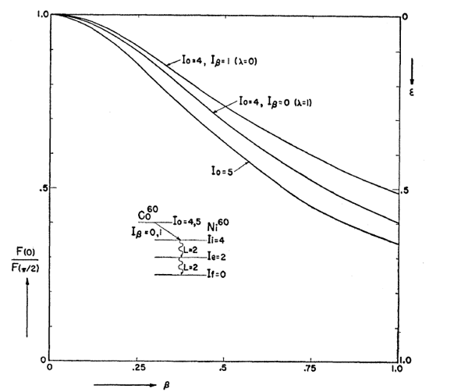
Motivation: ⁶⁰Co Decay
An important source of background in my experiment (Majorana neutrinoless double beta decay search)
Background rate depends on both gammas hitting one detector: angle between the gammas matter
Well-known angular dependence, used for thermometry (“nuclear orientation thermometry”)
P(θ=0) / P(θ=π/2)
Phys. Rev. 101, 1381 (1956).
gμB/kT

Slide 4
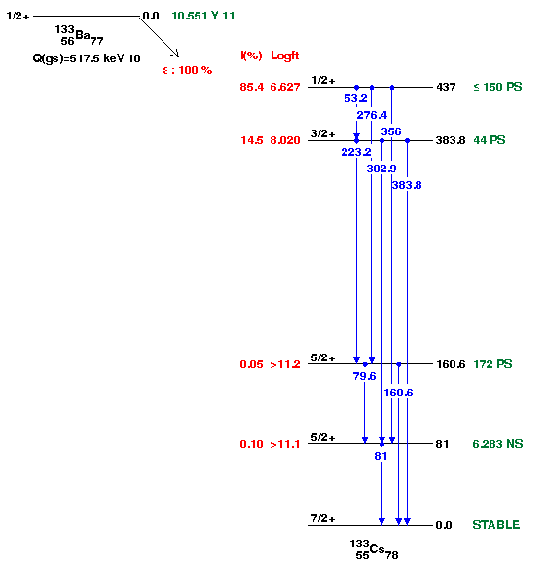
Motivation: ¹³³Ba
A common calibration source for radiation detectors
My experiment: spectral fit useful for determining dead layers, active volume
Gamma summing depends on angular correlations in the cascade

Slide 5
IT Multipole Expansion
Nucleus decays from level with J = J₁, parity π, to state with J = J₂, parity π’, via emission of a gamma with angular momentum L:
Nomenclature:
 | L = 1 | L = 2 | L = 3 | L = 4 | L = …
π’= π | E1 | M2 | E3 | M4 | …
π’= π | M1 | E2 | M3 | E4 | …

Slide 6
IT Multipole Expansion
For a particular value of M₁, consider the transition:
In this transition, the amplitude for photon emission in direction k is
To include all M₁, sum over the density matrix for the nuclear polarization states and square to get the probability for emission in direction k
Clebsch-Gordannery
Nuclear Data
Spherical Harmonics
Notes:
|J_1^\pi,M_1\rangle \rightarrow |J_2^{\pi'},M_2\rangle + |L,M\rangle
<número>

Slide 7
IT Multipole Expansion
For a particular value of M₁, consider the transition:
In this transition, the amplitude for photon emission in direction k is
To include all M₁, sum over the density matrix for the nuclear polarization states and square to get the probability for emission in direction k
Notes:
|J_1^\pi,M_1\rangle \rightarrow |J_2^{\pi'},M_2\rangle + |L,M\rangle
<número>

Slide 8
Sampling Gamma Emission
Relevant equations are given explicitly in Alder and Winther, Electromagnetic Excitation, Appendix G (1975).
Required nuclear data is the dominant L, and for some transitions, the next most-important L (L’) and the relative strength between it and the dominant L (δ). Available from the same ENSDF files from which PhotoEvaporation is derived, Laurent has made a test version in the past that included these.
Notes:
<número>

Slide 9
Sampling Gamma Emission
Typical calculation for an excited nucleus with J=J₁ that is going to de-excite to levels with J = J₂, J₃, … down to the ground state:
Start unpolarized: the “statistical tensor” representing the entangled nuclear state is trivial (rank 1 and equal to 1).
Sample k based on J₁^{π}, J₂^{π’}, and L (and sometimes also L’ and δ).
Update the statistical tensor based on the sampled value of k: the statistical tensor now represents a non-trivial entanglement of M₂ states.
Repeat from step 2 for J₂ ➞ J₃, J₃ ➞ J₄, etc. until you reach the ground state.

Slide 10
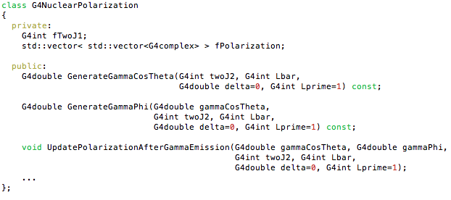
G4NuclearPolarization
Encapsulates / manages statistical tensor representing the entangled nuclear spin state throughout a gamma cascade

Slide 11
G4NuclearPolarization
Encapsulates / manages statistical tensor representing the entangled nuclear spin state throughout a gamma cascade
I ignore gamma polarization, although it could be easily added later if there is a need.
Not specific / particular to gamma cascades! Could be used e.g. for beta decay as well (although I have not implemented it)

Slide 12
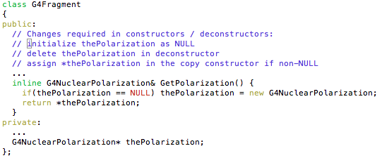
G4NuclearPolarization
As a nuclear property, I propose to add the nuclear polarization info to G4Fragment:
Would go in processes/hadronic/models/util

Slide 13
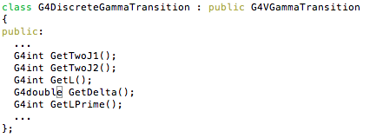
Transition Data
Loaded into G4DiscreteGammaTransition along with other transition data. Then provide access:

Slide 14

Gamma De-excitation
With the polarization object and the transition data, angular correlations can be (optionally) generated within G4VGammaDeexcitation::GenerateGamma(): Current Code: will become…

Slide 15
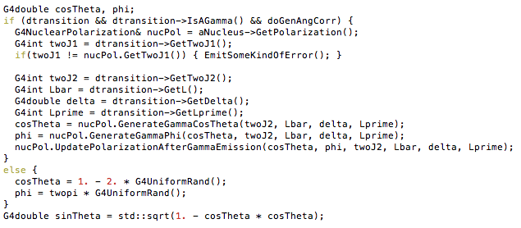
Gamma De-excitation
With the polarization object and the transition data, angular correlations can be (optionally) generated within G4VGammaDeexcitation::GenerateGamma():

Slide 16
Gamma De-excitation
With the polarization object and the transition data, angular correlations can be (optionally) generated within G4VGammaDeexcitation::GenerateGamma():
Allow to turn off and on Settable by messenger

Slide 17
Gamma De-excitation
With the polarization object and the transition data, angular correlations can be (optionally) generated within G4VGammaDeexcitation::GenerateGamma():
Need to set J₁ in nucPol
at the top of the cascade
(I’m not confident on where to do this yet)

Slide 18
Additional Required Tools
Angular momentum coupling: need to compute Wigner 3J, 6J and 9J symbols
G4Clebsch has 3J but not the others
gsl has these but G4 doesn’t use useful things like gsl
Angular distributions: need to compute associated Legendre polynomials
neutron/particle_hp have Legendre polynomials but not associated Legendre polynomials
CLHEP seems to have at least most of what is needed but the paired-down version in G4 does not include CLHEP’s Legendre polynomial code
gsl also has these…
Random number generation: need to sample from simple polynomial functions
Surprised not to find generic code for generating random numbers from a simple polynomial, not in G4 or in CLHEP. Maybe I didn’t look hard enough.

Slide 19
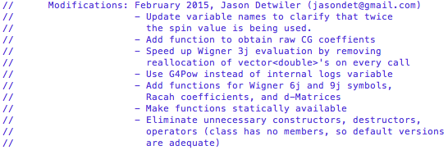
G4Clebsch
Currently in processes/hadronic/models/im_r_matrix. I propose to move it to global.
My change log:
Changes are backwards-compatible

Slide 20
G4Clebsch Testing
Generate 3 lists of parameters and solutions for each Wigner symbol (3J, 6J, 9J)
Exhaustively scan through all angular momenta up to J = 5 that satisfy selection rules
Generate random sets of parameters up to J = 10 that satisfy selection rules
Generate random sets of parameters up to J = 10 that do not need to satisfy selection rules
Comparison to gsl:
Found bug in gsl: https://savannah.gnu.org/bugs/?29606
Comparison to Mathematica:
For 9-j symbol, used angular.m notebook by Andrei Derevianko (University of Nevada, Reno)
Agreed to within a few parts in 10⁻¹² for all values tests, and to within machine precision for all cases of physical relevance (lower J)

Slide 21
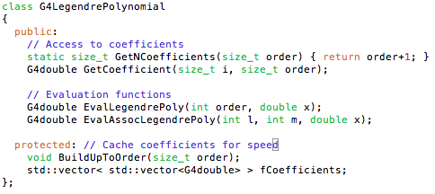
G4LegendrePolynomial
Propose to put this in global.

Slide 22
G4LegendrePolynomial Testing
Generate Associated Legendre Polynomials with Mathematica through l=30
Coefficients
Evaluations at random x-values
Compare to results from G4LegendrePolynomial
Coefficients and evaluations agree to within machine precision

Slide 23
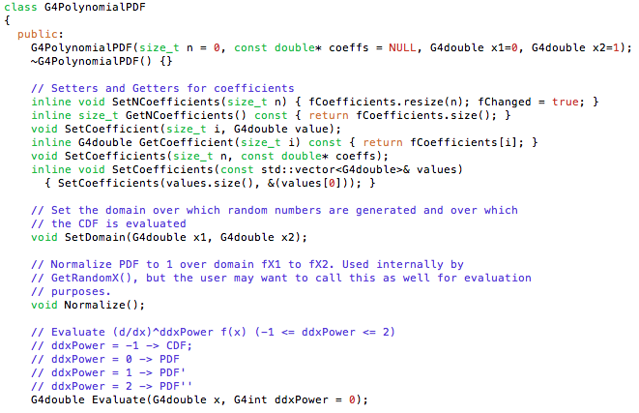
G4PolynomialPDF

Slide 24
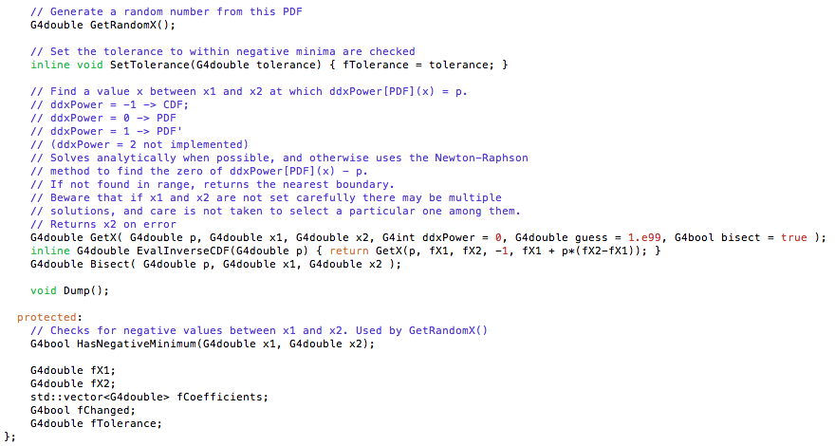
G4PolynomialPDF
I propose to put this in global

Slide 25
G4PolynomialPDF Testing
Randomly generate 100 polynomials with Mathematica 10
Endpoints generated with Tan[RandomReal[{-Pi/2,Pi/2}]]
Random # of coefficients between 1 and 30 generated in same fashion
Only accept polynomials that are nonnegative between endpoints
Need well-defined PDFs
Normalize polynomials

Slide 26
G4PolynomialPDF Testing
Generate 10000 random x-values for each polynomial and evaluate each polynomial at all 10000 points
Convert each polynomial to PDF and randomly sample 10000 times
Save polynomials, evaluations, random x-values, and random samples to disk
For each polynomial, compute max relative error of normalizing coefficients with G4PolynomialPDF.Normalize() compared to normalizing with Mathematica
We achieve agreement to machine precision

Slide 27
G4PolynomialPDF Testing
For each polynomial, evaluate at 10000 random x-values with G4PolynomialPDF.Evaluate() and find max error relative to Mathematica
We achieve agreement to within machine precision
Randomly sample each polynomial 10000 times with G4PolynomialPDF.RandomX()
For each PDF, compare random sampling to Mathematica with ROOT KolmogorovTest

Slide 28
G4PolynomialPDF Testing
KS test comparing above data to uniform distribution gives p-value of 0.73

Slide 29
G4NuclearPolarization Testing
Rough test: checked that it generates correct polynomials for simple cases
Deep low-level test: check that it generates correct PDFs for multi-level cascades with high J₁ / J₂ / L (highly non-trivial entangled polarization state)
High-level test: generate ⁶⁰Co decay and “measure” the angular distribution produced by G4

Slide 30
G4NuclearPolarization Low-Level Testing
Generate spherical distributions for three successive gammas emitted by nucleus
First gamma establishes polar axis
Second gamma establishes azimuthal axis
Distribution of angle between first and third gamma can be calculated by integrating out second gamma

Slide 31
G4NuclearPolarization Low-Level Testing
Code analytical expression for polarization tensor in Mathematica
From Alder and Winther
Compare theoretical prediction to Falkoff, Phys Rev 82, 98 (1951).
Good agreement, so Mathematica expression seems coded correctly
Integrated squared error of 1.6 E-7 (over 4π solid angle)

Slide 32
G4NuclearPolarization Low-Level Testing
Compute polarization tensor in Mathematica for gamma triple cascade
Calculate distribution of angle between 1st and 3rd gamma.
Generate 1000 angle distributions with 1000 samples in each distribution
Use G4NuclearPolarization to generate 1000 gammas from this transition 1000 times
Compute 1000 KS statistics between G4 and Mathematica generated distributions

Slide 33
Looks Good, Right?
Randomly generated G4 distribution (blue) overlaid with theoretical prediction (purple)

Slide 34
Problem!
KS test comparing above data to uniform distribution gives p-value of 3.5 E-7

Slide 35
Cause?
Not enough terms in ROOT KS distribution?
Doubtful, includes 3 terms which is good to machine precision.
Random numbers not random?
Maybe, Mathematica uses an extended cellular automaton generator, G4 uses Mersenne Twister
Fun fact, Stephen Wolfram did research on cellular automata…
Round-off error in code?
Would have to be a small numerical effect
Could be in G4 or Mathematica. Will compare each to a theoretical prediction

Slide 36
G4NuclearPolarization High-Level Testing
Use G4RDM to generate nuclear decay at the center of a spherical vacuum.
Tag gamma positions as they exit the sphere
Histogram angular correlations and compare to theoretical expectations
Setup is up-and-running, verified that G4 indeed generates isotropic gammas
Need to finish implementation and obtain custom PhotoEvaporation data files to proceed

Slide 37
Status / To-Do
G4Clebsch, G4LegendrePolynomial, and G4PolynomialPDF are tested and ready-to-go
Will try to track down subtle numeric issue in G4NuclearPolarization. But it is already good enough for most applications I can imagine.
Need an updated custom version of PhotoEvaporation3.1 with the multipolarity and delta information.
Also need feedback / buy-in on proposed implementation, and info on meeting release schedule deadlines.
Will complete implementation in G4.10.1 and test it with the high-level tools. Will test at least with ⁶⁰Co and ¹³³Ba. Can complete in ~1 month once PhotoEvaporation data is in hand.
Will then profile / optimize code: expect angular correlation computations to be fast relative to geometry and other physics calculations.
Red items are for your consideration at this workshop. I’m sorry I could not make it, I would really have liked to join.

