Slide 1


UPH Simulation with Automation Line Layout
Name : Richard Schiepek
Computer Science, University of Applied Sciences Rapperswil
Mentor : Rattagarn Vardcheeranon
Department : Tooling Software Department

Slide 2
Agenda
Objective
Requirements
Technology
Architecture
Asfsad
Fasd

Slide 3

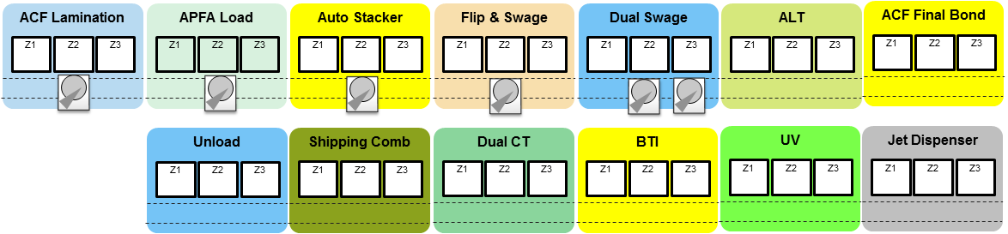
Objective
Software Simulation of an assembly line
See the process flow and detect “traffic jam”
Calculate “out to out” time and uph
Reduce experiments in a physical line by validating a concept before implementation

Slide 4
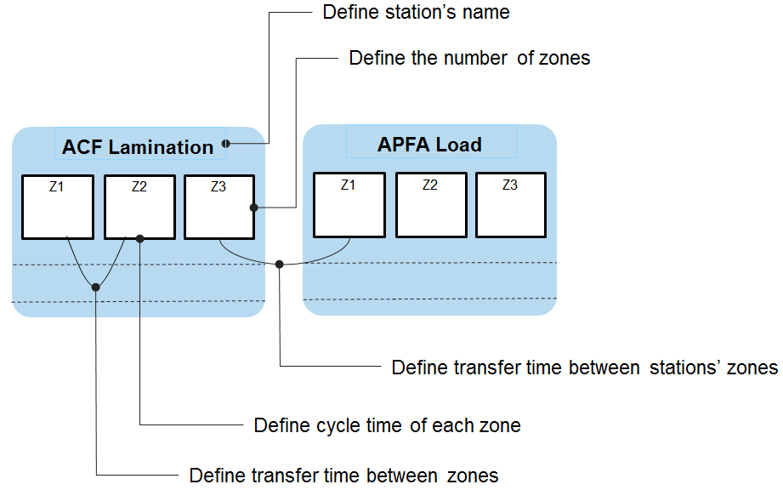
Requirements
Visualization of the line layout
Run simulation
step by step / rounds
Calculate uph and out to out
Save and load assembly lines
Dualzone / Autostacker logic
Validate user inputs

Slide 5
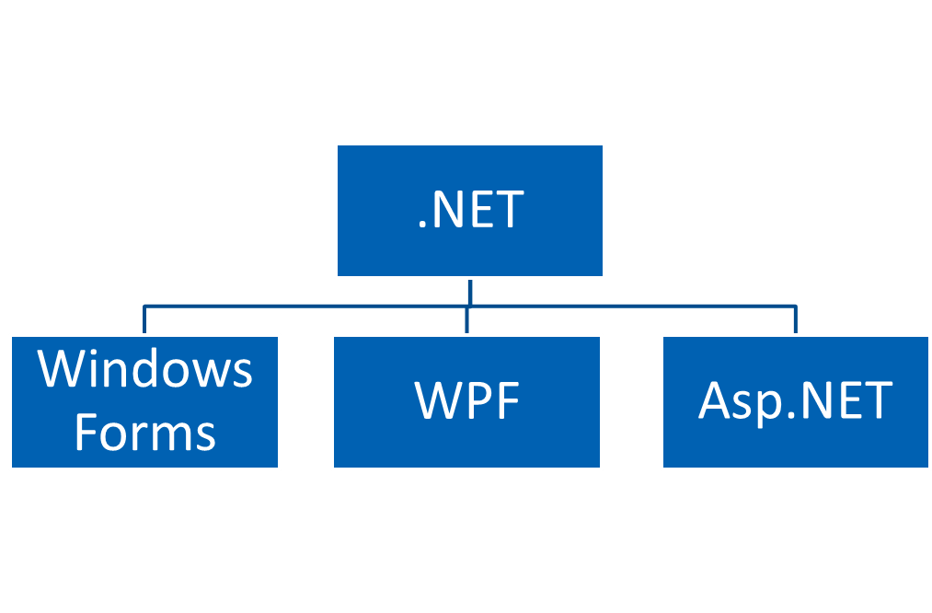


Technology

Slide 6


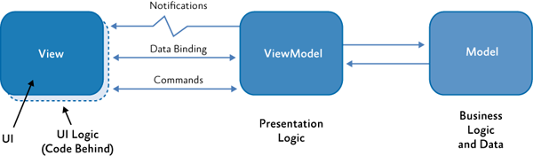
Architecture
MVVM (Model – View – ViewModel)

Slide 7
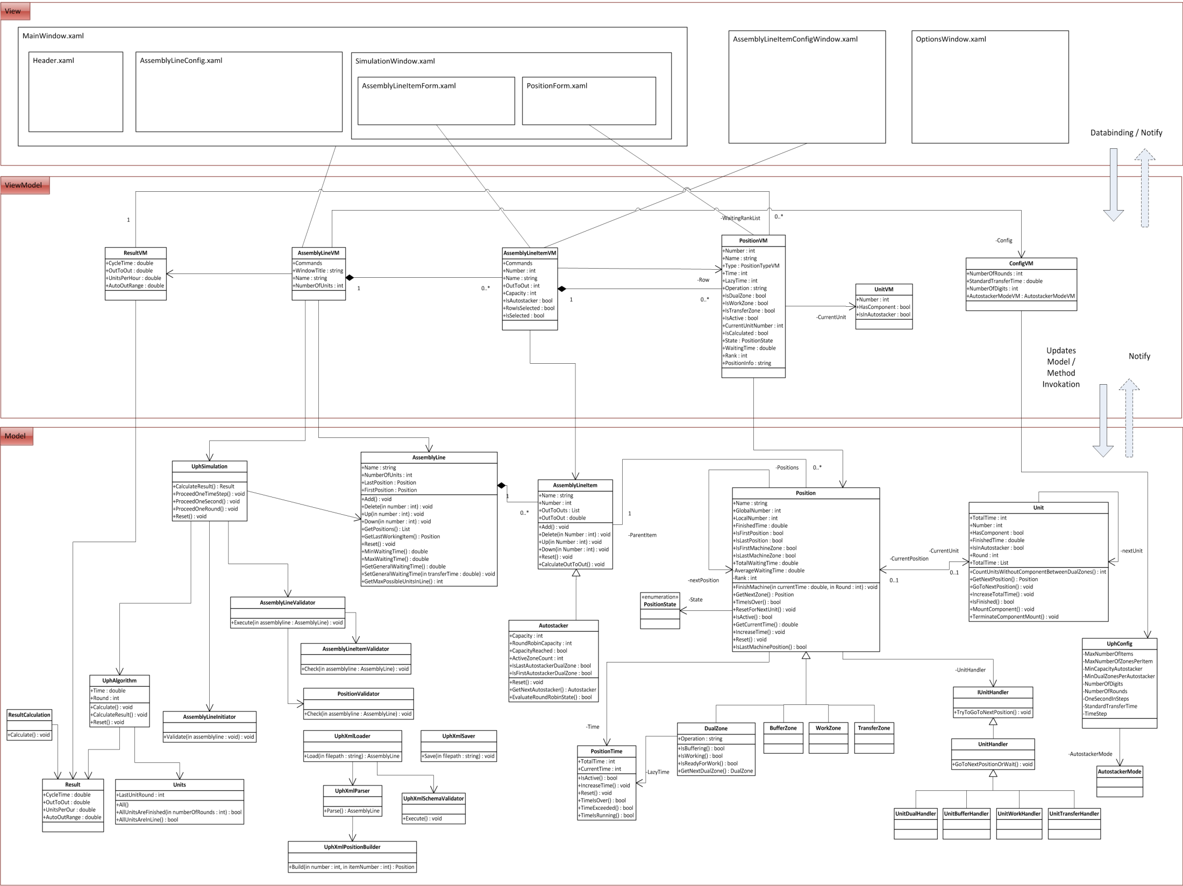
Architecture

Slide 8
Load and Save

Slide 9
Project Method

Slide 10
Result
ROI (Return on Investment)

Slide 11
Suggestion

Slide 12



